Slide 1
An Unexpected Storm
What do we know about storms?
Notes:
Introduce the new unit on weather. Students should have some prior understanding of water cycling and its role in weather formation. This lesson will build upon that understanding. (It may be helpful to review the water cycle together using a diagram your students are familiar with.) Your introduction should take into account where your students are in their learning about water cycling and weather.
An example introduction could be: “Severe weather can put people’s lives and property at risk. If we can predict when severe weather is likely to happen, we can help people be better prepared when it happens. In this unit, we are going to explore where, when, and why storms form and how we can predict the ways in which they might impact communities, especially by bringing heavy rain or snow.”

Slide 2

Case Study: 2013 Colorado Storm
In September 2013, a storm stalled over the region around Boulder, Colorado bringing a weeklong deluge of rain, resulting in dangerous floods.
  Watch a video about the Colorado storm and observe how the precipitation affected the city of Boulder, CO.
  Look at before and after photos of Boulder, CO.
Notes:
Watch the video of the Colorado storm. Before showing the video, ask students to think about the different ways communities are affected by precipitation or a lack of precipitation. Help students identify a few ways our communities are uniquely dependent on precipitation.
The video is 6 minutes, 48 seconds in length and provides a case study. For this lesson, focus on the first part of the video (up to 2:08). If you would like to show more of the video, the following break down and time codes are provided:
0:00-2:08—Introduction to the 2013 Colorado floods and past floods in this same area. Some effects are shown.
2:09-4:11—Engineering considerations related to managing future floods based on past experiences are addressed.
4:12—End of video on the 2013 flood and community resilience.
6:13—A cause is mentioned.

Slide 3
What do we think?
Step 1: What happens in the atmosphere to cause a storm?
  Think about what you know about the water cycle and how storms form. Write what you know about what happens in the atmosphere to cause rain, snow, and other types of precipitation.
Step 2: What are my experiences with storms and precipitation?
  Think about a time when you experienced a storm.
Notes:
Pass out Lesson 1: Student Activity Sheet.
Step 1:
Discuss students’ ideas about the causes of the storm. After watching the video, have students write their ideas in Lesson 1: Step 1. Allow students to share what they heard about causes of the precipitation in the video (e.g., a very slow-moving storm, an unusual amount of water vapor in the air) or their own ideas about what caused the heavy precipitation. As students share, wonder aloud: “Is that a cause of the storm or an effect from the storm?”
Suggested prompts for discussion:
Where did all the moisture over Colorado come from?
What had to happen to make that moisture turn into rain?
Has our community experienced too much or too little precipitation before?
Note: Remind students to focus on what factors caused the rainstorm and not the flood.
Step 2:
Broaden the discussion to other storms and precipitation. Working in small groups, ask students to share their experiences of storms and precipitation in Lesson 1: Step 2. This can include their experiences with storm impacts such as flooding, damage to structures, or loss of power as well as safety considerations such as avoiding lightning or floods. This is a great opportunity to incorporate any recent or significant local storm experiences that your students might remember into your discussion.
Focus the discussion on water cycling and precipitation. Students will bring a variety of experiences to the broadening discussion. As students share, elicit what they know about water cycling processes. As students share, record important ideas that students appear to agree upon. These ideas will be helpful leading into the modeling activity next.
Suggested prompts:
How do storms begin in the first place?
What needs to happen so that rain or snow starts to fall?
Why do some places get heavier precipitation but other places do not?
Notice if your students have any misconceptions pertaining to a specific part of the water cycle. For example, a common misconception is that clouds are made of water vapor instead of liquid water. Addressing any misconceptions now will aid your students as they progress through the lessons.

Slide 4
Model for the Colorado Storm
Step 3: Represent what you know about storms.
What caused the rain in the Colorado storm you saw in the video? Draw and label a picture in the box.
  Your picture should show all the factors that led to rain.
  Include labels in your drawing that explain how each factor led to rain.
  Be prepared to share your thinking with the class.
Notes:
Prompt students to draw an initial model. Their model in Lesson 1: Step 3 should represent the factors they believe led to the unusual amount of precipitation in the area around Boulder, Colorado. Tell students to draw and label as much as they know about how storms form, including when and where, that can help them explain the Colorado storm.
If students are not yet familiar with drawing graphic models, summarize the activity by explaining how their illustration is a model because it represents processes that happen on Earth. This type of model development is a consistent feature of GLOBE Weather.

Slide 5

Similarities and Differences
Step 4: How were my ideas similar or different from my peers’ ideas?
Notes:
Compare students’ initial models. Use small groups for students to share and compare their models. Ask students to compare similarities and differences between how each group member represented the storm in Lesson 1: Step 4. Then, groups summarize for the class what they noticed and wondered about as they compared their models.
At the same time, support the discussion by doing the following:
Voice how the models make you wonder and question what’s happening in the storm: “This is really interesting, as we see all these different ideas about how this might work. It makes me think of lots of questions. I’m curious about all the ideas I didn’t really think about before.”
Point out common features/mechanisms that students were using across models, such as clouds, wind, air, precipitation, and temperature differences. Consider recording these common features in a public space.
Set the class mission. After students share their models, tell them that more investigation is needed to better understand the cause of storm formation: “We should try to figure out how all of this works to cause a storm.”

Slide 6

Driving Question Board
Our driving question:
What causes different kinds of storms?
Your questions related to our driving question.
Notes:
Orient students to the Driving Question Board. In a public space—either physical or digital—share the Driving Question Board with students. The Driving Question Board can be a bulletin board, a piece of butcher paper or chart paper posted on the wall, or a piece of paper projected on a document camera. A digital board is possible, but the purpose of the Driving Question Board is to publicly document students’ questions. Therefore, the Driving Question Board should be visible to students throughout the unit. This is where the students post their questions and where students return to answer their questions throughout the unit. The Driving Question Board should have the unit driving question written at the top: “What causes different kinds of storms?”

Slide 7
Step 5: What questions do I have about storms and precipitation?
  Write down at least two of your own questions.
  Share your questions with your group.
  Make edits if you want to change your question.
  Post your questions to the Driving Question Board!
Notes:
Ask students to write and share questions. Explain to students that by the end of the unit, they should be able to answer the driving question but that they also should have their own questions. Ask students to write their own questions related to the driving question and the Anchoring Phenomenon at the bottom of their activity sheet in Lesson 1: Step 5. Then have students share these initial questions in a small group to refine the questions before posting them to the Driving Question Board.
Post students’ questions to the Driving Question Board. Pass out sticky notes (or a comparable method) to groups of students and have them write their questions on the notes. Ask individual students or student groups to share their questions with the class. As student groups share their questions have them post the questions to the Driving Question Board. (Note: If you choose a digital option, be prepared to project the digital board for the whole class.)
Organize questions on the Driving Question Board. As you notice patterns emerge with student questions, help students to organize the questions around similar themes.
Prompt students to brainstorm what data or information they need to answer their questions. After students share their questions, focus students on: “What sort of data could we analyze or what sort of investigations could we do in our class to help us answer our questions.” Ask students to take a moment to think about this, then record their ideas on a piece of chart paper or in a designated area on the Whiteboard and/or near the Driving Question Board (e.g., “we need videos of storms and clouds, we need weather reports and data, maybe we need to do some experiments with water”).

Slide 8
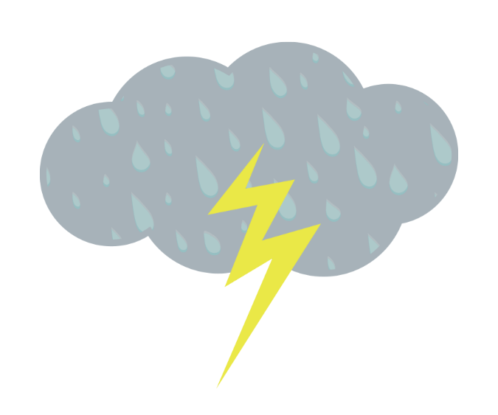
Next Time
We will dig into some of our questions and start figuring out what causes storms to form.
Notes:
Emphasize that they will probably need to start looking at weather data for different kinds of storms to see what’s happening when there is precipitation.

