Slide 1
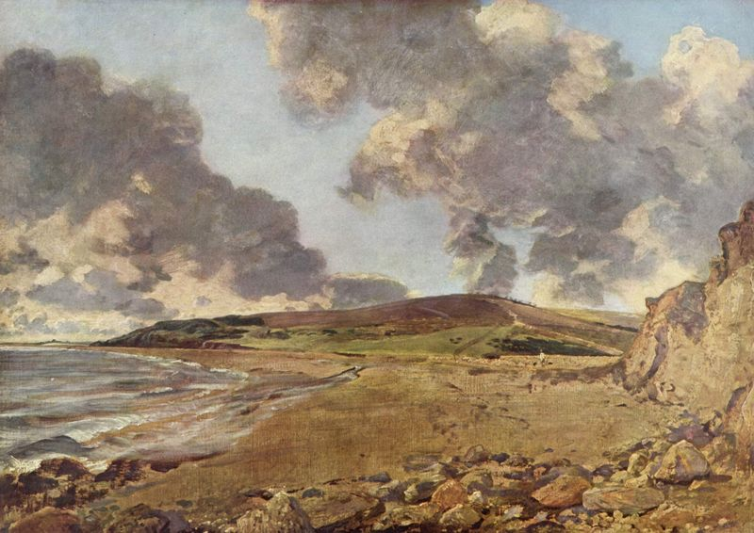
The Art of Clouds
Can you guess which clouds the artist painted?

Slide 2
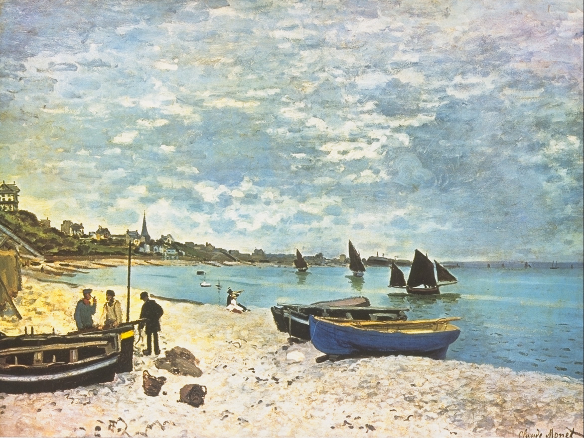
Can you identify cloud types in landscape paintings?
Directions: Take a look at each piece of art and try to identify the clouds. The following slide has the answer. Good luck!

Slide 3
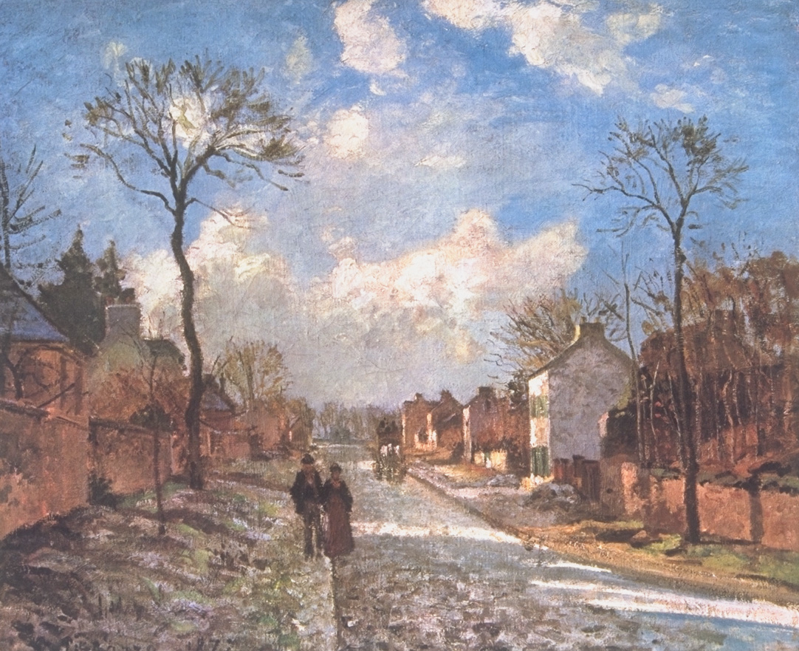
Title: Route de Louveciennes
Artist: Camille Pissarro, a nineteenth century French Impressionist painter

Slide 4
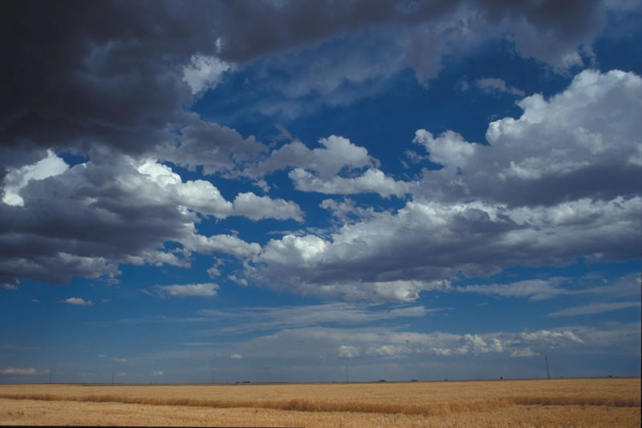
There are cumulus clouds. The clouds have distinct edges and puffy shapes.
Photo: Carlye Calvin/UCAR

Slide 5
Title: The Beach at Sainte-Adresse
Artist: Claude Monet, a nineteenth century French Impressionist painter

Slide 6
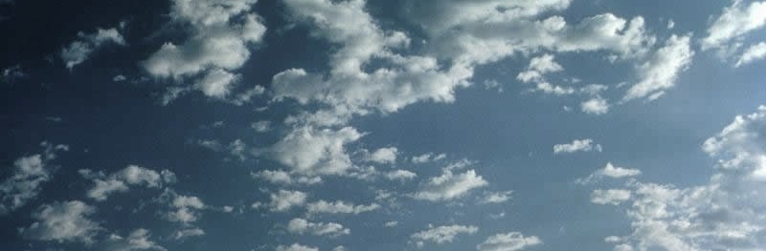
Altocumulus clouds that look like little puffs are painted with large brushstrokes of soft white and blue.
Photo: Carlye Calvin/UCAR

Slide 7
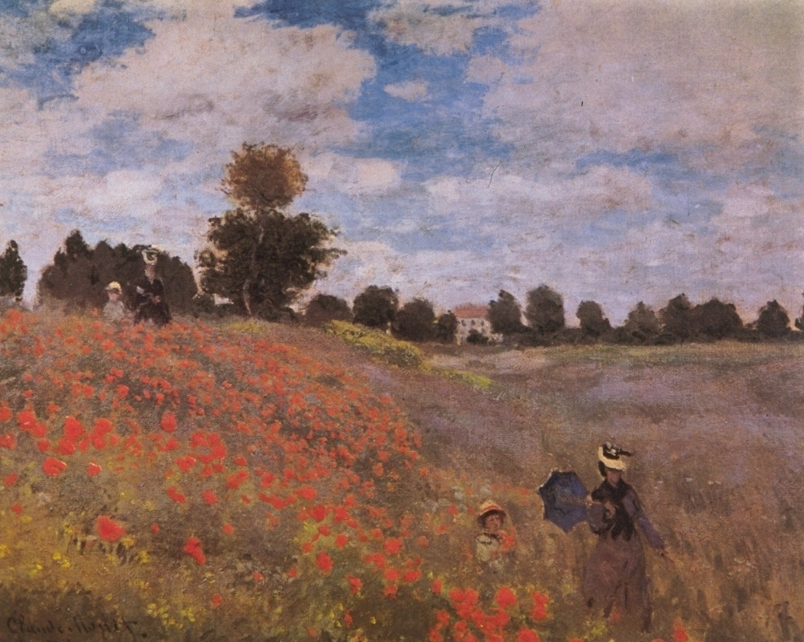
Title: Field of Poppies
Artist: Claude Monet, a nineteenth century French Impressionist painter

Slide 8
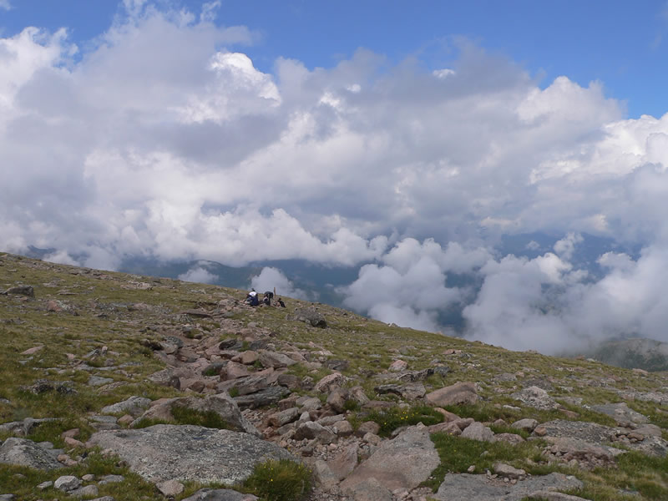
Low cumulus clouds with distinct edges and puffy shapes
Photo: Olga and Sergei Kuznetsov

Slide 9
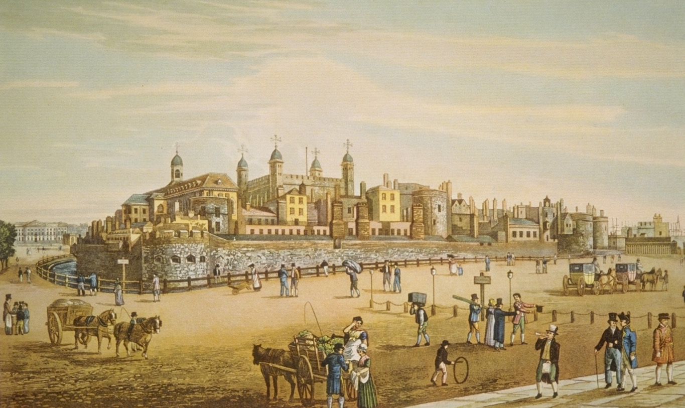
Title: The Tower of London
Artist: Robert Havell, an early nineteenth century British artist

Slide 10

These are mostly long mid-level clouds called altostratus.
Photo: Peggy LeMone

Slide 11
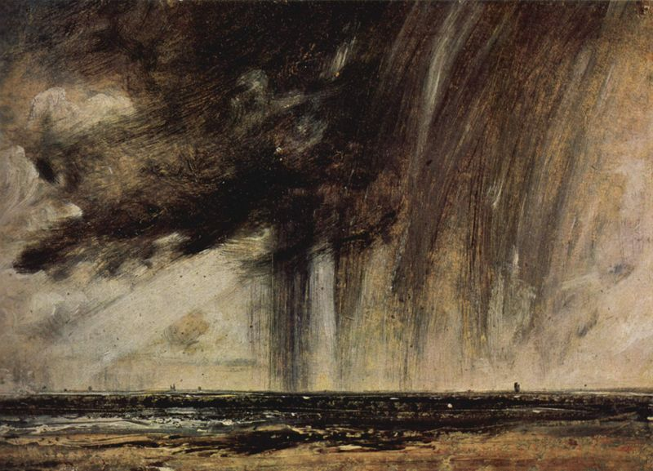
Title: Seascape Study with Rain Cloud
Artist: John Constable, a ninteenth century British artist

Slide 12
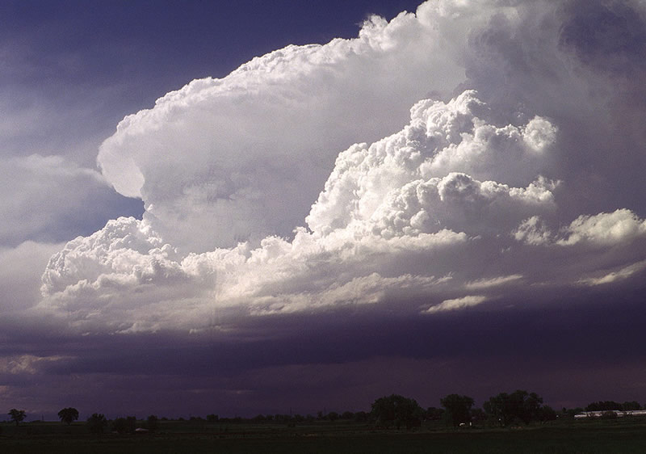
Cumulonimbus clouds can turn dark and cause rain. The rain is usually not widespread. Instead it is in one spot.
Photo: Wikipedia

Slide 13
Title: Weymouth Bay
Artist: John Constable, a ninteenth century British artist

Slide 14
These cumulus clouds are beginning to grow vertically. They might have turned into a thunderstorm later in the day.
Photo: Olga and Sergei Kuznetsov

Slide 15
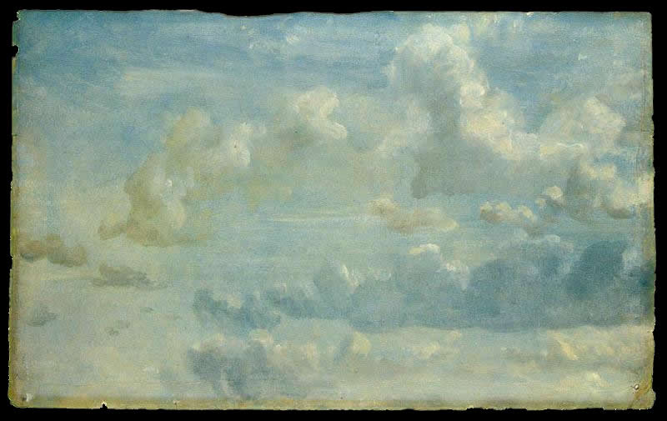
Title: Cloud Study
Artist: John Constable (1776-1837) British painter

Slide 16
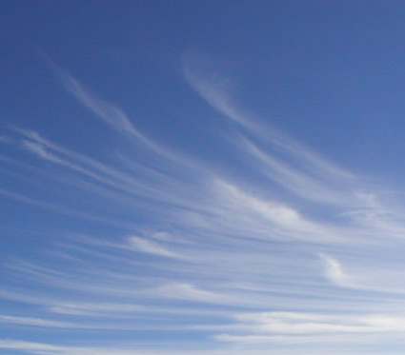
The clouds in front are cumulus.
There are wispy cirrus clouds behind.
Photos: Lisa Gardiner (top) Olga and Sergei Kuznetsov (bottom)

Slide 17
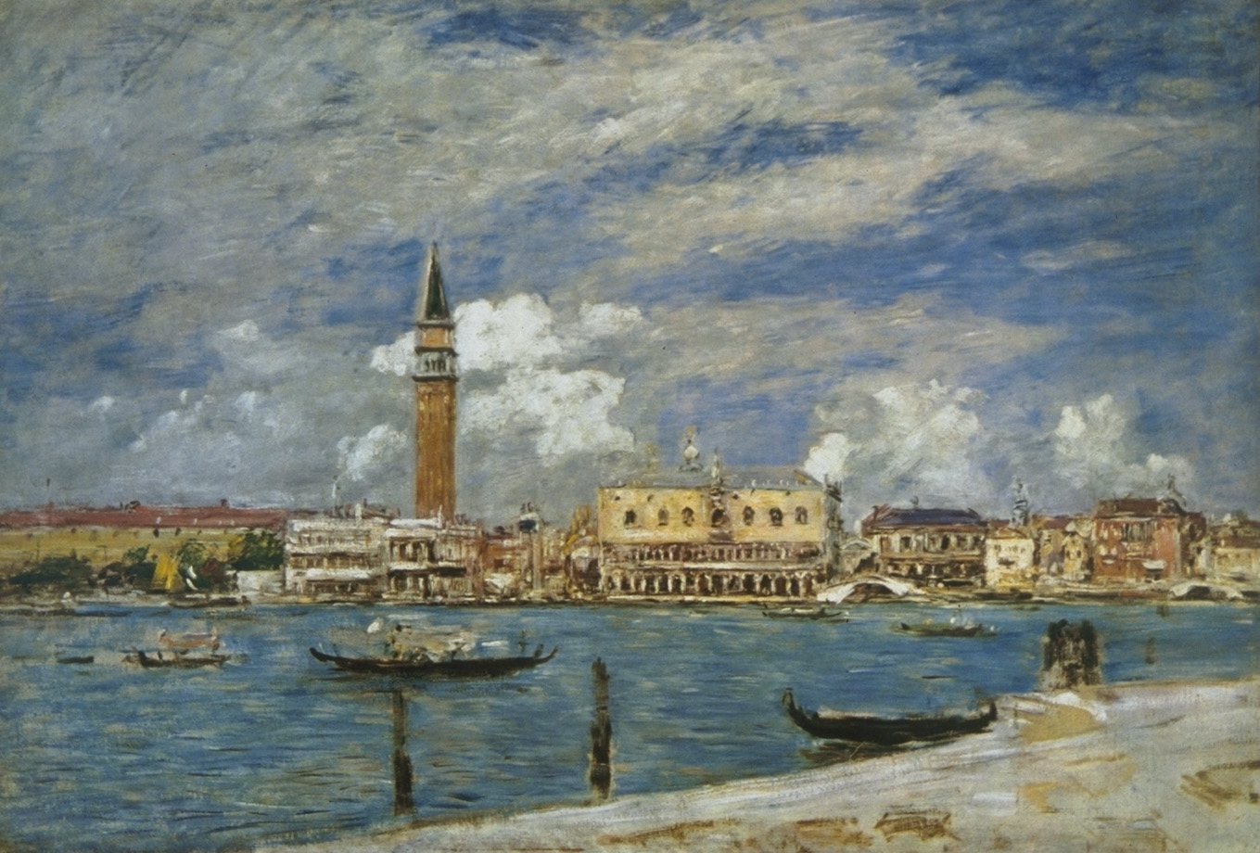
Title: Place Saint-Marc a Venise, Vue du Grand Canal
Artist: Eugene Bourdin, a nineteenth century French painter

Slide 18
The clouds that are higher in the atmosphere might be altocumulus or stratocumulus.
The low clouds look like cumulus.
Photo: Carlye Calvin

Slide 19
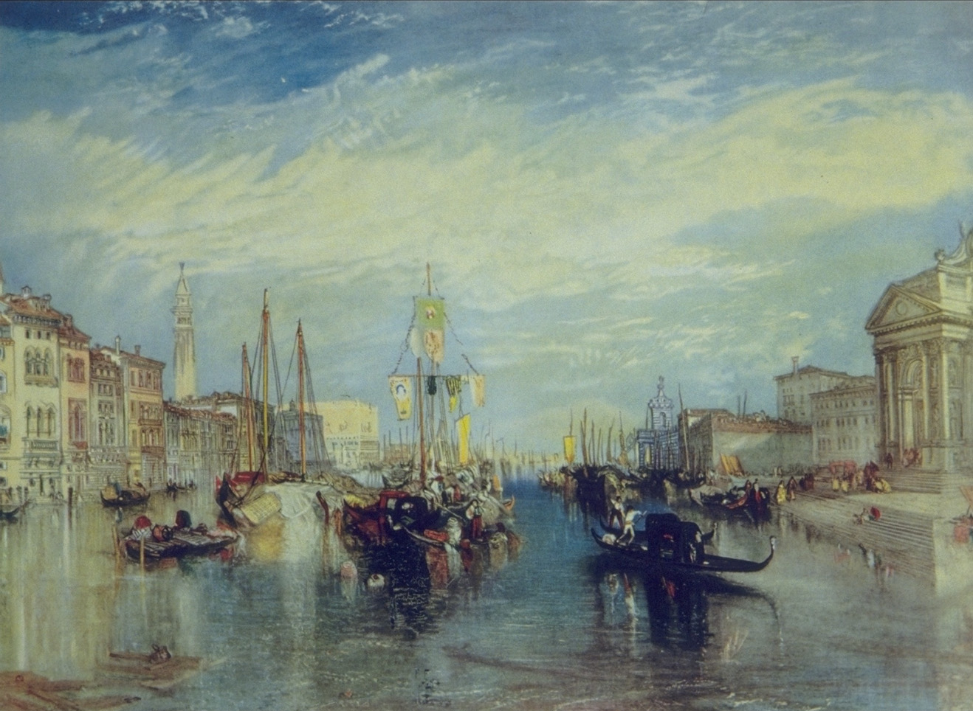
Title: The Grand Canal, Venice
Artist: Joseph Mallord William Turner, a ninteenth century British artist

Slide 20
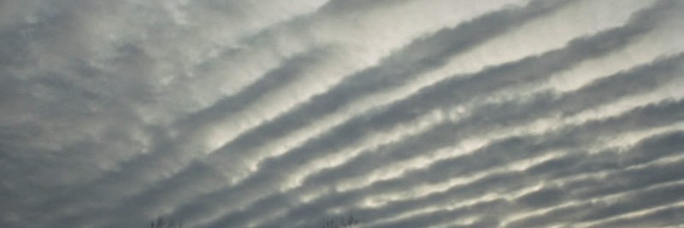
This type of altocumulus cloud is sometimes called a mackerel sky because the cloud looks like the markings on a mackerel fish.
Photo: Peggy LeMone

Slide 21
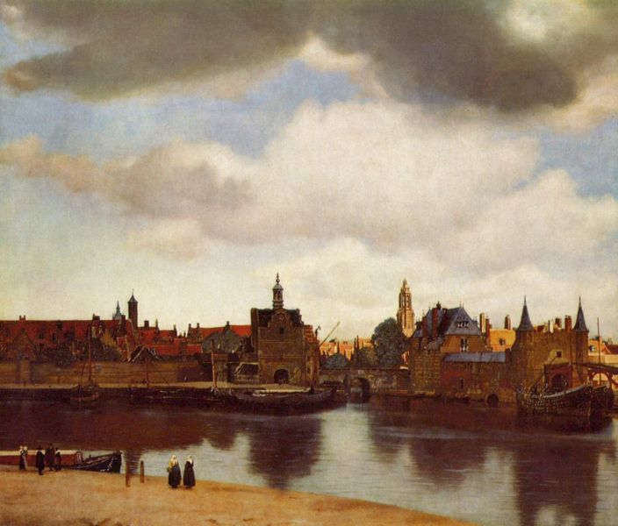
Title : View of Delft
Artist: Jan Vermeer, a seventeenth century Dutch painter

Slide 22
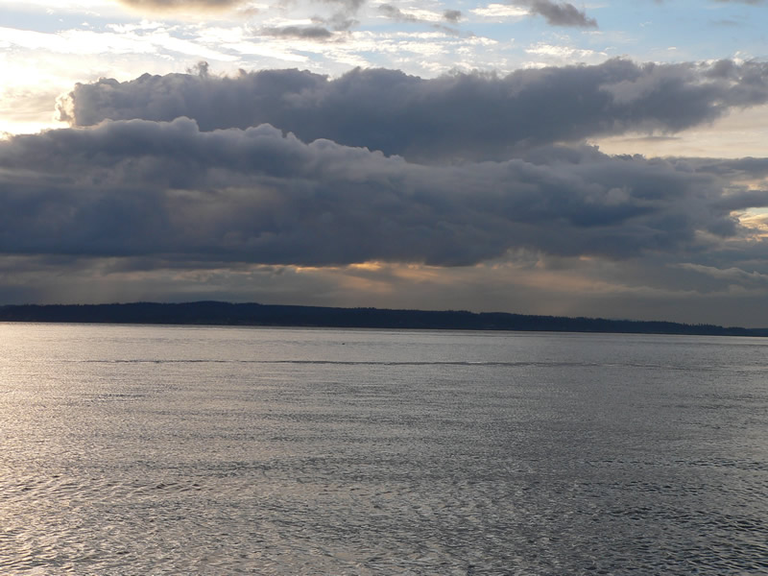
The clouds in this painting look like stratocumulus.
Photo: Olga and Sergei Kuznetsov

Slide 23
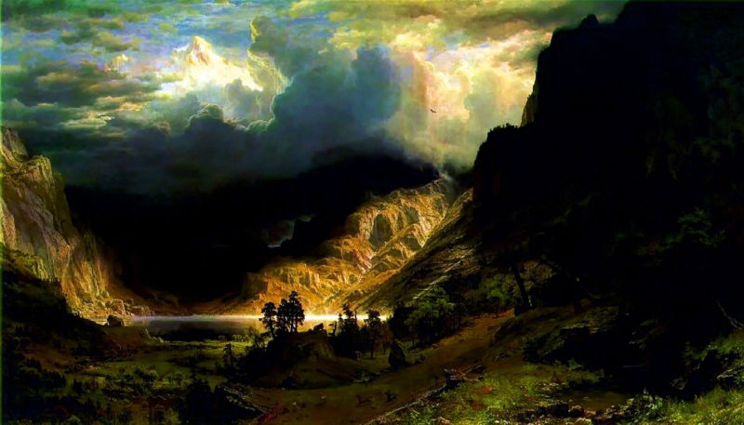
Title: Storm in the Rocky Mountains
Artist : Albert Bierstadt, nineteenth century American landscape painter

Slide 24
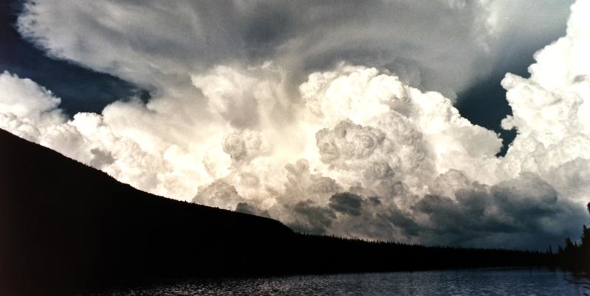
The clouds have the rounded crisp edges and vertical development of cumulonimbus clouds.
Photo: Wikipedia

Slide 25
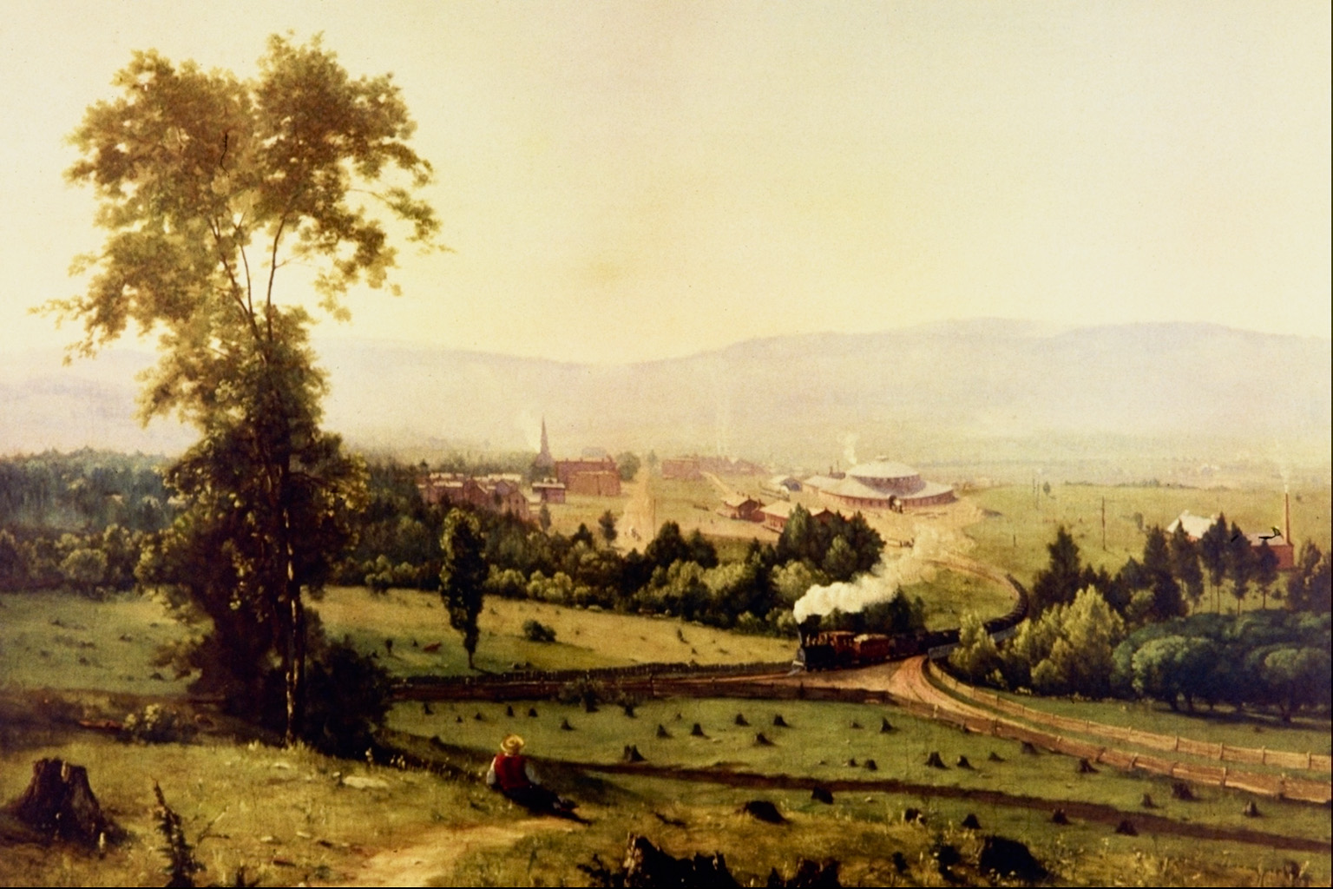
Title: The Lackawanna Valley
Artist: George Inness, a nineteenth century American painter

Slide 26
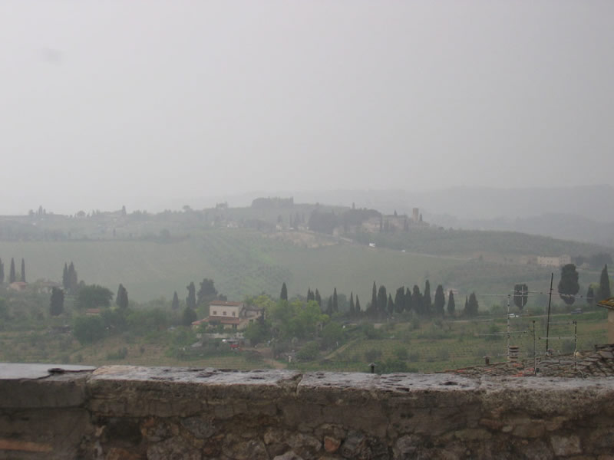
There is a low and uniform layer of stratus clouds. Note that the smoke from the chimney is going straight up so there must not be much wind.
Photo: Sara Martin

Slide 27
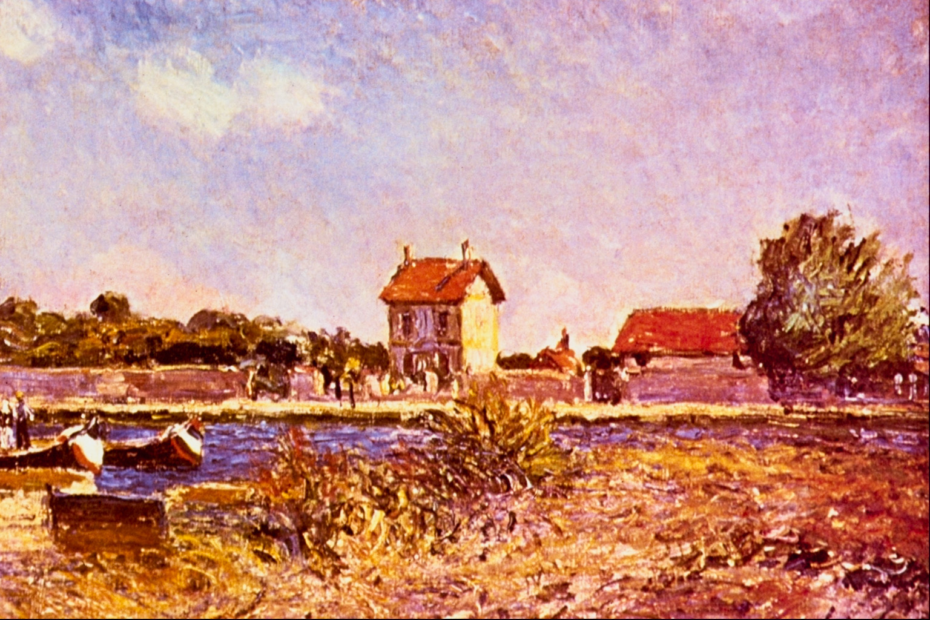
Title: Saint-Mammes
Artist: Alfred Sisley, nineteenth century English Impressionist painter

Slide 28
There are just a few small cumulus clouds in the upper left.
Photo: Carlye Calvin

Slide 29
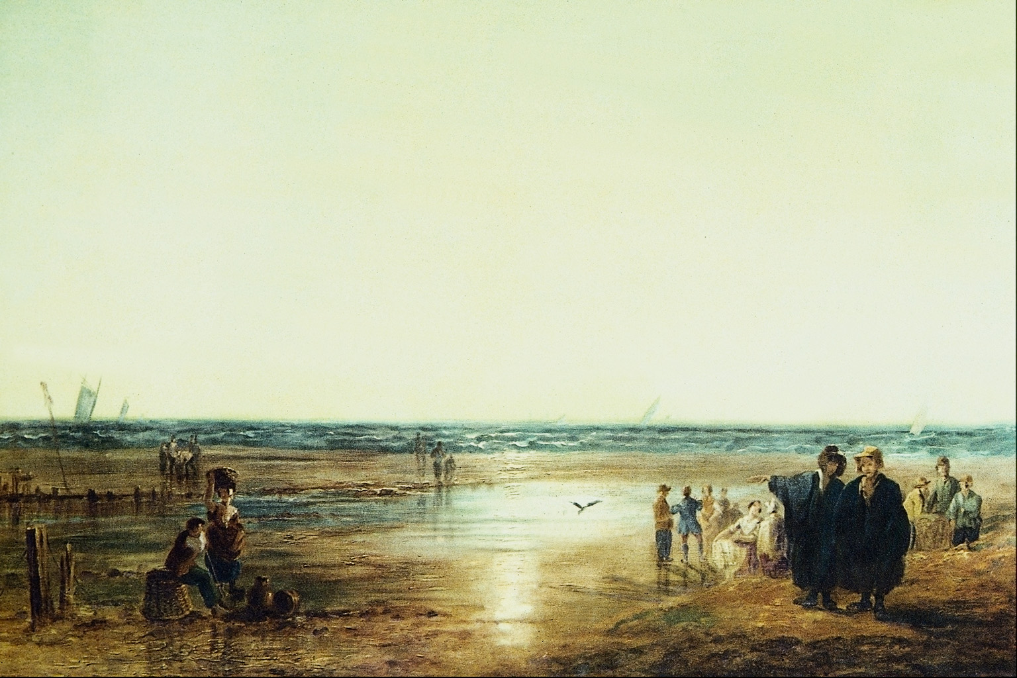
Title: Seacoast
Artist: Richard Parkes Bonington (1802-1828) English landscape painter

Slide 30
This sky has a uniform cover of stratus or altostratus clouds.
Photo: Sara Martin

Slide 31
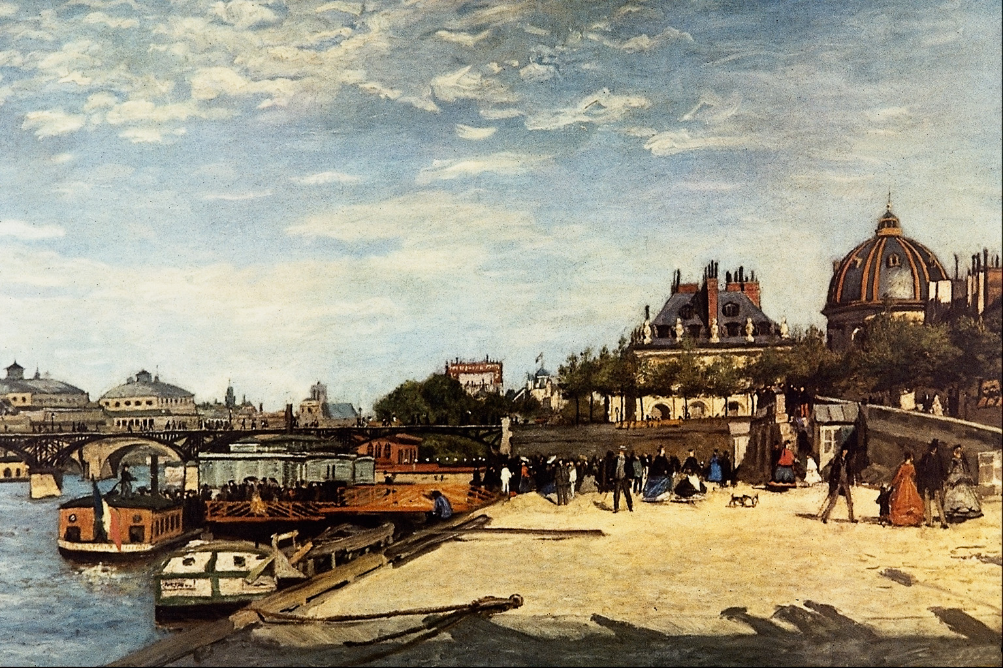
Title: Le Pont des Arts
Artist: Pierre-Auguste Renoir (1841-1919) French painter

Slide 32
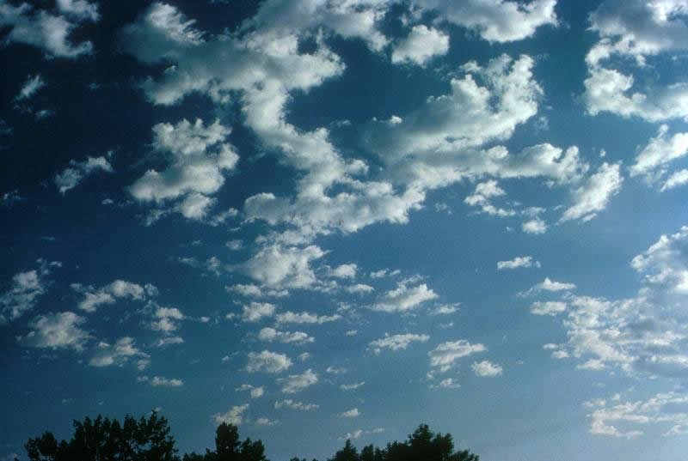
There appears to be two cloud types in the sky: mid-level altocumulus clouds and
lower stratocumulus clouds.
Photos: UCAR (top) Olga and Sergei Kuznetsov (bottom)

Slide 33
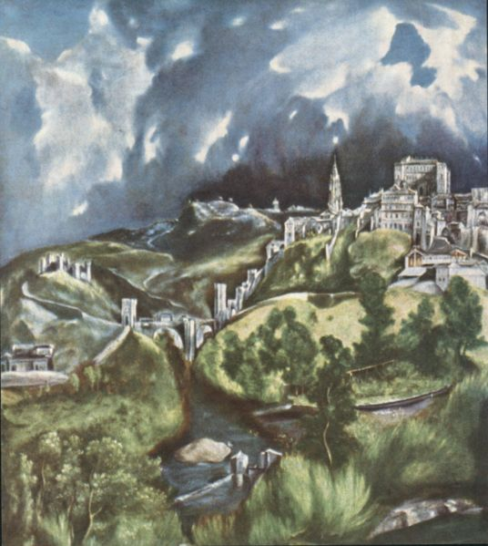
Title: View of Toledo (Spain)
Artist: El Greco, a 17th Century artist from Greece who lived in Spain

Slide 34
The towering dark clouds in the sky look like thunderstorm clouds called cumulonimbus.
Photo: Wikipedia

Slide 35
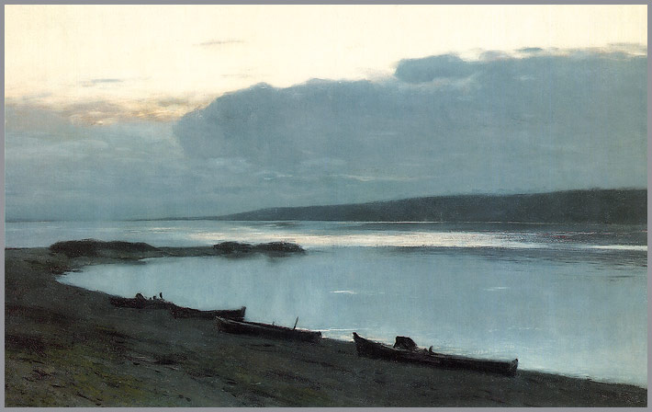
Title: Evening on the Volga
Artist: Issac Levitan, a ninteenth century Russian landscape painter

Slide 36
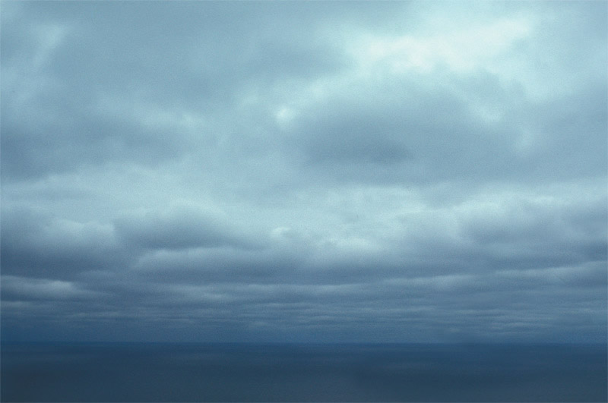
These are large stratocumulus clouds.
Photo: Peggy LeMone

Slide 37
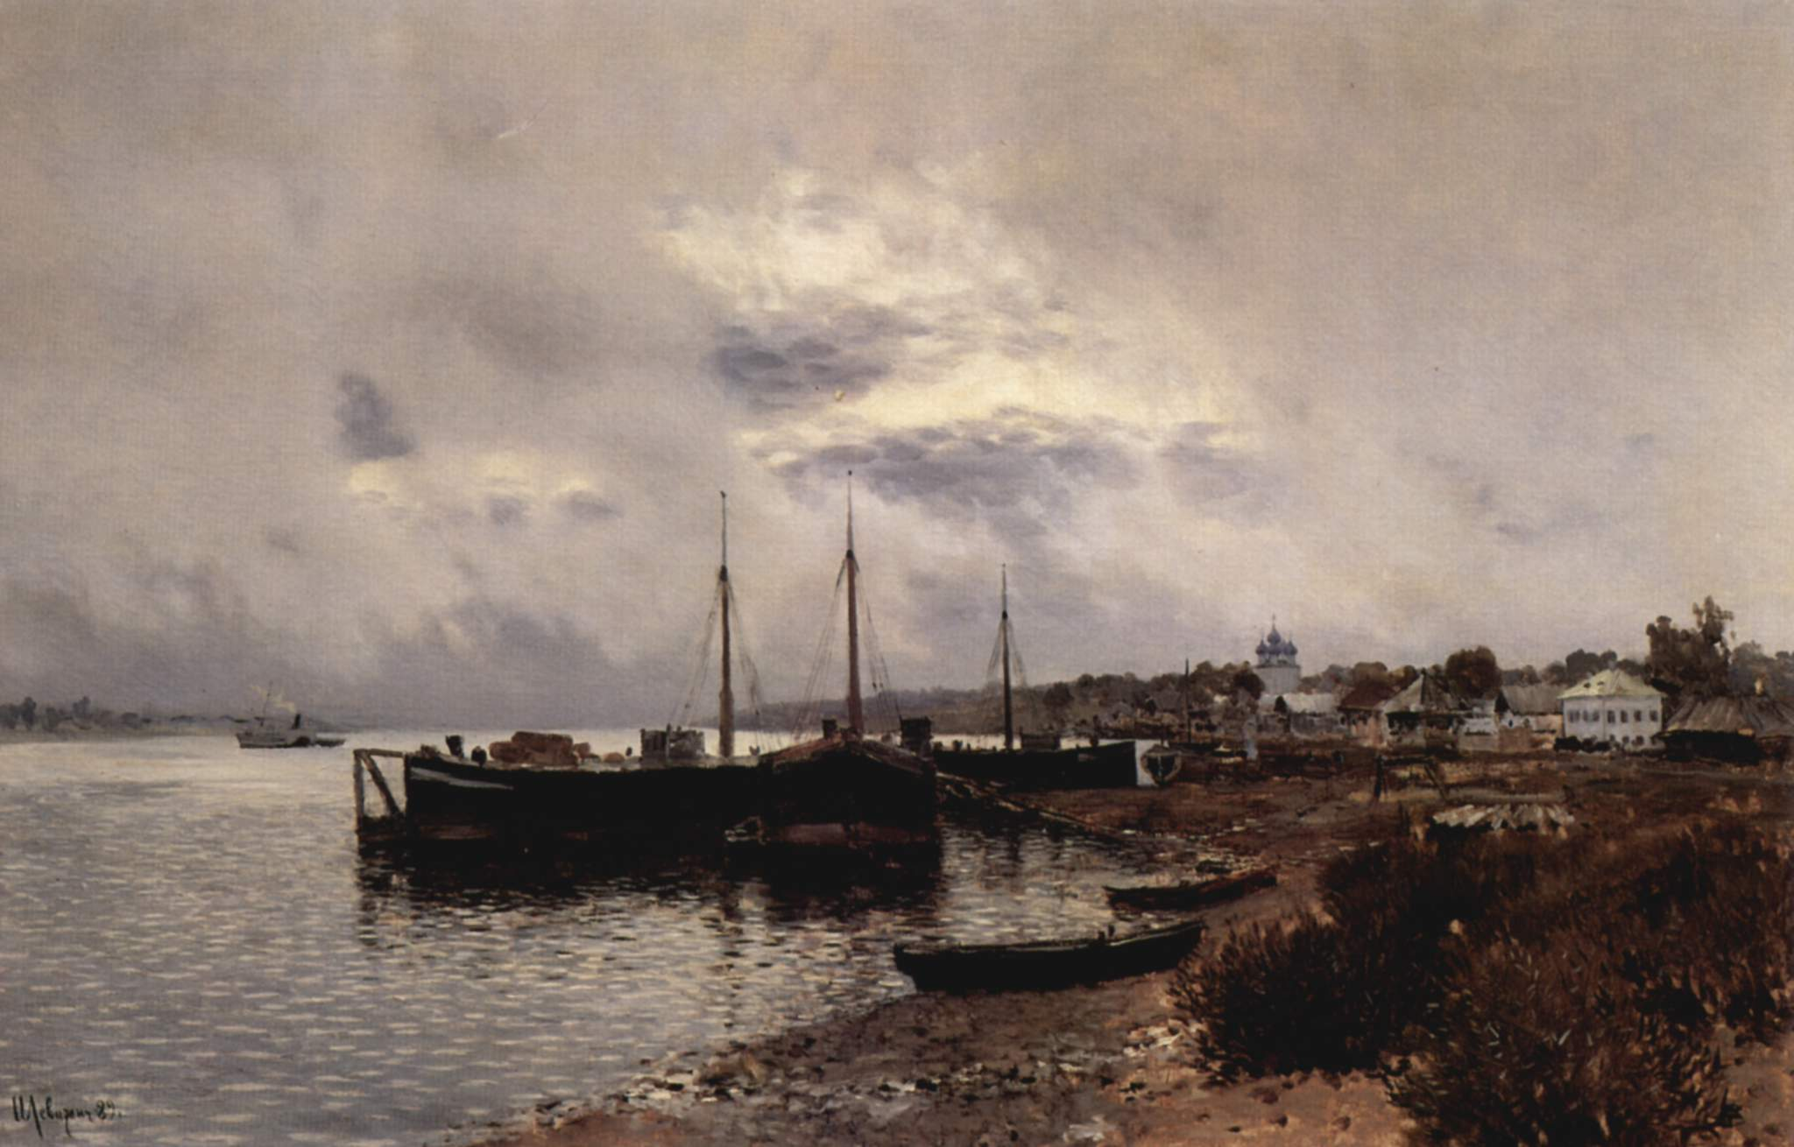
Title: After the Rain The Lake of Terni
Artist: Issac Levitan, a ninteenth century Russian landscape painter

Slide 38
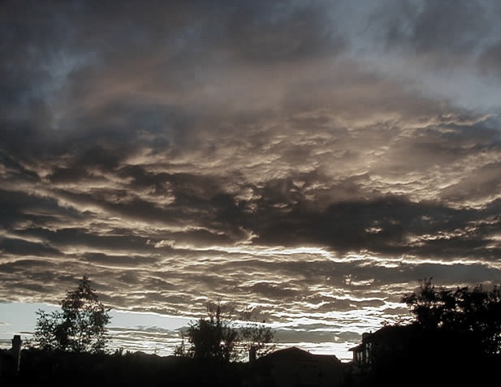
After rain has ended, broken pieces of low clouds called scud are left in the sky. Behind the scud are altocumulus clouds.
Photo: Peggy LeMone

Slide 39
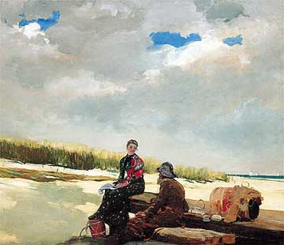
,
Title: Cloud Shadows
Artist: Winslow Homer, a ninteenth century American painter and illustrator

Slide 40
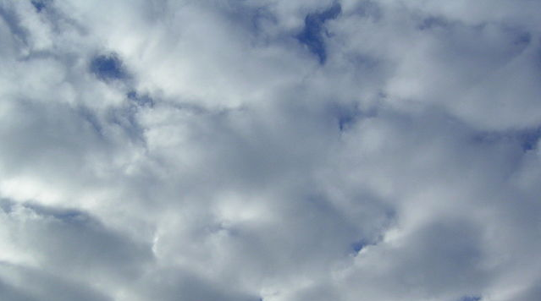
These are stratocumulus clouds.
Photo: Wikipedia
Notes:
wikipedia

Slide 41
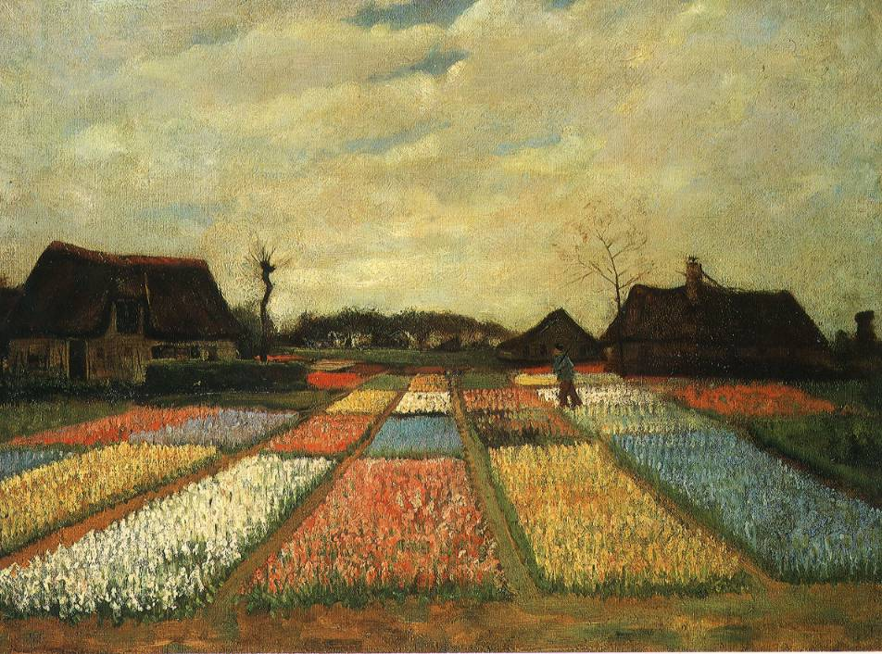
,
Title: Flower Beds in Holland
Artist: Vincent van Gogh, nineteenth century Dutch painter

Slide 42
Stratocumulus clouds look long like stratus, but are puffy like cumulus.
Photo: Peggy LeMone

Slide 43
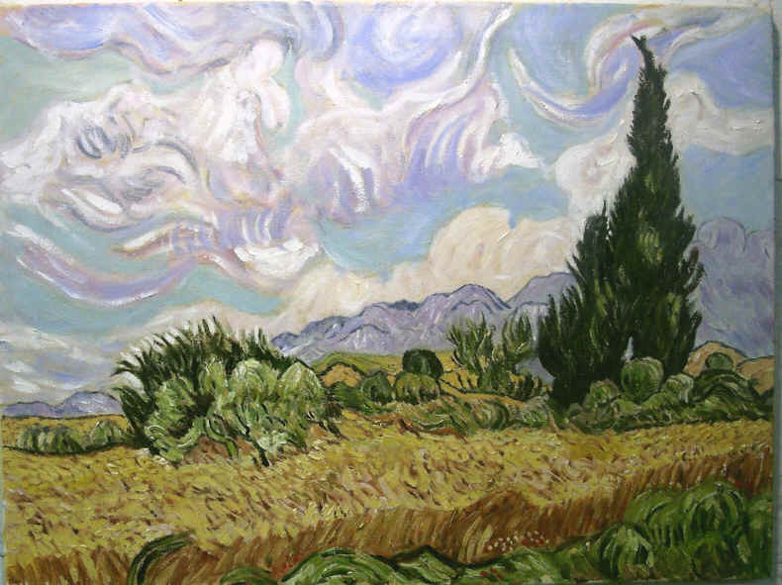
,
Title: Wheat Field with Cypress Trees
Artist: Vincent van Gogh, a nineteenth century Dutch painter

Slide 44
What types of clouds did van Gogh see in the sky when he captured this scene? It is difficult to tell!
?

Slide 45
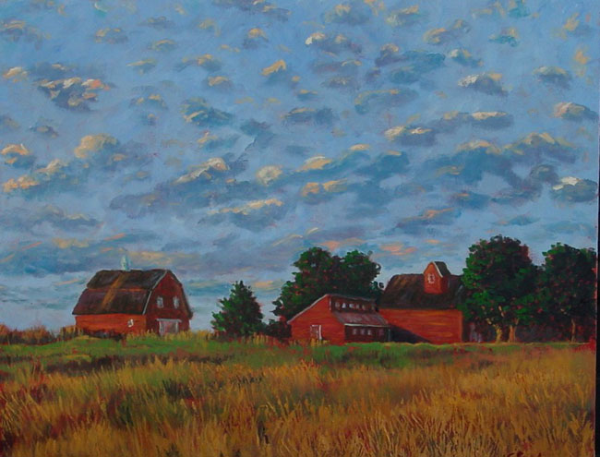
Title: Altocumulus
Artist: Graeme Stephens, contemporary artist and atmospheric scientist at Colorado State University

Slide 46
He painted altocumulus clouds!
Photo: UCAR

