Slide 1
Cloud Data Collection with GLOBE
Please download the free GLOBE Observer app on your mobile device
Create an account (use your teacher email)
Learn more about GLOBE Observer at: https://observer.globe.gov

Slide 2
Welcome to GLOBE Weather
A New NGSS-Based Middle School Unit Denver, Colorado
March 6th & 7th, 2020
Notes:
Over the next three days we will dig in to the curriculum, hone in our understanding of weather concepts and hopefully make space to discover what questions we have about the content (maybe answer some of those questions), and introduce you to using the GLOBE program in your classroom.
Introduce UCAR & partners in creating GLOBE Weather
Introduce ourselves
Schedule for the day: Reference agenda & resources handout, scheduled breaks, but take care of yourselves!
In your binder is the full curriculum!!! Also downloadable from the GLOBE Weather Curriculum website.
Introduce partners in the project: UCAR, NASA, GLOBE, BSCS

Slide 3
GLOBE Weather Development Process
Activity | Timing
Curriculum design discussions Scoping out DCIs and SEPs that connect to NGSS Develop 1st draft of curriculum | Winter-Spring 2017
PD workshop for 1st cohort of field test teachers | Summer 2017
Classroom Field Test #1 | Fall 2017
Analysis of field test data, curriculum revisions | Winter-Spring 2018
PD workshop for 2nd cohort of field test teachers | Summer 2018
Classroom Field Test #2 | Fall 2018
Analysis of field test data, final curriculum revisions | Winter-Spring 2019
Dissemination: released website, teacher workshops, train-the-trainer workshop, presentations | Spring 2019-Present
Notes:
Quick background of the project: need for NGSS aligned curriculum, desire to use GLOBE data and data collection, 2 year process, multiple field tests and revisions, etc.

Slide 4
From your laptop:
Navigate to: PollEv.com/melissarumme026
Enter your screen name
From your mobile device:
Compose a new text message to the number: 22333
To join the session send the message: melissarumme026
www.polleverywhere.com
Notes:
Have them get out laptops or devices (smart phone, tablet)
explain Poll Everywhere
PRESENTER NOTE: be sure to log in to Poll Everywhere in advance! Must have chrome extension installed to use w/in Google slides. If using Powerpoint, might have to re-imbed poll everywhere slides for them to be active

Slide 6
Teaching the science of weather is challenging.
Processes involved are difficult to observe
The atmosphere is a chaotic system
How you experience weather is different depending on where you are on the Earth
Many unknowns, even for weather scientists!
Misconceptions are prevalent
Background knowledge required
Notes:
Show of hands to measure agreement with this statement: Teaching the science of weather is challenging.
Weather is challenging to teach for many of the same reasons that weather is challenging to predict!

Slide 7
Get to know each other
1-2-4-All
Engage everyone simultaneously in generating ideas
1- Take a moment to read your card and reflect on your own
Why is the claim false and what should change to make it true?
2- Find a partner: introduce yourself and discuss your cards
Which claims/misconceptions do your students struggle with?
4- Form a group of four: introduce yourselves and discuss
Which concepts are most challenging to teach, and why?
All- Whole group share out
Notes:
Pass out misconception cards, one to each person-- Each card contains a misconception (eg, is FALSE!)
Many adults hold misconceptions about weather, if it’s challenging for adults it’s highly likely that students might struggle as well.
Take this opportunity to introduce yourselves to each other, perhaps say something about your background, and reflect on some of the more challenging weather concepts and your experiences teaching weather.
Use the misconception cards to guide your discussion with each other.
1 minute: 2 minutes: 4 minutes: then all discussion
GLOBE Weather points out places to look for student misconceptions

Slide 8
Goal setting
What do I hope to walk away with from this workshop?
Notes:
Write down somewhere (don’t share)
Who are your focal students?
Think of two or three students you work with who have been less engaged in science or STEM. Please describe them...you will be reflecting on how effectively this content and/or approaches would engage your focal students throughout GLOBE Weather
Our goals for you: Improve confidence in teaching weather: both in content and pedagogy, familiarity with GLOBE weather curriculum as a tool

Slide 9
An Unexpected Storm
What do we know about storms?
© 2019 University Corporation for Atmospheric Research. All Rights Reserved
Notes:
Introduce Anchor
“Severe weather can put people’s lives and property at risk. If we can predict when severe weather is likely to happen, we can help people be better prepared when it happens. In this unit, we are going to explore where, when, and why storms form and how we can predict the ways in which they might impact communities, especially by bringing heavy rain or snow.”
Introduce the CO storm:
2013 there was an unusual storm that lasted for 7 days, dropping over 15 inches of rain, causing about $2 billion worth of damages.

Slide 10
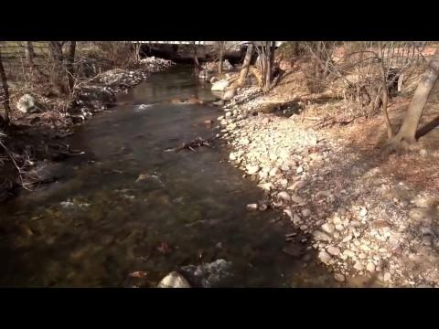
An Unexpected Storm
STEP 1:
What happens in the atmosphere to cause a storm?
https://scied.ucar.edu/boulder-floods
Notes:
Watch video
Discussion: us using Talk Moves checklist questioning when applicable. Record ideas on board/ chart paper
Have teachers take out sentence stems half sheet
With our first group share-out, I’d like us to try using the Sentence stems as a way to support discussion with our students, which they will be doing a lot of in GLOBE Weather. (Questioning/Discussing/Argumentation are science practices!)
Prompts:
What did you hear in the video about the causes of the precipitation?
Where did all the moisture over CO come from?
What had to happen to make that moisture turn into rain?
Make sure to focus on what caused the rainstorm (not the flood). “Is that a cause of the storm or an effect from the storm?”

Slide 11
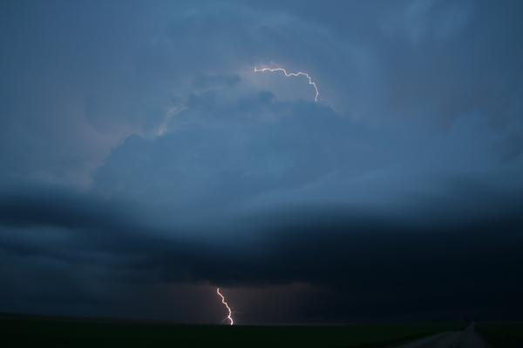
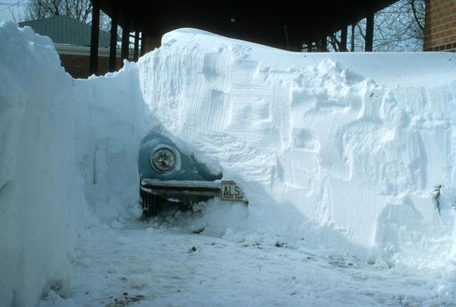
An Unexpected Storm
STEP 2: What are my experiences with storms?
Notes:
Think about a storm you have experienced and would like to share about.
2 minutes to share storm experiences with a partner
Whole class discussion:
Ask for teachers to share what they heard from their partners.
Have teachers take out sentence stems half sheet
Prompts:
How do storms begin in the first place?
What needs to happen so that rain or snow starts to fall?
Why do some places get heavier precipitation but other places do not?
Where does all the water come from before it falls as rain or snow?
Focus on water cycle, record ideas on chart paper from before

Slide 12
An Unexpected Storm
STEP 3: Represent what you know about storms
What caused the rain in the Colorado storm?
Notes:
Pass out Lesson 1: Step 3 SAS
Draw & label a picture in the box on your SAS. Your picture is a model of how this storm happened.
Your picture should show all of the factors that led to rain.
Include labels in your drawing that explain how each factor led to rain.
Share models with others at your table, comparing/contrasting with each other. One person from each group report about trends from their models to the whole group.
***This type of model development is a consistent feature of GLOBE Weather***

Slide 13
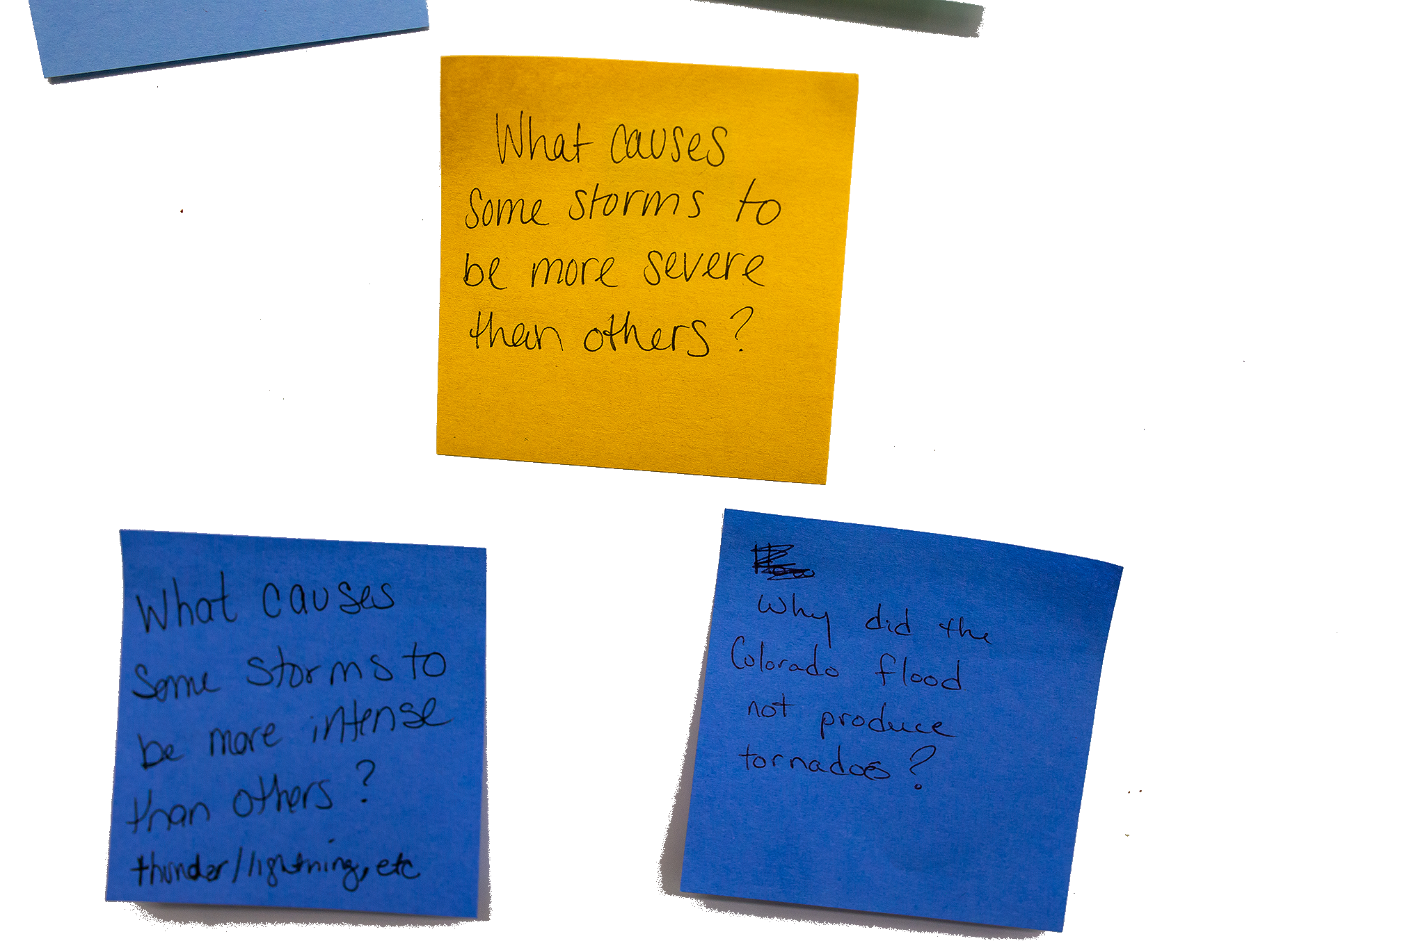
DRIVING QUESTION BOARD
This is where the students post their questions and where students return to answer their questions throughout the unit.
Unit Driving Question:
What causes different kinds of storms?
Notes:
By the end of the unit, students should be able to answer the driving question, but they also likely have their own questions. And perhaps you have some questions that have started to come up as well. We don’t want to lose track of these questions, so we will track them on our DQB
Write unit driving question across top of the driving question board: What causes different kinds of storms?
Write questions on your own related to “What causes different kinds of storm?” and the Anchoring Phenomenon (Colorado Storm) on the post-it notes provided at your table. Write one question per post it!
Form “Scientist Semi-circle” and take turns reading/posting questions to the DQB. After a question is added, ask if anyone else has the same question or a related question. Group like questions together.
Chart papers hanging on wall, divided into 4 sections: LS1, LS2, LS3, Other. As question is read out, we decide which section the question should be posted in

Slide 14
Break (10 min)
Notes:
add instructions for creating teacher account at globe.gov

Slide 15
Cloud Data Collection with GLOBE
Please download the free GLOBE Observer app on your mobile device
Create an account (use your teacher email)
Learn more about GLOBE Observer at: https://observer.globe.gov

Slide 16
What is inquiry?
ENGAGE: Learners are engaged collaboratively by questions
EXPLORE: Learners give priority to evidence
EXPLAIN: Learners formulate explanations from evidence
ELABORATE: Learners revise their explanations in light of alternative explanations
EVALUATE: Learners communicate and justify their proposed explanations
Notes:
We engage with weather phenomenon using the inquiry cycle, or 5E’s. In the anchor, we engaged with a phenomenon and hopefully piqued interest for exploration. We also did a bit of pre-assessment by asking you construct a working explanation that we can build upon.
The 5E’s are referenced at the beginning of each lesson. These align to the NGSS science practices as well, we are learning by doing what scientists do. Look at LS1 as an example (table of contents, at beginning of each lesson). By the time we get to explain, we are really looking for understanding in the way students are explaining what they are seeing.
Elements of inquiry approach to learning:
Open ended questioning vs questions with yes/no answers
Engaging students with phenomenon that don’t have one obvious answer
Asking students to design their own explanations by constructing models
Providing time to share our ideas with each other, and then to go back and update/revise our ideas
LOTS of discussion

Slide 17
An alarming statistic!
Research on student discussion revealed that its use in middle and high school classrooms varied from only 14 to 68 seconds per class period.
(Wilkinson & Nelson 2013)
Notes:
Make time for students to share their ideas! Activating the speaking part of our brains helps with memory & retention. Students should be talking way more than the teacher!
Try to warm yourself to the idea that a noisy classroom is one in which learning is happening!

Slide 18
Inquiry and Productive Talk
For inquiry to work, students must engage in productive talk, or talk that extends our thinking.
How can we create a culture of talk in our classrooms?
Notes:
GLOBE Weather prioritizes student discussion throughout. We are attending to this piece now because rich conversations that push students to think deeper don’t just magically happen. We have to teach students how to talk to each other in an academic way, to disagree, to challenge each other’s ideas with the goal of increasing our understanding.
I’d like us to spend a few moments now thinking about this question:
How can we create a culture of talk in our classrooms?
Thankfully we have tools: Reference Primer, checklist, talk moves
We had an introduction to the talk moves already, and I was using the checklist as the facilitator!
During activities time I encourage you to practice engaging in productive talk. You can use the checklist, sentence stems and the coaching prompts to get a sense for what this type of discussion should look like.

Slide 19
How can we create a culture of talk in our classrooms?
1-2-4-All
Engage everyone simultaneously in generating ideas
1- On your own, read through the Elements of Academically Productive Talk. What questions come up for you?
2- Stand up and find a partner. Discuss something that you found compelling/intriguing from the reading.
4- Join to make a group of four. Discuss ideas for attending to this in your classrooms. What have your experiences been?
All- Whole group share out
Notes:
Open up the PRIMER, go through the list of 7 things to support productive talk. Point out Checklist of Talk Moves, Sentence stems as tools for productive talk.
1-2-4-All discussion, use sentence stems in your discussion

Slide 20
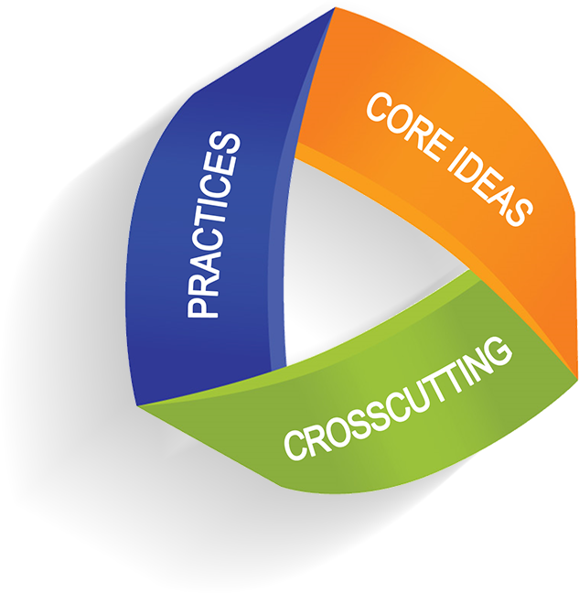
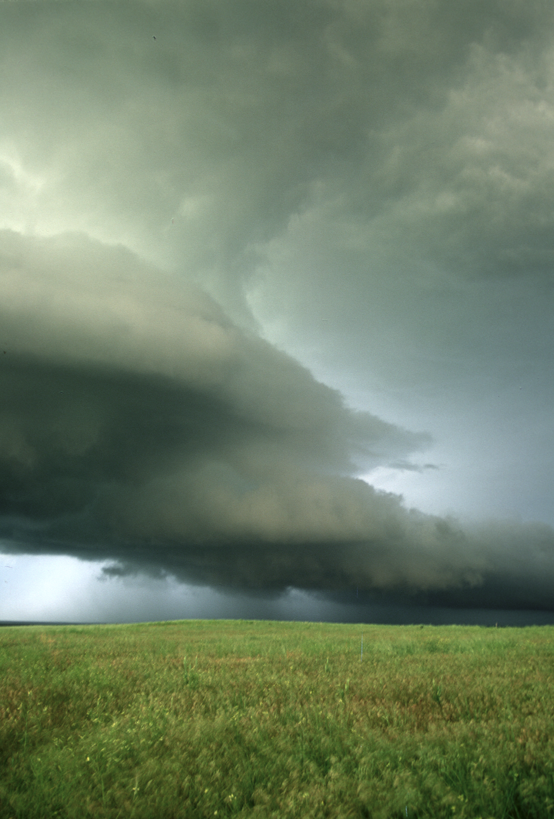
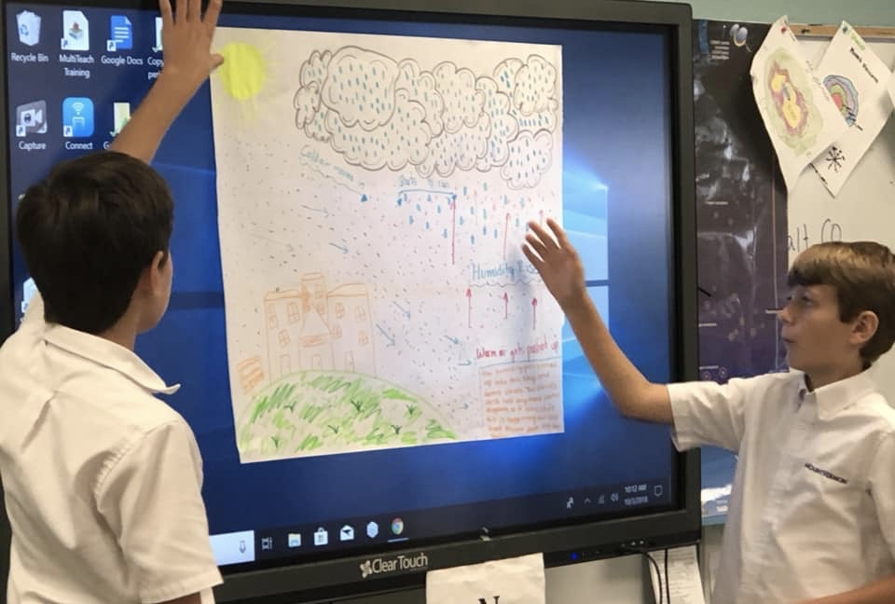
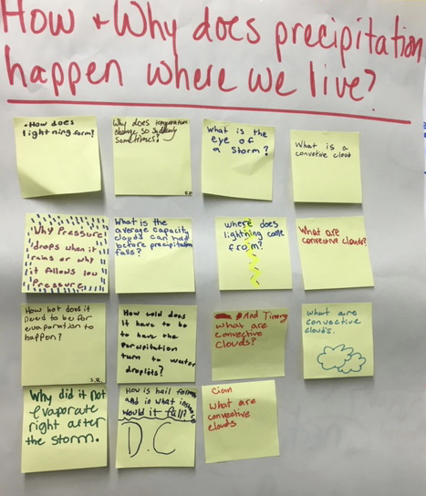
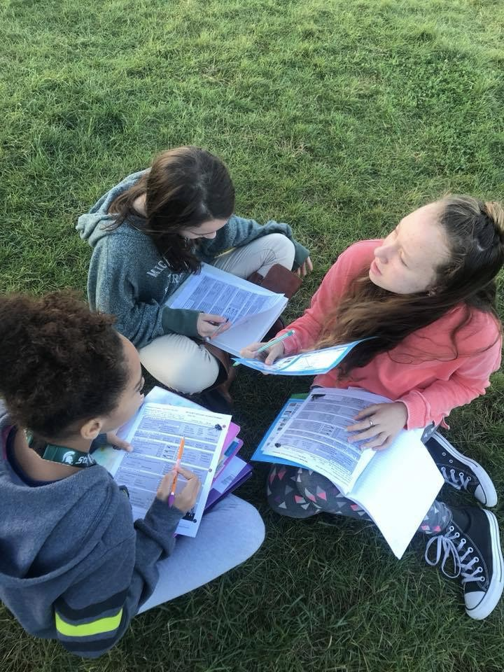
Overview of GLOBE Weather
NGSS
Storyline approach
A focus on weather phenomena
Student experiences with data analysis & modeling
Connection to the GLOBE Program
Notes:
Storyline as a way to sequence learning in a logical flow from beginning to end, connecting what we’ve just done to what we did before and to what is coming next.
Phenomena: Surprising or interesting things students have experienced but cannot easily explain.
Data analysis: Using strategies to interpret what i see/ what it means, drawing and writing on graphs and maps.
Modeling: different types of models: working models, consensus models, tracking model ideas
Questioning: Driving questions board to track and revisit student generated questions
Connection to GLOBE: GLOBE is a NASA program, GLOBE Weather introduces teachers to using GLOBE resources to: collect weather data using GLOBE protocols, Analyze GLOBE weather data
As many states and districts are moving towards adopting NGSS, there is a growing need for curriculum that is aligned. This unit was created to meet that need.

Slide 21
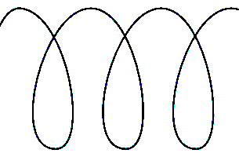
GLOBE Weather Curriculum
Anchor phenomenon
Three guided-inquiry learning sequences
Culminating task
Assessments
Snow Day?
Applying our learning to other types of storms
An Unexpected Storm
Extreme rainfall events impact a community
From Cloud to Storm
A Front Headed Your Way
Worldwide Weather
Short-lived, isolated storms
How and why storms move around the Earth
Stormy weather over a large region for many days
Notes:
Here is how the story unfolds: Change of scale, different ways that we experience weather: local, regional, global

Slide 22
Features of GLOBE Weather
Scavenger Hunt!
Can you find examples of all of these icons throughout the curriculum?
How might these features support your instruction?
Notes:
Explain how the curriculum is organized, start w tabs in the binder.
Info within the overview, background info at the beginning of each learning sequence, and assessments
As we go through the curriculum, be on the look-out for these icons
We encourage you to flip between the teacher guide and the student activity pages, etc. whenever you feel called to do so.

Slide 24
NGSS https://www.nextgenscience.org/
Science and Engineering Practices:
Developing and using models
Analyzing and interpreting data
Disciplinary Core Ideas:
ESS2-C:The Roles of Water in Earth’s Surface Processes
ESS2-D: Weather and Climate
Crosscutting Concepts:
Cause and effect
Systems and systems modeling
Patterns
Performance Expectations:
MS-ESS2-5:Collect data to provide evidence for how the motions and complex interactions of air masses result in changes in weather conditions.
MS-ESS2-4: Develop a model to describe the cycling of water through Earth's systems driven by energy from the sun and the force of gravity.
MS-ESS2-6:Develop and use a model to describe how unequal heating and rotation of the Earth cause patterns of atmospheric and oceanic circulation that determine regional climates.
Notes:
Look at example of an NGSS page in the curriculum pg 36
Explain 3-Dimensional Teaching if needed
Reference SCIENCE PRACTICES HANDOUT: Other practices included in GLOBE Weather: asking questions, explaining, communicating
Any small shifts you can make in your lessons to expose students to the practices is an amazing way to increase engagement and learning
*point out strikethroughs

Slide 25
How do I find more
GLOBE Weather resources?
Notes:
We are going to take a few moments to explore what the website has to offer.

Slide 26
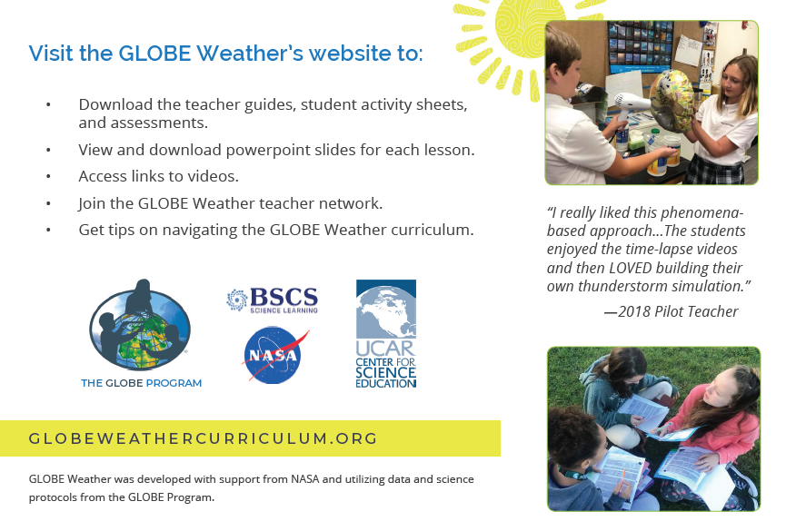
© 2019 University Corporation for Atmospheric Research. All Rights Reserved
Notes:
Everyone navigate to globeweathercurriculum.org
We have a wealth of resources on this site, it’s more than just a downloadable copy of the curriculum.

Slide 27
From Cloud to Storm
LEARNING SEQUENCE 1
What causes an isolated storm?
© 2019 University Corporation for Atmospheric Research. All Rights Reserved
Notes:
Introduce Learning Sequence 1
We begin to investigate what causes a storm to form and first consider isolated storms, which are localized, short lived storms.

Slide 28
What scientific concepts do we draw upon to explain how a storm forms?
Notes:
Have them discuss with a partner, maybe write out as a list on the board:
What are the steps for storm formation, and what science concepts are a work during each of those steps (first.. the sun warms the ground-- we must understand radiation and heat transfer, etc)

Slide 29
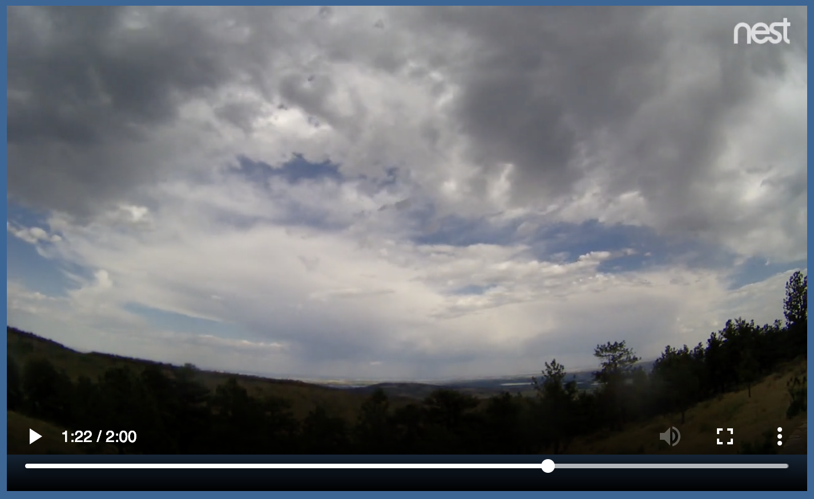
Watching the Sky
What we can learn about storms by watching clouds in the sky?
Students watch time lapse videos of a sunny day & a stormy day
Notes:
Pass out LS1 packet
Point out that we are going to go through the activities quickly now to get an idea of sequence, and that we will explore the activities as stations afterwards.
Let’s get back to our curriculum to see how students will explore these topics
We first understand the weather by what we observe in the sky
Watch time lapse video to see that storms form throughout the day, and typically happen in the afternoon

Slide 30
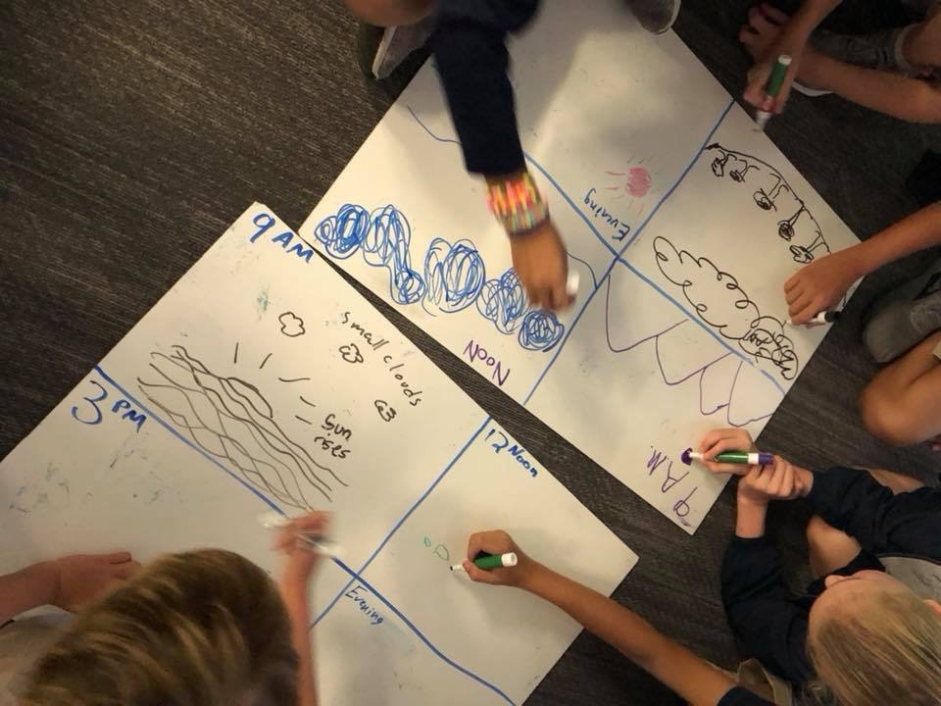
Watching the Sky
Students construct a time series diagram showing how an isolated storm forms throughout the day.
Notes:
We organize our thinking around what happened throughout the day when a storm formed by making a time series diagram.

Slide 31
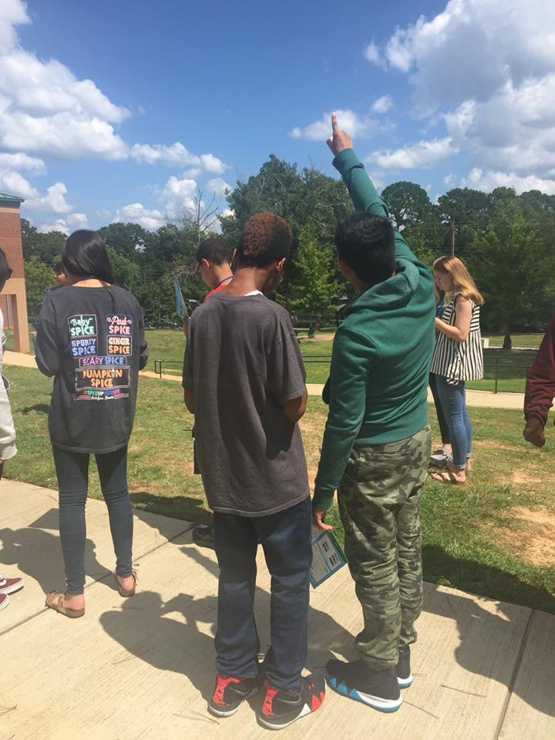
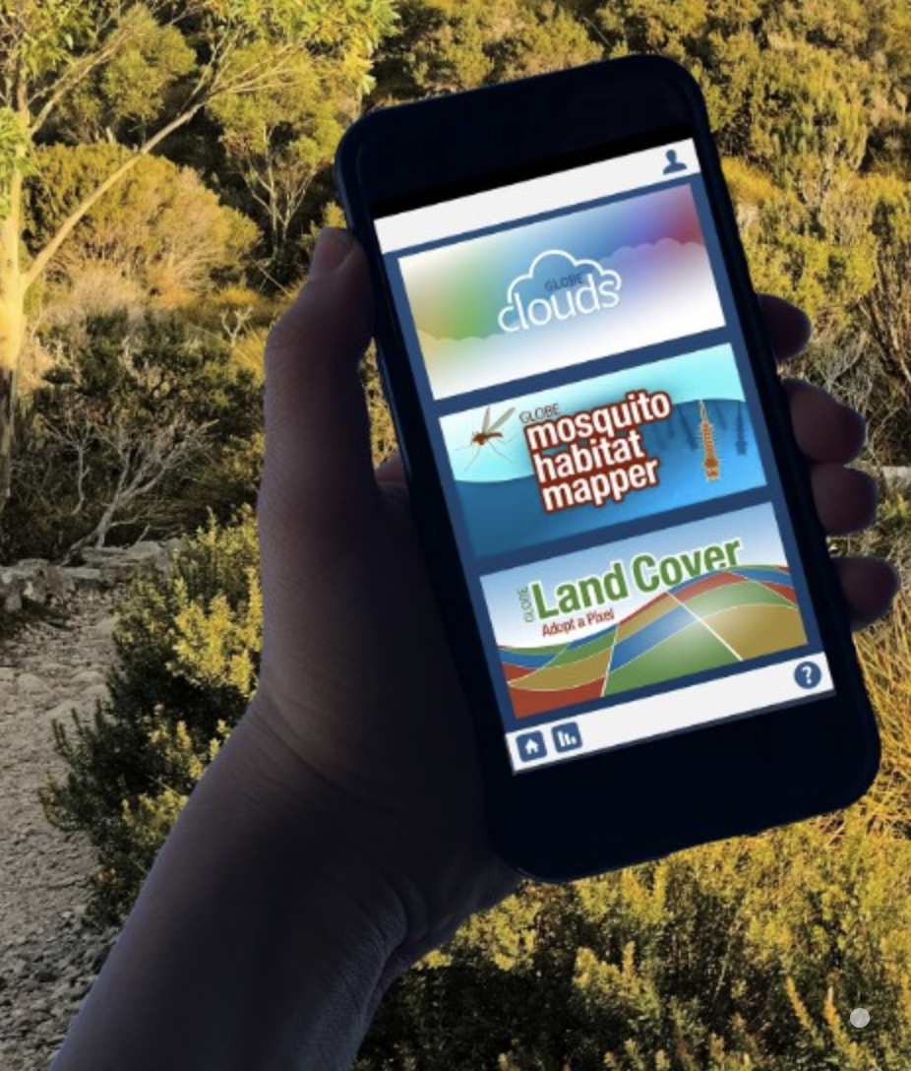
Watching the Sky
Students observe clouds outside
An opportunity to use GLOBE protocols to
collect data as a citizen scientist
Notes:
We go outside to make cloud observations to begin to connect what we see in the sky with what is happening with the weather

Slide 32
Predict
Step 1: Use the temperature near the ground to predict the other temperatures.
How would temperature change as a weather balloon traveled from the ground to the clouds?
Where would it be warmer or cooler?
°C
°C
°C
21° C
Notes:
Now that have made the connection between clouds and storms, we naturally consider what processes are responsible for clouds to form, and to do so we must start by investigating temperature. Lesson 3 helps students puzzle through how water from the ground ends up as clouds in the atmosphere:
Students make predictions of how temperature changes from the surface to altitudes where clouds form

Slide 33
Virtual Weather Balloon Simulation
https://scied.ucar.edu/virtual-ballooning
Notes:
And use a Virtual Weather Balloon Simulation to collect data about how temperature changes with altitude

Slide 34
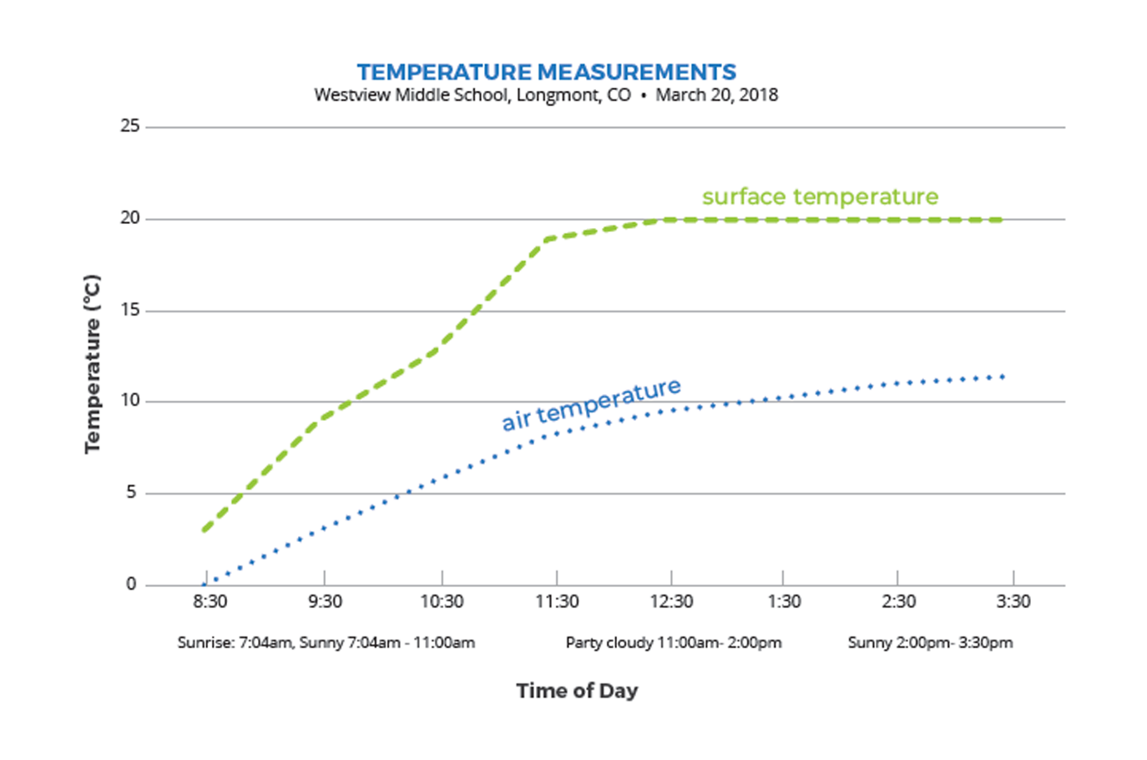
Investigation: Surface Temperature
Notes:
Now that have made the connection between clouds and storms, we naturally consider what processes are responsible for clouds to form, and to do so we must start by investigating temperature. Lesson 3 helps students puzzle through how water from the ground ends up as clouds in the atmosphere.
Students use data to compare surface temperature and air temperature, If doing the GLOBE Surface Temperature and Air Temperature protocols your students, like we will do this afternoon, you could collect your own data and make a graph of that.
Westview Middle School DATA SET (if questions about where the data come from)
Middle school students in Longmont, Colorado wanted to know how the ground temperature (surface temperature) compared to air temperature. They measured both temperatures over a school day. Their surface temperature data were measured on their school track and their air temperature thermometer was located on the school roof. The students agreed these two surfaces were the most similar, which is why they selected the school track for their surface temperature location. They measured both temperatures every hour during the school day. They also made observations of cloud cover.

Slide 35
WHAT I SEE & WHAT IT MEANS
The green line is always above the blue line
The surface is
warmer than the air
Notes:
Reference I2 handout and SAS
Use the Identify and Interpret (I²) Sensemaking Strategy to analyze and interpret the graphed data
What I See: Look at different parts of the graph. Do you notice patterns? Differences? Parts of the Graph?
What it Means: Write a What It Means statement to explain what you think is happening in each part of the graph.

Slide 36
How does temperature relate to cloud formation?
How does surface temperature compare to air temperature?
How does the Sun warm the atmosphere?
How might temperature change as you increase in altitude?
SHARE
-
TRADE
Notes:
Share-Trade:
Find a partner. Use your WIS/WIM statements to discuss your ideas about the question on the slide.
Trade WIS/WIM papers, find a new partner and discuss the 2nd question.
Trade WIS/WIM papers again, find a new partner and discuss the 3rd question, which isn’t explicitly addressed with the surface temperature graph, but could be implied...

Slide 37
Make a model
Step 5: Make a model of how sunlight warms the atmosphere.
Your model should explain:
How surface temperature is related to the sunlight
How air temperature is related to surface temperature
How the air temperature changes from the ground to higher altitudes
How you know the above three things using evidence from temperature data
Notes:
Turn to Lesson 3: Step 5 (pg 12)
Introduce the Working Model for explaining temperature patterns. In Lesson 3: Step 5, students will develop a Working Model of surface heating to explain temperature patterns, with the ground surface having the warmest temperatures and temperature decreasing with altitude. This is a Working Model because it’s a work in progress and does not capture a complete representation of the system, only part of the system.

Slide 38
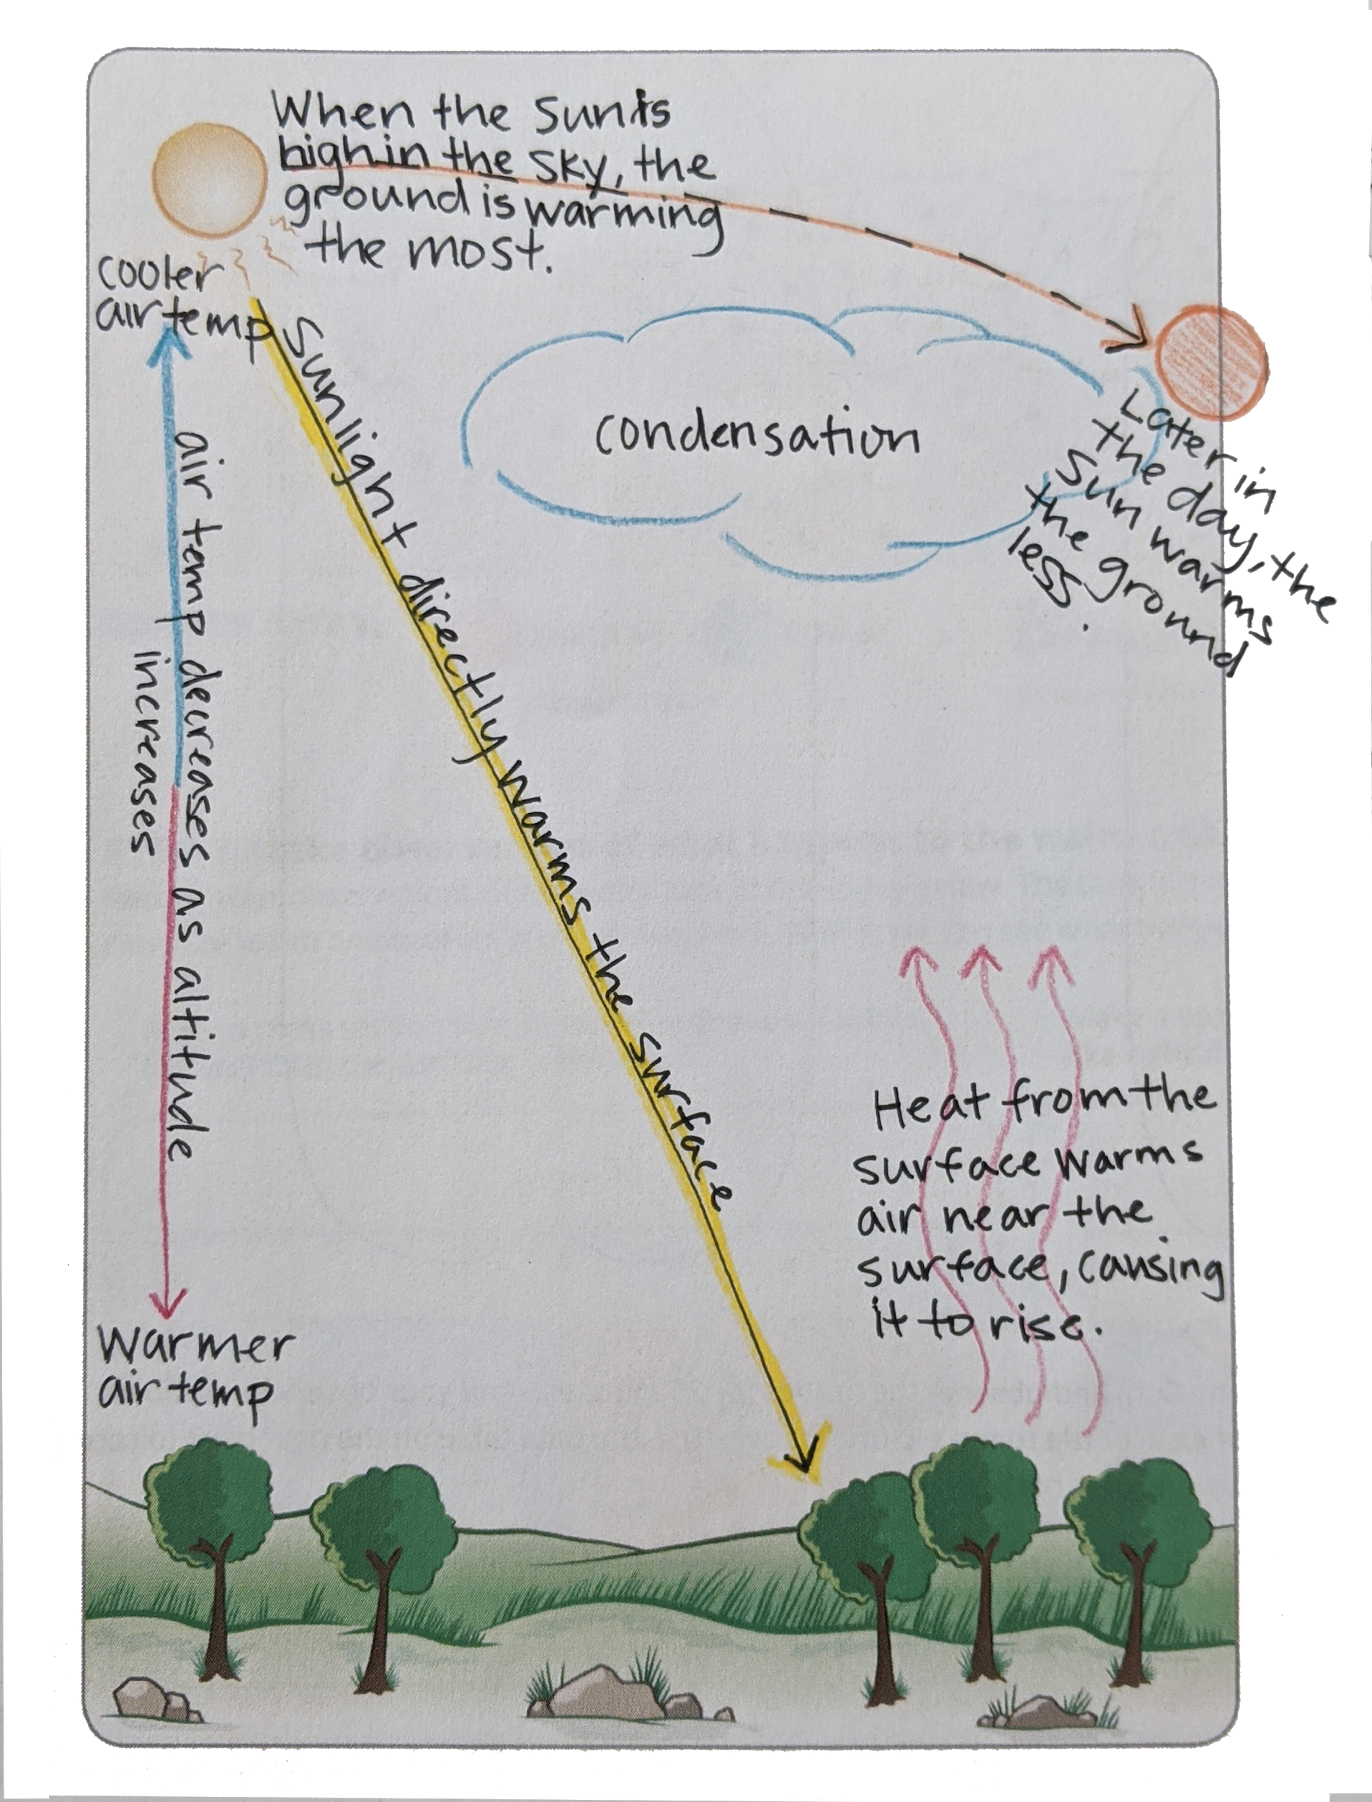
Notes:
picture of Lesson 3: Step 5 working model for how sunlight warms the surface

Slide 39
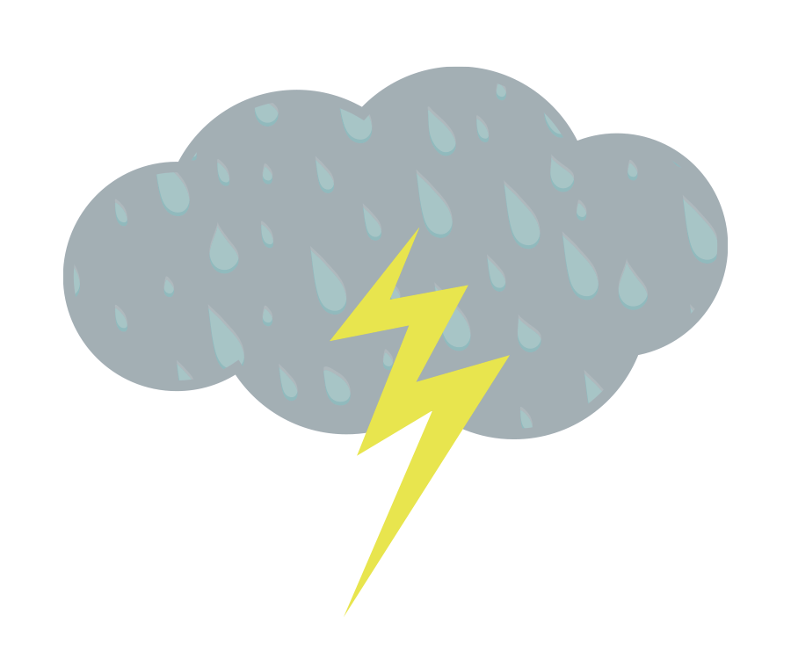
Misconceptions
How do you help students shift their thinking when they hold misconceptions?
Notes:
Turn to pg.34 in Teacher Guide
At this point, often we start to see student misconceptions popping up! Look over list of misconceptions common during this learning sequence. Hold a discussion around strategies to address misconceptions.
Understanding of the water cycle is important
Understanding why water evaporates, where the source of heat comes from
Understanding how the air is warmed
Understanding trends in air temp
Understanding how temperature related to clouds forming

Slide 40
Why are there storms on some days but not others?
Notes:
What is different about a sunny day and a stormy day?

Slide 41
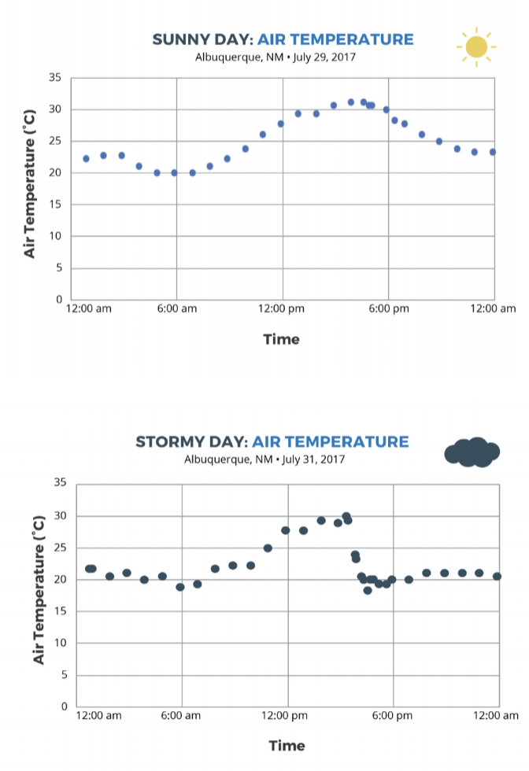
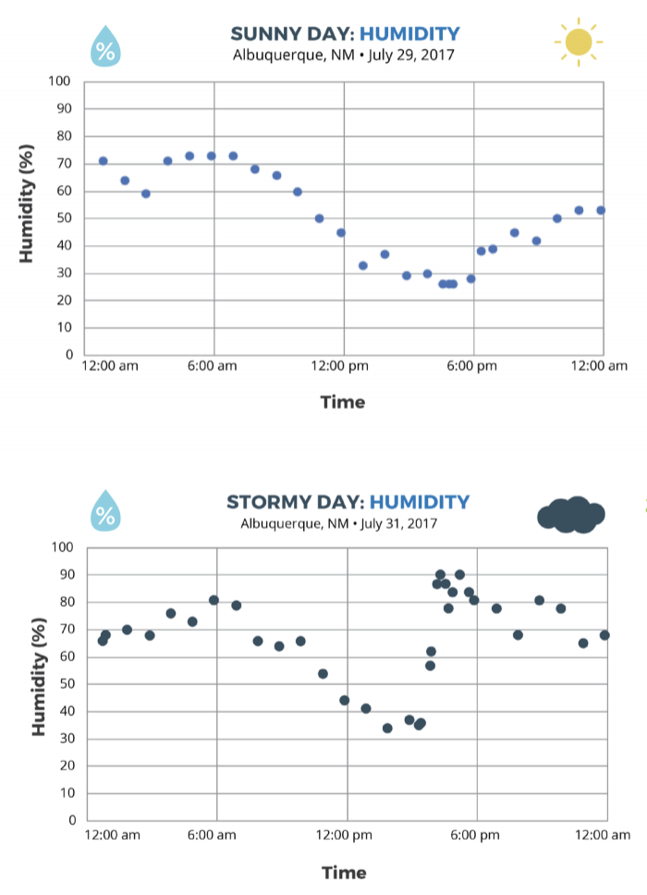
Comparing a sunny day and a stormy day
Notes:
We ask “what is different about a stormy day vs a sunny day?”
Comparing air temperature and adding in HUMIDITY

Slide 42
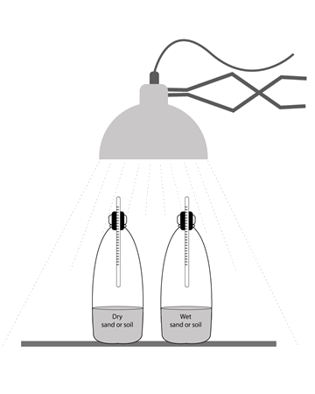
Investigation: Storm in a Bottle
Step 3: Make a storm in a bottle.
Using what you know about temperature and relative humidity, create a model of a sunny day and stormy day using clear bottles with different contents.
Notes:
What conditions are needed for a storm to form?
-We learn that a source of moisture, or humidity is needed (moist air mass, body of water, etc)

Slide 43
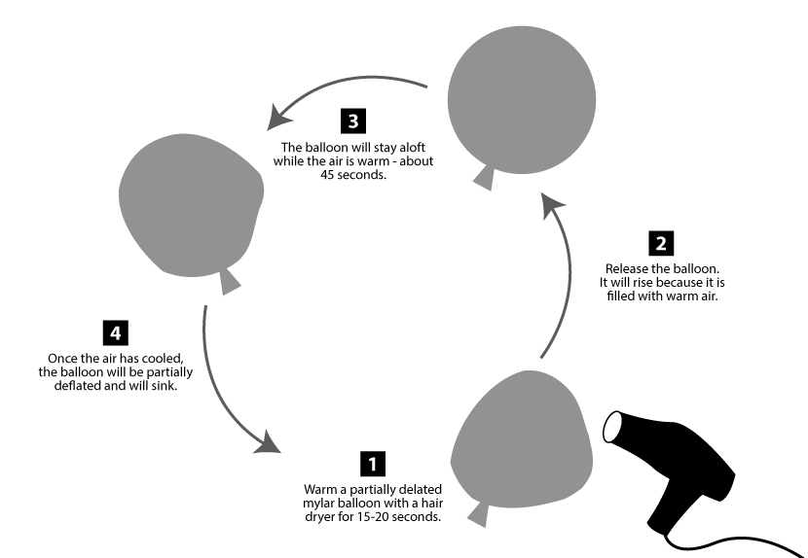
Investigation: Mylar Balloon
Step 1: Observe warmed and cooled air.
https://scied.ucar.edu/warming-mylar-balloon
Notes:
Why does warm air rise and cool air sink? Most students can recall that warm air rises, but why?

Slide 44
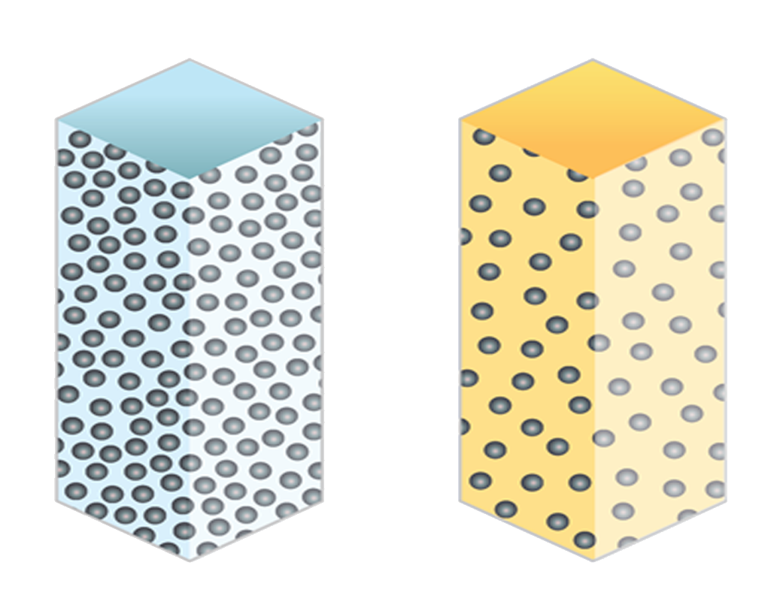
Interactive Reading
Step 2: Air on the Move
Read about the differences between cold and warm air.
Draw a diagram of 20 air molecules inside the mylar balloon when they are warmed and when they are cooler.
Cold Air
Warm Air
Notes:
To explain why warm air rises and cool air sinks:
Density differences between warm & cool air

Slide 45
Interactive Reading
Step 2: Air on the Move
Read about how gravity affects air molecules.
Draw air molecules between the planet and the top of the atmosphere.
Notes:
We read about how gravity affects air molecules, which creates pressure differences at the surface and higher up in the troposphere

Slide 46
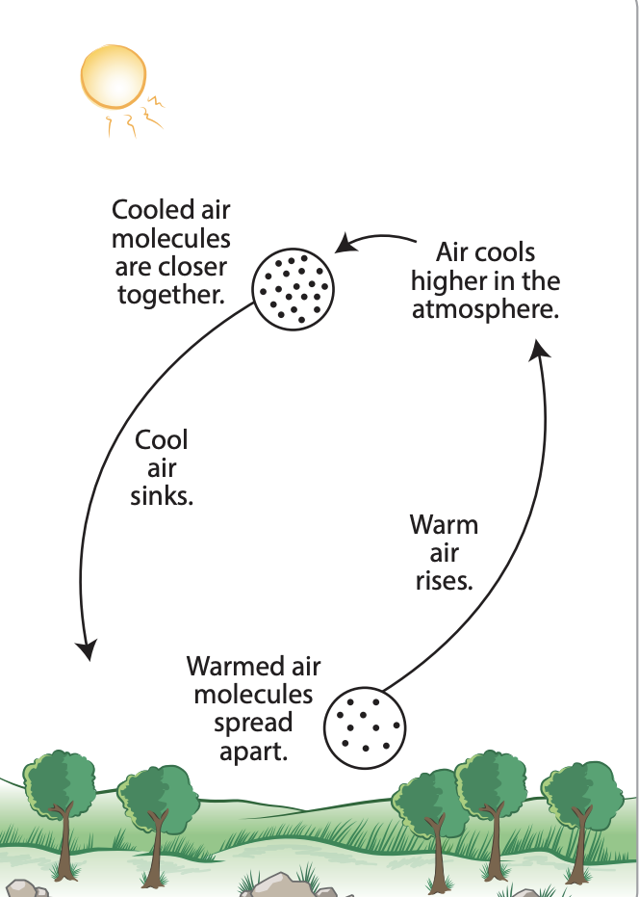
Step 2: Air on the Move (continued)
Putting it all together to explain the cycle of rising of warm air and the falling of cold air, called convection.
Notes:
Students put all that together to describe convection.
What is the story of an air molecule as moves, rising and falling, in the atmosphere?

Slide 47
Simulation: Make a Thunderstorm
https://scied.ucar.edu/make-thunderstorm
Notes:
We apply our learnings about the conditions needed for a storm to form with the Make a Thunderstorm simulation.

Slide 48
Lunch Break- be ready to start at 12:55pm

Slide 49
Cloud Data Collection with GLOBE
Please download the free GLOBE Observer app on your mobile device
Create an account (use your teacher email)
Learn more about GLOBE Observer at: https://observer.globe.gov

Slide 50
Activities Exploration
LEARNING SEQUENCE 1
Try out the activities wearing your “student hat” first
Refer to your Teacher Guide to begin thinking about how you would facilitate the activity
Coaching prompts and Talk Moves are facilitation supports as well
Work together, discuss with each other!
Notes:
Explain stations quickly

Slide 51
GLOBE Atmosphere Protocols

Slide 52
Outline
Why GLOBE?
What is GLOBE?
GLOBE by the numbers
Benefits for GLOBE Teachers & Students
Next Steps

Slide 53
Why GLOBE?
Access to 25 year-old database: 179,160,433 measurements
Authentic field-based science
Data collection with consistency through protocols
Allows for comparable data around the world
Protocols developed and agreed upon by NASA scientists

Slide 54
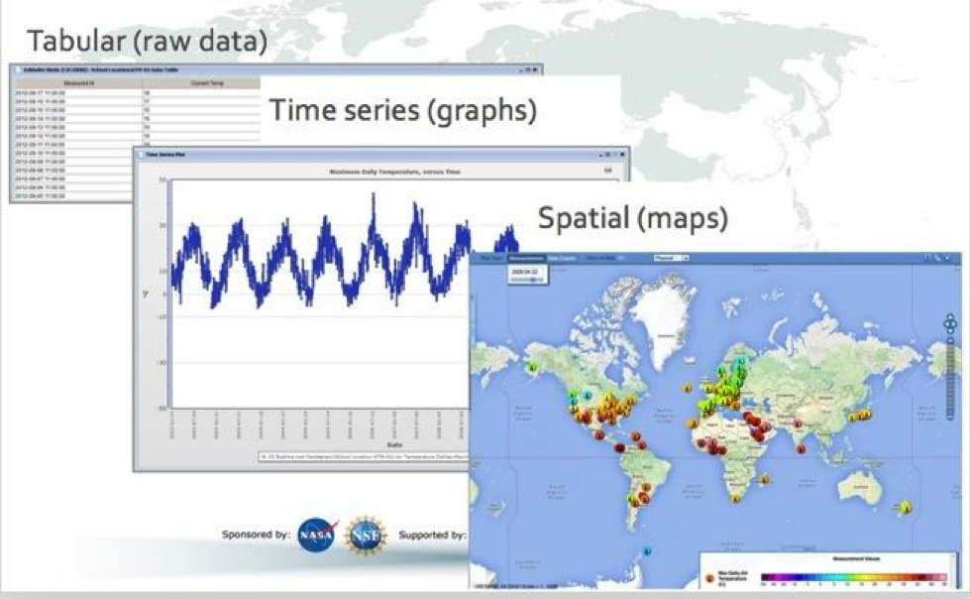
Visualization Tool
Notes:
https://www.globe.gov/globe-data/visualize-and-retrieve-data

Slide 55
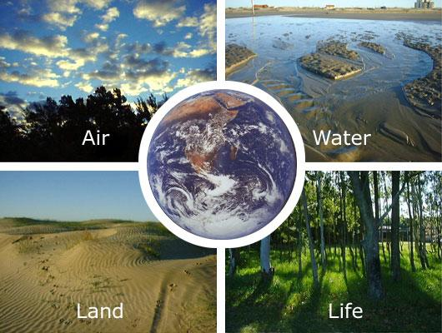
"Earth System Science is a relatively new field of study that focuses on the operation of the whole Earth, including the atmosphere, hydrosphere, biosphere, and geosphere. These four spheres can be thought of as four machines or systems that are connected together to make one larger machine -- the whole Earth system.”

Slide 56
The GLOBE Program: Global Learning and Observations to Benefit the Environment
Examples of GLOBE Protocols:
Atmosphere - air temperature, precipitation, clouds
Hydrosphere - temperature, pH, mosquito habitats
Soils/Pedosphere - soil moisture, temperature, characterization
Biosphere - green up/down, land cover, fire fuel, carbon cycle
How to participate:
Protocol eTrainings
GLOBE Observer
Notes:
Vision: A worldwide community of students, teachers, scientists, and citizens working together to better understand, sustain, and improve Earth’s environment at local, regional, and global scales.
Mission: To promote the teaching and learning of science, enhance environmental literacy and stewardship, and promote scientific discovery.
Outside for Cloud/Sky Observations (app + paper data sheet) and surface temperature measurements

Slide 57
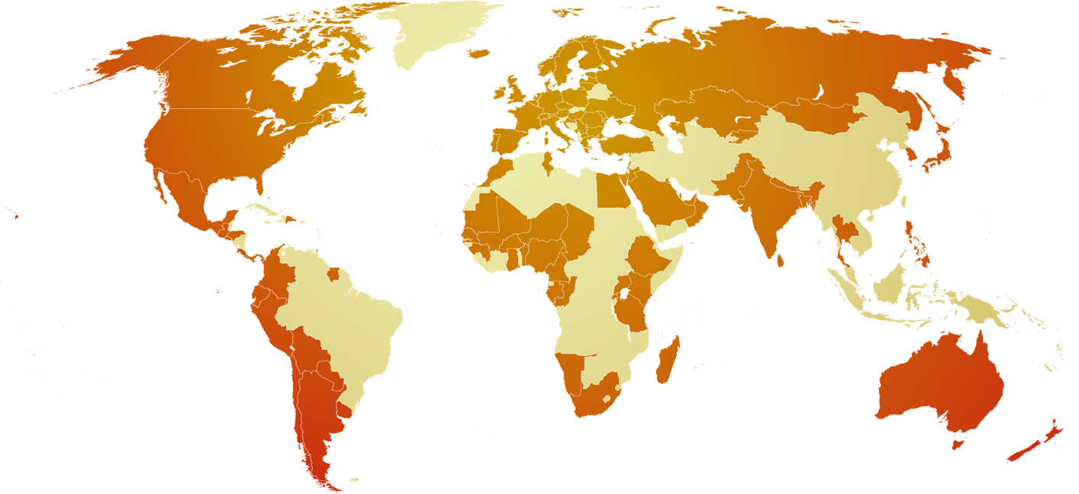
GLOBE by the Numbers
123 Countries
36,935 Schools
39,244 Teachers
170,361 GLOBE Observers
Connect with schools around the world
Join the GLOBE Community
Connections with scientists
Annual and Regional Meetings
Student Research Symposia
International Virtual Science Symposium
Access to support

Slide 58
Next Steps
Learn more about
Guide to the GLOBE website
E-Learning modules for protocols
Entering data on the GLOBE website: tutorials
Online data visualization
Field campaigns
Colorado Partner Collaborative
Questions?
jristvey@ucar.edu
303-497-2591

Slide 59
LS1: Research Projects with GLOBE
https://www.globe.gov/science-symposium
Notes:
Highlight event -
Focus on - Resources available; badges - addressing scientist skills

Slide 60
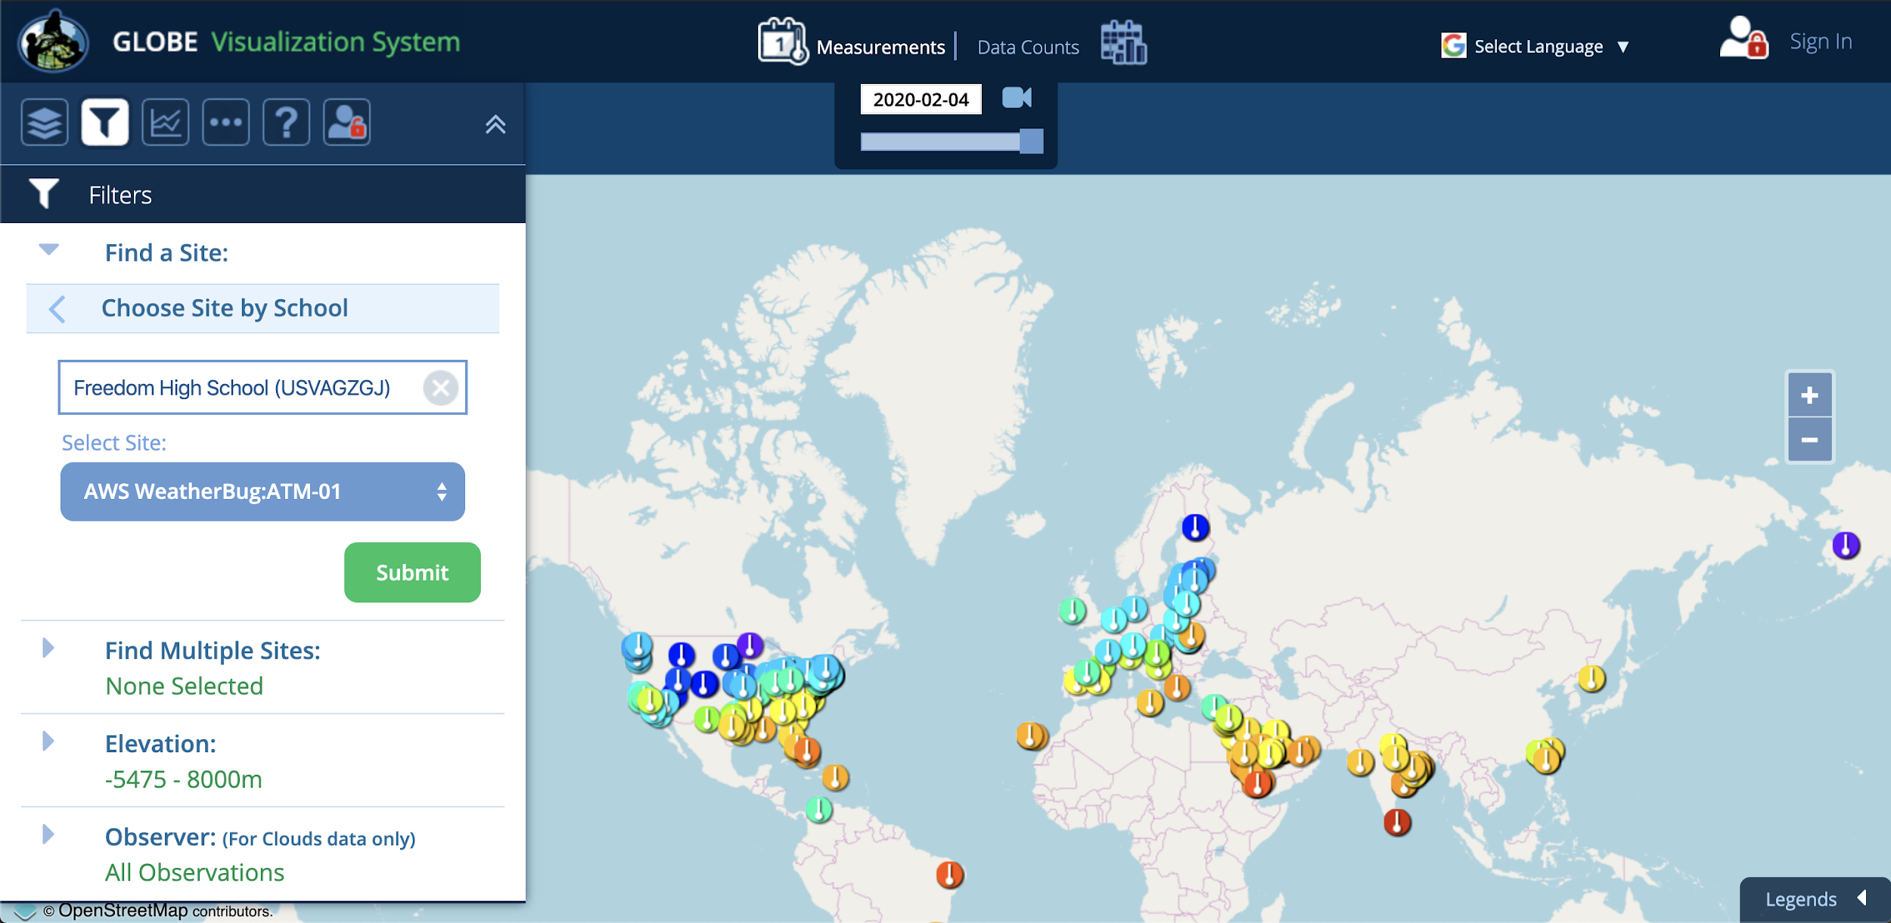
LS2: GLOBE Data Visualization Tool
https://vis.globe.gov/GLOBE/

Slide 61
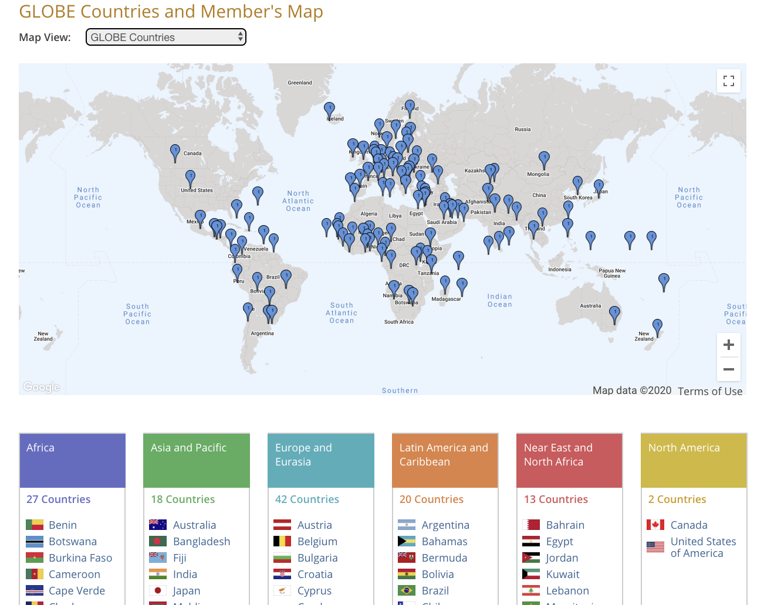
LS3: GLOBE Community
https://www.globe.gov/globe-community/community-map

Slide 62
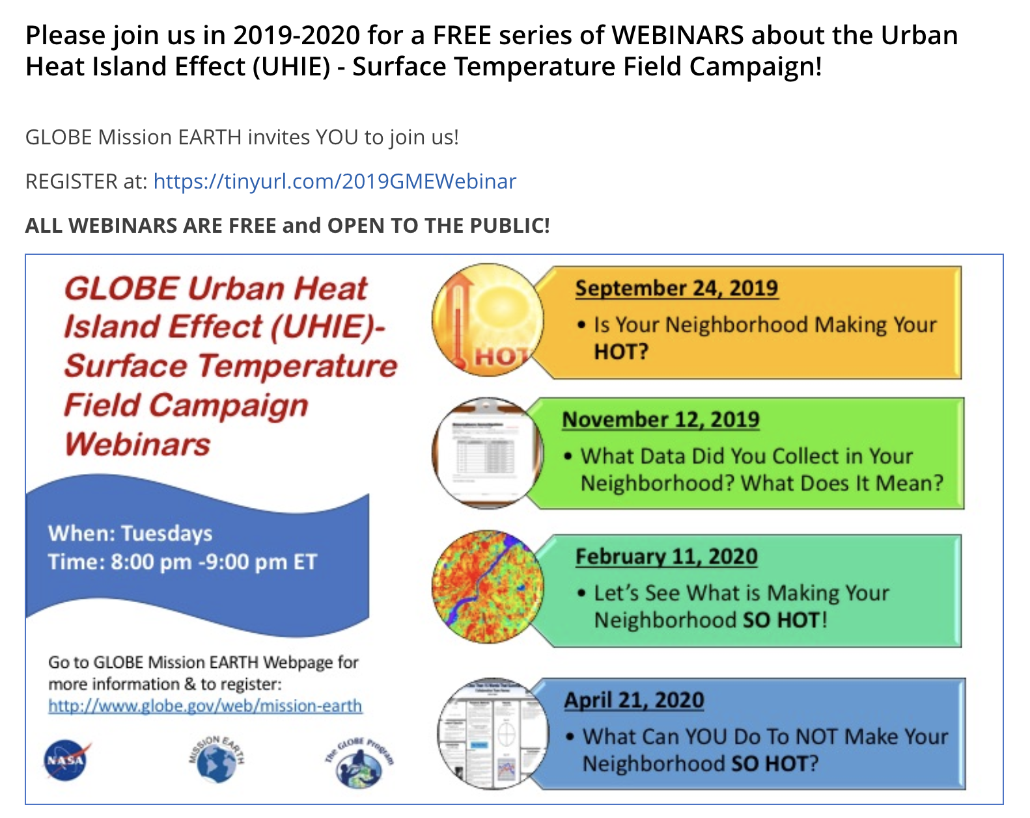
Surface Temperature Field Campaign

Slide 63
Break (10 min)

Slide 64
Current questions:
What is different about a stormy day and a sunny day?
Why does warm air go up and cool air go down?
What are the perfect conditions to make a storm?
Notes:
Storyline link: these questions are driving our explorations, and hopefully new questions are emerging as well. Students may be trying to apply the LS1 learnings to the CO Storm at this point, and they should realize that we don’t have the whole story yet.

Slide 66
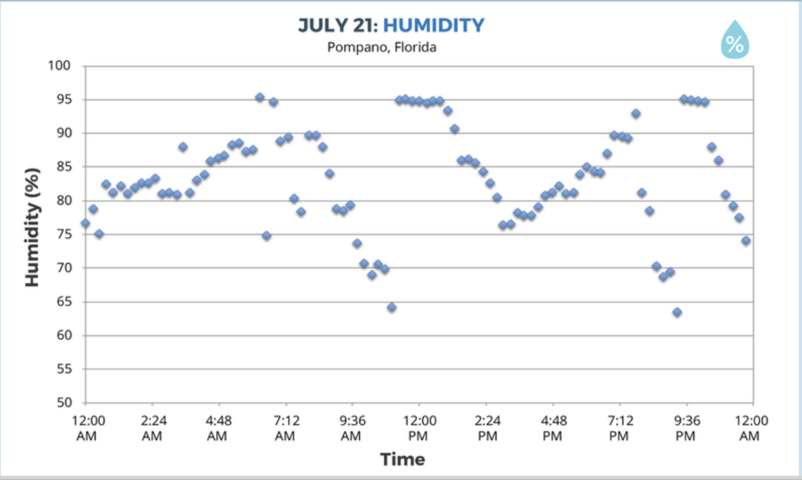
Notes:
We also see a spike in humidity just as the storm begins

Slide 67
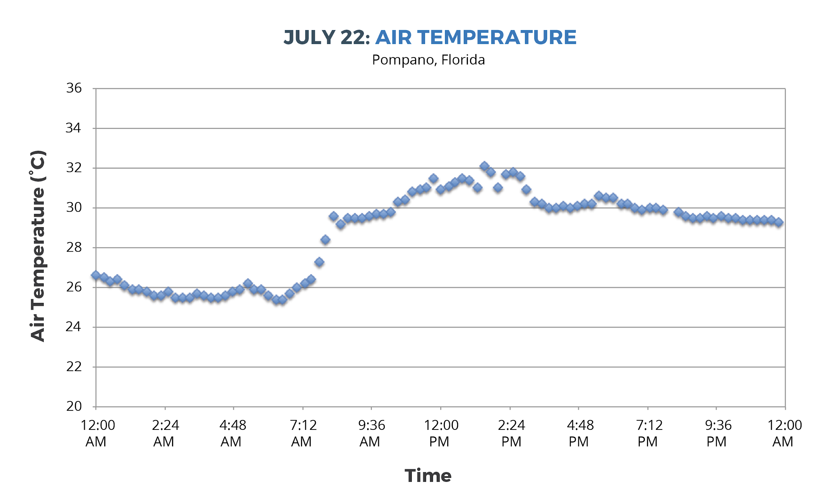
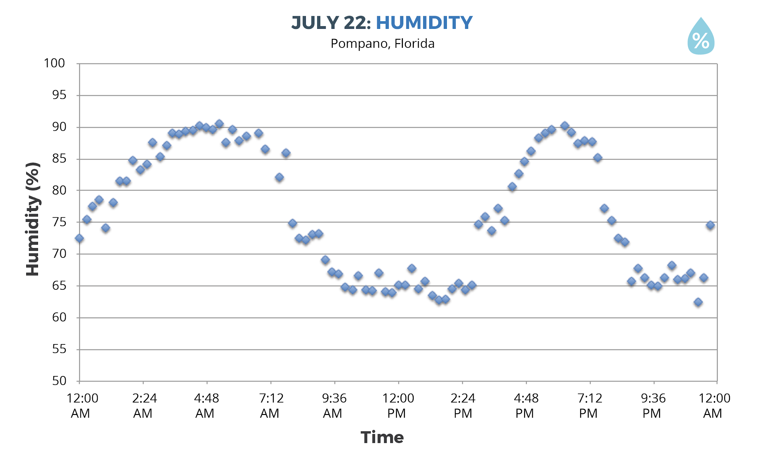
Why didn’t it rain on July 22nd?
Notes:
There wasn’t enough humidity. No drop in air temp, no spike in humidity= no storm!

Slide 68
Step 3: Create a Model to describe how precipitation happens in an isolated storm
Draw and write in the illustration. Your model should explain:
•What happens to energy from the Sun that leads to the isolated storm?
•What happens to water at the surface and clouds that lead to the isolated storm?
•How air temperature and humidity change as air moves from the ground to the clouds?
•How air moves between the ground and where the storm forms?
Notes:
Turn to Lesson 5: Step 3 (pg 22) of Student Activity Sheet, make a working model to track your thinking thus far.
*ENCOURAGE THEM TO USE THE COLORED PENCILS, MARKERS, ETC
Refer to lessons 3,4 & 5 to make your model
Look at Model Idea tracker for ideas
Think of your model as telling the story of the isolated storm

Slide 69
Model Idea Tracker
What ideas do we agree should be added to the Model Idea Tracker?
The Model Idea Tracker is used to record consensus ideas that help explain a phenomenon. These ideas are generated by students and agreed upon as a class.
Notes:
The Idea Tracker will be built upon throughout the entire unit. These ideas are important understandings that we uncover as the story unfolds!
Ask teachers to suggest big ideas so far to include on the Model Idea tracker. Bring over any ideas from the list about the Colorado storm
Make a list on chart paper:
Evaporation of water at the surface is important for clouds/storms
Evaporation happens because of heating from sunlight
Clouds form when water condenses
The surface is warmer than the air above it
Air near the surface is warmer than air where clouds form

Slide 70
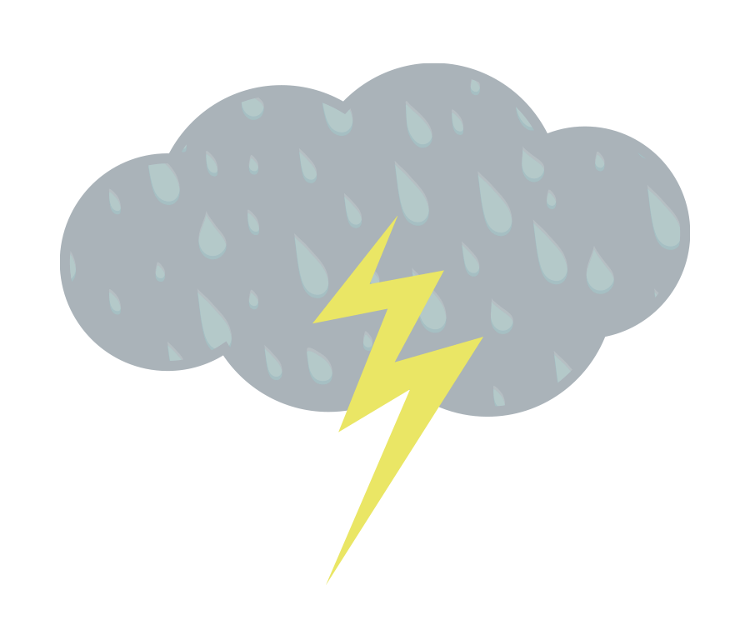
Make a Consensus Model
What has to happen for an isolated storm to form?
•Share ideas from student models from Step 3
•Draw a Consensus Model for the class, using ideas from student
models.
•Use data or other evidence from our investigations to support the
ideas added to the Consensus Model.
Notes:
Using your working models, discuss and agree upon ideas as a group to create a consensus model
Reference Model idea tracker
(if time, revise working models)
The revisions don’t have to reflect the consensus model exactly, but should be in a way that makes sense to you.

Slide 71
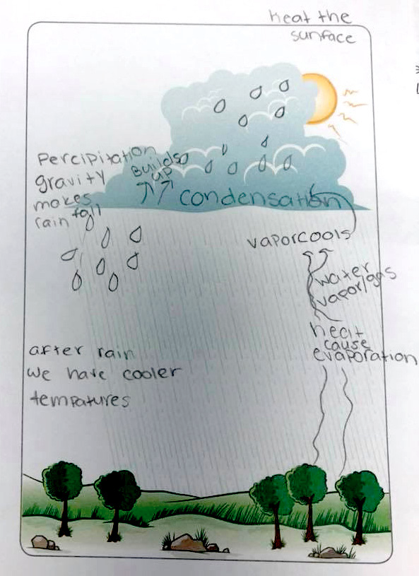
Example of a student model
Notes:
example of a student model, just for kicks

Slide 72
DRIVING QUESTION BOARD
What questions can we now answer?
Do we want to add any new questions?
How can we use the DQB as an assessment?
Notes:
Point out storyline connection: the questions are motivation to continue exploring the content!
How can we use the DQB as an assessment?
This is a good time to assess how students are progressing. You can formalize the DQB as much as you’d like, having students write out answers to the questions or brainstorm how we could find the answer to our questions (what tests could we do?)

Slide 73
Sensemaking
How are you/focal student connecting
with the content?
Did any new ideas come up for you? How could these activities fit in to what you already do and extend them?
What are you wondering about now?
Where would your focal student get stuck?
What challenges come up for you?
Notes:
Group share out
explain the Thinking Routine (connect-extend-challenge)
ask for someone to share a connection, an extension, a challenge
use sentence stems

Slide 74
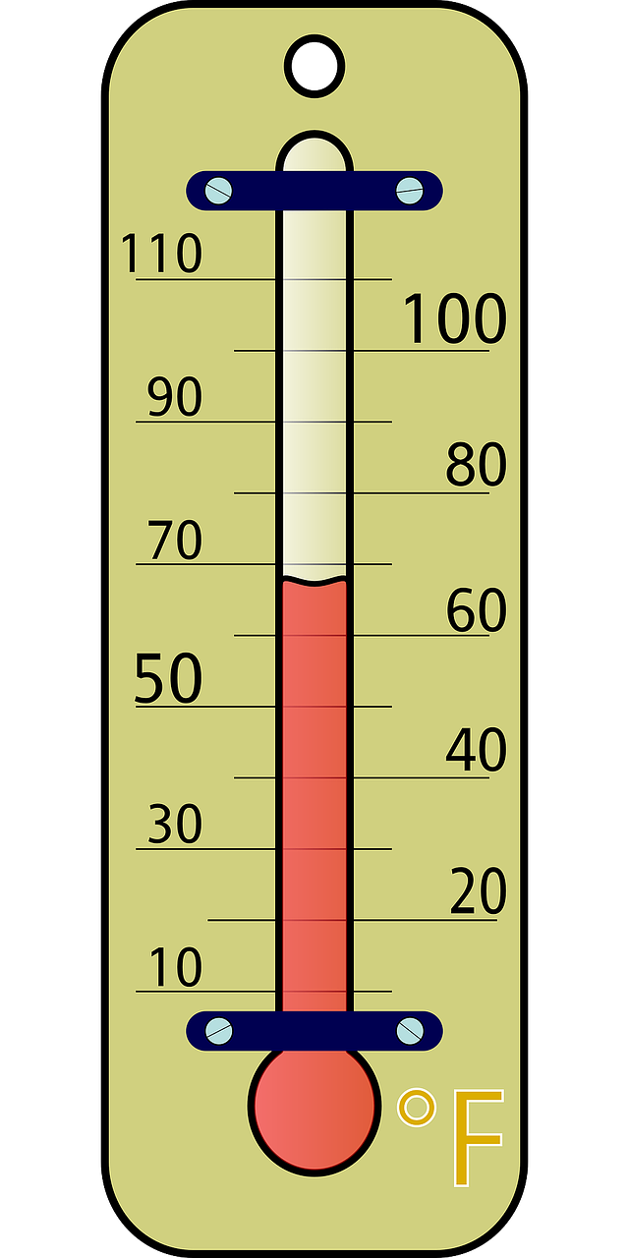
How are you feeling?
Notes:
To wrap up today… let’s take our temperature. What’s coming up for you? How are you feeling about the day? What are you wondering about?
use paper evals

Slide 75
end of Day 1 slides
Notes:
add word cloud from this morning to Day 3

Slide 76
Welcome to Day 2
GLOBE Weather
Notes:
Point out agendas for today

Slide 77
Looking back:
What is different about a stormy day and a sunny day?
Why does warm air go up and cool air go down?
What are the perfect conditions to make a storm?
Notes:
Storyline link: these questions are driving our explorations, and hopefully new questions are emerging as well. Students may be trying to apply the LS1 learnings to the CO Storm at this point, and they should realize that we don’t have the whole story yet.

Slide 78
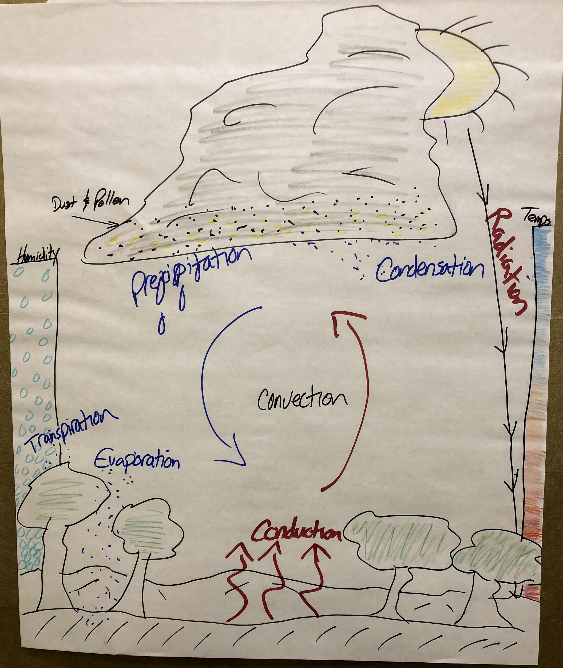
Does our model for an isolated storm explain the Colorado storm?
Notes:
Image of the isolated storm model: does the model fit for all storms?
Reference the consensus model we made yesterday as well

Slide 79
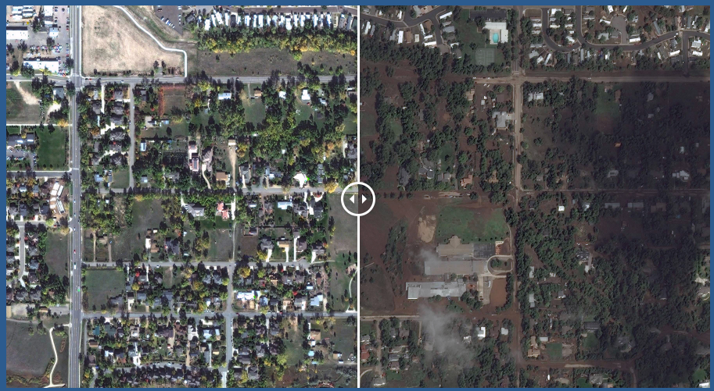
Case Study: 2013 Colorado Storm
Did the Colorado storm happen in the afternoon?
What parts of our model might explain the Colorado storm?
Photos link
Notes:
Return to the Anchoring Phenomenon again. Ask students: “Did the Colorado storm happen in the afternoon?” Students might remember that the video revealed that the storm lasted several days. Ask students what parts of their models might explain the event and what they think could be different. Since the Colorado event lasted much longer than the typical isolated storm, something else might be going on in that type of storm. Use this to initiate further investigations into different kinds of storms that students will explore in Learning Sequence 2.
“Our model helps us explain some kinds of storms, but the storm in Colorado lasted a lot longer. The Colorado storm might be a different kind of storm, so we need to do some more investigating to figure it out.”
Emphasize the power and limitation of models. Have students talk about the kinds of storms that their models explain well, but also the types of storms that do not fit their models. Explain to students that models are tools to help us explain things happening in the world but that they are not always perfect and cannot capture everything. This is especially true for models of complex systems like weather, which is why weather is predicted probabilistically.

Slide 80
What other types of storms cause precipitation?
Notes:
Since the isolated storm model doesn’t explain the Boulder storm, there must be other types of storms to consider.
What ideas do you have about this? Call out other types of storms...

Slide 81
A Front Headed Your Way
LEARNING SEQUENCE 2
What other types of storms cause precipitation?
© 2019 University Corporation for Atmospheric Research. All Rights Reserved
Notes:
Introduce Learning Sequence 2
We shift focus to look at storm fronts, which happen over a larger region and often for a longer period of time.

Slide 82
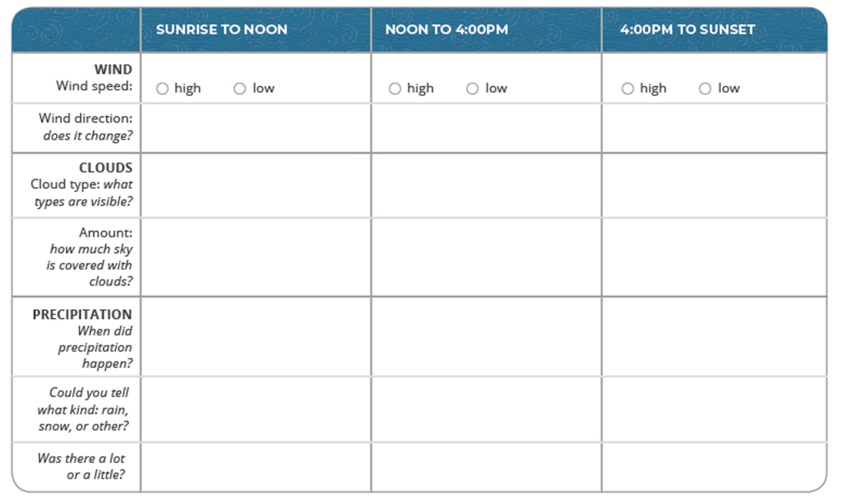
Cold front time-lapse video
Step 1: Make observations about the cold front.
Notes:
Pass out LS2 SAS packets
Students make observations of the cold front time-lapse video and brainstorm about storms they have experienced are different than isolated storms

Slide 83
Weather Forecast for a Cold Front
Make a claim: What day did the cold front move through the area? Use evidence to support your idea.
Notes:
Lesson 7: Step 3 (pg. 28) Examine a weather forecast of a cold front.
On your own, determine when the front moved through the area? How do you know?

Slide 84
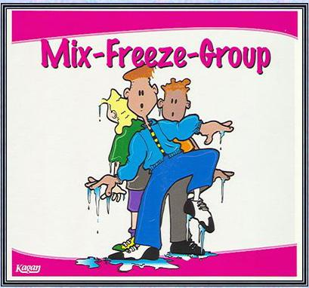
Weather Forecast for a Cold Front
Share your claim: What day did the cold front move through the area? Use evidence to support your idea.
Step 3: Interpret a weather forecast for a cold front.
Work with your group of 3 to interpret what is happening before, during, and after the front.
Notes:
Mix-freeze-group to form a group of 3.
share your claims and reasoning with your group
interpret what the air was like before, during, and after the front; use the questions on pg. 28 to guide you

Slide 85
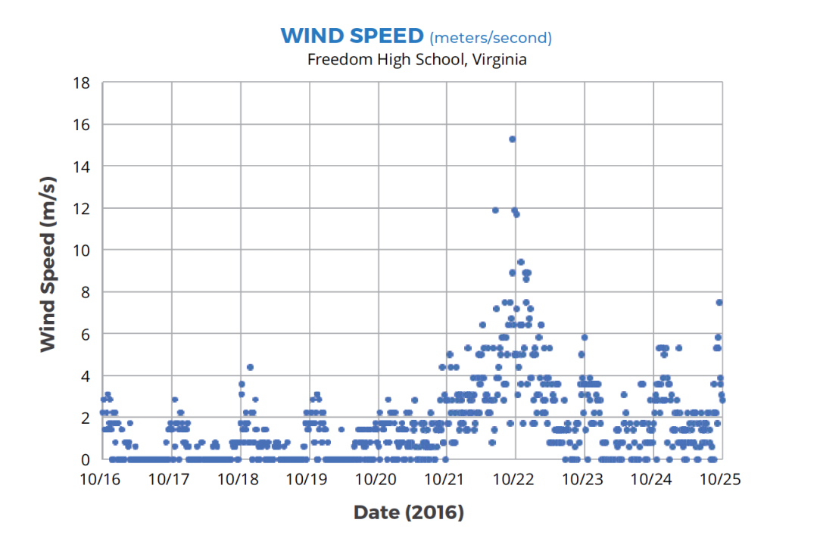
Step 3: Describe the wind speed before, during, and after a cold front.
Circle on the graph when the cold front passed through South Riding, VA.
Notes:
In Lesson 8: Students look at air temp, humidity, and this time also wind speed data about a storm front, so over several days vs just one day as before, to consider how the air changes before, during and after a cold front.

Slide 86
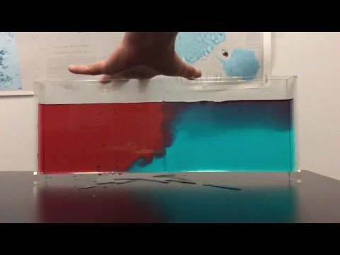
Storms and Precipitation along a Front
Notes:
We’re going to demonstrate this for you in just a minute!

Slide 87
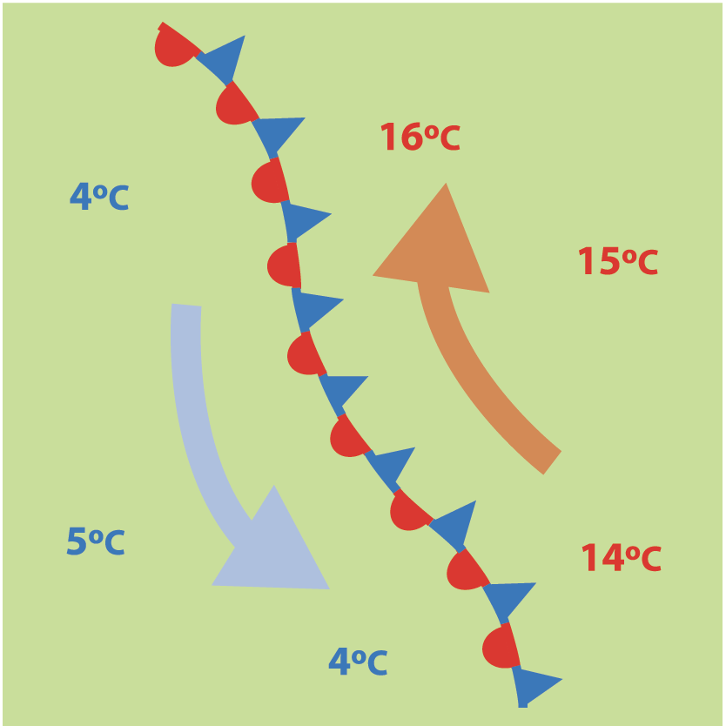
Gathering more information
Step 4: Investigate air masses and fronts.
Read the article about air masses and fronts.
Stop and think as you encounter questions in the text.
Notes:
Readings on air masses and fronts to figure out what happens when different air masses come together

Slide 88
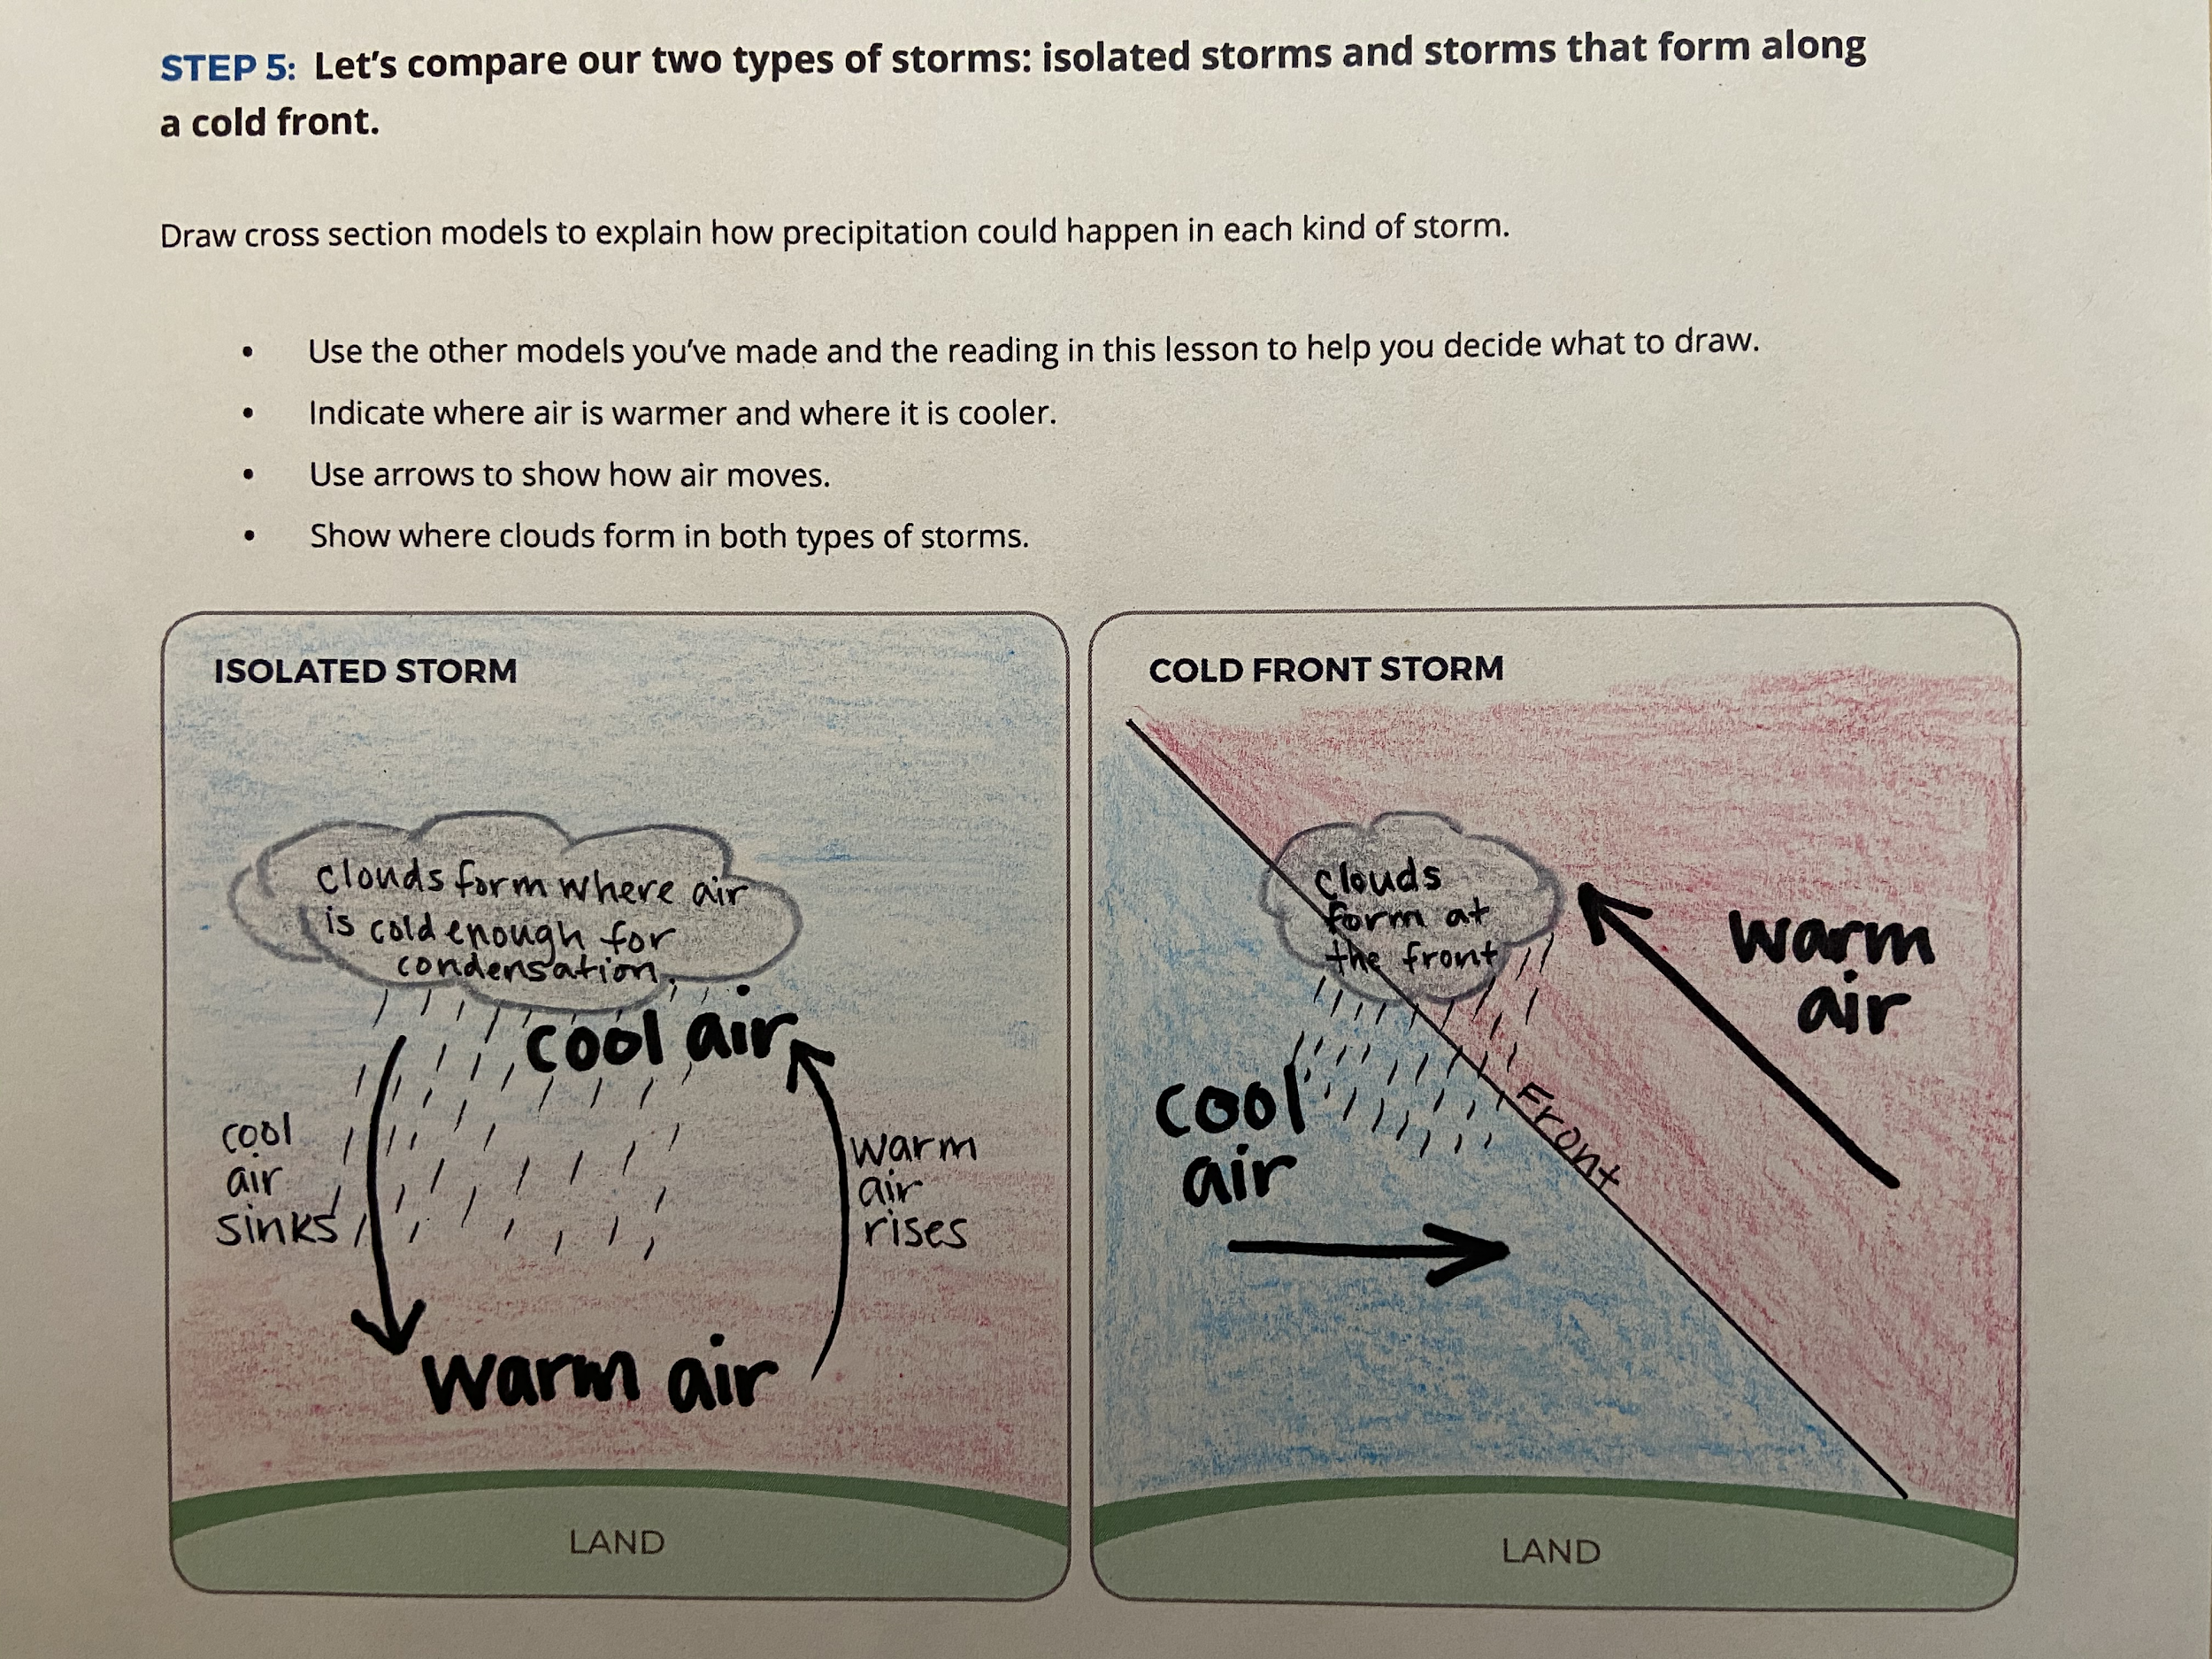
Notes:
Lesson 9: Step 5 from SAS key??

Slide 89
Activities Exploration
LEARNING SEQUENCE 2
Try out the activities wearing your “student hat” first
Refer to your Teacher Guide to begin thinking about how you would facilitate the activity
Coaching prompts and Talk Moves are facilitation supports as well
Work together, discuss with each other!
Notes:
Explain stations quickly

Slide 90
Storms and Precipitation along a Front
Notes:
Demo with whole group, show the video? Then leave set up for teachers to try during activities exploration.
What did you notice? What happened to the warm fluid? What happened to the cold fluid? Why did this happen?

Slide 91
Break (10 min)

Slide 92
Make a Model
Step 3: Develop a model for explaining precipitation during the front.
Your model needs to explain:
The location of the cold air mass.
The location of the warm air mass.
The direction that each air mass is moving.
Where you’d expect clouds to form.
Write a caption for your model.
Notes:
Turn to Lesson 9: Step 3 of the Student Activity Sheet
Model. Explain to students that we need to model how precipitation is happening along the front. Direct students to the list of items to include in their model in Lesson 9: Step 3 of their student activity sheets. (Note: The model has the air before the front on the right side and the air after the front on the left side.)

Slide 93
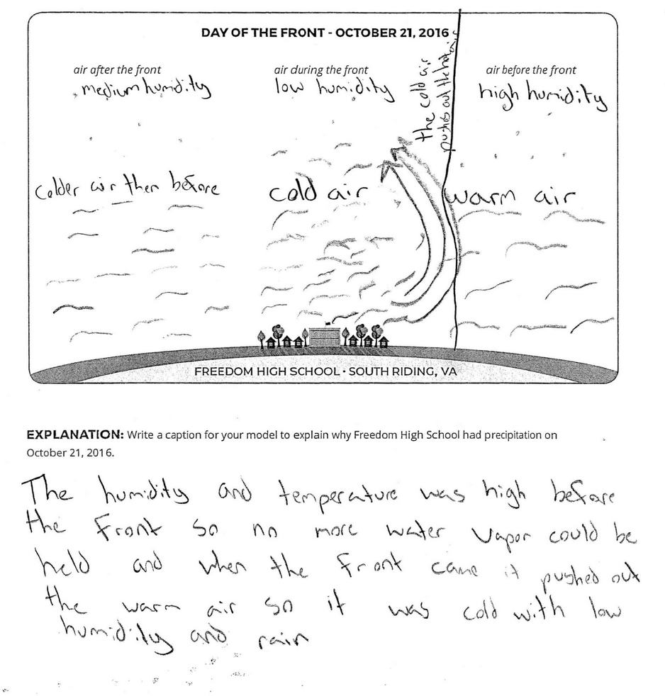
Notes:
Example of a student model

Slide 94
Develop a class Consensus Model
Create a Consensus Model for Precipitation Along a Cold Front.
Discuss ideas from your individual models
Be sure to include the ideas from the Model Idea Tracker in your model.
Notes:
Pass out a piece of chart paper to each table
Each table group creates a consensus model on big chart paper.
Do mini-gallery walk to share

Slide 95
Lesson 9: Step 6: Focus on the big picture using our cold front model.
Choose a day: Each member of your group will choose one day of data to map.
Color and label your map:
Color locations where the temperature is greater than 30℃ RED.
Color locations where the temperature is equal to, or less than, 30℃ BLUE.
Draw slanted rain lines near the location if it had precipitation.
Add the red and blue colors to the key.
Notes:
Turn to Lesson 9: Step 6 of the Student Activity Sheet
Read through the instructions together for labeling and coloring their maps. Break students into groups of four and ensure that each student within the group is assigned a different day to map.
Tell students to use data to locate the front on a map and to identify where and why certain locations have precipitation. Point out that students will be considering how conditions changed over four days at each specific location but also how conditions changed over the four days for the entire region. Let students know that by examining a map view we are able to gain a larger perspective over a region, which is different than the localized cross-sectional views from before.

Slide 96
Step 6 continued: Focus on the big picture using our cold front model.
Compare Maps:
Line up all four maps in order, September 8-September 11.
Follow directions to add the front and air masses to your maps.
Notes:
Students map their data and combine their maps for analysis. Students color and label maps individually. In groups of four, students combine their maps into a four-day sequence. Together, students locate the front and label this on each of the four maps. They use the temperature data to locate and color the cold and warm air masses.

Slide 97
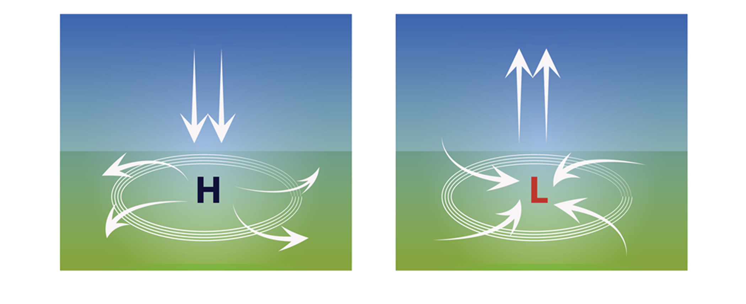
Air movement in high & low pressure
Notes:
Lesson 10: Step 1 Connect air pressure to rising and sinking air
Point out that students are first introduced to the symbols for high and low pressure used on weather maps.
Discuss the image that shows how air moves in areas of high and low pressure:
How the density of the sinking air in an area of high pressure is different than the density of the rising air in a low-pressure area?
How does the vertical up and down movement of air pressure connect with the horizontal toward and away movement? (focus on the arrows moving toward the area of low pressure and the arrows moving away from the area of high pressure)
Make a hands-on connection to air movement in high and low pressure. Each person makes a balloon filled with a golf-ball-sized amount of lentils. Tell students that the beans inside the balloon represent molecules of air. They are to place their balloon on a piece of paper and trace a circle around the edges of their balloon. Have one student push down on the balloon, simulating high pressure. The other student should trace a new circle around the edges of the “pressurized” balloon. Next simulate low pressure by releasing the balloon. Compare the size of the two circles. Students can take turns simulating high pressure on the balloon and low pressure by releasing the balloon.
Take turns explaining to each other what happens to air under high pressure and low pressure, using the following prompts:
What happens to air when there is high pressure? Where does it go?
The circles you drew show how air moves at the ground level.
Why was the circle bigger for the air under high pressure?

Slide 98
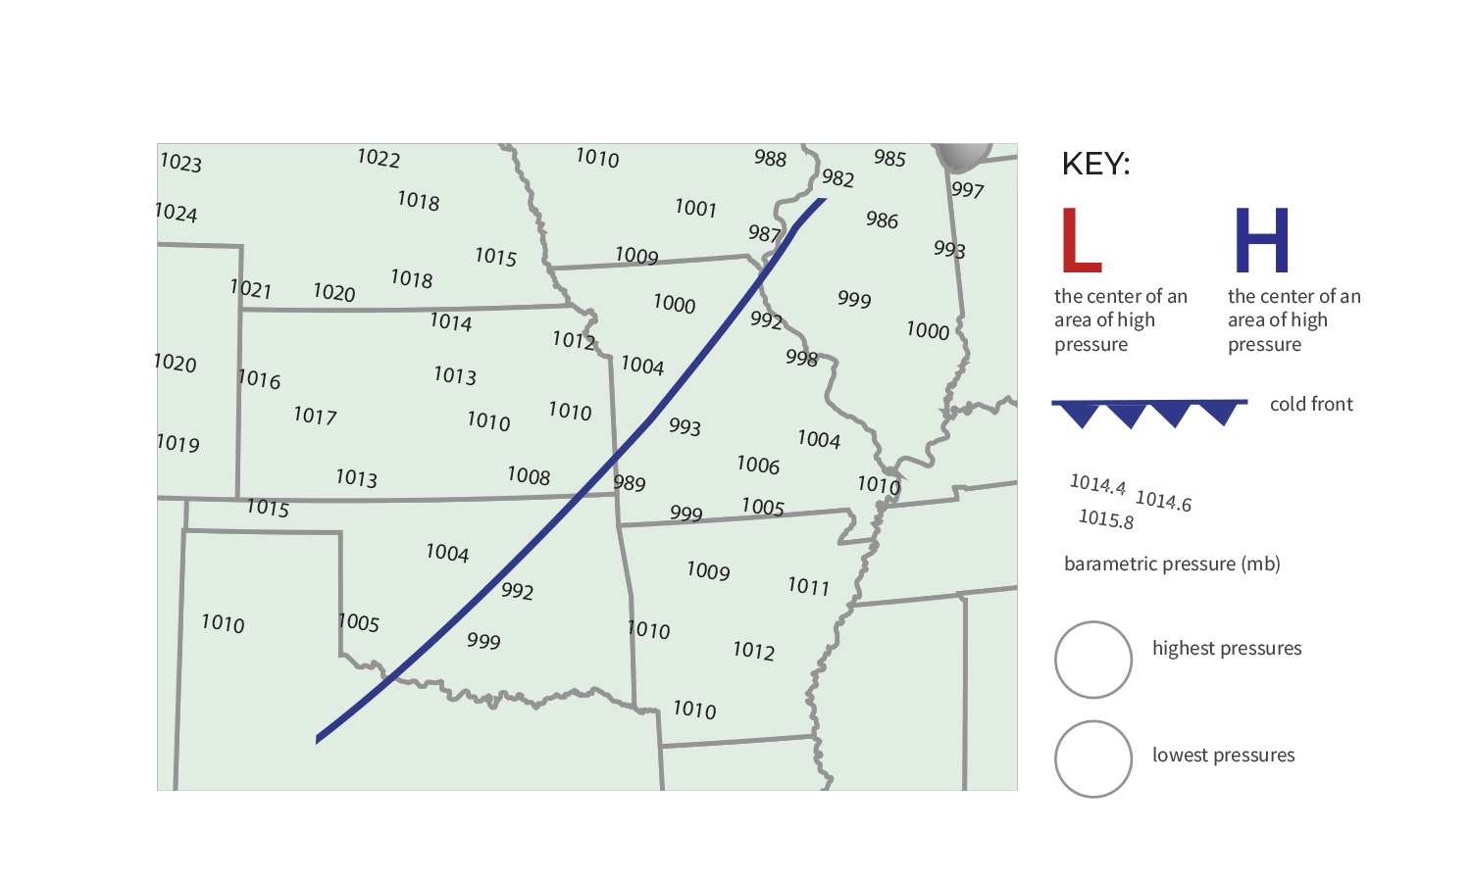
Front on the Move
barometric pressure (mb)
Notes:
Turn to Lesson 10: Step 2 student activity sheet
To help us determine which way the front is moving, we incorporate PRESSURE to our model
Discuss
Which way did the wind blow? What evidence do you have to support your claim?
This is the first time students are introduced to the symbols for a front, which they likely have seen in weather forecasts. The triangles always point in the direction the front is moving!
Have teachers draw the front, H & L symbols onto their SAS
Also, note that we switched from a cross sectional model to using maps.

Slide 99
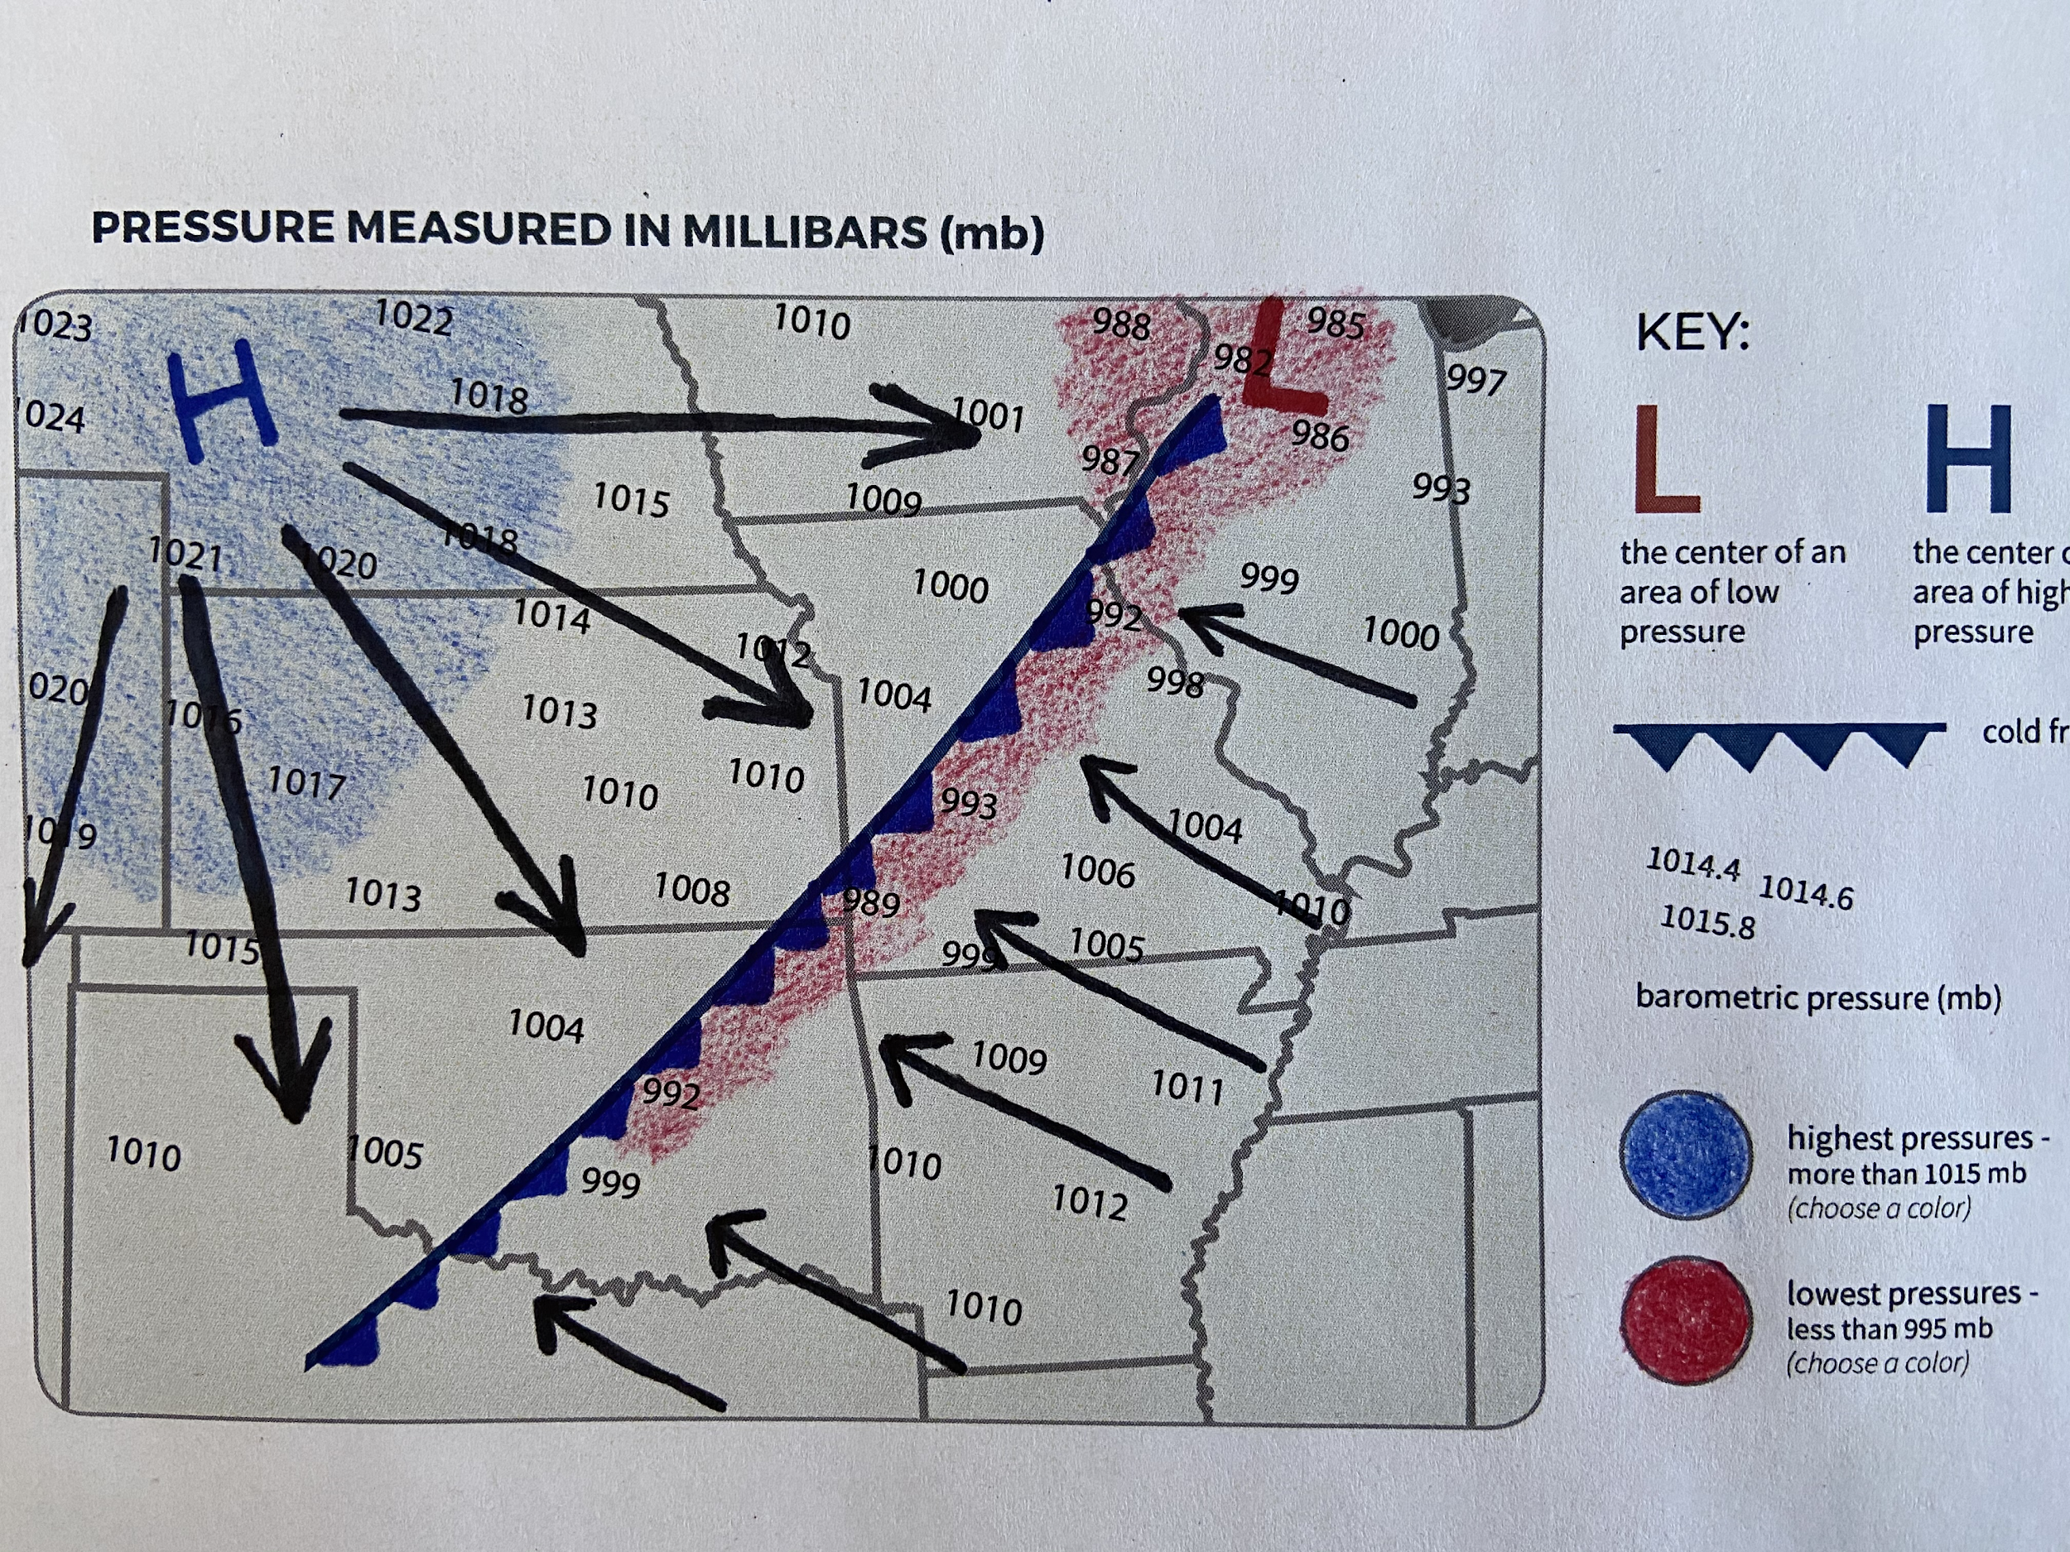
Notes:
picture of key to Lesson 10: Step 2

Slide 100
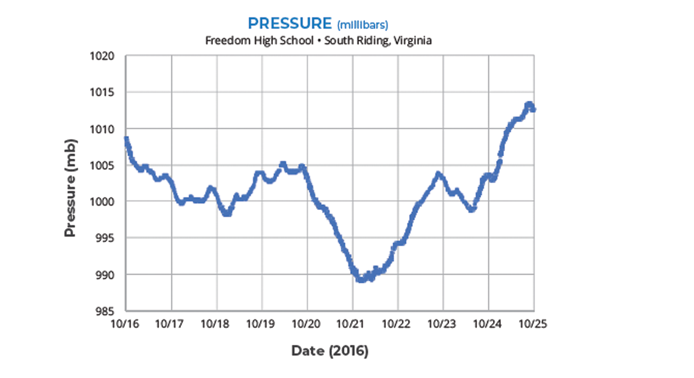
Step 3: Analyze pressure data in one location.
How did the pressure change over time (before, during, and after the cold front)?
Notes:
Turn to Lesson 10: Step 3 of the Student Activity Sheet
Students analyze a pressure graph of this same storm front, as observed from Freedom High School.
What do you see? What are you noticing?
Where is the pressure the lowest in relation to a storm front? (Just before/during the storm)
What is the pressure like just after the storm? (High, cool air but less moisture)

Slide 101
Case Study: 2013 Colorado Storm
Compare the Colorado storm with what we know about isolated storms and cold fronts.
Notes:
Revisit the Anchoring Phenomenon. The stage is set for using these models to figure out what’s happening with the Colorado storm.
Look at the Table of Rainfall (Lesson 11: Step 1) pg. 42 SAS, make a claim about the CO Storm (poll everywhere)

Slide 103
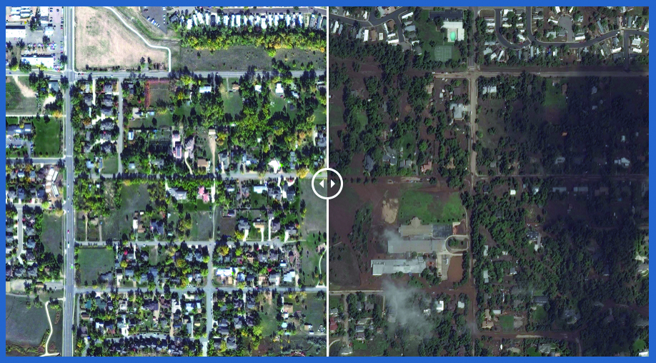
How is the Colorado Storm different from other storms we have learned about?
Notes:
Turn to Lesson 11: Steps 2 & 3
What was unique about the CO Storm?
This storm is different from isolated storms and typical cold fronts because of the length of time it rained and the lack of movement (stalling).
Model ideas from the CO storm:
A warm, moist air mass got pushed up by a cooler air mass.
Low pressure pulled more air towards the storm system
High pressure was pushing air away from it.
Three areas of high pressure “trapped” the front and it stalled
Low pressure kept pulling in moisture from the Gulf of Mexico and Pacific Ocean.

Slide 104
Notes:
Lesson 11: Step 2 KEY- model for the Boulder storm

Slide 105
Model Idea Tracker
What ideas do we agree should be added to the Model Idea Tracker?
Discuss at your tables
Notes:
Discuss model ideas at tables and then share the poster.

Slide 106
DRIVING QUESTION BOARD
What questions can we now answer?
Do we want to add any new questions?

Slide 107
Misconceptions
What strategies have you had success using to address these misconceptions?
Notes:
Turn to pg.68 in Teacher Guide, look over list of misconceptions common during this learning sequence. Hold a discussion around strategies to address misconceptions.

Slide 108
Sensemaking
How are you/focal student connecting
with the content?
Did any new ideas come up for you? How could these activities fit in to what you already do and extend them?
What are you wondering about now?
Where would your focal student get stuck?
What challenges come up for you?
Notes:
Group share out
explain the Thinking Routine (connect-extend-challenge)
ask for someone to share a connection, an extension, a challenge
use sentence stems

Slide 109
Lunch Break- be back at 12:35pm

Slide 110
Worldwide Weather
LEARNING SEQUENCE 3
Why do storms move in predictable patterns around the world?
© 2019 University Corporation for Atmospheric Research. All Rights Reserved
Notes:
Introduce Learning Sequence 3
LS3 considers how and why storms move around the Earth.

Slide 111
How do storms move around the world?
Notes:
Find someone who….

Slide 112
Storm movement time-lapse video
Step 1: How do storms move across North America?
Watch a video of storm movement across North America from March to April 2017.
Find one part of the video that captures your eye.
Capture what you saw in a drawing.
Explain how or why these patterns form.
Wonder: what new ideas or questions do you have?
Notes:
Pass out LS3 packet
Turn to Lesson 12: Step 1 & 2 of the Student Activity Sheet
NORTH AMERICA STORM MOVEMENT TIME-LAPSE VIDEO
Use FIND-CAPTURE-EXPLAIN-WONDER routine to think about the patterns of storms moving across N America
Draw in Lesson 12: Step 1 SAS

Slide 113
Storm movement time-lapse video
Step 1: How do storms move across North America?
Notes:
Time-lapse video of storm movement across North America from March to April 2017:
https://www.youtube.com/watch?v=jC3H2k8lONU&feature=youtu.be
In this video, the white areas are places with more water vapor (moisture) in the air, which indicates where precipitation is happening. The date appears in the upper left. Students are seeing the curvature of Earth in this video because the satellite is so far away, so due east is in the upper right and due west is in the upper left. Two cold fronts pass though this video:
The best option is March 6–8
A second option is March 29–31
What patterns do you notice?
Air with water vapor in it generally travels west to east across North America.
Air with water vapor in it travels in squiggly, curling, and/or spinning lines.
Certain areas have repeated patterns in cloud cover (e.g., the West Coast gets a lot of water vapor from the Pacific Ocean, and some areas, like Mexico, have a “pulsing pattern” in water vapor).

Slide 114
NASA Global Rainfall & Snowfall (April-Sept 2014)
Notes:
Lesson 12: Step 3 & 4 SAS
This image/video shows global precipitation which is an indicator of storms.
Use Use FIND-CAPTURE-EXPLAIN-WONDER routine again.
What patterns do you notice?

Slide 115
What could be causing patterns of global storm movement?
Step 5: Form an initial explanation. Answer the questions:
What do you already know about what causes rain?
What do you already know about what causes air to move?
How could the same processes affect the whole world?
Notes:
Lesson 12: Step 5 of the Student Activity Sheet

Slide 116
Step 1: Observe patterns in annual average temperature.
Notes:
We explore “Why is it hotter at the equator than other places on Earth?”

Slide 117
Why is it hotter at the equator than other places on Earth?
STEP 2: Observe Energy Angles
Work in groups of three to investigate what happens to light when it shines on graph paper at different angles.
Notes:
To answer that we must understand what happens when sunlight strikes Earth’s surface.

Slide 118
Step 4: Analyze temperature and latitude
Notes:
We zero in on latitude and why temperature is predictable at specific places as we begin to focus on weather in the tropics, where most of the storms seem to happen (and also where it is hottest!).

Slide 119
Demonstration: Global Convection Cells
Step 3: Record observations of the water movement.
Draw how the water moves through the tank.
Notes:
We return to convection to understand how air moves between the tropics and the midlatitudes.

Slide 120
Step 4: Describe how and why air moves in the tropics.
Focus on how air is moving in the tropics.
Draw arrows to connect the dots and show how air is moving in the atmosphere, just as the water moved in the convection demonstration.
Write a caption to describe air movement in your model.
Notes:
Relate the convection demonstration to how and why air moves in the tropics.

Slide 121
Activities Exploration
LEARNING SEQUENCE 3
Try out the activities wearing your “student hat” first
Refer to your Teacher Guide to begin thinking about how you would facilitate the activity
Coaching prompts and Talk Moves are facilitation supports as well
Work together, discuss with each other!
Notes:
Explain stations quickly

Slide 122
Global Air Circulation Diagram
Step 5: Create a model to describe air pressure and clouds at different latitudes.
Notes:
Turn to Lesson 14: Step 5 of the Student Activity Sheet
Introduce the Global Air Circulation Diagram in Lesson 14: Step 5. Orient students to this diagram and point out that it shows how air moves around the whole world, not just in the tropics.
Have students create a model of air pressure and humidity. Annotating the illustration in Lesson 14: Step 5, students should create a model locating the areas of low and high atmospheric pressure and the locations that are likely to be cloudy because air is rising. Use the arrows indicating air movement as clues.
Lead a class discussion about the diagram. Focus students on convection near the equator and encourage students to draw on their understanding of convection from Learning Sequence 1 and high and low pressure from Learning Sequence 2 to explain air movement in tropical convection. The one important thing for students to notice in the midlatitudes at this point is that convection moves in the opposite direction. This will be revisited in Lesson 15.
Use the prompts below to guide your discussion:
Where is air rising from Earth’s surface into the atmosphere and why?
Worldwide, where is air sinking from the atmosphere to Earth’s surface and why?
How is air moving across Earth’s surface and why?
Where do you think there are areas of high and low pressure and why?

Slide 123
Consensus Model: Air Movement in the Tropics
Create a model that will answer the question:
How and why does air move in the tropics?
Identify ideas from the Model Idea Tracker that will help us answer the question.
Consider how the model for global air circulation you created in Step 5 helps answer the question.
Notes:
Consensus Model: Take stock of ideas from the Model Idea Tracker that will help answer this question. Develop a Consensus Model at each table. Have small groups consider ideas from the models they created in Lesson 14: Step 4 and Step 5. Then do gallery walk to share models.
KEY MODEL IDEAS THAT SHOULD BE REPRESENTED IN THE CONSENSUS MODEL:
As warm air rises at the equator, it creates an area of low pressure.
Sunlight (solar radiation) is more concentrated at the equator because incoming sunlight shines directly on the equator, concentrating it in a smaller area.
Sunlight (solar radiation) is more spread out toward the poles because incoming sunlight hits the surface at an angle, spreading the light out over a larger area.
The amount of concentrated solar radiation influences air temperatures; more concentrated solar radiation causes warmer air temperatures and more spread out solar radiation causes cooler air temperatures.
There are more areas where warm air is rising near the equator and more areas where cool air is sinking at 30°N and 30°S.
Cooler air moves along the surface of the Earth toward the area of low pressure to replace the rising warm air.
Horizontal movement of air along the surface of the Earth is wind, which causes storms to move.

Slide 124
NASA Global Rainfall & Snowfall (April-Sept 2014)
Notes:
Compare the video to our model for air movement in the tropics…
What is missing from our model that we see in the video?

Slide 125
A Curveball
The Coriolis effect...
Because the Earth is spinning, air does not travel in a straight line!
White arrows→ How storms move with a non-spinning Earth
Black arrows→ How storms move with a spinning Earth
Notes:
Turn to Lesson 15 student activity sheet, pass out balloons
Due to rising and sinking of air (convection) and the uneven heating of the Earth we would expect storms to move north from the equator towards the poles and then straight south again (as shown by the white arrows). But as we saw in the video of Global Rain & Snowfall, storms actually curve and twist around the Earth, in predictable patterns (as seen by the black arrows).
With a partner, make a model of the Coriolis effect activity, follow directions on Lesson 15 sheet

Slide 126
Demonstrate Understanding: Back to Back Strategy
Where do you think there are areas of high and low pressure and why?
How does air move across the Earth’s surface and why?
Why does the air in the tropics curve east to west? Why does the air in the mid-latitudes move west to east?
Notes:
Demonstrate our understanding of air under high pressure and low pressure. Form two lines, standing back-to-back with a person from the other line. After the question is read, reflect on your own, then turn and face your partner to discuss. Before the next question, the person at the end of the line moves up to the front of their line, and everyone else shifts down one position so that everyone has a new partner. Only one line should move, the other line stays put!
Answer to first question:
low pressure equator, at 60N and 60 S
high pressure= at 30N & 30 S, at poles
Answer to second question:
Storms move counter-clockwise in the northern hemisphere
Storms move clockwise in the southern hemisphere
Answer to third question:
Because of the Coriolis effect…
Prevailing winds: 3 areas of convection N of equator & 3 areas of convection S of equator
storms move towards the equator between the midlatitudes & equator; storms move towards the poles above/below that, and then back towards the equator from the poles

Slide 127
Model Idea Tracker
What ideas do we agree should be added to the Model Idea Tracker?
Discuss at your tables
Notes:
Discuss model ideas at tables and then share the poster.

Slide 128
DRIVING QUESTION BOARD
This is where the students post their questions and where students return to answer their questions throughout the unit.
Unit Driving Question:
What causes different kinds of storms?
Notes:
As we complete Learning Sequence 3, let’s take a moment to revisit our Driving Question Board…
What questions we can answer now?
What could we do with any unanswered questions at this time?

Slide 129
Misconceptions
What strategies have you had success using to address these misconceptions?
Notes:
Turn to pg.101 in Teacher Guide, look over list of misconceptions common during this learning sequence. Hold a discussion around strategies to address misconceptions.

Slide 130
Wrap up GLOBE Weather
How do you plan to use GLOBE Weather?
What adaptations or extensions might you use?
What other weather teaching resources do you use?
How can we help students make connections
between weather and our daily lives?
Notes:
Write each question on a big chart paper, hang around the room. Participants can contribute answers to each of the questions on post its or writing on the charts.

Slide 131
Break (10 min)

Slide 132
Snow Day
CULMINATING TASK
How can we apply what we’ve learned about weather to a winter storm?
© 2019 University Corporation for Atmospheric Research. All Rights Reserved
Notes:
Introduce Culminating Task
We apply our learnings about weather and storms to a new type of storm--- snow storm!

Slide 133
Where did the moisture come from? Where do you think the storm will go next?
Notes:
Pass out CT SAS pages
Introduce the California storm (Winter Storm Quid). Read the forecast aloud.
Remember, to cause precipitation storms need 2 things:
Rising cooling air
Moisture
Where did the moisture come from?
Which direction is the CA storm moving?

Slide 134
SNOW
Why did the storm cause rain in some places and snow in other places in California?
RAIN/SNOW MIX
RAIN
Air temperature decreases as altitude increases
Notes:
Heavenly is at higher elevation than South Lake Tahoe, and we learned in Learning Sequence 1 that air temperature decreases as altitude increases. Lower temperatures would allow for snow instead of rain.

Slide 135
As the storm moved east, why did it snow in some areas but not in others?
Complete Steps 1- 4 in table groups
Notes:
Here we see the path of the storm front over several days. As the storm moves inland from the west to the east, it becomes cold enough to snow in Nevada. The question we investigate now is why do some areas get more snow than others? And further, why did some areas get no snow at all?
Complete Steps 1-4 in small groups.

Slide 136
Areas with heavy snowfall are colored blue
Areas with no snowfall have a “x” on the map
What was the trend in snowfall?
Heavy Snow
No Snow

Slide 137
Areas with humidity >70% are colored blue
How does the humidity data help you understand why it snowed in some places but not in others?
Notes:
How does the humidity data help you understand why it snowed in some places but not in others?
Places with high humidity & near the L pressure area would get snow.

Slide 138
Where will schools have a snow day on February 24, 2017
Complete Steps 1- 4 in table groups
Notes:
In Challenge 2 we discovered where is snowed on Feb 23. Now we want to predict what will happen on Feb 24. Work in small groups to complete Challenge 3.

Slide 139
What is your prediction for February 24?
Notes:
Where do you think it will snow more than 5cm on Feb 24th? Why?

Slide 140
Step 4: Warning Map
Comparing your prediction to the Warning map:
Which towns should cancel school on February 24?
Notes:
What is the story of this storm that students would need to tell to predict where the snow day would be?
Where did we have some debate or disagreement? How would you approach this with your students?

Slide 141
Assessments in GLOBE Weather
Pre-assessment (Lesson 1 & Lesson 12)
Formative assessments built in throughout the curriculum
exit tickets, student models, discussions, driving question board
Summative assessment for each Learning Sequence (3)
Overall assessment for the entire unit
Notes:
Pre-assessments: Anchor (draw a model for how you think the Boulder storm happened) and Lesson 12 (coming up with an initial explanation for how storms move around the globe).
Formative assessments built in: Look at exit ticket example on pg. 40, revisiting the DQB, creating models, discussions
Assessment section at the end of the binder: Summative assessments for LS1, LS2, and LS3. Also an overall assessment for the entire unit.

Slide 142
NGSS 3-Dimensional Assessment Must Haves:
Be focused on a phenomenon
Require students to engage in sensemaking
Require students to use both science ideas and practices
Make sense to students
Support intended purpose and use
Notes:
Pass out the Assessment Pre-Screener handout; pull out the SEPs handout,
The Task Annotation Project in Science surfaced some features that distinguish NGSS tasks from science tasks not designed for the NGSS—the ”must haves” of any NGSS assessment.
Break into 3 groups, each group will use the pre-screener handout to look closely at either the LS1, LS2, or LS3 assessment and evaluate if the “must haves” are met, if it meets the criteria for a NGSS assessment.

Slide 143
NGSS https://www.nextgenscience.org/
Science and Engineering Practices:
Developing and using models
Analyzing and interpreting data
Disciplinary Core Ideas:
ESS2-C:The Roles of Water in Earth’s Surface Processes
ESS2-D: Weather and Climate
Crosscutting Concepts:
Cause and effect
Systems and systems modeling
Patterns
Performance Expectations:
MS-ESS2-5:Collect data to provide evidence for how the motions and complex interactions of air masses result in changes in weather conditions.
MS-ESS2-4: Develop a model to describe the cycling of water through Earth's systems driven by energy from the sun and the force of gravity.
MS-ESS2-6:Develop and use a model to describe how unequal heating and rotation of the Earth cause patterns of atmospheric and oceanic circulation that determine regional climates.
Notes:
Use this slide to show the DCIs addressed in GLOBE Weather during assessment evaluations

Slide 144
Notes:
Compare to word cloud from beginning

Slide 145
Notes:
insert slide of word cloud from Day 1

Slide 146
Housekeeping
To receive your $300 stipend payment:
Turn in payment form today (preferred!)
or
Email on your own
Must be submitted no later than March 20
note: you can call in your SS# if you prefer not to send it on the form

Slide 147
We want your feedback!
https://forms.gle/vM43xw7PFUZe3czw8

Slide 148
Thank You!
Photo by Eliott Foust

