Slide 1
Worldwide Weather
Why do storms move in predictable patterns around the world?

Slide 2
Storms on the Move
How do storms move around the world?

Slide 3

Looking back
Where do you think the storm was a day before? Where was it two days before?
Where do you think the moisture for that storm came from?
Notes:
Navigate from the previous lesson.
At the end of the previous lesson, students followed one storm moving across the United States. Help the class think about how that is a very long way for moisture to travel.
Suggested prompts:
Where do you think the storm came from that traveled across the United States?
Where do you think the moisture for that storm came from?
Tell students that in this activity they are going to investigate the global pattern of storm movement.
Note: Prior experience with world maps and the global view of Earth will allow the remaining activities to go more smoothly. Introduce world maps, a globe, and/or Google Earth if needed.

Slide 4
Storm movement time-lapse video
Step 1: How do storms move across North America?
  Watch a video twice of storm movement across North America from March to April 2017.
    First time: Watch closely and observe movements.
    Second time: Draw arrows on the map to indicate the direction that each storm moves through the region.
Notes:
Lesson 12: Step 1 of the Student Activity Sheet
Observe storm movement patterns across North America. Tell students that one way to identify regular patterns in storm movement is to look at weather patterns from a satellite point of view from above instead of from locations on the ground. Introduce students to the North America Storm Movement video context (see below). Tell students they will make observations from the video:
While students watch the video for the first time, have them make observations without taking notes. Point out a cold front over the central U.S. to connect with what students learned in Learning Sequence 2.
Watch the video a second time, and now have students take notes and draw the path of the storms on their student activity sheets (Lesson 12: Step 1). Focus students on monitoring the direction that storms travel.
NORTH AMERICA STORM MOVEMENT TIME-LAPSE VIDEO
Time-lapse video of storm movement across North America from March to April 2017:
https://www.youtube.com/watch?v=jC3H2k8lONU&feature=youtu.be
In this video, the white areas are places with more water vapor (moisture) in the air, which indicates where precipitation is happening. The date appears in the upper left. Students are seeing the curvature of Earth in this video because the satellite is so far away, so due east is in the upper right and due west is in the upper left.
Two cold fronts pass though this video:
The best option is March 6–8
A second option is March 29–31
If students would like to see if the same pattern is visible at another time of year, have them watch the time-lapse video from January to February: https://www.youtube.com/watch?v=ntC070Sh9t0&feature=youtu.be
Discuss observations as a class. Draw out ideas around the west to east pattern across North America. Patterns students might notice are as follows:
Air with water vapor in it generally travels west to east across North America.
Air with water vapor in it travels in squiggly, curling, and/or spinning lines.
Certain areas have repeated patterns in cloud cover (e.g., the West Coast gets a lot of water vapor from the Pacific Ocean, and some areas, like Mexico, have a “pulsing pattern” in water vapor).

Slide 5

Why is storm movement important?
Step 2: Why is this pattern important?
  Explain why would it be helpful to understand the patterns of storm movement.
Notes:
Lesson 12: Step 2 of the Student Activity Sheet
Have students think about why it’s important to understand why storms move in predictable patterns. In Lesson 12: Step 2, have students record ideas about why understanding storm movement patterns might be helpful to people and their communities.
Have students share some of these ideas.
How could understanding patterns of storm movement be helpful to people and communities?

Slide 6
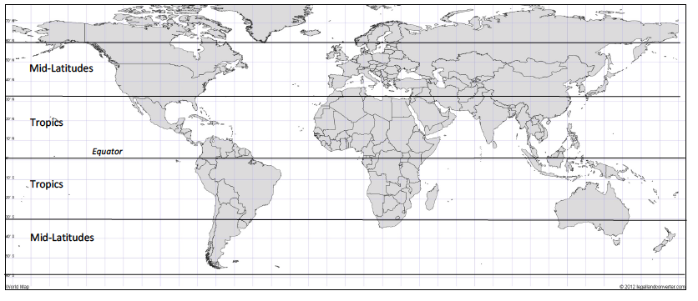
Step 3: Observe precipitation movement around the world.
Watch a video of storms as they move around the world.
Draw arrows and write on the map to record your observations.
Notes:
Lesson 12: Step 3 of the Student Activity Sheet
Consider precipitation movement patterns around the world.
Ask students if they think there are similar patterns in other parts of the world and prepare them to look for that in the next video.
Observe precipitation movement patterns around the world. Introduce students to the NASA rainfall and snowfall video context (see below). Tell students they will make observations from the video. Play the video and mute the sound.
The first time students watch the video, have them make visual observations without taking notes. Discuss their initial observations of storm movement patterns across North America.
Watch the video a second time, now taking notes and drawing on the map in Lesson 12: Step 3. You may want to show the video multiple times or pause the video to allow for note taking.
NASA GLOBAL RAINFALL AND SNOWFALL VIDEO
Satellite measurements of global precipitation from April to September 2014:
https://pmm.nasa.gov/education/videos/gpms-first-global-rainfall-and-snowfall-map
This two-minute video shows how precipitation moves globally from April to September 2014, with data collected just below the clouds. The green-yellow-red colors indicate rainfall and the blue-purple colors indicate snowfall, which students may not notice in the video. The voiceover explains how the data was collected and some patterns students might notice, so we suggest muting. The video provides a global view and zooms in on the United States (0:25), South America (0:50), and the Atlantic Ocean (1:25).

Slide 7
How does precipitation move around the world in predictable patterns?
Step 4: Discuss your observations.
  What patterns do you notice about how precipitation moves around the world?
  What questions do you have about these patterns?
Notes:
Lesson 12: Step 4 of the Student Activity Sheet
Share observations and generate questions in small groups.
Have students discuss their observations and generate questions about those observations in small groups or pairs.
Question prompts for discussion are in Lesson 12: Step 4:
What patterns do you notice about how precipitation moves around the world?
What questions do you have about those patterns?
Conduct a whole class discussion.
Discuss the guiding question: “How does precipitation move around the world in predictable patterns?” Draw out students’ ideas working toward the following key patterns:
Key pattern: Precipitation near the equator moves from east to west.
Key pattern: Precipitation in the midlatitudes moves from west to east.

Slide 8

Driving Question Board
What new questions about patterns of storm movement do you want to add to the Driving Question Board?
Notes:
Generate questions to investigate in Learning Sequence 3.
Have students share their questions about the observed patterns. Add these questions to the Driving Question Board to reference throughout Learning Sequence 3.
Focus students on causal questions and elicit responses to the following key questions:
Why do storms move in predictable patterns around the world?
Why do storms in the tropics move in different directions than the midlatitudes?
Why do storms move from east to west near the equator in the Northern Hemisphere?
Why do storms move from west to east in the midlatitudes in the Northern Hemisphere?

Slide 9

Explaining Global Patterns
Why do storms move in predictable patterns around the world?
Why do storms move in different directions in the tropics and midlatitudes?
Notes:
Navigate from the previous activity.
Tell students that they’ll try to answer these questions in Learning Sequence 3:
Why do storms move in predictable patterns around the world?
Why do storms move in different directions in the tropics and midlatitudes?

Slide 10
What could be causing patterns of global storm movement?
Step 5: Form an initial explanation. Answer the questions:
  What do you already know about what causes rain?
  What do you already know about what causes air to move?
  How could the same processes affect the whole world?
Notes:
Lesson 12: Step 5 of the Student Activity Sheet
Form initial ideas about causes of precipitation movement patterns, based on what we already know. Have students answer the questions in Lesson 12: Step 5 of their student activity sheets to begin to explain what could be causing the patterns of storm movement. Pull out the Model Idea Tracker and encourage them to use what they learned from Learning Sequences 1 and 2. As students work, circulate and prompt students who are stuck:
What do you already know about what causes rain?
What do you already know about what causes air to move?
What would cause storms to move?
How could the same processes affect the whole world?
Model Ideas that might help students:
Hot air rises as part of convection (Learning Sequence 1).
Cool air sinks as part of convection (Learning Sequence 1).
Air moves from areas of high to low pressure (Learning Sequence 2).
Facilitate a whole class discussion about students’ initial explanations. Have students share their initial explanations (answers to Lesson 12: Step 5: Question 3). Consider recording multiple and conflicting student ideas in a public place to be revised later (e.g., chart paper, PowerPoint, smart board). If students have conflicting ideas, pull out the important Model Ideas they are drawing on.

Slide 11

Looking forward
How might temperature cause air to move on a global scale?
Notes:
Look forward to the next lesson. Allow multiple explanations to linger. Tell students that there are a few things to investigate. In the next lesson, they’ll start by investigating temperature:
How might temperature cause air to move on a global scale?

Slide 12
Heating Up
Why is it hotter at the equator than other places on Earth?

Slide 13


Looking back
How might temperature cause air to move in different ways on a global scale?
Notes:
Navigate from the previous lesson.
At the end of the previous lesson, students discussed what they noticed about the movement of weather in North America and the world. Remind students that they have been thinking about how heating can cause air to move and that heating can also cause pressure differences.
The question they are trying to answer is: How does temperature cause air to move on a global scale?

Slide 14

Making connections
What are some ideas we have about how temperature affects air movement?
Notes:
Ask students: “What are some ideas we have about how temperature affects air movement?”
Encourage students to use models and Model Ideas from Learning Sequences 1 and 2 as well as prior knowledge that might help them explain why air would move. Track student thinking on the board. Students will likely say something about how warmer air rises and cooler air sinks (based on what they learned in Learning Sequences 1 and 2). Use this idea to link to the next step.

Slide 15
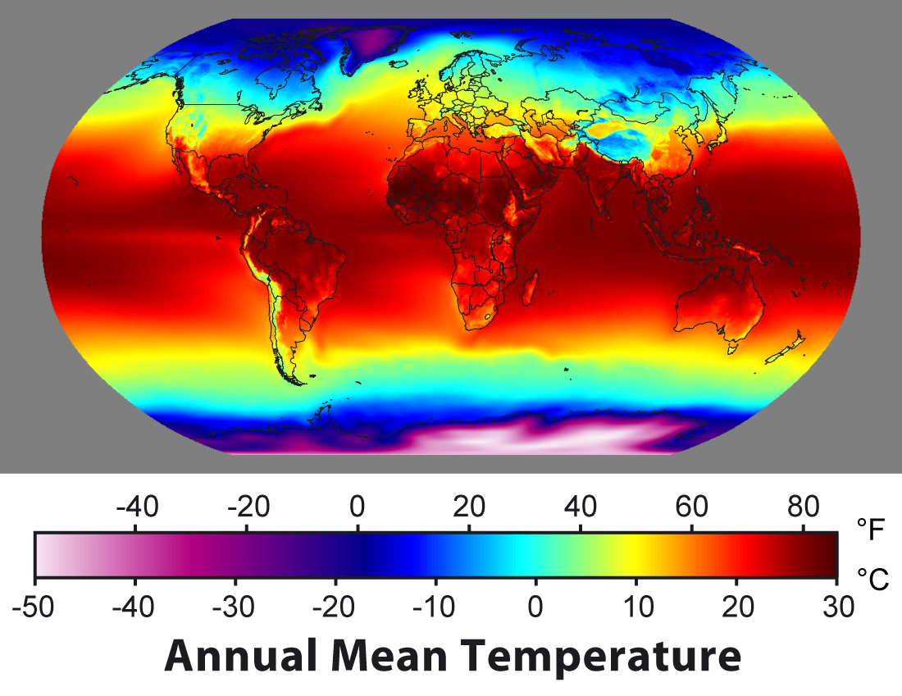
Step 1: Observe patterns in annual average temperature.
Notes:
Lesson 13: Step 1 of the Student Activity Sheet
Show students a global map of average annual temperatures (Lesson 13: Step 1). Ask students to study the map and write down patterns they notice. Then, as a whole class, ask students to share the temperature patterns they noticed. Most students will notice that it is much warmer at the equator then the poles, and there is a gradient between. They may also point out the parallel pattern between the northern and southern hemispheres.
KEY PATTERN: Temperatures are warmer at the equator and cooler at the poles.
KEY PATTERN: Temperature follows a pattern of warmer bands in the middle (and around the equator) and cooler bands toward the poles.
Ask students: “Why is it hotter at the equator than other places on Earth?” Give students time to think about this and write down some initial ideas below the map in Lesson 13: Step 1 of their activity sheets. Ask students to share their thinking with the class. (Note: Students might say, “The equator is hotter because it’s closer to the Sun.” This is a common student misconception, which should be cleared up by the Energy Angles activity below. If students have this misconception, make sure to address it directly after the Energy Angles activity.)
Tell students that in the next activity, they will use a model to explore why it’s hottest at the equator.

Slide 16
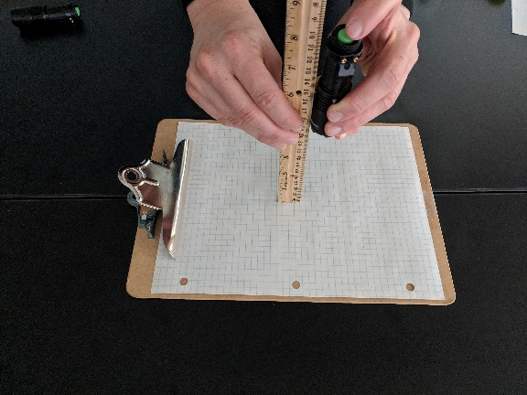
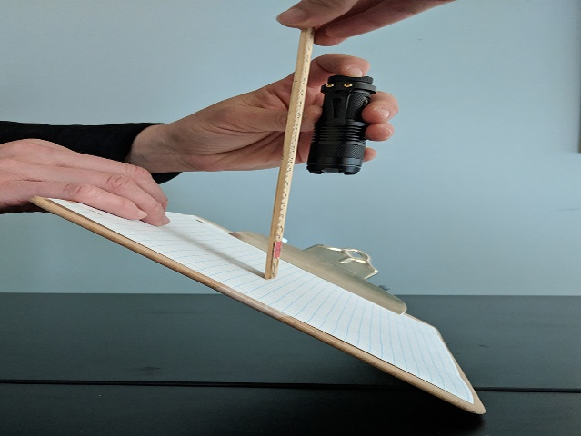
Step 2: Observe Energy Angles
Investigate what happens when sunlight strikes Earth’s surface at different angles.
  Follow the instructions on your activity sheet.
  Discuss the questions at the bottom of the page with your group after you complete the activity.
Notes:
Lesson 13: Step 2 of the Student Activity Sheet
Set up the Energy Angles activity. Tell students: “We are going to use a flashlight, clipboard, and graph paper to study what happens when sunlight strikes Earth’s surface.” Prior to starting, ask students to explain what the following parts of the set-up represent:
What does the flashlight represent? [Sunlight]
What does the clipboard represent? [The Earth’s surface]
Give students about 10 minutes to complete the activity, using the Lesson 13: Student Activity Sheet, Step 2.
Notes:
This activity works best in groups of three: one student to hold the clipboard (the surface of the Earth), one student to hold the flashlight and ruler (the Sun), and one student to trace where the light falls on the graph paper (the recorder).
If possible, darken your classroom or move to a room without windows.
Students will shine their flashlights down on the paper from straight above while the clipboard is lying flat on the table and again when the clipboard is tilted at an angle (with one edge resting on the table). When creating the angled set-up, tilt the clipboard to about 45˚ or more.
Both times the recorder will outline the area that the flashlight lights up. Consider having students use different colors and overlap the images (e.g., shine the light in approximately the same spot both times) to accentuate the differences.
The distance between the flashlight and the paper will vary depending on how bright your flashlight is. Students will want to choose a distance that allows the entire image to fit on the paper with ample space around the borders. The investigation works best when the flashlight is fairly close to the paper, at a distance of less than 5 cm.
It is important that the distance between the flashlight and the clipboard stay the same the whole time, but also equally important that the flashlight remain pointing straight down towards the table, even when the clipboard is titled at an angle. If it helps, point out to students that the Sun is not changing position, but rather we are changing where we are on the Earth; when the Earth’s surface is flat we are at the equator, and when the Earth’s surface is tilted we have moved far from the equator. Use a globe to point out hypothetical locations on the Earth where we might be “standing.”
**To do this activity as a demonstration instead, shine a flashlight straight above onto the ceiling of a darkened room and then angled at the ceiling.**

Slide 17
Making sense of the data
Was there any difference in the amount of light coming from the flashlight? Did it change or stay the same?”
What happened when you tilted the clipboard?
If you were standing in one of the squares on the clipboard, within which one do you think you would feel the most heat? Why?
Notes:
Make sense of the data. As a whole class, ask students to share their findings from the investigation. Ask students: “When did the light cover more of the paper, straight on or tilted?” Consider asking if any of the groups counted the number of squares illuminated, and if so, which way lighted more squares. Students will notice that there were more squares lit when the clipboard was tilted.
Use the following questions to guide a discussion to make sense of what this means:
Was there any difference in the amount of light coming from the flashlight? Did it change or stay the same?” [The amount did not change.]
So what happened when you tilted the clipboard? [The area got bigger; the light spread out.]
If you were standing in one of the squares on the clipboard, within which one do you think you would feel the most heat? Why? [Help students realize that it would be hotter in the circle where the heat is more concentrated and cooler in the circle where the heat is more spread out.]

Slide 18
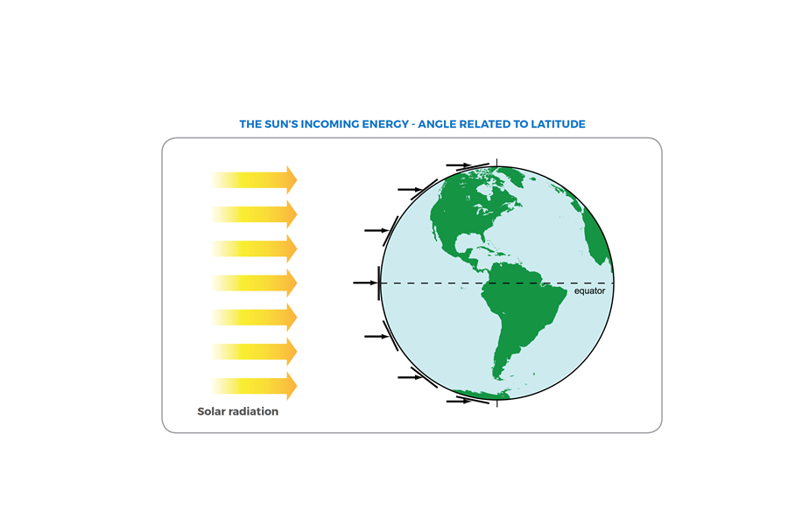
What does this mean for Earth’s surface?
Notes:
Now, let’s think about what this means for Earth. Demonstrate shining the flashlight directly at the equator of the inflatable globe, holding the flashlight horizontally. Then, keeping the flashlight horizontal, shine the light toward the poles. If students need support relating their clipboard model to the Earth, have a student hold their clipboard at the equator (so that it is vertical) and then at a high latitude location (so that it’s at an angle). Have them make connections between where the light is more concentrated (the smaller circle on the graph paper) and where the light is more spread out.
Alternatively, project the “What does this mean for Earth’s surface?” slide with the image of the Earth instead of using the physical model.

Slide 19
Step 3: Think about the Sun’s incoming energy.
Which area receives more concentrated sunlight? What is your evidence?
Which area receives less concentrated sunlight? What is your evidence?
How does the concentration of sunlight affect temperatures? Which areas are hotter? Which areas are colder?
Notes:
Lesson 13: Step 3 of the Student Activity Sheet
Have students apply these ideas to diagrams of what this means for uneven heating on Earth. Say: “We are going use what we just did with the flashlights and clipboards to think about what this would look like on Earth’s surface.” Direct them to Lesson 13: Step 3. Ask, “What do you notice about this image?” Students should notice that the “clipboard” from Lesson 13: Step 2 is now placed at certain points on Earth (e.g., the slanted clipboard could be the Earth’s surface at midlatitudes and the non-slanted clipboard could be the Earth’s surface at the equator). Students should think about where solar radiation is more concentrated and where it is more spread out (less concentrated) as they answer the questions.

Slide 20
Making sense
What did this activity help us figure out about why it is hotter at the equator than other places on Earth?
  Add your ideas to the Model Idea Tracker
Notes:
What did this activity help us figure out related to our question: Why is it hotter at the equator than other places on Earth? Ask students to summarize what they learned from the Energy Angles activity.
Write these ideas on the Model Idea Tracker.
Sunlight (solar radiation) is more concentrated at the equator because incoming sunlight shines directly on the equator, concentrating it in a smaller area.
Sunlight (solar radiation) is more spread out toward the poles because incoming sunlight hits the surface at an angle, spreading the light out over a larger area.
The amount of concentrated solar radiation that warms the land influences air temperatures just above the land. More concentrated solar radiation causes warmer air temperatures. More spread out solar radiation causes cooler air temperatures.
Note: This is where you can end the lesson for the first day.

Slide 21
Temperature and Latitude
Look closely at the data graph cards—what do you notice?
Use what you have learned about temperature at different latitudes to match the graph cards to each of the five cities based on what you think the temperature pattern in that city would be.
Notes:
Tell students they are going to look closer at temperature data by latitude. If you split this lesson across two days of class time, begin day two by asking students to describe general differences in temperature between Earth’s poles and the equator and why they believe there are different temperatures. Revisit the Model Idea Tracker as needed to remind students where they are in the investigation of uneven heating between the equator and the poles.
Divide students into groups and preview the GLOBE Temperature and Latitude data graph cards, location cards, and maximum/minimum temperature cards to orient students to the activity. Pass out a card set to each group. Ask students what they notice about the graphs.
Students may notice the following:
The x-axis is time and this data was collected over several years.
The data in different places was not collected over the same time period.
Some graphs have strong shifts in temperature over seasons, and some locations have little variation.
Tell students that GLOBE students in five locations around the world took measurements of maximum daily temperature (the warmest temperature each day) and that these are the graphs of that data. Their task is to figure out the location of the data based on what they understand about how temperatures vary by latitude. (Note: The graphs introduce seasonal shifts in temperature, which is NOT part of this unit. If you have already taught seasons in your class, this is a good place to have students make connections. If you have not taught seasons in your class, ask students to focus on the range of temperatures, focusing on where warmer and cooler temperatures are and not the seasonal shifts within the year.)
GLOBE Locations:
Juuan Lukio/Poikolan Koulu, Finland
WANAKA Field Station, Vermont, USA
Many Farms High School, Arizona, USA
Hamzah Bin Abdulmutalib Secondary School at Jeddah, Saudi Arabia
Wp/Minu/D S Senanayake College, Sri Lanka
Allow students time to match the graphs/temps/locations for each of the five locations. Have the groups share their initial matches with another group and discuss any differences before they begin to record them on the student activity sheet.

Slide 22
Step 4: Analyze temperature and latitude
Use the clues below to help you decide how graphs and locations match:
  Clue 1: Seasonal differences are stronger at higher latitude (farther from the equator). At or near the equator, there is usually no seasonal difference in temperature.
  Clue 2: Temperatures are warmer at low latitude (close to the equator) than at high latitude (far from the equator).
Notes:
Lesson 13: Step 4 of the Student Activity Sheet
In Lesson 13: Step 4, have students complete their explanations of locations based on the temperature and latitude data. Using the clues below, students can revisit their matches and then write down their final best guesses.
CLUE 1: Seasonal differences (fluctuations from colder to warmer temperatures) are stronger at higher latitude (farther from the equator). At or near the equator, there is usually no seasonal difference in temperature.
CLUE 2: Temperatures are warmer at low latitude (close to the equator) than at high latitude (far from the equator).

Slide 23
Model Idea Tracker
What have we figured out so far about how the Sun heats the Earth?
What does uneven heating have to do with how air moves?
Notes:
Revisit the Model Idea Tracker to summarize Model Ideas about uneven heating.
Summarize the Model Ideas from this lesson:
Sunlight (solar radiation) is more concentrated at the equator because incoming sunlight shines directly on the equator, concentrating it in a smaller area.
Sunlight (solar radiation) is more spread out toward the poles because incoming sunlight hits the surface at an angle, spreading the light out over a larger area.
The amount of concentrated solar radiation influences air temperatures; more concentrated solar radiation causes warmer air temperatures and more spread out solar radiation causes cooler air temperatures.
Then ask: “So we know that Earth is heated unevenly by the Sun. Some places have more direct solar radiation, and other places have more spread out solar radiation. That causes temperature differences on Earth. But how does that have anything to do with how air moves?
Give students a few minutes to wonder about this question. Ask if they can pull from the Model Idea Tracker, particularly as it relates to pressure differences and air temperatures. Some students may say something about different air temperatures being related to hot air rising and cool air sinking. Push students to explain how temperature differences cause air to move and might cause convection cells. Build on this idea by telling students that they will think about temperature differences and how they cause air to move in the next lesson.

Slide 24

Looking forward
How does uneven heating relate to air movement in the tropics?
Notes:
Tell students: “We saw different patterns of storm movement in the tropics and the midlatitudes. So, next time, we’ll start by thinking about how air moves in the tropics and how uneven heating relates to air movement in the tropics.”
How does uneven heating relate to air movement in the tropics?

Slide 25
Air Movement in the Tropics
How and why does air move in the tropics?

Slide 26
Looking back
What is the relationship between air movement and the pattern of storms around the Earth?
How does uneven heating relate to air movement in the tropics?
  Remember the video of global rain & snow from Lesson 12.
Notes:
Revisit the Learning Sequence 3 phenomenon and question: Why do storms move in predictable patterns around the world? Remind students that the class is investigating how air moves on a global scale because air movement is related to patterns in storm movement.
(Optional: Show the NASA global rainfall and snowfall video from Lesson 12 to remind students of the precipitation movement pattern in the tropics.)
Navigate from the previous lesson. At the end of the previous lesson, students figured out that solar radiation causes uneven heating of Earth, which leads to air temperature differences. Students figured out that air at the equator will be warmer than air in the midlatitudes. Remind students of the next question to investigate: How does uneven heating relate to air movement in the tropics?
Prepare students to develop a Working Model. Tell students they will develop a Working Model to explain how and why air moves in the tropics. Have students review the Model Idea Tracker to draw on ideas from lessons 1 to 13. Tell students that not all ideas will be helpful, but some might. Encourage students to draw on ideas from the previous lesson about solar radiation, as well as how temperature relates to air movement from Learning Sequence 1 and how pressure relates to air movement from Learning Sequence 2.
Remind students that the purpose is for them to try to draw on their existing knowledge to start developing an explanation. They don’t need to be certain about their models at this point.

Slide 27
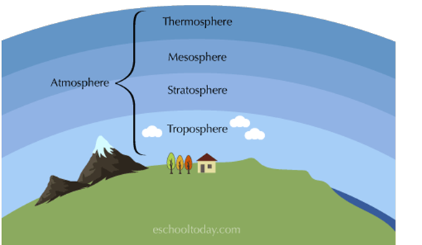
Layers of the Atmosphere
Notes:
Lesson 14: Step 1 of the Student Activity Sheet
Orient students to the illustration of the Earth’s atmosphere in Lesson 14: Step 1 of the student activity sheet. Show the cross-section of Earth’s atmosphere (slide: Layers of the Atmosphere) and relate it to the illustration on their activity sheets. While the atmosphere does have four distinct layers, the illustration on their activity sheets is focusing just on the Earth’s surface and the troposphere layer of the atmosphere, because this is where all weather occurs.

Slide 28
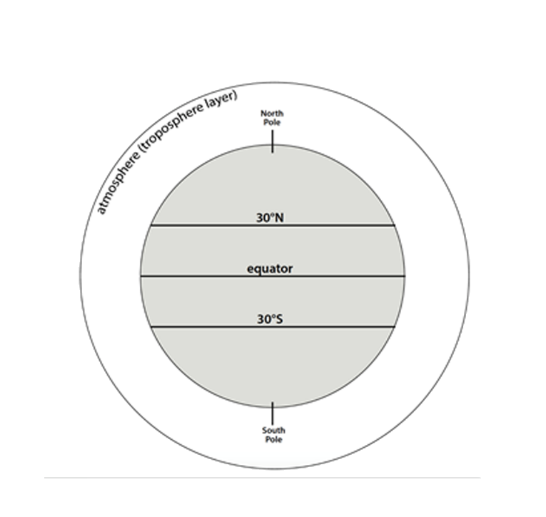
Step 1: Develop a Model
How do you think air is moving in the tropics between 30ºN and 30ºS? Why?
Draw arrows in the troposphere to indicate:
Where warm air is rising
Where air goes when it gets to the top of the troposphere
Where cool air is sinking
Notes:
Students record an initial Working Model. In Lesson 14: Step 1 of their student activity sheets, students record a model that explains how air movement in the tropics relates to latitude. Encourage students to share their working models with others as they finish.
Use the following prompts to guide students as you circulate the class:
Where might air be rising from Earth’s surface to the atmosphere, and why?
Where might air be sinking from the atmosphere to Earth’s surface, and why?

Slide 29
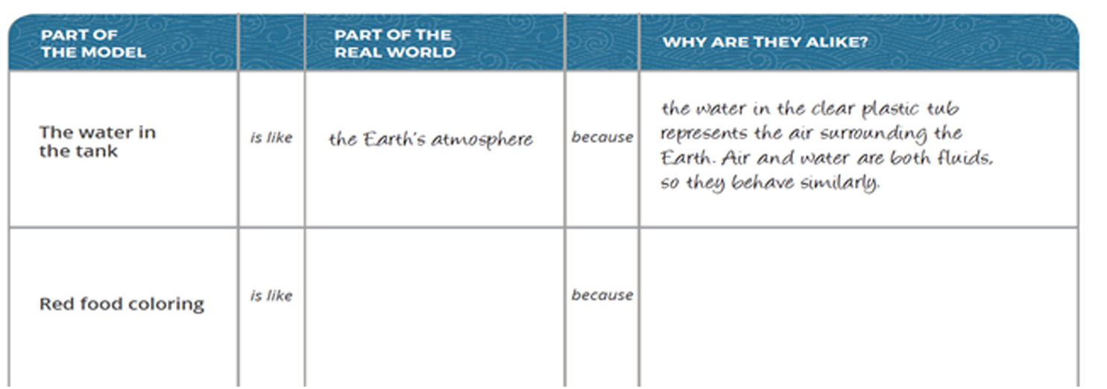
Demonstration: Global Convection Cells
Step 2: Investigate air movement across Earth’s surface.
Instructions: With a partner, write a statement that connects the water tank demonstration to the real world and explains why they are alike.
Notes:
Lesson 14: Step 2 of the Student Activity Sheet
Introduce the goal of the convection demonstration.
Tell students that the goal of this demonstration is to help them think about how and why air moves across the Earth’s surface within global convection cells near the equator. Students can also make observations about the rest of the convection cycle.
Discuss what each part of the tank represents.
Orient students to demonstration set-up and what each part represents.
The water in the tank represents air. This model uses water to simulate air because both air and water are fluids, so they behave similarly, but water can be seen.
The red food coloring represents air at the equator.
The blue food coloring represents air at 30°N and 30°S.
The cup full of hot water represents solar radiation.
The bottom of the tank represents Earth’s surface.
Have students work with a partner to fill out the third column (“Why are they alike?”) of the analogy map in Lesson 14: Step 2. Students should come up with reasoning to explain why the analogy works (e.g., Why is red coloring a good choice to represent air at the equator?).

Slide 30
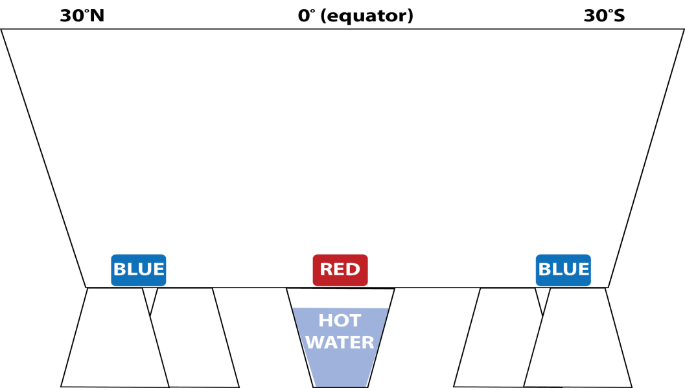
Demonstration: Global Convection Cells
Step 3: Record observations of the water movement.
Draw how the water moves through the tank.
Notes:
Lesson 14: Step 3 of the Student Activity Sheet
Prepare for observations.
Students may wish to make a video or take photos. They might make sketches or write about the changes. Explain that having several ways to document what is happening is a good idea because different types of data can be used together to help us understand what is happening. Have students plan how they will document what happens in the tank and set up an observation table.
Set up the demonstration. Explain how the demonstration will be completed. The key idea here is that students watch what is happening along the bottom of the tank, as it represents air movement, or winds, across Earth’s surface. Ask students to predict what will happen when the cup of hot water is added. Put the red and blue food coloring drops at the base of the tank. Heat the water, add it to the cup, and place the cup with hot water under the red food coloring in the tank. It will take about one minute for the red dye to start rising and convection to start. The blue dots should also slowly begin to pull towards the center of the tank (towards the red dot).
Make observations. Have students draw what they notice happening in the tank in Lesson 14: Step 3 of their activity sheets. Students should observe that the red food coloring rises and the blue food coloring is pulled in from the sides of the tank to the middle of the tank. Have students record their ideas about what they see, why they think it is happening, and what they wonder about in the boxes below their drawings.

Slide 31
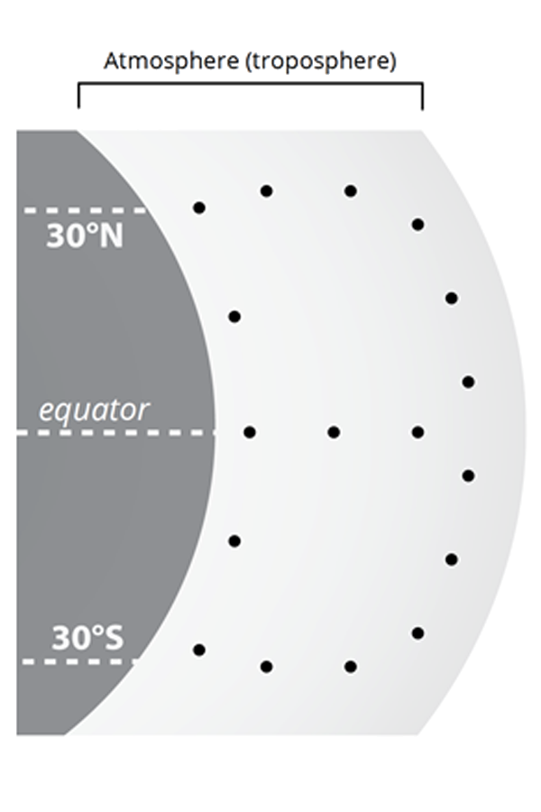
Step 4: Describe how and why air moves in the tropics.
Focus on how air is moving in the tropics.
Draw arrows to connect the dots and show how air is moving in the atmosphere, just as the water moved in the convection demonstration.
Write a caption to describe air movement in your model.
Notes:
Lesson 14: Step 4 of the Student Activity Sheet
Relate the convection demonstration to how and why air moves in the tropics. Orient students to the model, pointing out that we are focusing only on the convection cells near the equator. Have students develop a model in Lesson 14: Step 4, using their observations of the tank to describe how air is moving in the tropics (between 30°N and 30°S of the equator). Students should be able to explain why air is rising and sinking.
Share observations and lead a discussion of the demonstration. Have students explain what they observed and why it happened. Use the following questions to guide this discussion:
What happened to air at the surface of the Earth when it received direct heat?
What happened to the pressure where the warm air rose?
Why would the air move from the cool location to the warm location?
Students may need support to understand why the cool air is pulled across Earth’s surface toward the equator. This is a good time to remind students what they know about pressure and how air moves from high to low pressure. Students may also not realize that this horizontal movement represents winds. Have them think about what they would feel if they stood at the bottom of the tank. Remind them that the bottom of the tank represents the Earth’s surface.

Slide 32
Revisit the Model Idea Tracker
What did we figure out about why air moves in the tropics?
  Share ideas and add them to the Model Idea Tracker.
Notes:
Revisit the Model Idea Tracker to summarize Model Ideas about air movement. Summarize the new Model Ideas from this lesson and record them on the Model Idea Tracker.
Model Ideas:
As warm air rises at the equator, it creates an area of low pressure.
Cooler air with higher pressure moves across Earth’s surface toward the area of low pressure to replace the rising warm air.
Horizontal movement of air across Earth’s surface is wind.

Slide 33
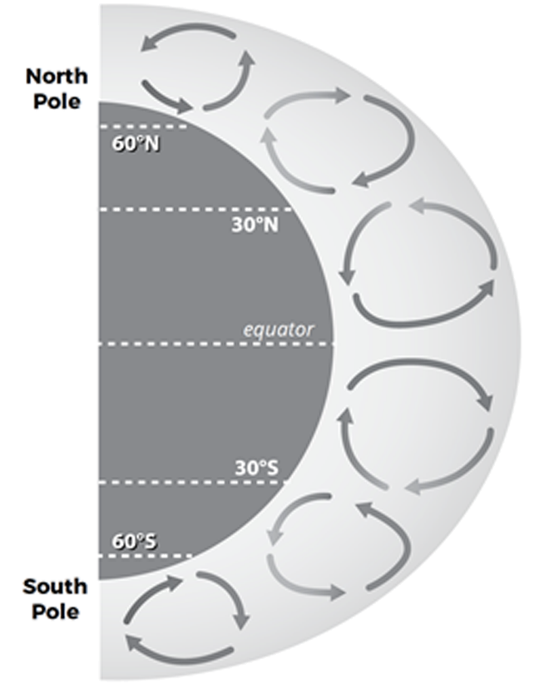
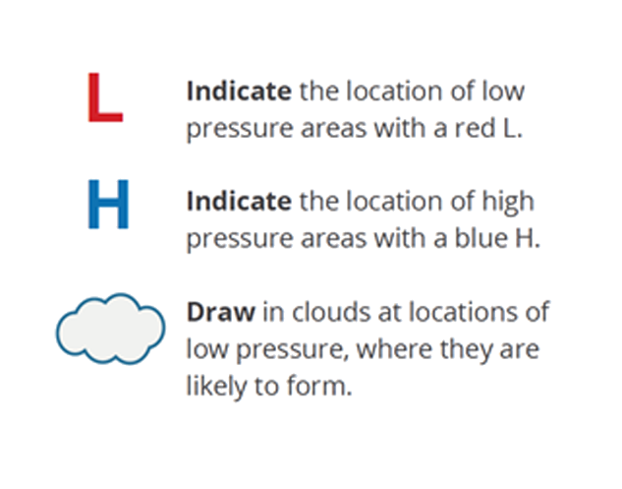
Global Air Circulation Diagram
Step 5: Create a model to describe air pressure and clouds at different latitudes.
Notes:
Note: Do not hand out Lesson 14: Step 5 until students get to this point, as the previous steps involve students discovering the pattern of convection cells that is provided here.
Lesson 14: Step 5 of the Student Activity Sheet
Introduce the Global Air Circulation Diagram in Lesson 14: Step 5. Orient students to this diagram and point out that it shows how air moves around the whole world, not just in the tropics.
Have students create a model of air pressure and humidity. Annotating the illustration in Lesson 14: Step 5, students should create a model locating the areas of low and high atmospheric pressure and the locations that are likely to be cloudy because air is rising. Use the arrows indicating air movement as clues.
Lead a class discussion about the diagram. Focus students on convection near the equator and encourage students to draw on their understanding of convection from Learning Sequence 1 and high and low pressure from Learning Sequence 2 to explain air movement in tropical convection. The one important thing for students to notice in the midlatitudes at this point is that convection moves in the opposite direction. This will be revisited in Lesson 15.
Use the prompts below to guide your discussion:
Where is air rising from Earth’s surface into the atmosphere and why?
Worldwide, where is air sinking from the atmosphere to Earth’s surface and why?
How is air moving across Earth’s surface and why?
Where do you think there are areas of high and low pressure and why?

Slide 34
Conclusion
What new ideas do we have about global air movement?
  Share ideas and add them to the Model Idea Tracker.
Notes:
Document new Model Ideas on the Model Idea Tracker at the end of the discussion. Students figure out the following:
Warm air is rising at the equator because of concentrated sunlight (solar radiation), which heats air, causing it to rise. An area with rising air has low pressure.
Cool air is sinking at 30°N and 30°S, which is an area of high pressure.
Convection happens on a global scale.

Slide 35
Making sense
What would we experience on the surface of the Earth?
If you stood just north of the equator, where would you feel winds coming from?
If you stood just south of the equator, where would you feel winds coming from?
Notes:
Ask students what we would experience on the surface of the Earth. Have students wonder about what the air movement would be like if we were standing at the surface of the Earth near the equator. Tell students that air movement across Earth’s surface is what we experience as wind. It’s okay if students are not sure about this yet.
If you stood just north of the equator, where would you feel winds coming from?
If you stood just south of the equator, where would you feel winds coming from?

Slide 36
Consensus Model: Air Movement in the Tropics
Create a model that will answer the question:
    How and why does air move in the tropics?
Identify ideas from the Model Idea Tracker that will help us answer the question.
Consider how the model for global air circulation you created in Step 5 helps answer the question.
Notes:
Revisit the Learning Sequence 3 phenomenon and question: Why do storms move in predictable patterns around the world? Remind students that the class is investigating air movement patterns because precipitation is moisture in the air. Remind students that we’re focusing only on air movement in the tropics for now.
Review the question that the Consensus Model will help us answer:
How and why does air move in the tropics?
Take stock of ideas from the Model Idea Tracker that will help answer this question. Have students nominate ideas from the Model Idea Tracker that they think will be helpful for answering this question. All of the ideas from Learning Sequence 3 will be helpful as well as some ideas from Learning Sequences 1 and 2 about warm air rising, cool air sinking, and air moving from high to low pressure.
Develop a class Consensus Model. Have small groups consider ideas from the models they created in Lesson 14: Step 4 and Step 5 and the ideas from the Model Idea Tracker. Have each group present which ideas they propose including in the Consensus Model. As small groups present, have students discuss if they agree or disagree with the ideas in each group’s model. Come to consensus about what should be in the model and document a Consensus Model in a public space that reflects agreed upon ideas.
KEY MODEL IDEAS THAT SHOULD BE REPRESENTED IN THE CONSENSUS MODEL:
As warm air rises at the equator, it creates an area of low pressure.
Sunlight (solar radiation) is more concentrated at the equator because incoming sunlight shines directly on the equator, concentrating it in a smaller area.
Sunlight (solar radiation) is more spread out toward the poles because incoming sunlight hits the surface at an angle, spreading the light out over a larger area.
The amount of concentrated solar radiation influences air temperatures; more concentrated solar radiation causes warmer air temperatures and more spread out solar radiation causes cooler air temperatures.
There are more areas where warm air is rising near the equator and more areas where cool air is sinking at 30°N and 30°S.
Cooler air moves along the surface of the Earth toward the area of low pressure to replace the rising warm air.
Horizontal movement of air along the surface of the Earth is wind, which causes storms to move.

Slide 37
A Curveball
When air and storms move, why do they curve?

Slide 38
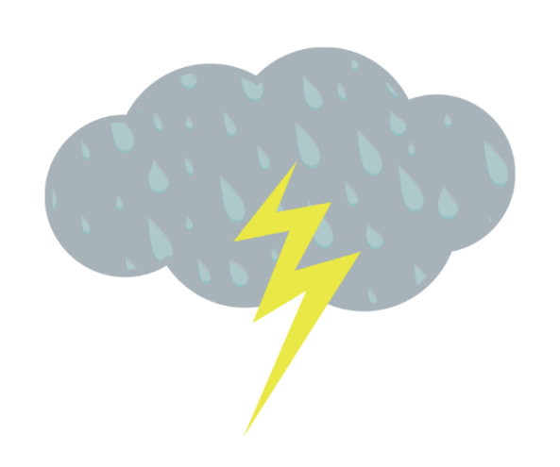
Looking back
Why do storms move in predictable patterns around the world?
Notes:
Navigate from the previous lesson. Remind students that they just developed a Consensus Model to explain air movement in the tropics. Remind students of the Learning Sequence 3 question and how it connects to air movement:
Why do storms move in predictable patterns around the world?

Slide 39
Storm Movement in the Tropics
Use the Air Movement in the Tropics Consensus Model to predict how storms move in the tropics.
  Based on what you know about air movement, predict storm movement in the tropics.
Notes:
Use the model to predict how storms move in the tropics. Have students use their Air Movement in the Tropics Consensus Model to predict how air or wind moves across Earth’s surface in the tropics. Orient students to where storms would occur in their model (at the bottom of the atmosphere). Students should deduce that, because of convection, storms would move towards the equator in the tropics.
Based on what you know about air movement in the tropics, predict storm movement in the tropics.

Slide 40
Step 1: Compare storm movement with your model
Watch the Global Rainfall and Snowfall video again and compare actual precipitation movement in the tropics with your predictions.
  What kind of movement did you see in the video that isn’t explained by our model?
Notes:
Lesson 15: Step 1 of the Student Activity Sheet
Compare predictions to observed storm movement patterns.
Re-watch the NASA Global Rainfall and Snowfall Video from Lesson 12 and focus students on storm movement in the tropics. Have students record actual precipitation movement on the map using another color in Step 2. Compare the predicted air movement to actual precipitation movement.
NASA GLOBAL RAINFALL AND SNOWFALL VIDEO
https://pmm.nasa.gov/education/videos/gpms-first-global-rainfall-and-snowfall-map
This two-minute video shows how precipitation moves globally from April to September 2014, with data collected just below the clouds. The green-yellow-red colors indicate rainfall and the blue-purple colors indicate snowfall, which students may not notice in the video. The voiceover explains how the data was collected and some patterns students might notice, so we suggest muting. The video provides a global view and zooms in on the United States (0:25), South America (0:50), and the Atlantic Ocean (1:25).
Discuss the limitations of the model.
Remind students that all models need to be revised and tested and revised again. This model is not yet helping us fully explain observed patterns of precipitation movement at the equator nor other questions about precipitation movement generated in Lesson 12 that are on the Driving Question Board:
Why does precipitation move from east to west near the equator?
Why does precipitation move from west to east in the midlatitudes?
Why does precipitation move in different directions in the tropics and midlatitudes?

Slide 41
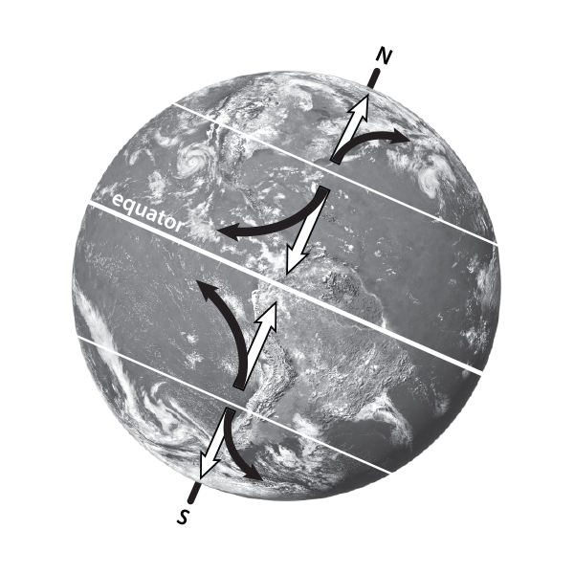
Step 2: Learn about the Coriolis Effect
Read the first paragraph of Lesson 15: Step 2 together as a class.
Complete the Stop and Do activity to make a model of the Coriolis effect.
Finish reading about the Coriolis effect .
Notes:
Lesson 15: Step 2 of the Student Activity Sheet
Navigate from the previous activity. Tell students that the model they developed explains the north-south aspect of storm movement in the tropics but not the east-west movement.
Read the first paragraph in Lesson 15: Step 2 about the Coriolis effect. Read this aloud with your students to introduce the new idea that the spinning of the Earth deflects winds.
Observe the Coriolis effect with a quick activity: Provide pairs of students with a round balloon and marker. Instruct students to inflate the balloon and draw an equator around the widest point in the center of the balloon. Also draw on the balloon “about” where the 30˚N latitude and 30˚S latitude lines would be. Tell students that this is a simple model of the Earth. Have one student hold the balloon at chest height (they should be able to look down at the top of the balloon) while the other draws an arrow starting at 30˚N going toward the equator. Then have the student holding the balloon slowly rotate it counterclockwise (to model the Earth spinning on its axis) as their partner draws another arrow, starting again from the same point on their balloon. Students should notice that when their model of Earth was turning, the arrow curved, but when their model wasn’t spinning, it did not.
Finish Reading about the Coriolis effect in Lesson 15: Step 2. Set the purpose of reading an article as a method to help students gather evidence to explain the east-west storm movement they observed in the video as well as additional evidence to explain the west-east storm movement in the midlatitudes. Students can read individually or as a whole group. Prompt students to Stop and Think as they encounter questions in the text. These questions are to help students make connections between the information they read and their previous observations.
Discuss the Coriolis effect. Lead a whole class discussion about the Coriolis effect. The big ideas students should walk away with are that the winds do move north and south, caused by convection, and they also move east and west, caused by the Earth’s rotation.
The unit thus far focused on explaining the north-south movement of air in tropical convection. Students may struggle to see how air moves across Earth’s surface toward the poles in midlatitude convection. You can help students see that convection in the midlatitudes travels in the opposite direction.
Suggested prompts:
Why does the air in the tropics curve east to west?
How does air move across Earth’s surface in midlatitude convection?
Why does the air in the midlatitudes move west to east?

Slide 42
Revisit the Model Idea Tracker
What new ideas do we have about global air movement?
  Share ideas and add them to the Model Idea Tracker.
Notes:
Add new ideas to the Model Idea Tracker. Summarize the new model ideas developed out of this discussion and add them to the Model Idea Tracker.
Model Ideas:
In the tropics, air moves across Earth’s surface towards the equator due to convection.
In the tropics, air moves across Earth’s surface east to west due to the Earth’s rotation.
In the midlatitudes, air moves across Earth’s surface toward the poles due to convection.
In the midlatitudes, air moves across Earth’s surface west to east due to the Earth’s rotation.

Slide 43
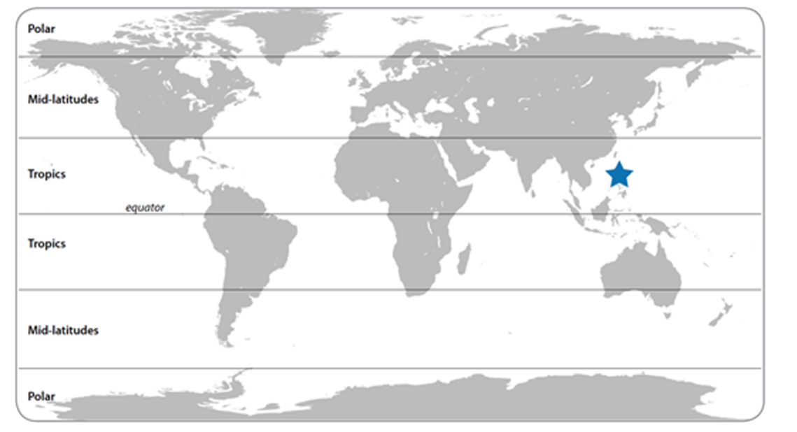
Storms in the Philippines and where you live
Step 3: Record an explanation.
Draw an arrow to indicate storm direction in the Philippines.
Draw a different symbol to show where you live.
Draw an arrow to indicate storm direction where you live.
Notes:
Lesson 15: Step 3 of the Student Activity Sheet
Navigate from the previous activity. Tell students that with their new ideas about the Coriolis effect, they are now prepared to explain more of the patterns in storm movement they observed in the tropics and the midlatitudes.
Record a final explanation. In Lesson 15: Step 3, have students use their model and new ideas about the Coriolis effect to record an explanation that describes where it is likely that storms will originate in the Philippines and where they live.

Slide 44
Conclusion
Where is it likely that storms come from where we live?
Why is being able to anticipate where storms come from important for communities?
How can we use our understanding of weather to prepare for storms?
Notes:
Lead a whole class discussion. Have students share their explanations for where weather comes from where they live and why this understanding is important for their daily lives. Have them connect back to their responses from Lesson 12.
Where is it likely that storms originate where we live?
Why is being able to anticipate where storms come from important for communities?
How can we use our understanding of weather to prepare for the impacts of storms?

Slide 45
Looking back
Locate Colorado on a map and determine which direction storms at this latitude are likely to travel.
Look back at your weather map model from Lesson 11: Step 2.
    Add an arrow to your weather map to indicate the direction that the storm is trying to move.
What stopped the storm from moving?
Notes:
Lesson 11: Step 2 of the Student Activity Sheet
Connect back to the Anchor. Have students look back at their Lesson 11 weather map model. On a world map, globe, or Google Earth, indicate the location of Colorado. Ask students to identify what direction storms are likely to travel based on its latitude. (Students should recognize that Colorado is located in the midlatitudes, so storms will tend to move from west to east.) Have students add an arrow to their weather map models to indicate the direction that the storm is trying to move. Ask students what stopped the storm from moving (high pressure to the east, north, and south).

