Slide 1
A Front Headed Your Way
What other types of storms cause precipitation?

Slide 2
A Different Kind of Storm
What other types of storms cause precipitation?

Slide 3

Looking back
What did we figure out about temperature and storms?
What did we figure out about humidity and storms?
Can anyone explain why the storm happened in the afternoon?
Notes:
Navigate from the previous lesson.
Ask students to remind the class of important Model Ideas learned during Learning Sequence 1. Briefly review the Consensus Model students developed for explaining moisture available for an isolated storm. Use the prompts below to guide your discussion.
Suggested prompts:
What did we figure out about temperature and storms?
What did we figure out about humidity and storms?
Can anyone explain why the storm happened in the afternoon?
End the discussion: “We know there are other kinds of storms, and our model only helps us explain precipitation in one kind of storm, so we have some more investigating to do.”
Elicit students’ prior knowledge of cold fronts. Ask students if they’ve heard of a cold front. If so, what do they know about cold fronts? Just from looking at the term, what would they expect from this kind of a storm? Students may focus on the extreme shift in temperature that happens with a front. Other students may think cold fronts can only happen in the winter. During the Engage lesson, it is okay for students to have incomplete or inaccurate ideas about cold fronts. Take note of what your students know and don’t know about cold fronts so that you can return to some of these ideas as this learning sequence unfolds.

Slide 4
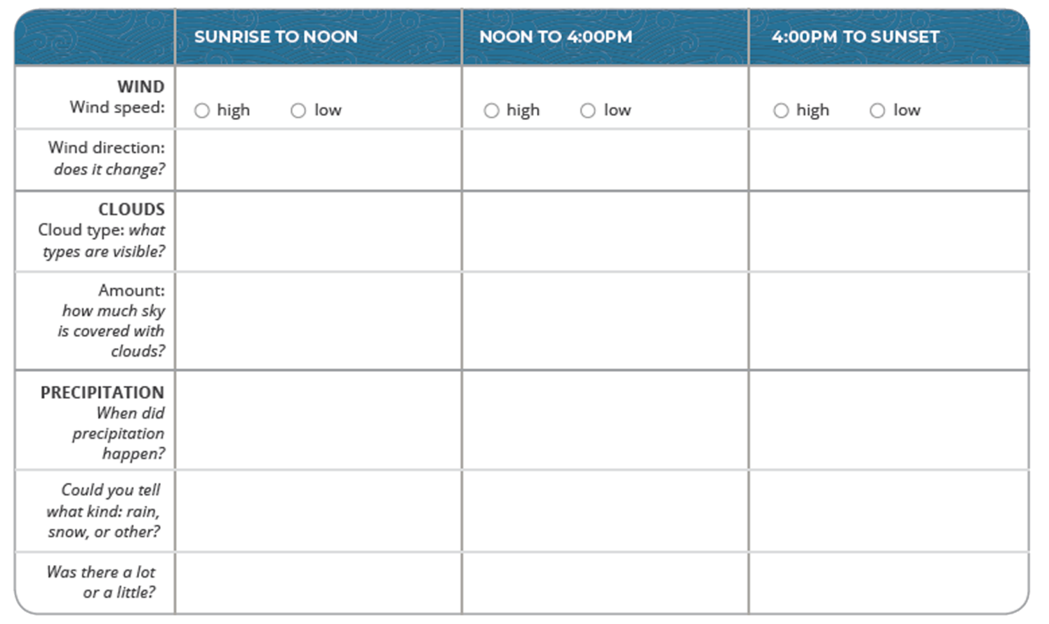
Cold front time-lapse video
Step 1: Make observations about the cold front.
This video was captured in Lyons, CO on May 8, 2017
Notes:
Lesson 7:Step 1 of the Student Activity Sheet
Make observations of the cold front time-lapse video. Tell students that you have a video of a cold front, and they need to figure out how this storm is different from the videos they’ve seen about isolated storms. Tell students they will watch the video twice:
The first time students watch the video, have them make observations without taking notes. Discuss their initial observations of how this storm might be different from the isolated storm.
Watch the video a second time, and have students take notes in Lesson 7: Step 1 of their student activity sheets. Focus students on monitoring a certain component of weather and the time of day. You can do this by assigning students a component (e.g., precipitation, cloud cover, cloud types, wind direction) to take notes on and by pausing the video at certain moments to look for evidence of time of day.
Have students share what they observed from the video to compile a comprehensive description of observations from the video.
Cold Front Time-lapse Video
Time-lapse video of cold front from Lyons, CO on May 8, 2017:
https://scied.ucar.edu/weather-timelapse-lyons-colorado-may-8-2017
Video break down and time codes:
0:00-0:52 — Sunrise-Noon
0:52-1:26 — Noon-4:00 p.m.
1:26-1:59 — 4:00 p.m.-Sunset
In the video you can see a few high-level cirrus clouds right after sunrise (starting at 20 sec.). Then mid-level clouds, lower and more uniform, form (starting at 27 sec.). Small, low-level cumulus clouds can be seen forming later (around 50 sec.). They grow into a cumulonimbus cloud that starts producing precipitation (about 1 min. 15 sec.). The cumulonimbus clouds change over the rest of the day, sometimes producing precipitation and sometimes not.
You may wish to provide some support for how students make observations from a time-lapse video because the cardinal directions are not given, clouds change so quickly, and precipitation can’t be quantified.
Wind: Have students look at the directions that clouds are moving (toward/away from camera, left or right). Remind students that winds might be moving in different directions at different altitudes.
Precipitation: Pause the video at a point when rain is visible.
Clouds: If students have learned types of clouds, pause the video to give students time to identify the cloud type with ID guides such as the GLOBE Cloud Chart (globe.gov/globecloudchart) or the UCAR SciEd Field Guide to Clouds (https://scied.ucar.edu/apps/cloud-guide). Or have students note a general trend in the amount of cloud cover.

Slide 5

Cold front time-lapse video
Step 1 (continued): How is the storm in the time-lapse video different from an isolated storm?
Notes:
Ask the question: “How is the storm in the time-lapse video different from an isolated storm?” Students should think about the question on their own first. Then discuss as a class and have students record answers on their activity sheet in Lesson 7: Step 1 (below the video observations box).
Student should notice that, unlike isolated thunderstorms, this storm comes earlier in the day, lasts longer, involves shifts in wind, and involves different cloud types.

Slide 6
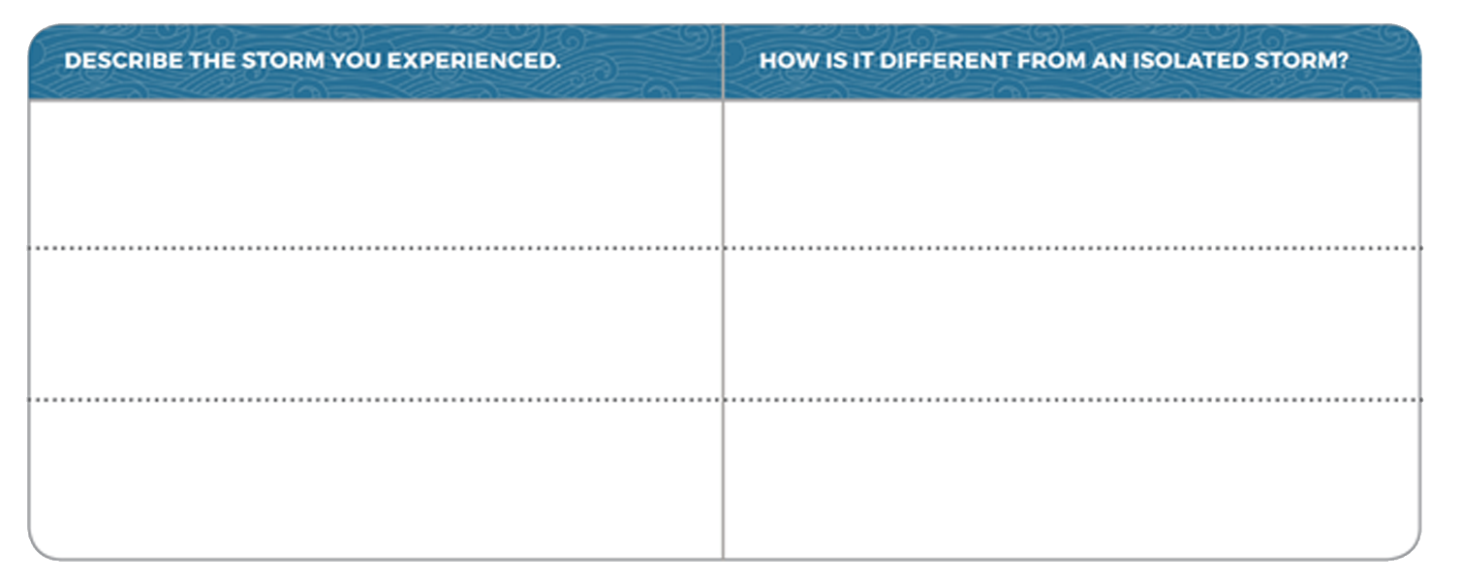
Thinking about storms
Step 2: Brainstorm different kinds of storms.
  Describe storms that you experienced, and explain what made them different from an isolated storm.
Notes:
Lesson 7:Step 2 of the Student Activity Sheet
Brainstorm other kinds of storms that don’t fit the current model. Ask students to work in small groups to brainstorm storms they’ve experienced that are not explained well by the Consensus Model for an Isolated Storm (e.g., thunderstorms at other times of day like the morning or middle of the night, a drizzly rainstorm that lasted all day, a blizzard). Students can record their ideas in Lesson 7: Step 2. Have the groups share their ideas aloud. Record important unexplained features of these storms (e.g., time of day doesn’t match, the length of the storm doesn’t match, the type of precipitation doesn’t match).
Use the following questions to elicit student ideas:
Did the storm happen in the afternoon, like the one in our model?
Did the storm last a short time (like a few hours), or did it last longer?
How did the storm change the weather? What was the temperature like before, during, and after the storm?

Slide 7
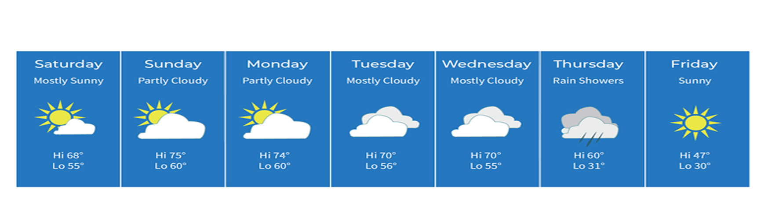
Weather Forecast for a Cold Front
Make a claim: What day did the cold front move through the area? Use evidence to support your idea.
Step 3: Interpret a weather forecast for a cold front.
  Work with your group to interpret what is happening before, during, and after the front.
Notes:
Lesson 7:Step 3 of the Student Activity Sheet
Examine a weather forecast of a cold front. After students note general patterns in a cold front, project a seven-day forecast that includes a cold front. Orient students to the forecast (What do you notice? What can we tell about the weather?). You may want to ask your students to make a claim about when the storm front moved through while just looking at the slide of the seven-day forecast before moving on to Lesson 7: Step 3 of the student activity sheet. Have students share their claims and the evidence from the forecast that supports their claim. Next, hand out the student activity sheets and in Lesson 7: Step 3 have students identify the day they think the cold front moved through the area. Record the temperatures before and after the cold front. Using information about clouds forming, ask students to estimate whether they think humidity was high or low. (Note that Fahrenheit is used instead of Celsius to match what is common in U.S. weather forecasts.)

Slide 8
Making sense
Think about temperature and humidity to discuss the questions below:
  What was the air like before the front in this location?
  What was the air like the day the front passed through the area?
  What was the air like after the front in this location?
Notes:
Discuss patterns in the air before and after the front.
Have students use their observations to discuss what the air was like before the front (Saturday-Wednesday), what it was like the day the front passed through the area (Thursday), and what it was like after the front passed (Friday).
End the discussion with the following question:
What kinds of data would be useful to figure out more about this kind of storm?
Listen for responses such as:
We should look to see what’s different about humidity and temperature in a cold front.
We should see how much it rained or snowed.

Slide 9

Driving Question Board
What new questions do you want to add to the Driving Question Board?
Notes:
Provide time for students to update the Driving Question Board. Students may want to add questions to the Driving Question Board now that they’ve thought more about cold fronts. Adding questions to the board can be completed as an Exit Ticket or a concluding activity to the Engage lesson.

Slide 10
Weather before, during, and after a Cold Front
How is air changing before, during, and after a cold front?

Slide 11
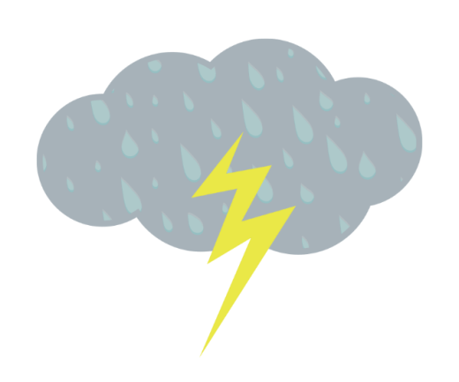
Looking back
What types of data would be useful to figure out more about this kind of storm?
Notes:
Navigate from the previous lesson. Review the question discussed in the previous lesson to motivate the need to look at data during a cold front: What types of data would be useful to figure out more about this kind of storm?
Listen for responses such as:
We thought it would be important to look at humidity and temperature data during a cold front.
We noticed the wind changing a lot during a cold front.
We wanted to know if the precipitation was a lot and if it rained or snowed.
Students will begin by examining temperature and humidity data building from their data analysis activities in previous lessons.
Motivate the reason to look at weather data. Explain that observing a storm in person (i.e., making visual observations, as they did during the Engage lesson) is one way to collect weather data. Using measurements from weather instruments is another way to collect weather data. Ask students to describe the types of measurements they’ve already found useful for making sense of storms (temperature, humidity).
End with: “Let’s see what’s going on with temperature and humidity before, during, and after a cold front to see what’s similar or different from what we already know.”

Slide 12
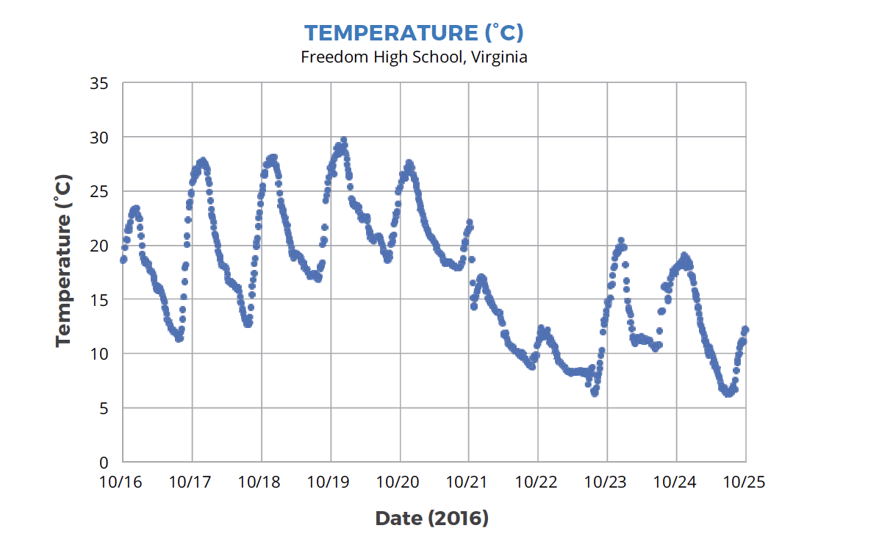
Step 1: Describe air temperature before, during, and after a cold front.
  Circle on the graph when the cold front passed through South Riding, VA.
  Note: The vertical lines on the graph indicate noon on each of the dates listed on the x-axis.
Notes:
Lesson 8: Step 1 of the Student Activity Sheet
Preview the new graphs. Ask students to look at the air temperature graph in Lesson 8: Step 1 and take note of what’s different about this graph compared to the sunny day and stormy day air temperature graphs from Learning Sequence 1 (e.g., now the graph has 10 days and not one day). Consider having students cover up all but one day on the graph to help them notice the connection to the diurnal pattern in the 24-hour temperature graph. Prompt students to notice where the data comes from, how long the data were collected, and other wonderings they have.
Use the following prompts:
What information is the graph showing?
Where were the data measured? What time of year?
What do we think the wiggly up and down line means?
How do the ups and downs relate to the temperature ups and downs on our sunny and stormy data graphs?
FREEDOM HIGH SCHOOL DATA SET
This data set comes from Freedom High School (a GLOBE school) in South Riding, Virginia. Data includes the temperature and (relative) humidity from October 16-25, 2016. In addition, pressure data from the same location and timeframe is found in Lesson 10. These data come from a WeatherBug automated weather station co-located with this GLOBE school. These automated stations record weather data daily every 15 minutes. These data can be found on the GLOBE Visualization Tool and the GLOBE Advanced Data Access Tool.

Slide 13
Step 1: Describe air temperature before, during, and after a cold front.
  Circle on the graph when the cold front passed through South Riding, VA.
  Note: The vertical lines on the graph indicate noon on each of the dates listed on the x-axis.
Notes:
Lesson 8: Step 1 of the Student Activity Sheet
Students use the weather report information to circle on the graph when the cold front passes through South Riding, Virginia. You may also choose to have students label “before,” “during,” and “after,” the front to aid in reading the graph.

Slide 14

Analyzing Data with the I² Sensemaking Strategy
Describe the temperature graph using What I See & What It Means statements.
Do you notice patterns? Do you notice interesting differences?
Explain what you think is happening in each part of the graph.
Write What I See statements on the graph to share your observations.
Next to each What I See statement, write What It Means statements.
Notes:
Students use the I² Sensemaking Strategy to make observations of the graph and to interpret those observations. Remind students to make observations before they begin to explain those observations. Students write their own What I See (WIS) statements first.
Have students share their WIS statements in partners or groups. Students can add to their graphs at this time.
Prompt students to add What It Means (WIM) statements next to each WIS statement. The WIM statements are students’ initial explanations of what’s happening in a specific part of the graph.
Ask several students to share their WIS and WIM statements aloud.

Slide 15
What patterns do you see in the air temperature graph?
Step 1 (continued):
  Describe the air temperature pattern before the cold front.
  Describe the air temperature pattern after the cold front.
  How does air temperature change when the front moves through?
Notes:
Use the questions from the student activity sheet in Lesson 8: Step 1 to guide a discussion about patterns in the graph, focusing on distinctions before, during, and after the front.
KEY PATTERN: Students should notice a regular diurnal pattern before the front that gets disrupted. This diurnal pattern returns after the front, but it’s colder.

Slide 16
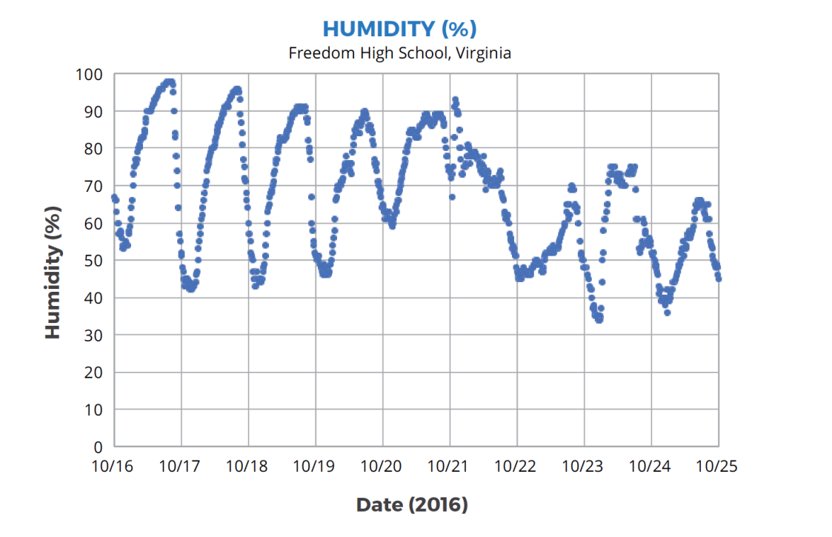
Step 2: Describe humidity before, during, and after a cold front.
  Circle on the graph when the cold front passed through South Riding, VA.
  Note: The vertical lines on the graph indicate noon on each of the dates listed on the x-axis.
Notes:
Lesson 8: Step 2 of the Student Activity Sheet
Have students circle/label humidity data on their graphs. You may also choose to have students label “before,” “during,” and “after,” the front to aid in reading the graph.

Slide 17
Step 2: Describe humidity before, during, and after a cold front.
  Circle on the graph when the cold front passed through South Riding, VA.
  Note: The vertical lines on the graph indicate noon on each of the dates listed on the x-axis.
Notes:
Lesson 8: Step 2 of the Student Activity Sheet
Have students circle/label humidity data on their graphs. You may also choose to have students label “before,” “during,” and “after,” the front to aid in reading the graph.

Slide 18
Analyzing Data with the I² Sensemaking Strategy
Describe the humidity graph using What I See & What It Means statements.
Do you notice patterns? Do you notice interesting differences?
Explain what you think is happening in each part of the graph.
Write What I See statements on the graph to share your observations.
Next to each What I See statement, write What It Means statements.
Notes:
Students use the I² Sensemaking Strategy to make observations of the graph and to interpret those observations. Remind students to make observations before they begin to explain those observations. Students write their own What I See (WIS) statements first.
Have students share their WIS statements in partners or groups. Students can add to their graphs at this time.
Prompt students to add What It Means (WIM) statements next to each WIS statement. The WIM statements are students’ initial explanations of what’s happening in a specific part of the graph.
Ask several students to share their WIS and WIM statements aloud.

Slide 19
What patterns do you see in the humidity graph?
Step 2 (continued):
  Describe the humidity pattern before the cold front.
  Describe the humidity pattern after the cold front.
  How does humidity change when the front moves through?
Notes:
Use the questions from the student activity sheet in Lesson 8: Step 2 to guide a discussion about patterns in the graph, focusing on distinctions before, during, and after the front.
KEY PATTERN: Students will notice changes in humidity before and after the front, which correlate with different air masses.

Slide 20
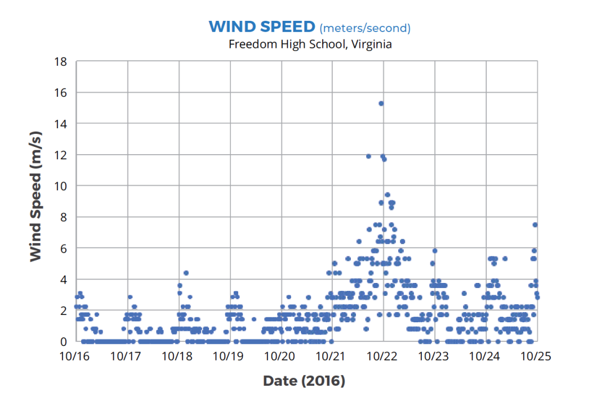
Step 3: Describe the wind speed before, during, and after a cold front.
  Circle on the graph when the cold front passed through South Riding, VA.
  Note: The vertical lines on the graph indicate noon on each of the dates listed on the x-axis.
Notes:
Student activity sheet Lesson 8:Step 3
Have students circle/label wind data on their graphs. You may also choose to have students label “before,” “during,” and “after,” the front to aid in reading the graph.

Slide 21
Step 3: Describe the wind speed before, during, and after a cold front.
  Circle on the graph when the cold front passed through South Riding, VA.
  Note: The vertical lines on the graph indicate noon on each of the dates listed on the x-axis.
Notes:
Lesson 8: Step 3 of the Student Activity Sheet
Have students circle/label wind data on their graphs. You may also choose to have students label “before,” “during,” and “after,” the front to aid in reading the graph.

Slide 22
Analyzing Data with the I² Sensemaking Strategy
Describe the wind speed graph using What I See & What It Means statements.
Do you notice patterns? Do you notice interesting differences?
Explain what you think is happening in each part of the graph.
Write What I See statements on the graph to share your observations.
Next to each What I See statement, write What It Means statements.
Notes:
Students use the I² Sensemaking Strategy to make observations of the graph and to interpret those observations. Remind students to make observations before they begin to explain those observations. Students write their own What I See (WIS) statements first.
Have students share their WIS statements in partners or groups. Students can add to their graphs at this time.
Prompt students to add What It Means (WIM) statements next to each WIS statement. The WIM statements are students’ initial explanations of what’s happening in a specific part of the graph.
Ask several students to share their WIS and WIM statements aloud.

Slide 23
What patterns do you see in the wind speed graph?
Step 3 (continued):
Describe the wind speed pattern before the cold front.
Describe the wind speed pattern after the cold front.
How does wind speed change when the front moves through?
Notes:
Use the questions from the student activity sheet in Lesson 8: Step 3 to guide a discussion about patterns in the graph, focusing on distinctions before, during, and after the front.
KEY PATTERN: Students will also notice that wind speeds increased as the front moved through. While they may not have all the information to understand the wind data, students should be able to correlate wind with the front.

Slide 24
Making sense
Why do you think the chances are high for precipitation the morning of October 21?
How is this storm similar to, or different from, the isolated storm?
If you collected weather data at your school, what types of weather events would you likely observe?
Notes:
Conclude the data analysis with a discussion of patterns in atmospheric conditions when the front first arrives on the morning of October 21:
Why do you think the chances are high for precipitation the morning of October 21?
How is this storm similar to, or different from, the isolated storm?
If you collected weather data at your school, what types of weather events would you likely observe?

Slide 25
Conclusion
What discoveries did you make about cold fronts?
  Share these ideas and record them in the Model Idea Tracker.
Notes:
Document Model Ideas to close the lesson. While students have not developed a model for a cold front yet, now is the time to document Model Ideas (rules of the system) based on their observations of cold front storms—both visual observations from the time-lapse video and data analysis. In this data analysis activity, students learn that humidity is high the morning of precipitation (very much like it was in the isolated storm). This Model Idea should be documented on the Model Idea Tracker.
Additional Model Ideas you may want to add at this time:
Temperatures are warmer before a cold front and follow the normal up/down pattern for a sunny day.
Temperatures are colder after the front, but also follow the normal up/down pattern for a sunny day.
Humidity is higher before a cold front and follows the normal up/down pattern for a sunny day.
Humidity is lower after a cold front, but also follows the normal up/down pattern for a sunny day.

Slide 26
Storms and Precipitation along a Front
What causes precipitation along a cold front?

Slide 27
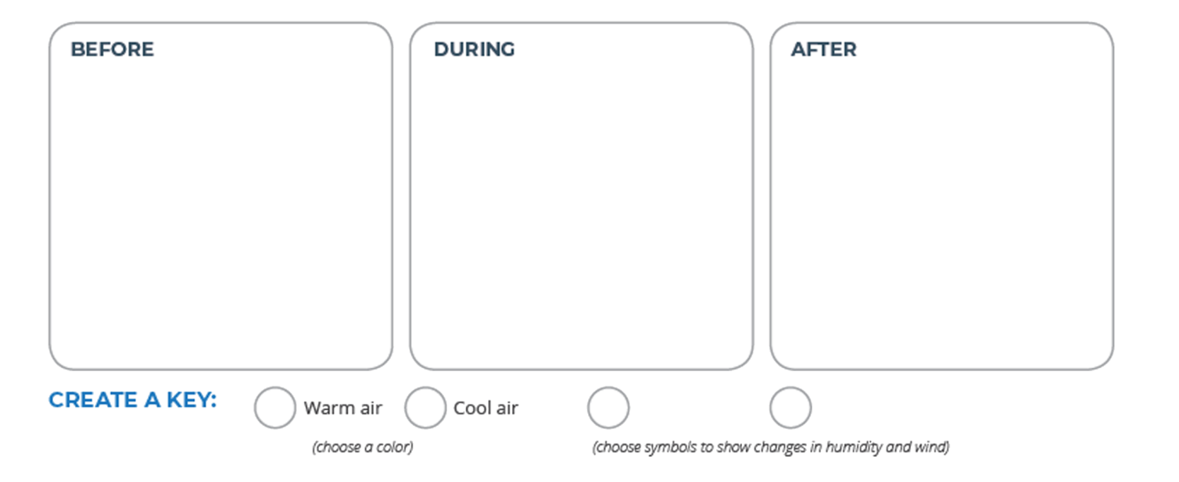
Step 1: How does the air change as a front moves through a place?
Illustrate the weather conditions (temperature, humidity, and wind) you might see a day before the front, during the front, and a day after the front arrived at Freedom High School, Virginia.
  Use color and symbols to show changes in temperature, humidity, and wind.
Notes:
Lesson 9: Step 1 of the Student Activity Sheet
Students review the previous lesson by drawing weather conditions before, during, and after a cold front. Direct students to Lesson 9: Step 1 in their student activity sheets. Ask students to draw a visual depiction of atmospheric conditions the day before, during, and the day after a cold front based on what they have learned in the previous activities (e.g., time-lapse video, weather forecast, data analysis from Freedom High School). Prompt students to include in their representations the temperature and humidity conditions based on prior evidence. This activity will help prime students for the density tank demonstration.

Slide 28
Discuss your illustrations
What days would you expect more rising warm air and why?
Would you expect more water vapor to be in the warm air or the cool air?
If we looked at the atmosphere where the two kinds of air “touched” what would we see?
Notes:
Discuss students’ illustrations using the question prompts below:
What days would you expect more rising warm air and why?
Would you expect more water vapor to be in the warm air or the cool air?
If we looked where the two kinds of air “touched,” what would we see?

Slide 29
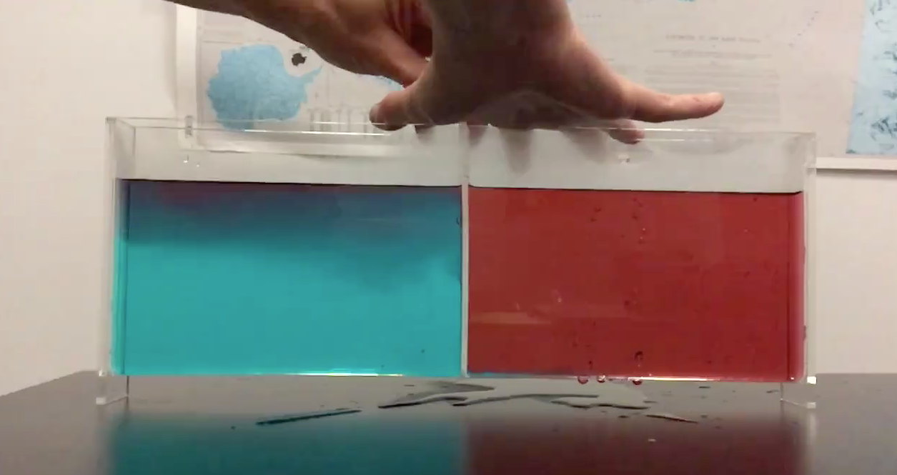
Investigation: When warm and cold fluids meet
Notes:
Figuring out the air at the front. Set the stage for this activity: “We need to make observations of what happens where warm and cold air meet to help us figure out why there is precipitation in the area where they meet. Since we can’t see air with our eyes, let’s use warm and cold water to represent the two air masses to figure out why precipitation forms along the boundary (front).” Set the purpose of the demonstration to figure out why precipitation forms along a front by making observations of a place where cold and warm fluids meet.
Refer to the Lesson 9: Step 1 Teacher Guide for instructions about the Demonstration: Precipitation Along a Front
Orient students to the model. Before adding water to the density tank, show students the model and explain that the tank represents the atmosphere. (You may wish to remind students that a physical model is a representation of a real-world phenomenon.)
Orient students to the parts of the model:
The bottom of the tank is the land surface.
The water in the tank represents air. This model uses water to simulate air because both air and water are fluids, so they behave similarly, but water can be seen.
Warm air ahead of the front will be simulated with warm water that is colored red.
Cold air behind the front will be simulated with chilled water colored blue.
Prepare for observations. Students will sketch a cross section on their student activity sheets after the demonstration. Note that this is the first time a cross-sectional view is introduced and that students may need to be oriented to this perspective (versus a map view). Also note that the water in the demonstration moves very quickly. Students may wish to make a video or take photos. Consider capturing the demonstration using slow-motion video for students to replay to make more detailed observations or by viewing the Density Tank slow-motion video provided below. Explain that having several ways to document what is happening is a good idea because different types of data can be used together to help us understand what is happening.
Predict what will happen. At the start of the demonstration, have a piece of plexiglass dividing the two halves of the tank. Explain how the demonstration will be completed. Ask students to predict what will happen when the barrier is removed.

Slide 30
Investigation: When warm and cold fluids meet
Step 2: Make observations of what happens to the warm and cold fluids in the tank.
  Use color and labels to diagram what you observed before and after the partition is removed.
  Time-lapse video of Density Tank Demonstration
Notes:
Lesson 9: Step 2 of the Student Activity Sheet
Add water to the tank. Simultaneously, pour cold water colored blue into the left side and warm water colored red into the right side of the tank. (Note: You can use ice to cool the blue water, but don’t include the ice in the tank because it is not a fluid.) Also, do not wait too long before pulling the plexiglass divider as some water may seep around the divider. Students should draw the demonstration set-up before the divider is removed in Lesson 9: Step 2 of their activity sheets.
Make observations. Remove the barrier and have students document what they see happening in the tank in Lesson 9: Step 2 of their activity sheets. Students should observe that the cold water flows under the warm water, and the warm water is pushed up. (Note: This happens rather quickly in a small tank, so you may wish to have enough warm and cold water on hand to repeat the model a few times.) Review student-captured videos or play the Density Tank slow-motion video several times as needed to assist students as they record their observations.

Slide 31
Making sense
What happened to the warm fluid? What happened to the cold fluid? Why did this happen?
What would happen to the warm air ahead of the front and the cold air behind the front when they come together?
How could this help us explain precipitation along the front?
Notes:
Make sense of the demonstration.
Ask students to share what they observed and articulate how they diagrammed the phenomenon.
Use the following questions to guide this discussion:
What happened to the warm fluid?
What happened to the cold fluid?
Let’s apply this model to the real-world. What would happen to the warm air ahead of the front and the cold air behind the front when they come together?
How could this help us explain precipitation along the front?
Students should make the analogy to the atmosphere—at a cold front, cold air goes underneath the warm air because it is denser. The warm air goes higher into the atmosphere because it is less dense. Remind students of how isolated storms form where warm, moist air rises higher in the atmosphere. At a cold front, warm, moist air is also pushed higher in the atmosphere, although the mechanism is different.
Students may need support to understand how the warm air is pushed up in this model since the top surface of the water in the tank remains the same. To help students, have them draw a horizontal line on their drawings or photos in the middle of the tank before the divider was removed and after. Note how much of the red (warm) water was below the middle before (half of it) and after (much less than half) the divider was removed.

Slide 32

Conclusion
What happens when cool air and warm air meet?
  Share these ideas and record them in the Model Idea Tracker.
Notes:
Document a new Model Idea on the Model Idea Tracker.
Students figure out that when cold air and warm air meet, cold air goes underneath, while warm air goes up.
Model Idea:
When cold air meets warm air, the cold air goes below the warm air. The warm air goes up into the atmosphere.

Slide 33
Looking back
Why does precipitation happen when cold and warm air meet?
Notes:
Navigate from the previous activity.
Based on their observations of the density tank, elicit students’ initial explanations for why precipitation happens where cold and warm air meet.
Think back to what we know about warm and cold air and humidity. Which kind of air is able to evaporate more water? Warm air or the cool air?
When the warm air rises in the atmosphere, describe what happens to the moisture in the warm air.

Slide 34
Small Group Model
Step 3: Develop a model for explaining precipitation during the front.
  Your model needs to explain:
      The location of the cold air mass.
      The location of the warm air mass.
      The direction that each air mass is moving.
      Where you’d expect clouds to form.
  Write a caption for your model.
Notes:
Lesson 9: Step 3 of the Student Activity Sheet
Small group Consensus Model. Explain to students that we need to model how precipitation is happening along the front. Direct students to the list of items to include in their model in Lesson 9: Step 3 of their student activity sheets. Allow students time to discuss this list in groups to brainstorm their ideas. When they are ready, they can diagram and label their models on their activity sheets as a group. They should discuss how best to represent their ideas in the model. (Note: The model has the air before the front on the right side and the air after the front on the left side. This follows the convention of most cold front models; however, it may be counterintuitive to students because the Freedom High School data for the air before the front was on the left side of the graph and the air after the front was on the right side of the graph. Take time to orient students to the transition between the graphed data and the modeling convention.)

Slide 35
Gathering more information
Step 4: Investigate air masses and fronts.
  Read the article about air masses and fronts.
  Stop and think as you encounter questions in the text.
Notes:
Lesson 9: Step 4 of the Student Activity Sheet
Readings on air masses and fronts. Use the scientific reading (Lesson 9: Step 4) to clarify and challenge students’ models. Orient students to the different weather maps in the reading (What do the different symbols mean? What information does the map show?). Set the purpose: “Let’s read more about this phenomenon of a cold front to help us clarify a few of the questions we still have. Then we’ll come back to our models to make some adjustments.” Students can read individually or as a whole group. Prompt students to stop and think as they encounter questions in the text. These questions are to help students make connections between the information they read and their previous investigations.

Slide 36
Draw cross-sectional models
Step 5: Let’s compare our two types of storms: isolated storms and storms that form along a cold front.
Draw cross-sectional models to explain how precipitation could happen in each kind of storm:
  Use the other models you’ve made and the reading to help you decide what to draw.
  Indicate where air is warmer and where it is cooler.
  Use arrows to show how air moves.
  Show where clouds form in both storm types.
Notes:
Lesson 9: Step 5 of the Student Activity Sheet
Compare two types of storms. At the end of the reading (Lesson 9: Step 5), students are prompted to diagram two different ways moisture becomes available—the first way is in the isolated storm through convection, and the second way is in a cold front through the interaction of two air masses. These diagrams can inform their models for precipitation along a cold front (from Lesson 9: Step 3).

Slide 37
Revise your model
Discuss new ideas from the reading.
Work in your group to revise your model from Step 3, based on new ideas from the reading.
Share your group models with the class.
Notes:
Revise small group Consensus Models.
Say: “Some things in the reading we already knew, but there was new information we read about. Let’s go back to our models (Lesson 9:Step 3) and add details using this new information.” This gives students time to discuss new ideas. As students work, circulate around the room prompting students to add to their models.
Use the following prompts:
Where in your model is the warm air mass? Where in your model is the cold air mass?
How can you use what we observed in the tank to explain what’s happening right here where they meet?
Can you label where there is more moisture and what’s happening for it to become precipitation?

Slide 38
Develop a class Consensus Model
What ideas should we add to the Model Idea Tracker?
Create a Consensus Model for Precipitation Along a Cold Front.
  Be sure to include the ideas from the Model Idea Tracker in your model.
Notes:
Develop a class Consensus Model.
Ask each group to share one revision they made to their models. As you start to notice patterns in the models (e.g., the warm air ahead of the front is a warm air mass, the warm air mass has more moisture), ask students if they agree we should add this to the Model Idea Tracker. Once several ideas have been added to the Model Idea Tracker, transition to creating the Consensus Model. Decide how to represent each Model Idea in the Consensus Model.
Model Ideas:
Air masses can be different temperatures (warm, cold).
Air masses can have different amounts of moisture (a lot or a little).
When a cold air mass meets a warm air mass, the cold air will push the warm air up in the atmosphere.
If the warm air mass has a lot of moisture, the air cools when it gets pushed upward, condenses, and may precipitate.

Slide 39
Revisit Explanations
Return to your Step 3 explanation: Write a caption for your model to explain why Freedom High School had precipitation on October 21, 2016.
  Use the Consensus Model for Precipitation along a Cold Front to revise your explanation.
Notes:
Revisit the explanation for South Riding, Virginia (Lesson 9: Step 3).
After the Consensus Model is complete, prompt students to use this model to revise their explanation of the temperature and humidity changes in South Riding, Virginia and why precipitation likely occurred along the cold front. This can be done as a class discussion.

Slide 40
Looking back
How does the moisture turn into precipitation along the front? What causes that?
What would need to happen for more precipitation to happen, or for less to happen?
Notes:
Navigate from the previous activity.
In the previous activity, students learned that precipitation forms along the boundary between cold and warm air masses in a cold front.
Have students explain why the precipitation is located along the boundary, using the following prompts:
How does the moisture turn into precipitation along the front? What causes that?
What would need to happen for more precipitation to happen, or for less to happen?
Talk about perspective. Up until now, students have explored a cold front looking at a single location as the front moves through. They’ve developed a model for explaining precipitation along the front but from a cross-sectional perspective. Ask students: “After a front passes through a place, where does it go next?” Tell students that we need to zoom out to see how big the front is, how it travels, and what happens to the precipitation along the front. Zooming out will transition students from a cross-sectional view to a map view, so take time to orient students to what they are examining in this new data set.

Slide 41
Step 6: Focus on the big picture using our cold front model.
Choose a day: Each member of your group will choose one day of data to map.
Color and label your map:
  Color locations where the temperature is greater than 30℃ RED.
  Color locations where the temperature is equal to, or less than, 30℃ BLUE.
  Draw slanted rain lines near the location if it had precipitation.
  Add the red and blue colors to the key.
Notes:
Lesson 9: Step 6 of the Student Activity Sheet
Plan for mapping the cold front. Direct students’ attention to Lesson 9: Step 6 of their student activity sheets. Tell students to use data to locate the front on a map and to identify where and why certain locations have precipitation. Point out that students will be considering how conditions changed over four days at each specific location but also how conditions changed over the four days for the entire region. Let students know that by examining a map view we are able to gain a larger perspective over a region, which is different than the localized cross-sectional views from before.
Read through the instructions together for labeling and coloring their maps. Break students into groups of four and ensure that each student within the group is assigned a different day to map.
Students map their data and combine their maps for analysis. Students color and label maps individually. In groups of four, students combine their maps into a four-day sequence. Together, students locate the front and label this on each of the four maps. They use the temperature data to locate and color the cold and warm air masses.

Slide 42
Step 6 continued: Focus on the big picture using our cold front model.
Compare Maps:
  Line up all four maps in order, September 8-September 11.
  Follow directions to add the front and air masses to your maps.
Notes:
Lesson 9: Step 6 of the Student Activity Sheet
Plan for mapping the cold front. Direct students’ attention to Lesson 9: Step 6 of their student activity sheets. Tell students to use data to locate the front on a map and to identify where and why certain locations have precipitation. Point out that students will be considering how conditions changed over four days at each specific location but also how conditions changed over the four days for the entire region. Let students know that by examining a map view we are able to gain a larger perspective over a region, which is different than the localized cross-sectional views from before.
Read through the instructions together for labeling and coloring their maps. Break students into groups of four and ensure that each student within the group is assigned a different day to map.
Students map their data and combine their maps for analysis. Students color and label maps individually. In groups of four, students combine their maps into a four-day sequence. Together, students locate the front and label this on each of the four maps. They use the temperature data to locate and color the cold and warm air masses.

Slide 43
Making sense
How can we use temperature to figure out the kind of air over a region?
Where do we think the cold air mass comes from? Why?
Where do we think the warm air mass comes from? Why?
If we predicted the weather for the next day, which direction would the front move?
Let’s use our model to figure out why some locations along the front had precipitation, while others did not.
Notes:
Class discussion and reflection.
Ask students to share their observations of the front moving and the location of the warm and cold air masses. Prompt students to use temperature data to back up their decision about the location of air masses. A second line of discussion should focus on why some locations along the front had precipitation while other locations did not.
Use the following questions to guide this discussion:
How can we use temperature to figure out the kind of air over a region?
Where do we think the cold air mass comes from? Why?
If we predicted the weather for the next day, which direction would the front move?
Let’s use our model to figure out why some locations along the front had precipitation while others did not.
Power and Limitation of Models: Weather Predictions
The last question in the set above might lead to a discussion of students’ models for explaining precipitation along a cold front. Not all locations along the front have precipitation, so students should consider how their models help them figure out what’s happening in the places with precipitation and what might be happening where there is no precipitation. Students may identify that their model is limited—there must be other factors that control the amount of precipitation that their model does not take into account. It’s important to talk about the parts of their model that are helpful for understanding precipitation along a cold front and where their model might be incomplete.

Slide 44
Front on the Move
What causes fronts to move?

Slide 45
Looking back
If we predicted the weather the next day, which direction would the front move?
What do we think is causing the front to move?
Notes:
Navigate from the previous lesson.
Using students’ ideas from the Big Picture, review the following questions from the previous discussion:
If we predicted the weather the next day, which direction would the front move?
What do we think is causing the front to move?

Slide 46

Looking forward
Why is the front moving and where is it headed next?
Notes:
Set the purpose for this activity.
Explain to students: “Now that we know more about how a front works, let’s see if we can figure out why it’s moving and where it’s headed next. If we can figure this out, we know which communities should expect precipitation from the front when it arrives in their area.”

Slide 47
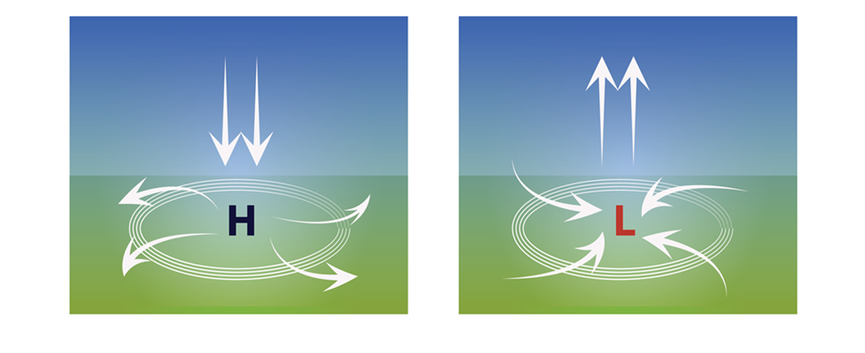
Step 1: Remember air pressure?
Notes:
Lesson 10: Step 1 of the Student Activity Sheet
Remind students about air pressure by physically modeling air pressure. Tell students that barometric pressure measurements are another weather measurement needed to figure out the direction of movement. Use beans or an equivalent item (lentils, beads, etc.) to have students model what air at high pressure might feel like compared to air at low pressure. Give students 20 beans to hold in one hand compared to five beans in the other hand. Have students close their eyes and pay attention to the pressure the beans are putting on the surface of their hands. (Note: The beans do not do a good job modeling the distance between the grains and whether the air is rising or sinking in the column. However, it can be used to help students understand that what’s in the column of air above a surface exerts pressure onto that surface.)
Optional extension: Measure barometric pressure using the GLOBE Barometric Pressure Protocol. The GLOBE Barometric Pressure Protocol is another excellent opportunity for students to make measurements of their environment and to provide experience with barometers as tools for measuring the weather. Introduce the GLOBE Barometric Pressure Protocol at this time if students will be making measurements. You will use an aneroid barometer or altimeter along with the protocol. If you have a digital barometer in your classroom or any other equipment for measuring barometric pressure, it would be valuable to take readings from those as well. The Barometric Pressure Protocol can be found at: www.globe.gov/do-globe/globe-teachers-guide/atmosphere
Connect air pressure to rising and sinking air. Direct students’ attention to Lesson 10: Step 1 of their student activity sheets. Have students read the page and then, as a class, discuss the image (below) that shows how air moves in areas of high and low pressure. Ask students to think about how the density of the sinking air in an area of high pressure is different than the density of the rising air in a low-pressure area. Point out that a large, blue “H” is used on a weather map to indicate the center of high pressure, and a large, red “L” is used to indicate the center of low pressure. (Note: It’s okay if students do not know why air turns in different
Connect the vertical up and down movement of air pressure with the horizontal toward and away movement. Using the same graphic, transition to focusing on the arrows moving toward the area of low pressure and the arrows moving away from the area of high pressure.
Make a hands-on connection to air movement in high and low pressure. Break students into pairs. Give each pair a balloon filled with a golf-ball-sized amount of dry beans (or lentils, beads, etc.). Tell students that the beans inside the balloon represent molecules of air. They are to place their balloon on a piece of paper and trace a circle around the edges of their balloon. Have one student push down on the balloon, simulating high pressure. The other student should trace a new circle around the edges of the “pressurized” balloon. Next simulate low pressure by releasing the balloon. Compare the size of the two circles. Students can take turns simulating high pressure on the balloon and low pressure by releasing the balloon.
Students should take turns explaining to each other what happens to air under high pressure and low pressure, using the following prompts:
What happens to air when there is high pressure? Where does it go?
The circles you drew show how air moved at the ground level.
Why was the circle bigger for the air under high pressure?
Refer to the diagrams in Lesson 10: Step 1 to help students make connections between air in the atmosphere and the balloon activity.
Demonstrate our understanding of air under high pressure and low pressure. Consider using a back-to-back strategy here to get students up and moving as they discuss their ideas. Students reflect on how the up and down movement of air influences the movement of air across the surface. Form two lines, standing back-to-back with a person from the other line.
Listen to the question the teacher asks related to the activity:
If air at an area of low pressure is rising, why would these arrows move toward it?
If air at an area of high pressure is sinking, why would these other arrows move away from it?
Ask students to individually reflect until the teacher calls: Turn (usually about 30 seconds). Then say: Turn.
Students discuss their reflections with the student with whom they were back-to-back.

Slide 48
Make a prediction
If areas of high pressure and low pressure were in the same region, how would you predict air to move between the two of them?
Notes:
Lesson 10: Step 2 of the Student Activity Sheet
Use pressure data to figure out which direction a front is moving. Direct students to Lesson 10: Step 2 of their student activity sheets. Read through the instructions together and orient students to the air pressure map.
Ask students to make predictions: If areas of high pressure and low pressure were in the same region, how would you predict air to move between the two of them?

Slide 49
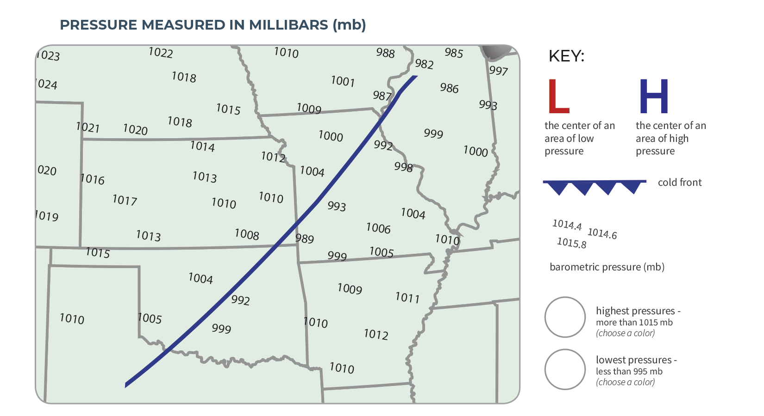
Step 2: Analyze pressure data over a region.
Color code areas with high and low pressure.
Draw arrows on the map to indicate which direction the wind is blowing.
Based on the wind direction, draw triangles on the front.
Mark the location with the highest pressure with a H and the area with the lowest pressure with a L.
Notes:
Lesson 10: Step 2 of the Student Activity Sheet
Give students time to complete the activity.

Slide 50
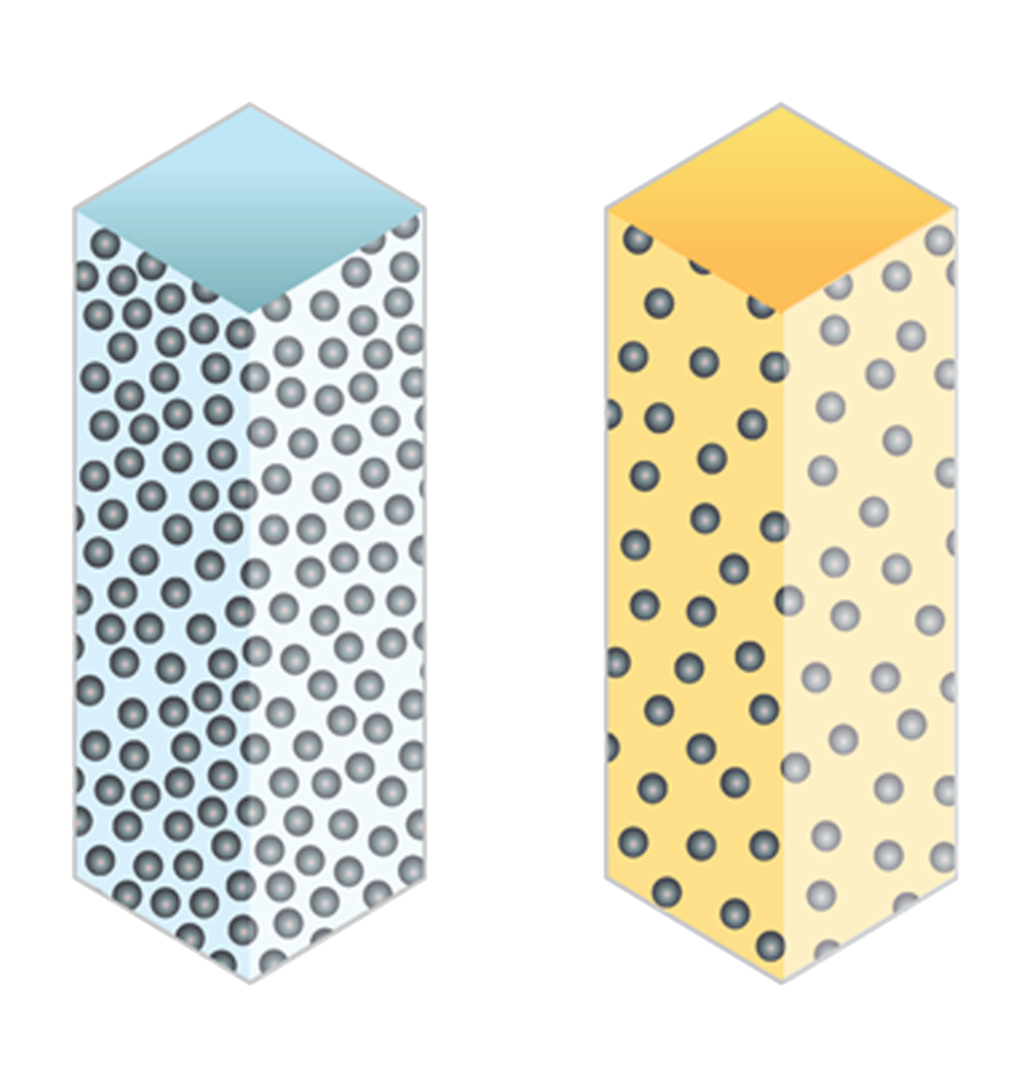
Which way did the wind blow?
Cold Air
Warm Air
Notes:
Discuss the patterns students see and how air pressure relates to movement. Keep the columns of cold air and warm air projected for students. Using the discussion prompt at the bottom of the student activity sheet, facilitate a discussion where students generate a claim about which way the wind blew. Students will continue to develop this explanation in the next activity.
Suggested question to discuss:
“The front is moving from the west (left side of the map) to the east (right side of the map). The arrows on the cold front point in the direction it is moving. Using the barometric pressure measurements, why might the front move in this direction?

Slide 51

Looking back
Where were high pressure and low pressure areas located in relation to the front?
Notes:
Navigate from the previous activity. Students started to develop an explanation for pressure by examining barometric pressure readings around a front. Have students review what they learned from this activity focusing on where high pressure was located (behind the front) and where low pressure was located (along the front and at the northern end).

Slide 52
Looking forward
If we go back to Freedom High School in Virginia and were expecting a cold front to come through, how would we expect pressure to change before, during, and after the front?
Notes:
Set the purpose for looking closer at pressure. Ask students: “If we go back to Freedom High School in Virginia and were expecting a cold front to come through, how would we expect pressure to change before, during, and after the front?
Tell students to use what they learned from the previous lesson (Lesson 10: Steps 1 & 2: Under Pressure) to predict what the pressure might be like as the front moves through a location. Elicit students’ initial ideas in response to this question.

Slide 53
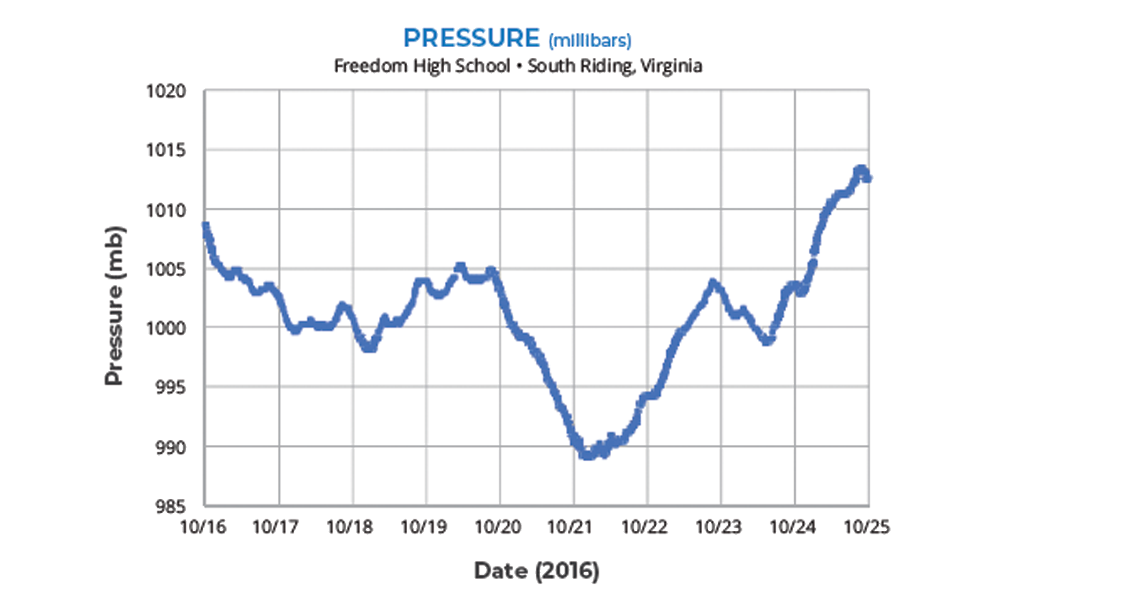
Step 3: Analyze pressure data in one location.
How did the pressure change over time (before, during, and after the cold front)?
Notes:
Lesson 10: Step 3 of the Student Activity Sheet
Direct students to Lesson 10: Step 3 on their activity sheets. Read through the instructions together. Prompt students to use the I² Sensemaking Strategy (What I See/What It Means) to analyze the barometric pressure graph. Remind students that they are now looking at a single location as the front moves through. Orient students to the graphed data as needed before they analyze the graph.
Students analyze and interpret the graph. Give students time to work together to analyze the barometric pressure graph. Prompt students to discuss and then answer the analysis questions below the graph.

Slide 54
Identify and Interpret Sensemaking Strategy
Describe the pressure graph using What I See & What It Means statements.
Do you notice patterns or any interesting differences?
Explain what you think is happening in each part of the graph.
Write What I See statements on the graph to share your observations
Next to each What I See statement, write What It Means statements.
Notes:
Students use the I² Sensemaking Strategy to make observations of the graph and to interpret those observations. Remind students to make observations before they begin to explain those observations. Students write their own What I See (WIS) statements first.
Have students share their WIS statements in partners or groups. Students can add to their graphs at this time.
Prompt students to add What It Means (WIM) statements next to each WIS statement. The WIM statements are students’ initial explanations of what’s happening in a specific part of the graph.

Slide 55
Making sense
Share What I See and What It Means statements.
How do these observations connect to areas of low and high pressure around the front?
Notes:
Discuss the data to generate Model Ideas. Discuss students’ observations of the graph. Focus students on sharing What I See statements first before transitioning to What It Means statements. As students share observations of low pressure and high pressure, ask them to make connections to the pressure regional map (Step 2) and where the areas of low and high pressure occurred around the front (e.g., near the front, behind the front).

Slide 56
Conclusion
What are the connections between high and low pressure and where the front is located?
Share these ideas and record them in the Model Idea Tracker.
Notes:
Generate patterns to explain pressure and turn these patterns into Model Ideas for the Model Idea Tracker.
Model Ideas rooted in the spatial, map view data may be:
Areas of high pressure are usually behind the cold front.
Areas of low pressure are around the front and at the northern end.
Model Ideas rooted in the analysis of temporal data may be:
After a cold front moves through, a location may experience high pressure associated with cooler, sinking air that has less moisture.
Just before and during the storm, an area may experience low pressure, which is associated with warm, rising air and precipitation.
Air moves from high to low pressure.

Slide 57
A Closer Look at Low Pressure Systems
What could cause a front to stall?

Slide 58

Looking back
What big ideas did we figure out last time?
Notes:
Navigate from the previous lesson. Have students summarize the ideas added to the Model Idea Tracker from the previous lesson. Consider doing this by asking students to stop and jot down big ideas they learned in the previous lesson. Use the discussion of these ideas to help you assess what big points students took away from the previous pressure activities.
Model Ideas rooted in the spatial, map view data may be:
Areas of high pressure are usually behind the cold front.
Areas of low pressure are around the front and at the northern end.
Model Ideas rooted in the analysis of temporal data may be:
After a cold front moves through, a location may experience high pressure associated with cooler, sinking air that has less moisture.
Just before and during the storm, an area may experience low pressure, which is associated with warm, rising air and precipitation.
Air moves from high to low pressure.

Slide 59
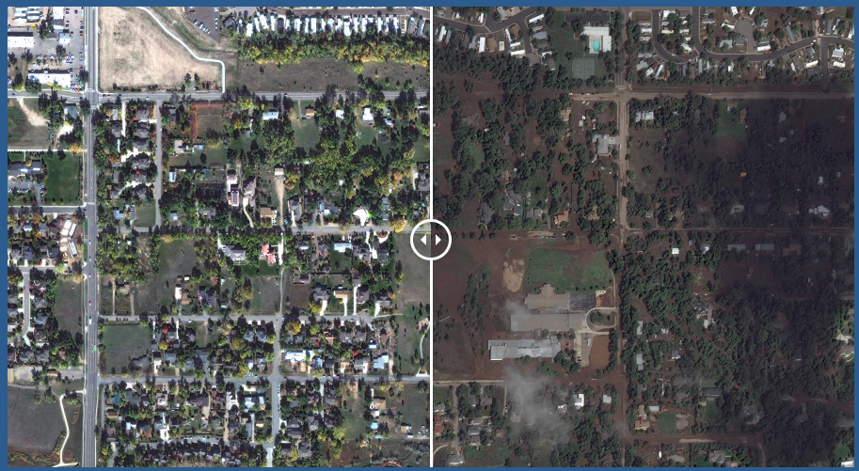
Case Study: 2013 Colorado Storm
Compare the Colorado storm with what we know about isolated storms and cold fronts.
  Video Link Photos link
Notes:
Revisit the Anchoring Phenomenon.
Set the stage for using these models to figure out what’s happening with the Colorado storm. Replay the video.
Case Study: Colorado Floods
In September 2013, a storm stalled over the region around Boulder, Colorado bringing a weeklong deluge of rain, resulting in dangerous floods.
Video: https://scied.ucar.edu/boulder-colorado-flood-how-citys-resilience-strategy-saved-it
Before/After Images: https://scied.ucar.edu/boulder-floods
The video is 6 minutes, 48 seconds in length and provides a case study. To help students focus on what happened in the flood, note the following time codes:
0:00-2:08— Introduction to the 2013 Colorado floods and past floods in this same area. Some effects are shown.
2:09-4:11— Engineering considerations related to managing future floods based on past experiences are addressed.
4:12— End of video on the 2013 flood and community resilience.
6:13— A cause is mentioned.
Explain that the Colorado Storm was an unusual storm.
Explain to students that the Colorado storm was different from an isolated storm and a cold front. Tell students that their job is to examine data from the Colorado storm and compare it with what they know about typical isolated storms and cold fronts.

Slide 60
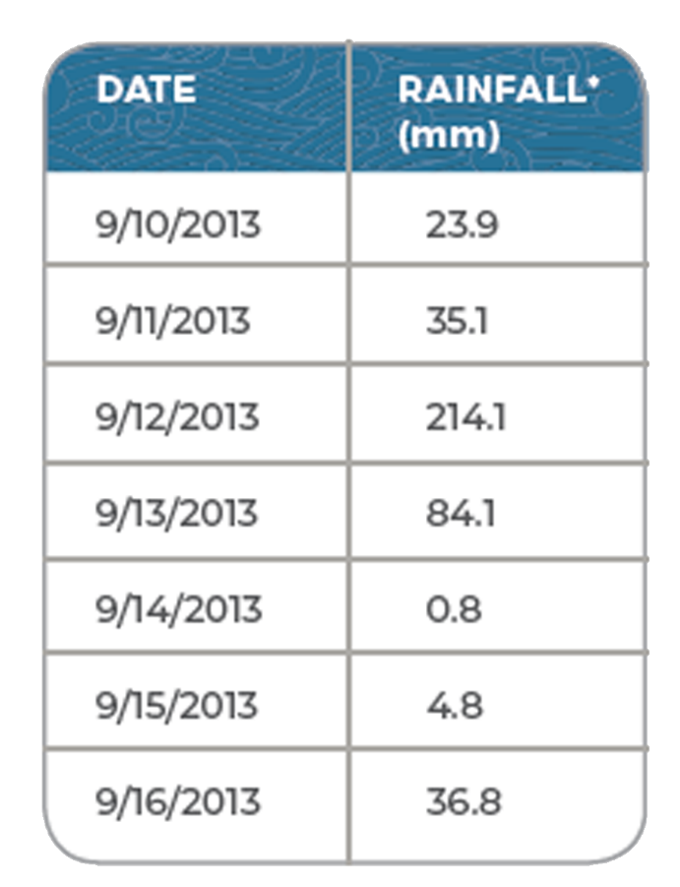
Step 1: Analyze data for the Colorado storm.
Use the table of daily rainfall totals to choose which of the claims is true about the Colorado storm:
The Colorado storm in September 2013 was an isolated storm.
The Colorado storm in September 2013 was a cold front.
The Colorado storm in September 2013 was unlike either an isolated storm or a cold front.
Notes:
Lesson 11: Step 1 of the Student Activity Sheet
Students analyze rainfall data from the Colorado storm to learn how long it lasted. Read the instructions at the top of the Lesson 11: Student Activity Sheet together. Arrange students in groups to do an analysis activity in Lesson 11: Step 1. After examining the rainfall data, students make a claim about whether the Colorado storm was an isolated storm, a cold front, or something different. Students should use evidence from throughout the unit to support their claim. Use a show of hands to see which claims the students initially support.
Ask students to think about how the Colorado storm is different from other storms they have learned about. This storm is different from isolated storms and typical cold fronts because of the length of time it rained and the lack of movement (stalling).

Slide 61
Step 2: Interpret the storm report.
Read the storm report to collect information about the air, moisture, and rain during the storm.
Create a model for the storm.
  Use the symbols from the key to develop a model of the storm.
  Show the direction air is moving based on the highs and lows.
  Show where the humid air that caused the storm is coming from.
Notes:
Lesson 11: Step 2 of the Student Activity Sheet
Students determine important factors in the storm. Students read a storm report (Lesson 11: Step 2) to collect information about why the storm stalled and lingered over one area for so long. Guide students to use what they have learned about how areas of high pressure can push air masses. Cue students to consider the balloon model we used in Lesson 10 as they think about how air pressure could stall a front. In the case of the Colorado storm, areas of high pressure boxed in the front, so it couldn’t move, which is why so much rain fell.
Have students construct a Consensus Model for the Colorado storm in small groups. Tell students to use the weather report to create a model on the map (Lesson 11: Step 2) showing the different forces at play in the Colorado storm. They should label where high pressure and low pressure are located, the front, and the air masses involved as well as where the moisture is coming from.

Slide 62
Develop a class Consensus Model
Groups share their models from Step 2.
Use group models to create a class Consensus Model to explain the Colorado storm. The model should explain:
  Where moisture came from for the storm.
  What kinds of air masses interacted in the storm and which air mass had the moisture for the storm.
  How precipitation happened when the two air masses interacted at the front.
  Why the front stalled, drenching parts of Colorado, as you discovered in Lesson 1.
Step 3: Use the model to answer the questions.
Notes:
Lesson 11: Step 3 of the Student Activity Sheet
Develop a whole group Consensus Model. Have small groups present their models to the class. As each small group presents, prompt students to ask questions about each other’s models. Note areas where groups seem to agree on what’s happening, and also note areas of differences. After all groups present their models, transition to developing a class Consensus Model. This model should reflect agreed upon ideas. Start with ideas that students agree on before moving to areas of disagreement or incomplete ideas. Students should use the model to answer the questions in Lesson 11: Step 3 about the Colorado storm.

Slide 63
Conclusion: Reflect on our Model
What does this model help us explain that other models could not explain?
What general ideas from our Model Idea Tracker helped us explain the Colorado storm?
What new Model Ideas could we add specifically for the Colorado storm?
Notes:
Reflect on the new model. After students build the new model, prompt them to think about what this new model helps to explain that the other models could not explain. Remind students that the Colorado storm was an unusual storm with all these unique variables. Look at the Consensus Model and identify a few underlying, general Model Ideas that would happen in most storms and a few unique, cased-based ideas that happened in the Colorado storm specifically.
General Model Ideas:
A warm, moist air mass got pushed up by a cooler air mass.
Low pressure was pulling air toward it.
High pressure was pushing air away from it.
Specific Model Ideas—Colorado storm:
Three areas of high pressure “trapped” the front and it stalled.
The low pressure kept pulling in moisture from the Gulf of Mexico and Pacific Ocean.
Power and limitation of models: Discuss how some Model Ideas can be useful for explaining parts of a storm but how there are also unique things that could be happening in any one storm that make it more difficult to predict.

Slide 64
Driving Question Board
What questions can we now answer?
What new questions should we add?
Notes:
Revisit the Driving Question Board. Give students time to revisit questions on the Driving Question Board. Students should share and explain questions they now feel they can answer. Students can also share new questions they may have about storms.

Slide 65
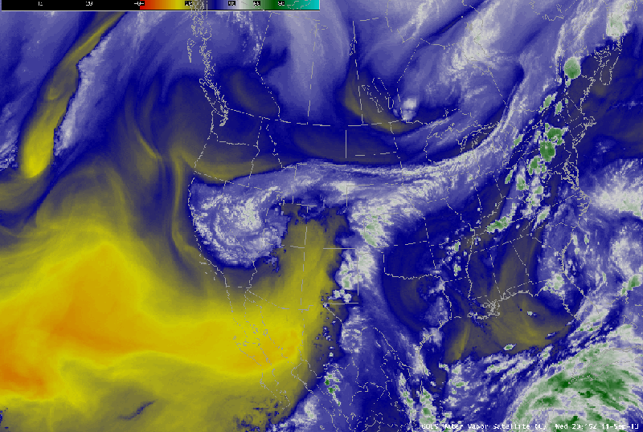
Colorado Storm: Satellite View
Observe the Colorado Storm from a satellite view
What do you notice about
how air was moving across
the United States when the
Colorado storm happened?
Notes:
Motivate Learning Sequence 3.
Look at satellite imagery for the Colorado storm to get students thinking about large-scale patterns. Ask students what they notice about the way air was moving across the U.S. when the Colorado storm happened.
Satellite Imagery: Colorado Floods
This satellite imagery shows water vapor over the U.S. on September 11 and September 12, 2013.
Video: https://www.bouldercast.com/the-2013-boulder-flood-two-years-and-three-billion-dollars-later/

Slide 66
Looking forward
Observe one other storm move across part of the United States.
  What direction does the storm move?
  Where might moisture for the storm come from?
Option 1: Southern Central U.S. to Mid-Atlantic region April 29–May 1, 2017
Option 2: U.S. Mid-Atlantic region January 20–22, 2016
Option 3: Southern California and U.S. West Coast January 5–7, 2016
Notes:
Broaden from Colorado to another region.
Choose one of the NASA videos below to preview with students. Use the video to notice patterns in the way air and storms move across the U.S. Ask students to identify the direction the storm moves and where the moisture for the storm could come from. This will help you set the stage for student learning in Learning Sequence 3 as students dive into latitudinal patterns of heating, precipitation, and prevailing winds.
Satellite Imagery: NASA Imagery of storms in the United States
These videos capture storms in the U.S. in different regions in 2016 and 2017. The imagery is made by NOAA’s GOES-East satellite (NASA/NOAA GOES Project). Select a region that might be most interesting for your students, or if time permits, view all three videos to notice similar and different patterns in the video.
Option 1: https://www.youtube.com/watch?v=V-euF5ScXbY
Dates: April 29–May 1, 2017
Location: Southern Central U.S. to Mid-Atlantic region
Option 2: https://www.youtube.com/watch?v=awVjB2VQxdU
Dates: January 20–22, 2016
Location: U.S. Mid-Atlantic region
Option 3: https://www.youtube.com/watch?v=estSuHF3Vwk
Dates: January 5–7, 2016
Location: Southern California and U.S. West Coast

