Slide 1





Mountain Rescue!
Flight Testing

Slide 2

Engineering Experiences
Re-engineer
?
Identify the need or problem
Reflect & share
Test
Research criteria, constrains, and other’s work
Design/build prototype
Brainstorm possible
solutions
Select best solution

Slide 3
Aerospace Engineer: Victoria Wilk
Victoria Wilk, Boeing – What does a mechanical
Engineer do who works in aerospace?
Victoria Garcia, NASA (Victoria is a deaf aerospace
engineer.)

Slide 4
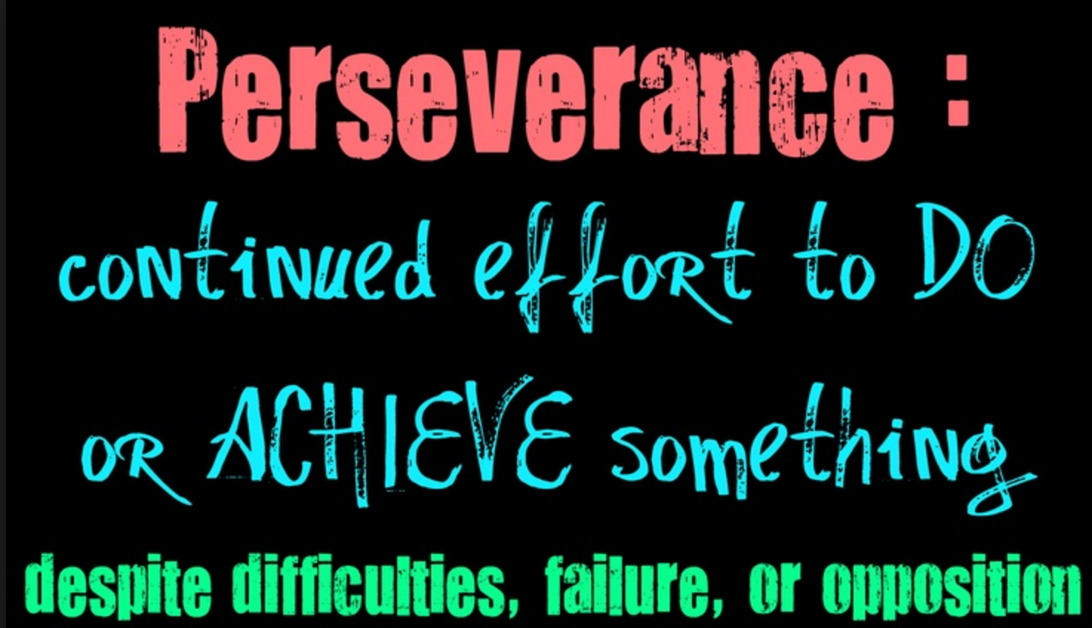
Failure & Struggle Make
Learning Happen! Really!
Engineers fail fast and fail often to learn!
Failure means just another try!

Slide 5
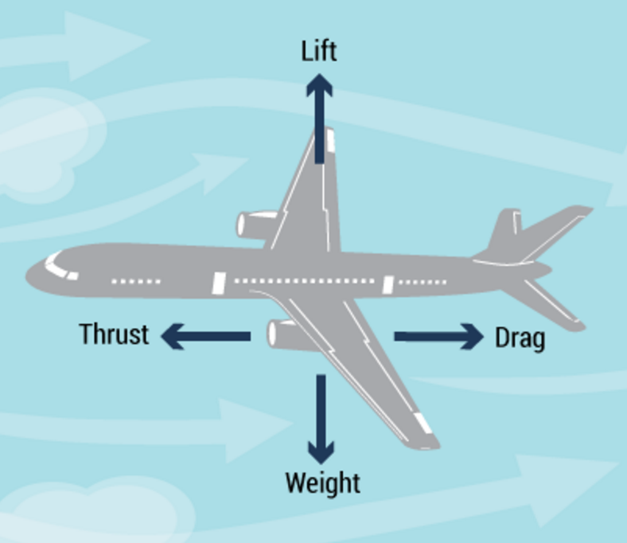
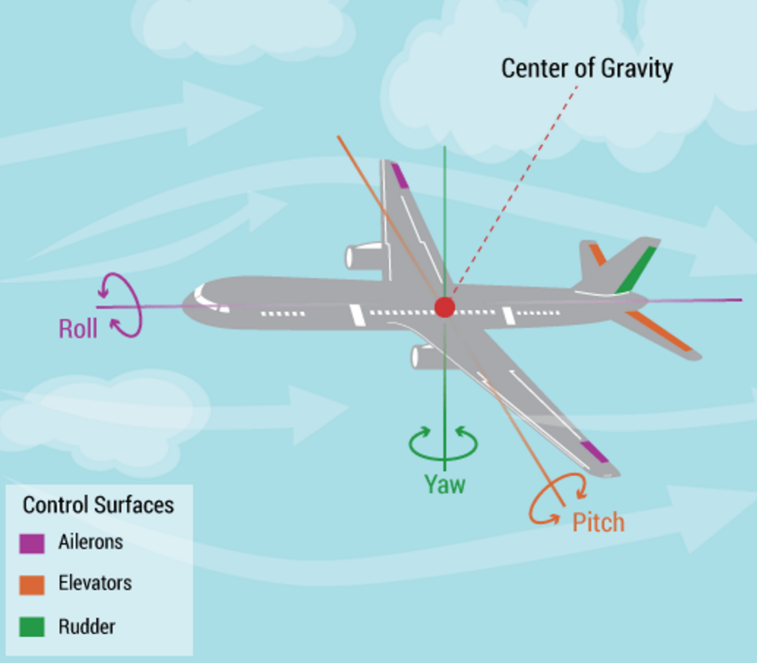
Aerospace Engineering Talk
Thrust, Drag, Lift, Weight
Pitch, Yaw, Roll
Plane’s Center of Gravity
Air & Air Pressure
Source: Boeing

Slide 6
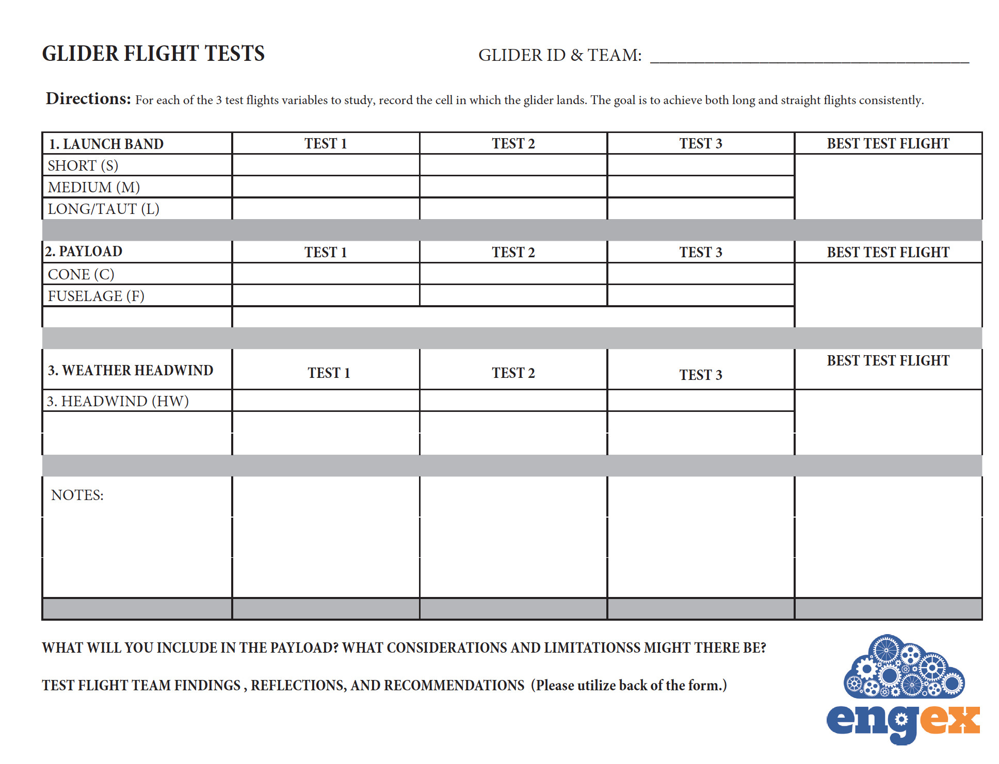
The Flight Test

Slide 7
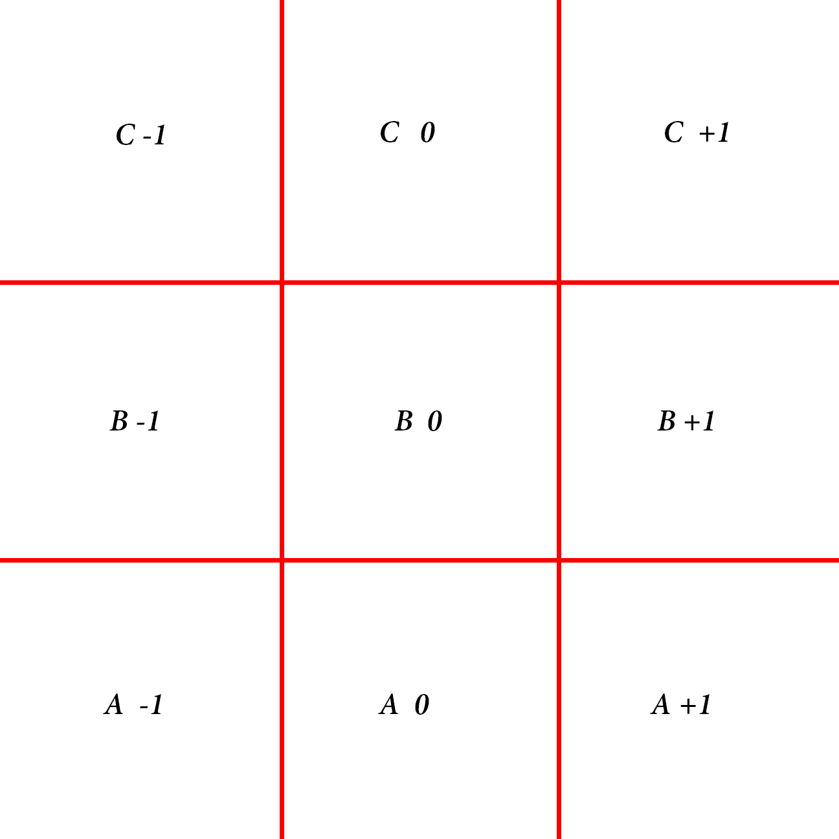
One Test Landing Field
Recording Pattern
Each square should
be the same size.
The entire grid
should cover the area
of glider test flight
landings.
Run a series of tests
to determine an
appropriate coverage
area for the grid overall
before student testing
begins.

Slide 8
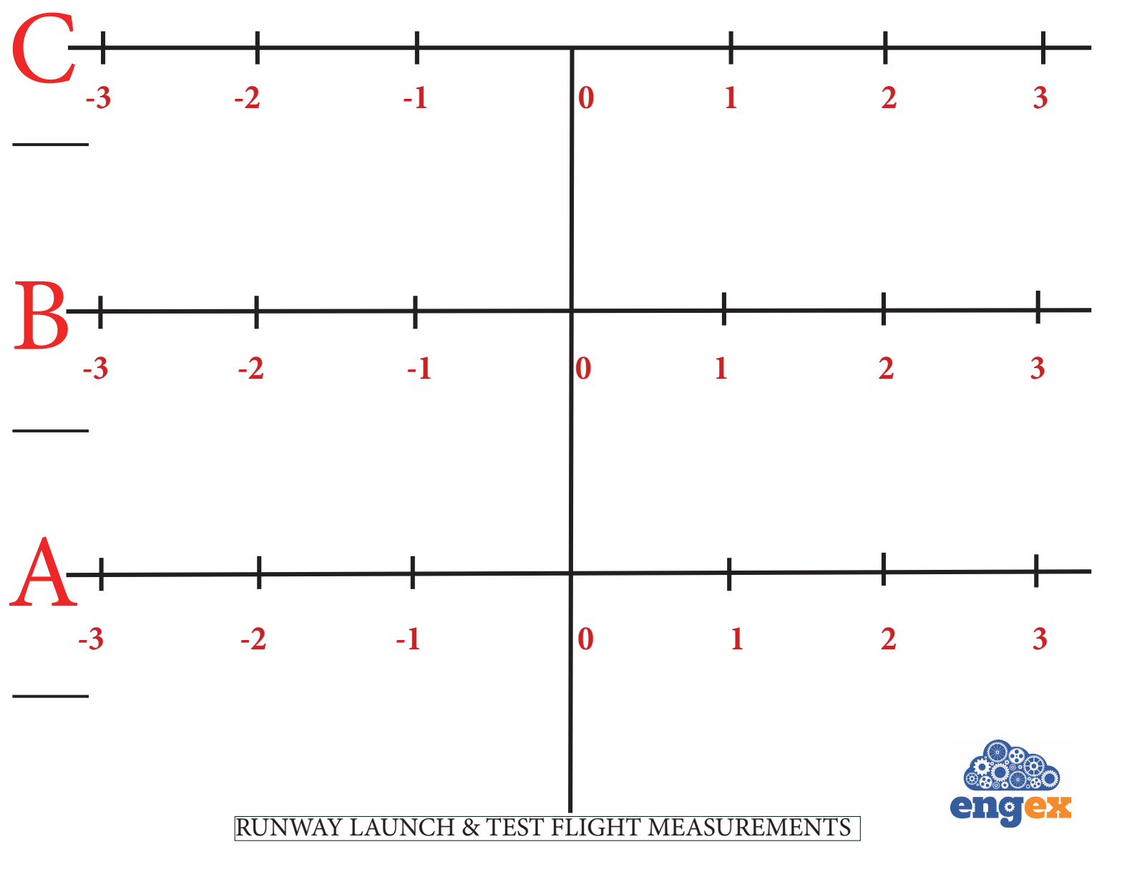
Another Possible Test Landing Field Recording Pattern

Slide 9
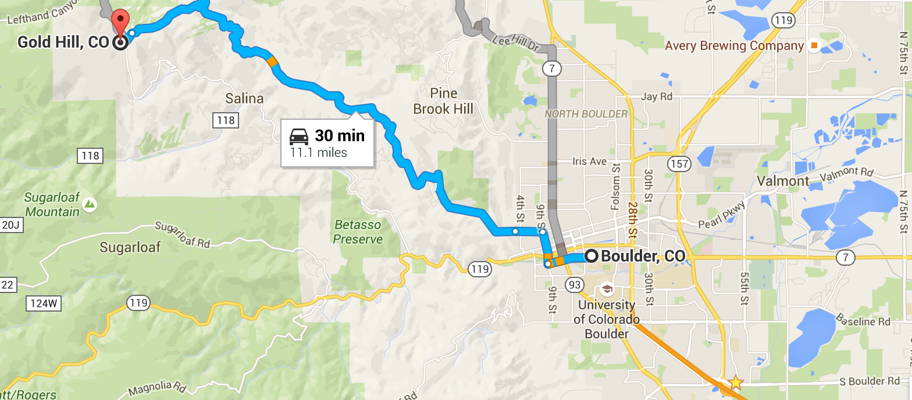
Distance,
Approx. 15 miles or 24 kilometers
Notes:
The glider must fly the 24-km flight uphill from Boulder to Gold Hill, CO. Can it make the rescue flight?

Slide 10

Rules? Safety?

Slide 11
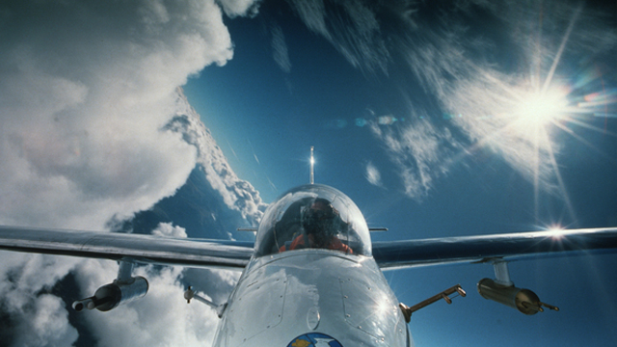
Class Discussion: Successes and Challenges
What did you find out about the flight of your glider and the best position of the thrust force at launch. Was your data consistent? Can your glider fulfill the Mountain Rescue Mission?

Slide 12
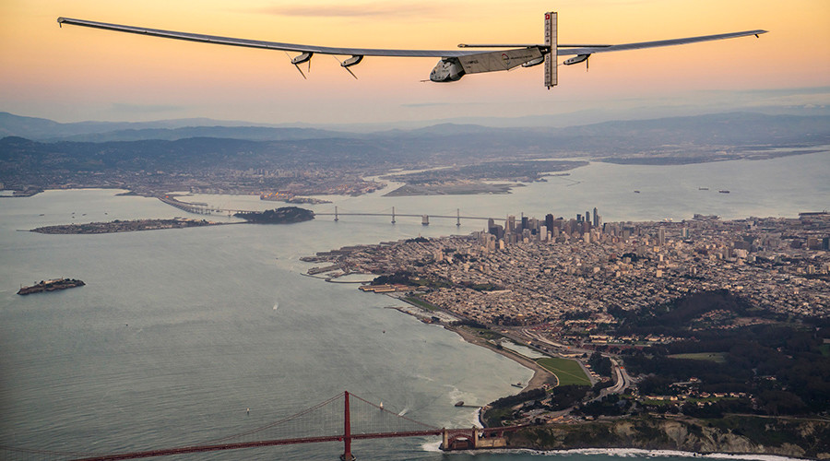
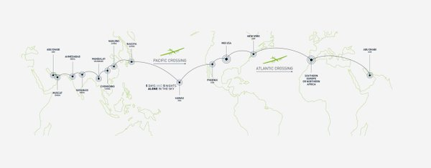
An Engineering Story 2016
Solar Pulse 2 Aircraft, 4/24/2016
http://on.rt.com/7ay4
Source: Solar Pulse, Reuters

