Slide 1
Welcome to GLOBE Weather
A New NGSS-Based Middle School Unit State University of New York
August 19-21, 2019
Notes:
We are excited to share with you this new curriculum, culminating product of a 2 year project, 5 week unit of instruction for use with middle school students.
Over the next three days we will dig in to the curriculum, hone in our understanding of weather concepts and hopefully make space to discover what questions we have about the content (maybe answer some of those questions), and introduce you to using the GLOBE program in your classroom.
Introduce ourselves
Schedule for the day: Reference agenda & resources handout, scheduled breaks, but take care of yourselves!
In your binder is the full curriculum!!! Also downloadable from the GLOBE Weather Curriculum website.
Give quick explanation of the project
Let’s become acquainted with the curriculum...

Slide 2
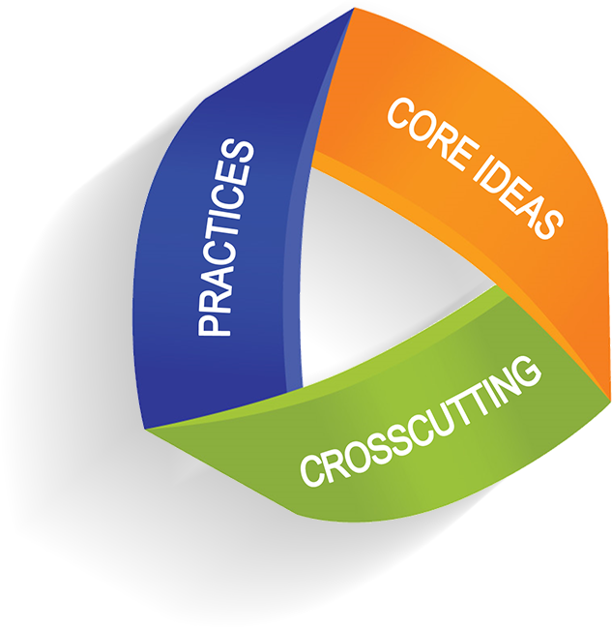
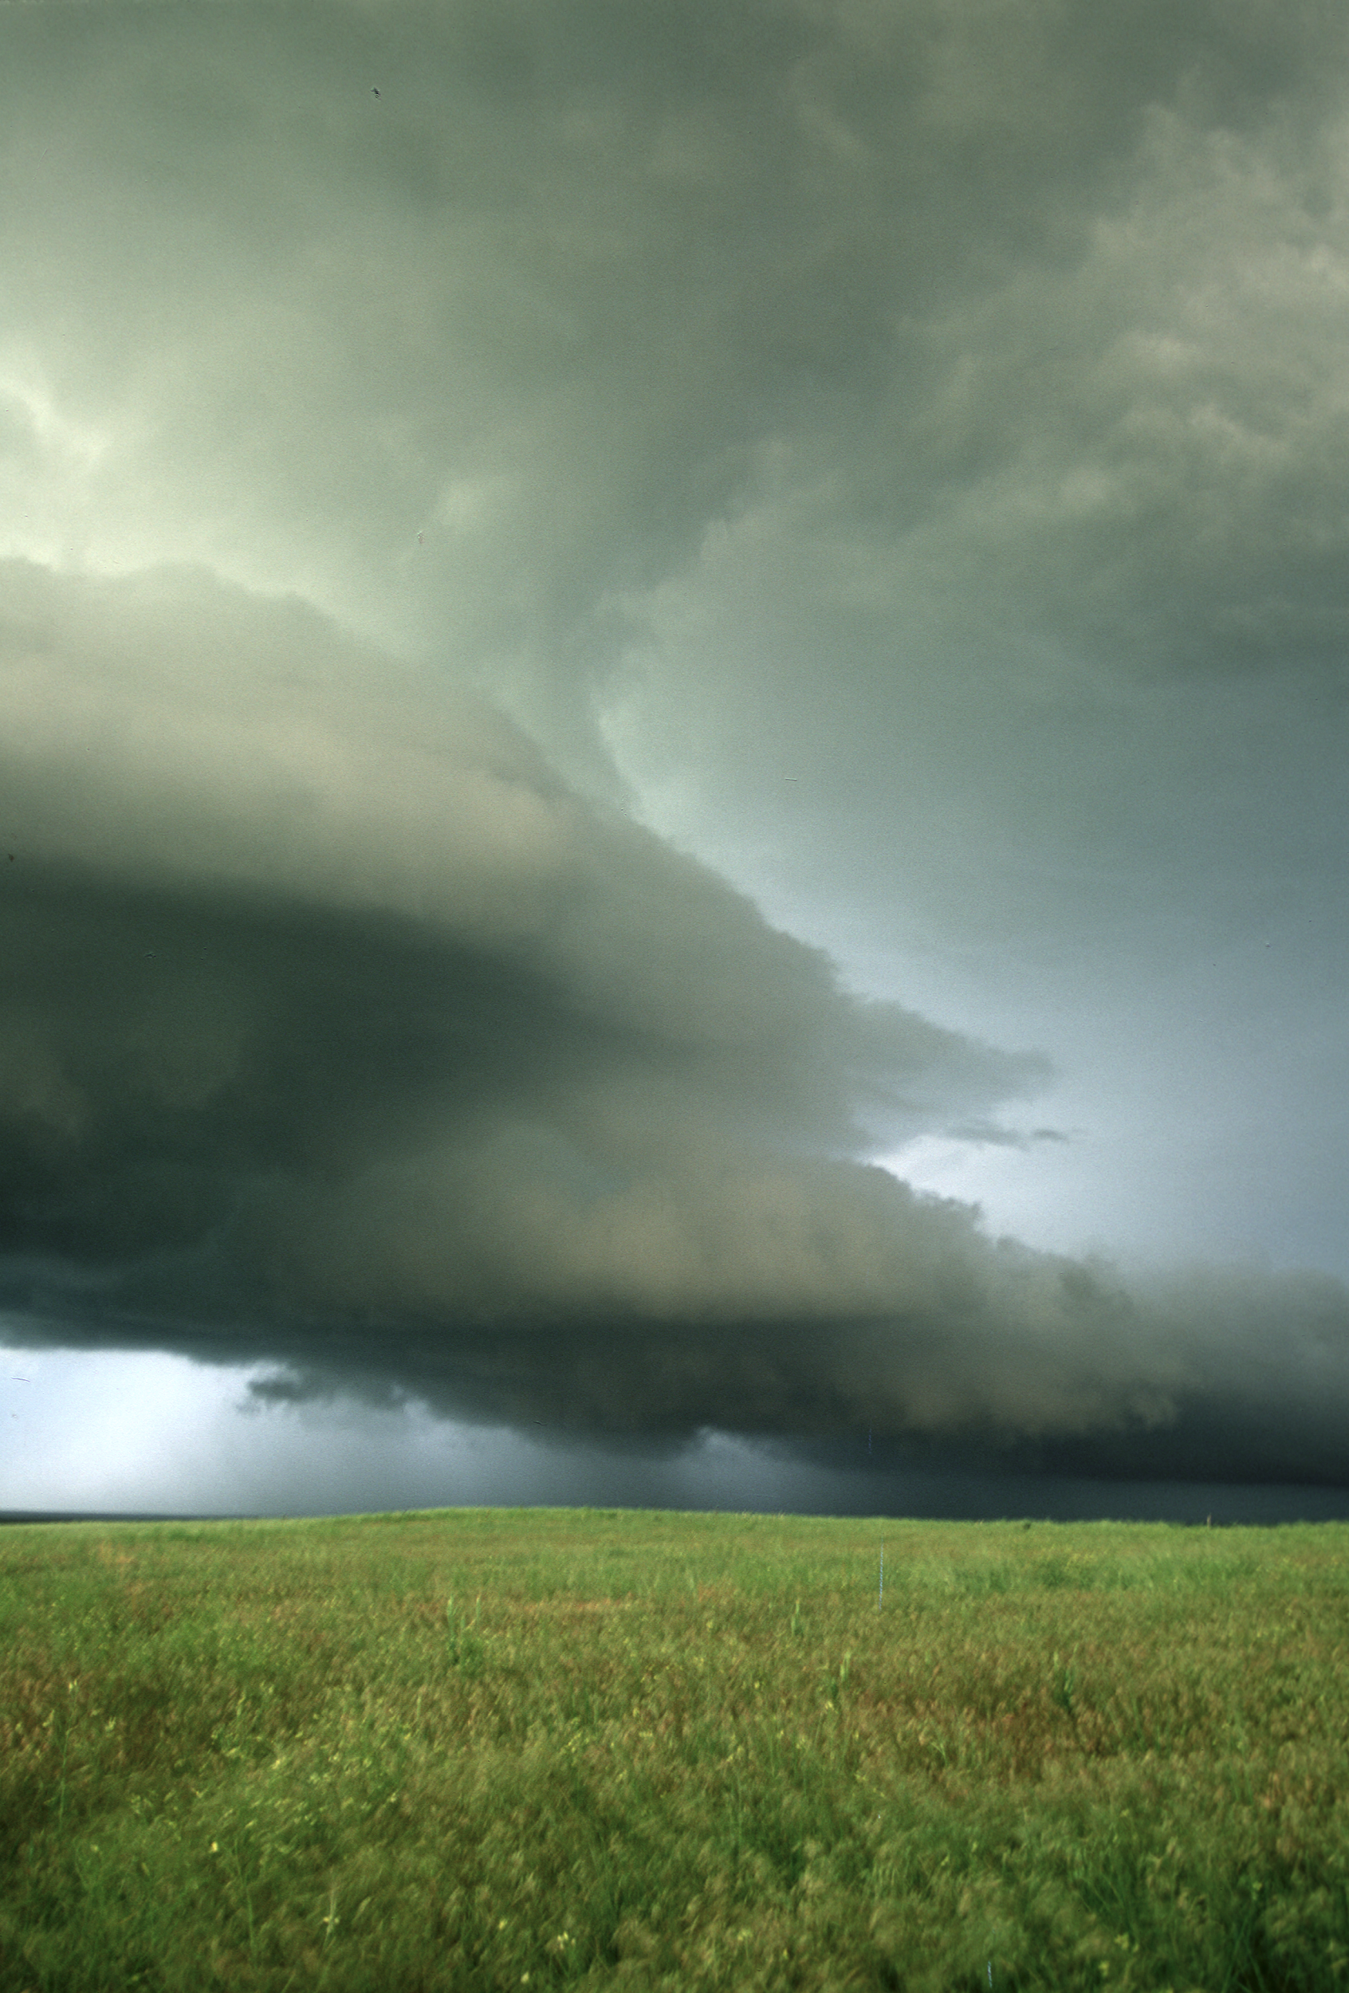
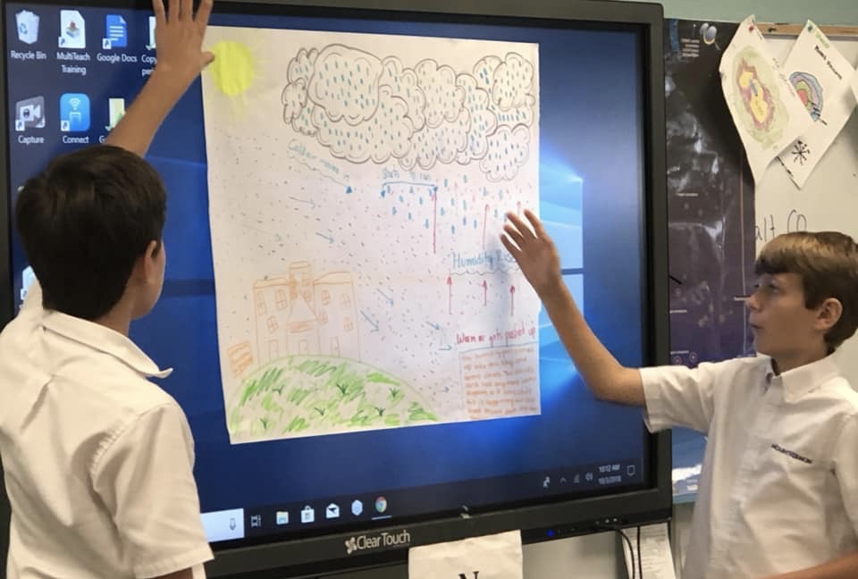
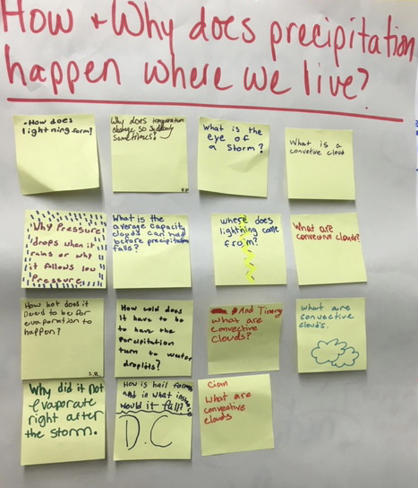
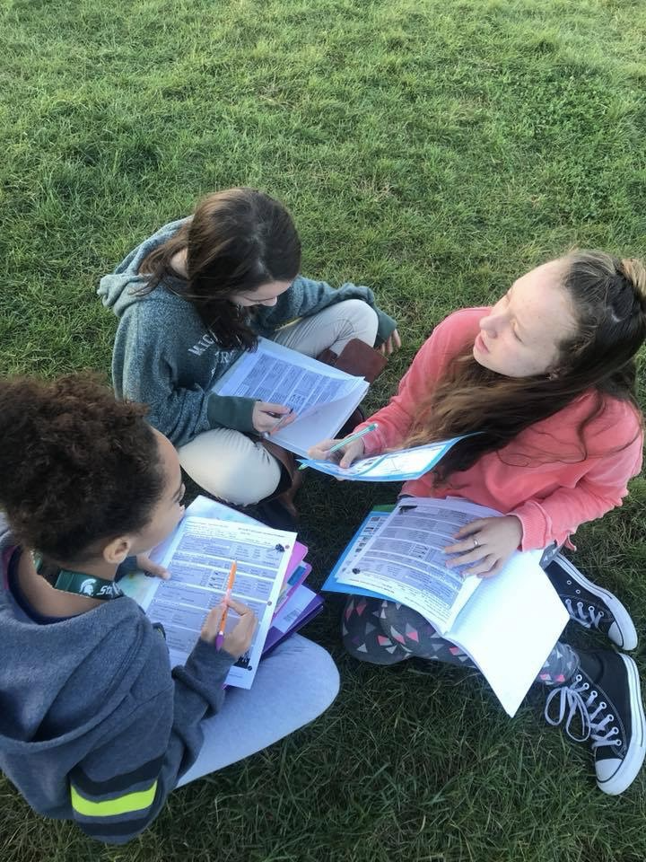
Overview of GLOBE Weather
NGSS
Storyline approach
A focus on weather phenomena
Student experiences with data analysis & modeling
Connection to the GLOBE Program
Notes:
Storyline as a way to sequence learning in a logical flow from beginning to end, connecting what we’ve just done to what we did before and to what is coming next.
ex: Before we can understand why one area has more storms than another, we need to understand how storms form in the first place, and before we can understand how storms form, we need to understand how the Sun warming the Earth moves water from the surface up into the atmosphere.
Phenomena: Surprising or interesting things students have experienced but cannot easily explain.
Data analysis: Using strategies to interpret what i see/ what it means, drawing and writing on graphs and maps.
Modeling: different types of models: working models, consensus models, tracking model ideas
Questioning: Driving questions board to track and revisit student generated questions
Connection to GLOBE: GLOBE is a NASA program, GLOBE Weather introduces teachers to using GLOBE resources to: collect weather data using GLOBE protocols, Analyze GLOBE weather data
As many states and districts are moving towards adopting NGSS, there is a growing need for curriculum that is aligned. This unit was created to meet that need.

Slide 3
Features of GLOBE Weather
Scavenger Hunt!
Can you find examples of all of these icons throughout the curriculum?
How might these features support your instruction?
Notes:
Explain how the curriculum is organized, start w overview section.
As I go through the curriculum, be on the look out for these icons
We want you to become really familiar w the curriculum, sometimes we will direct you to go to a certain part in the curriculum, but we encourage you to flip between the teacher guide and the student activity pages, etc. whenever you feel called to do so.

Slide 4
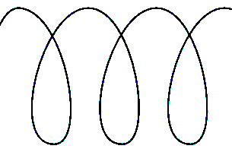
GLOBE Weather Curriculum
Anchor phenomenon
Three guided-inquiry learning sequences
Culminating task
Assessments
Snow Day?
Applying our learning to other types of storms
An Unexpected Storm
Extreme rainfall events impact a community
From Cloud to Storm
A Front Headed Your Way
Worldwide Weather
Short-lived, isolated storms
How and why storms move around the Earth
Stormy weather over a large region for many days
Notes:
Here is how the story unfolds: Change of scale, different ways that we experience weather: local, regional, global
Reference curriculum binder: organization/tabs
Mention frontmatter, background info at the beginning of each learning sequence, and assessments

Slide 5
What is inquiry?
ENGAGE: Learners are engaged collaboratively by questions
EXPLORE: Learners give priority to evidence
EXPLAIN: Learners formulate explanations from evidence
ELABORATE: Learners revise their explanations in light of alternative explanations
EVALUATE: Learners communicate and justify their proposed explanations
Notes:
We are engaging with weather phenomenon using the inquiry cycle, or 5E’s. The 5E’s are referenced at the beginning of each lesson. These align to the NGSS science practices as well, we are learning by doing what scientists do. Look at LS1 as an example (table of contents, at beginning of each lesson). By the time we get to explain, we are really looking for understanding in the way students are explaining what they are seeing.
Elements of inquiry approach to learning:
Open ended questioning vs questions with yes/no answers
Engaging students with phenomenon that don’t have one obvious answer
Empowering students to design their own methods for testing and collecting data
Providing time to share our ideas with each other, and then to go back and update/revise our ideas

Slide 6
Use text messaging or web responses like a clicker to gather real-time student responses: www.polleverywhere.com
From your laptop:
Navigate to: PollEv.com/melissarumme026
Enter your screen name
From your mobile device:
Compose a new text message to the number 22333
To join the session send the message MELISSARUMME026
Notes:
I’m wondering how many of you are familiar with NGSS, but to answer that question we are going to introduce Poll Everywhere, which we will be using throughout the workshop as a way to gather live responses.
explain Poll Everywhere
PRESENTER NOTE: be sure to log in to Poll Everywhere in advance! Must have chrome extension installed to use w/in Google slides. If using Powerpoint, might have to re-imbed poll everywhere slides for them to be active

Slide 8
NGSS https://www.nextgenscience.org/
Science and Engineering Practices:
Developing and using models
Analyzing and interpreting data
Disciplinary Core Ideas:
ESS2-C:The Roles of Water in Earth’s Surface Processes
ESS2-D: Weather and Climate
Crosscutting Concepts:
Cause and effect
Systems and systems modeling
Patterns
Performance Expectations:
MS-ESS2-5:Collect data to provide evidence for how the motions and complex interactions of air masses result in changes in weather conditions.
MS-ESS2-4: Develop a model to describe the cycling of water through Earth's systems driven by energy from the sun and the force of gravity.
MS-ESS2-6:Develop and use a model to describe how unequal heating and rotation of the Earth cause patterns of atmospheric and oceanic circulation that determine regional climates.
Notes:
Look at example of an NGSS page in the curriculum pg 36
Explain 3-Dimensional Teaching if needed
Reference SCIENCE PRACTICES HANDOUT: Other practices included in GLOBE Weather: asking questions, explaining, communicating
Any small shifts you can make in your lessons to expose students to the practices is an amazing way to increase engagement and learning
*point out strikethroughs

Slide 9
Goal setting
What do I hope to walk away with from this three day workshop?
Notes:
Write down somewhere (don’t share)
Who are your focal students?
Think of two or three students you work with who have been less engaged in science or STEM. Please describe them...you will be reflecting on how effectively this content and/or approaches would engage your focal students throughout GLOBE Weather
Our goals for you: Improve confidence in teaching weather: both in content and pedagogy, familiarity with GLOBE weather curriculum as a tool

Slide 11
Teaching the science of weather is challenging.
Processes involved are difficult to observe
The atmosphere is a chaotic system
How you experience weather is different depending on where you are on the Earth
Many unknowns, even for weather scientists!
Misconceptions are prevalent
Background knowledge required
Notes:
Show of thumbs to measure agreement with this statement: Teaching the science of weather is challenging.
Weather is challenging to teach for many of the same reasons that weather is challenging to predict!
Wear both our teacher hats and our student hats
As students grapple with complex concepts, their comfort level often goes down and they might be reluctant to share their thinking, students worry about not being “right”, about being embarrassed, etc. But research tells us how important it is for students to talk, to share ideas, as a way to deepen thinking. In order for them to do that the have to feel safe to make mistakes and take risks in the classroom. As educators, as colleagues, it’s important to be aware of how we can make this room a safe space to ask questions, explore misconceptions, to learn about weather.

Slide 12
Get to know each other
1-2-4-All
Engage everyone simultaneously in generating ideas
Each card contains a misconception (eg, is FALSE!)
1-2-4-All discussion:
Take a moment to read your card and reflect on your own.
Find a partner: take turns introducing yourself and reading your claim card aloud and have a discussion.
Options for discussion:
Why is the claim false and what should change to make it true?
Which claims/concepts do your students struggle the most with?
Which concepts are most challenging to teach, and why?
Form a group of four; repeat.
Notes:
Pass out misconception cards, one to each person
Many adults hold misconceptions about weather, if it’s challenging for adults it’s highly likely that students might struggle as well.
Take this opportunity to introduce yourselves to each other, perhaps say something about your background, and reflect on some of the more challenging weather concepts and your experiences teaching weather. What concepts to students struggle with? What concepts do you find challenging to explain or that you would like more support around?
Have everyone go around and introduce yourself before beginning to discuss, in case time runs out I at least want everyone to meet.
Use the misconception cards to guide your discussion with each other.
1 minute: 2 minutes: 4 minutes: then all discussion
GLOBE Weather points out places to look for student misconceptions

Slide 13
An Unexpected Storm
What do we know about storms?
© 2019 University Corporation for Atmospheric Research. All Rights Reserved
Notes:
Introduce Anchor
“Severe weather can put people’s lives and property at risk. If we can predict when severe weather is likely to happen, we can help people be better prepared when it happens. In this unit, we are going to explore where, when, and why storms form and how we can predict the ways in which they might impact communities, especially by bringing heavy rain or snow.”
Introduce the CO storm:
2013 there was an unusual storm that lasted for 7 days, dropping over 15 inches of rain, causing about $2 billion worth of damages.

Slide 14
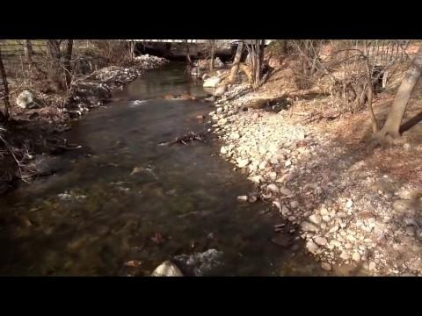
An Unexpected Storm
STEP 1:
What happens in the atmosphere to cause a storm?
https://scied.ucar.edu/boulder-floods
Notes:
Watch video
Discussion: us using Talk Moves checklist questioning when applicable. Record ideas on chart paper
Have teachers take out sentence stems half sheet
With our first group share-out, I’d like us to try using the Sentence stems as a way to support discussion with our students, which they will be doing a lot of in GLOBE Weather. (Questioning/Discussing/Argumentation are science practices!)
Prompts:
What did you hear in the video about the causes of the precipitation?
Where did all the moisture over CO come from?
What had to happen to make that moisture turn into rain?
Make sure to focus on what caused the rainstorm (not the flood). “Is that a cause of the storm or an effect from the storm?”

Slide 15
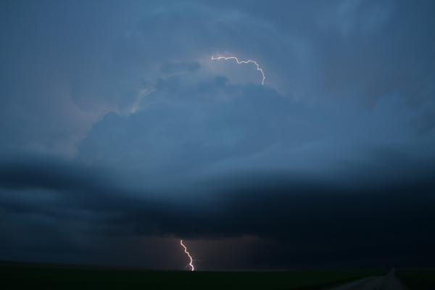
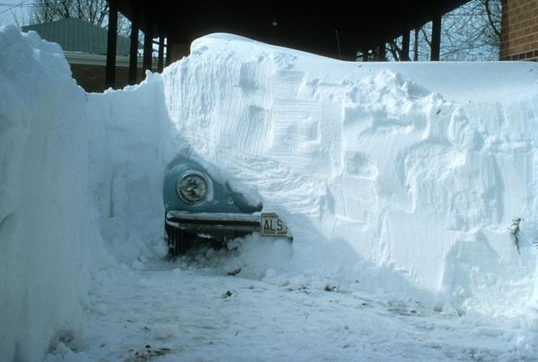
An Unexpected Storm
STEP 2: What are my experiences with storms?
Notes:
Think about a storm you have experienced and would like to share about.
2 minutes to share storm experiences with a partner
Whole class discussion:
Ask for teachers to share what they heard from their partners.
Have teachers take out sentence stems half sheet
Prompts:
How do storms begin in the first place?
What needs to happen so that rain or snow starts to fall?
Why do some places get heavier precipitation but other places do not?
Where does all the water come from before it falls as rain or snow?
Focus on water cycle, record ideas on chart paper from before

Slide 16
An Unexpected Storm
STEP 3: Represent what you know about storms
What caused the rain in the Colorado storm?
Notes:
Pass out Lesson 1: Step 3 SAS
Draw & label a picture in the box on your SAS. Your picture is a model of how this storm happened.
Your picture should show all of the factors that led to rain.
Include labels in your drawing that explain how each factor led to rain.
Share models with others at your table, comparing/contrasting with each other. One person from each group report the the whole group about trends from their models.
***This type of model development is a consistent feature of GLOBE Weather***

Slide 17
Inquiry and Productive Talk
For inquiry to work, students must engage in productive talk, or talk that extends our thinking.
How can we support productive talk in our classrooms?
Notes:
In order for inquiry to work, we must have a culture of talk in our classroom (asking questions, explaining, revising our thinking, sharing our thinking with others…).
But how do we get students to use their talk time to deepen thinking? We all know kids will talk with their friends forever, but we want them to be talking about their learning, which means we have to structure the way we engage students in talking so we can cultivate a culture in our classroom that supports productive talk, or talk that extends our thinking.
Open up the PRIMER, go through the list of 7 things to support productive talk. Point out Checklist of Talk Moves, Sentence stems as tools for productive talk.
What are your thoughts about the PRIMER (which ones speak to you or intrigue you?) What have your experiences been? What questions do you have?
GLOBE Weather is structured around having lots of student discussion. We are attending to this piece now because rich conversations that push students to think deeper don’t just magically happen. We have to teach students how to talk to each other in an academic way, to disagree, to challenge each other.
During activities time you all will get a chance to practice being inquiry coaches, and practice engaging in productive talk. You can use the checklist and sentence stems.

Slide 18
An alarming statistic!
A review of research on student discussion revealed that its use in middle and high school classrooms varied from only 14 to 68 seconds per class period.
(Wilkinson & Nelson 2013)
Notes:
Make time for students to share their ideas! Activating the speaking part of our brains helps with memory & retention. Students should be talking way more than the teacher!
Try to warm yourself to the idea that a noisy classroom is one in which learning can happen!

Slide 19
Break (10min)
Please download the free GLOBE Observer app on your mobile device and create an account to participate in cloud data collection today after lunch.
Learn more about GLOBE Observer at: https://observer.globe.gov

Slide 20
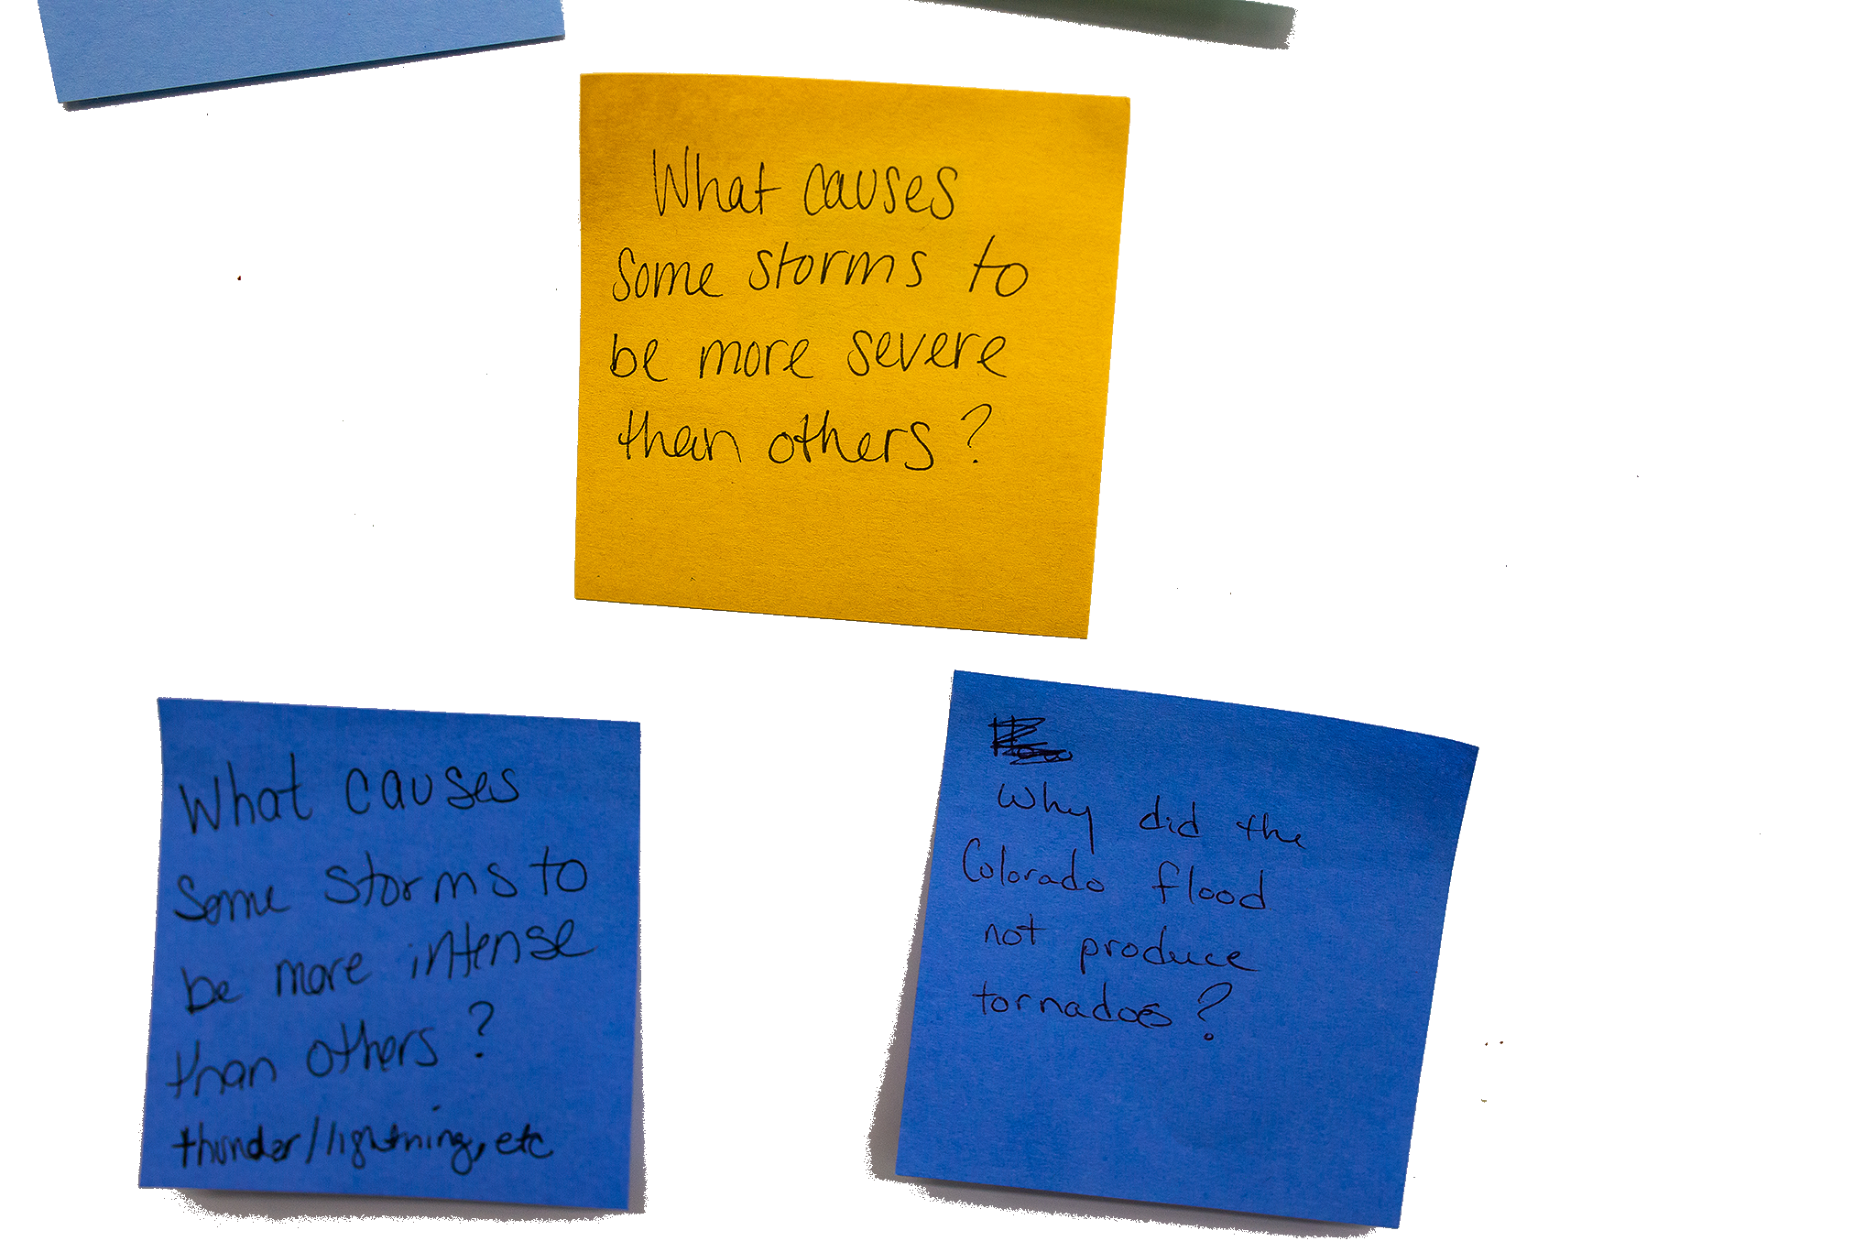
DRIVING QUESTION BOARD
This is where the students post their questions and where students return to answer their questions throughout the unit.
Unit Driving Question:
What causes different kinds of storms?
Notes:
By the end of the unit, students should be able to answer the driving question, but they also likely have their own questions. And perhaps you have some questions that have started to come up as well. We don’t want to lose track of these questions, so we will track them on our DQB
Write unit driving question across top of the driving question board: What causes different kinds of storms?
Write questions on your own related to “What causes different kinds of storm?” and the Anchoring Phenomenon (Colorado Storm) on the post-it notes provided at your table. Write one question per post it!
Form “Scientist Semi-circle” and take turns reading/posting questions to the DQB. After a question is added, ask if anyone else has the same question or a related question. Group like questions together.
Chart papers hanging on wall, divided into 4 sections: LS1, LS2, LS3, Other. As question is read out, we decide which section the question should be posted in

Slide 21
From Cloud to Storm
LEARNING SEQUENCE 1
What causes an isolated storm?
© 2019 University Corporation for Atmospheric Research. All Rights Reserved
Notes:
Introduce Learning Sequence 1
We begin to investigate what causes a storm to form and first consider isolated storms, which are localized, short lived storms.

Slide 22
What are the important pieces to put in place to understand how storms form?
Notes:
Have them discuss with a partner, maybe write out as a list:
What do you think are the important pieces to put in place to understand how a storm forms?

Slide 23
Science Talk
Notes:
Clouds & Convection video
There will be a quiz at the end!!
Ask if there are questions after video finishes playing, then go into Poll Everywhere quiz questions

Slide 24
Notes:
All of the above

Slide 25
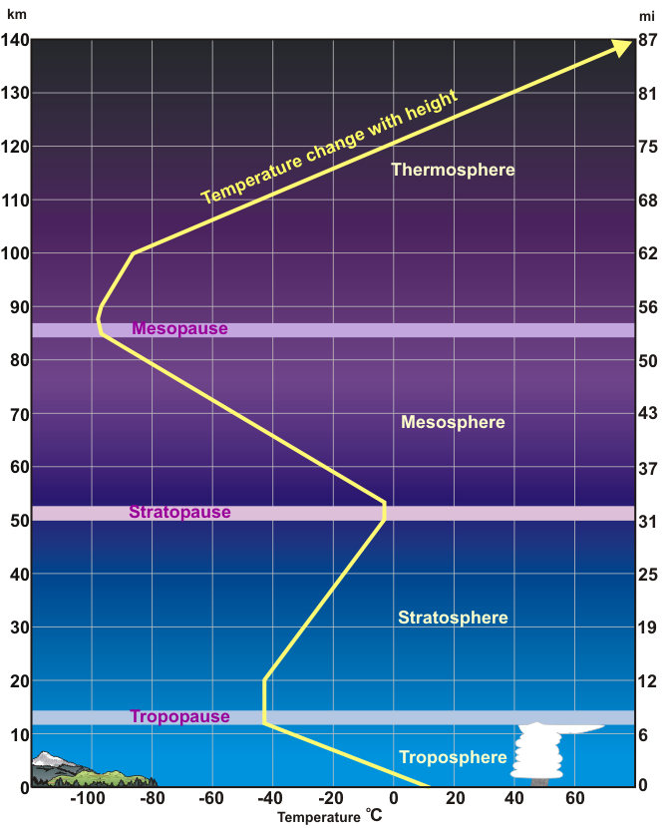
Cooling air temperature
Temperature cools with altitude in the troposphere.
NOAA - NWS

Slide 26
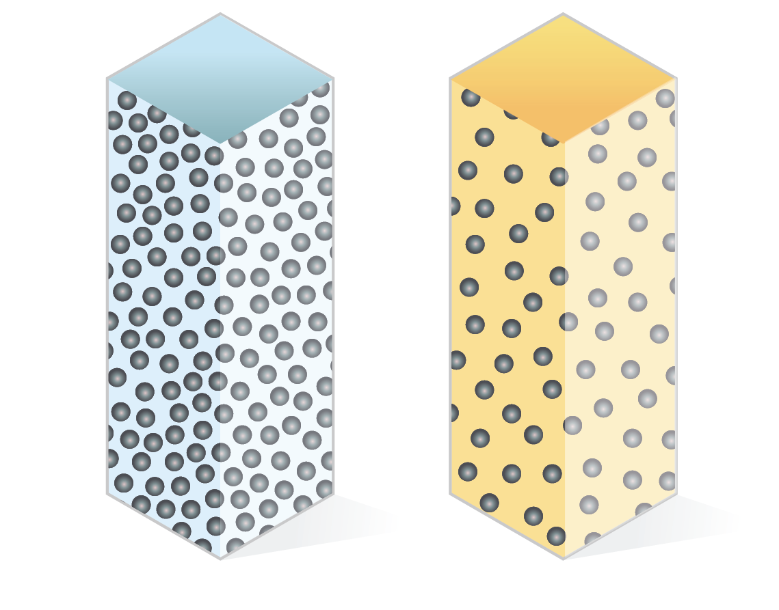
As air at the surface warms, molecules spread apart. The warmed air has lower pressure.
Cold Air
Warm Air
Notes:
And of course we must also have water/humidity because clouds are made of water!

Slide 27
Notes:
Both A & B

Slide 28
Low Air Pressure
Molecules are spread out.
Less moisture can fit.
High Air Pressure
Molecules are packed together.
More moisture can fit.
Notes:
More molecues= more moisture= more pressure
Less molecules= less moisture= less pressure
Because water is a polar molecule (one end positive, one end negative), water molecules attract to each other and “stick together”. In higher pressure where the molecules are closer together, more water molecules can fit together in the area due to the attractive forces.

Slide 29
Notes:
Convection

Slide 30
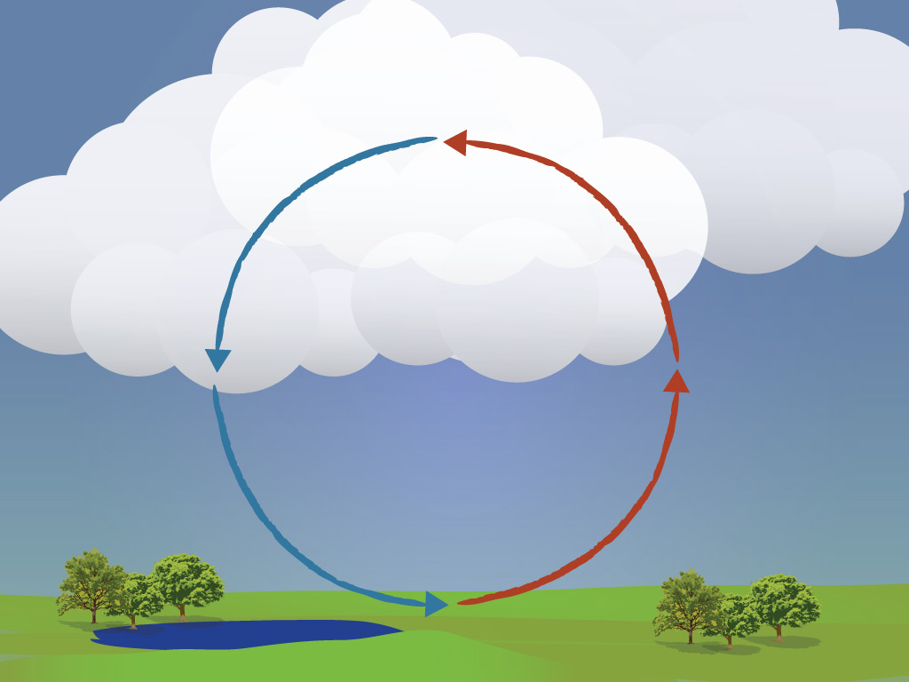
CONVECTION

Slide 31
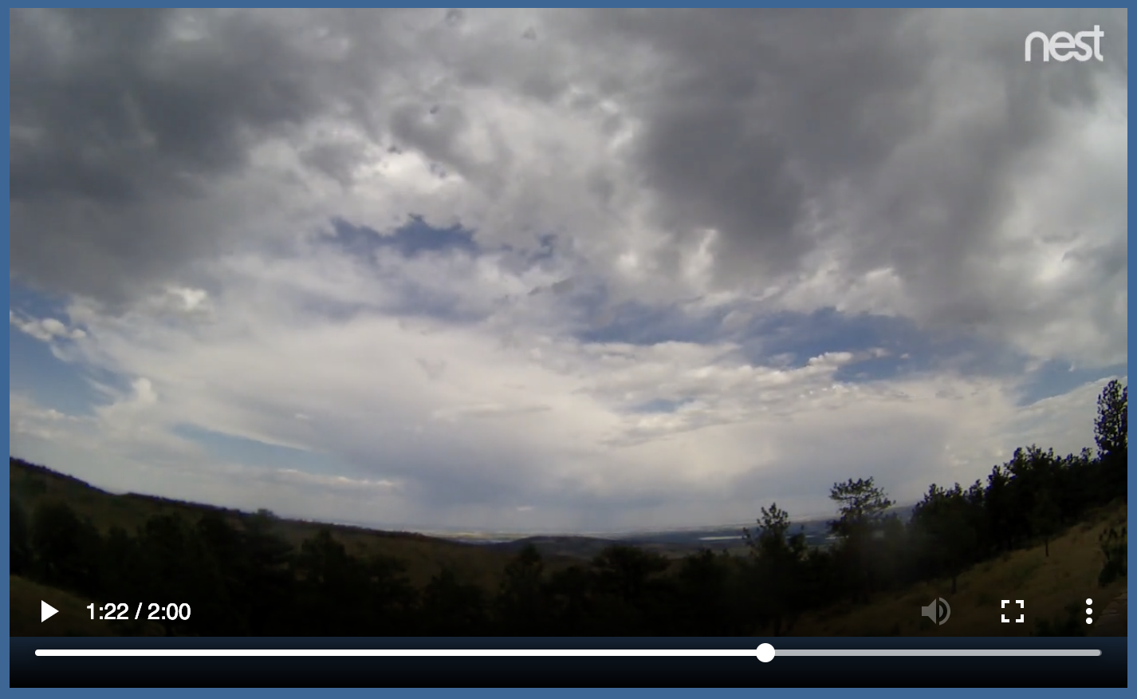
Watching the Sky
What we can learn about storms by watching clouds in the sky?
Students watch time lapse videos of a sunny day & a stormy day
Notes:
Let’s get back to our curriculum to see how students will explore these topics (and how you will explore them in just a few minutes!)
We first understand the weather by what we observe in the sky
Watch time lapse video to see that storms form throughout the day, and typically happen in the afternoon

Slide 32
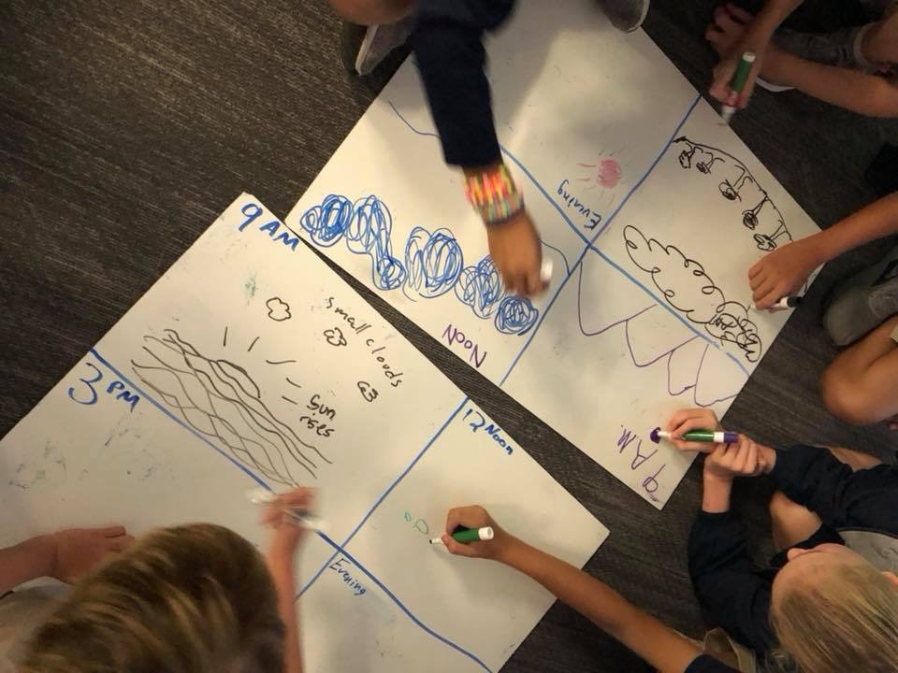
Watching the Sky
Students construct a time series diagram showing how an isolated storm forms throughout the day.
Notes:
We organize our thinking around what happened throughout the day when a storm formed by making a time series diagram.

Slide 33
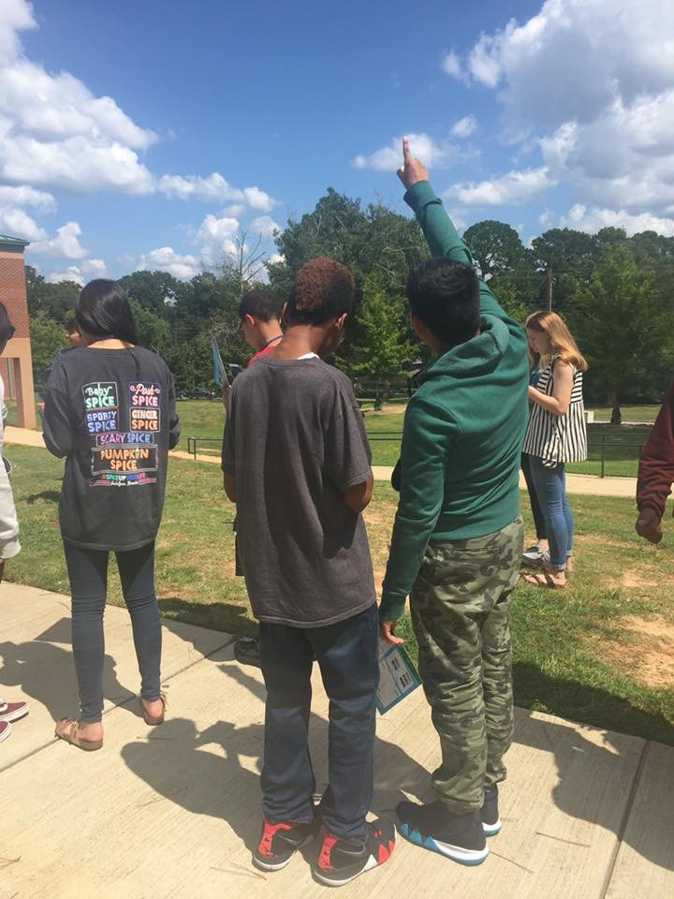
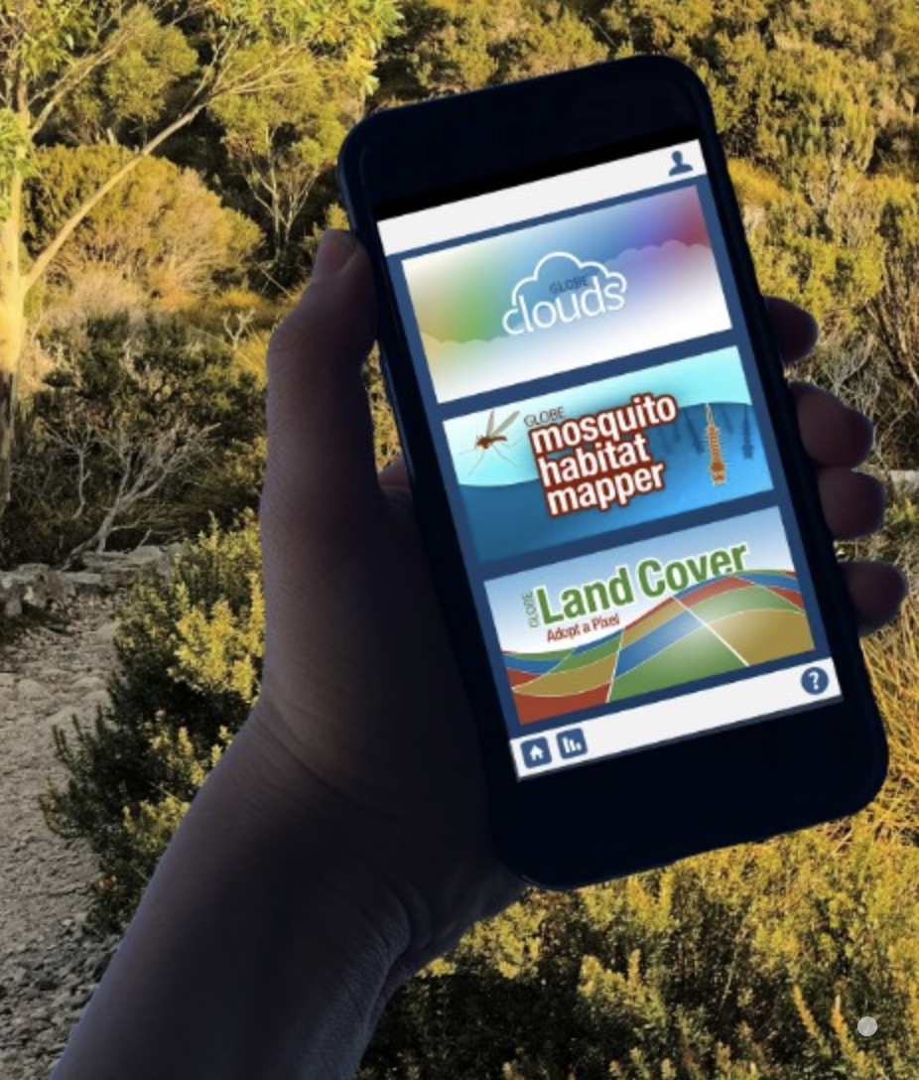
Watching the Sky
Students observe clouds outside
An opportunity to use GLOBE protocols to
collect data as a citizen scientist
Notes:
We go outside to make cloud observations

Slide 34
How does temperature relate to cloud formation?
How does the Sun warm the atmosphere?
How does surface temperature compare to air temperature?
How does temperature change as you increase in altitude?
Notes:
Now that have made the connection between clouds and storms, we naturally consider what processes are responsible for clouds to form, and to do so we must start by investigating temperature. Lesson 3 helps students puzzle through how water from the ground ends up as clouds in the atmosphere:
This is where some of the common misconceptions about weather start to come up.
Understanding of the water cycle is important
Understanding why water evaporates, where the source of heat comes from
Understanding how the air is warmed
Understanding trends in air temp
Understanding how temperature related to clouds forming

Slide 35
Predict
Step 1: Use the temperature near the ground to predict the other temperatures.
How would temperature change as a weather balloon traveled from the ground to the clouds?
Where would it be warmer or cooler?
°C
°C
°C
21° C
Notes:
Students make predictions of how temperature changes from the surface to altitudes where clouds form

Slide 36
Virtual Weather Balloon Simulation
https://scied.ucar.edu/virtual-ballooning
Notes:
And use a Virtual Weather Balloon Simulation to collect data about how temperature changes with altitude

Slide 37
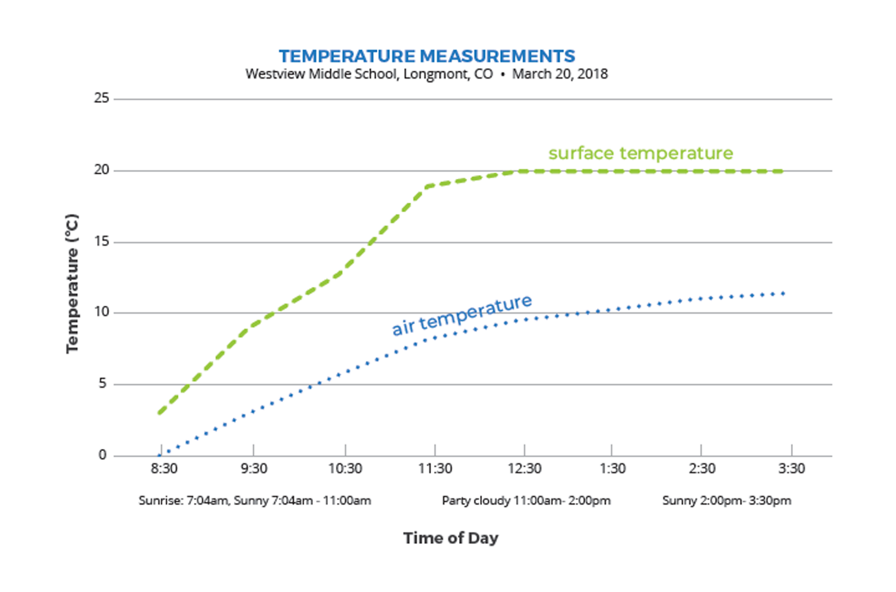
Investigation: Westview Middle School Data
Notes:
Next students use data to compare surface temperature and air temperature, If doing the GLOBE Surface Temperature and Air Temperature protocols your students, like we did outside today, would collect their own data and make a graph of that.
They use the Identify and Interpret (I²) Sensemaking Strategy to analyze and interpret the graphed data, which you will practice doing in a few moments
Westview Middle School DATA SET (if questions about where the data come from)
Middle school students in Longmont, Colorado wanted to know how the ground temperature (surface temperature) compared to air temperature. They measured both temperatures over a school day. Their surface temperature data were measured on their school track and their air temperature thermometer was located on the school roof. The students agreed these two surfaces were the most similar, which is why they selected the school track for their surface temperature location. They measured both temperatures every hour during the school day. They also made observations of cloud cover.

Slide 38
Activities Exploration: Lessons 2 & 3
Try out each of the activities wearing your “student hat” first
Refer to your Teacher Guide to begin thinking about how you would facilitate with students
Work together, discuss with each other!
Teacher coaches will practice using prompts and Talk Moves
Notes:
Pass out Lesson 2 & 3 SAS packet
Explain briefly how the stations will work
Ask for volunteers for who would like to try being the coaches first, call them over to brief them quickly once you release the others. Give them the coaching prompts and Talk Moves checklist on a clipboard

Slide 39
Lunch Break- be back at 12:55pm

Slide 40
The GLOBE Program: Global Learning and Observations to Benefit the Environment
Examples of GLOBE Protocols:
Atmosphere - air temperature, precipitation, clouds
Hydrosphere - temperature, pH, mosquito habitats
Soils/Pedosphere - soil moisture, temperature, characterization
Biosphere - green up/down, land cover, fire fuel, carbon cycle
How to participate:
Protocol eTrainings
GLOBE Observer
Notes:
Vision: A worldwide community of students, teachers, scientists, and citizens working together to better understand, sustain, and improve Earth’s environment at local, regional, and global scales.
Mission: To promote the teaching and learning of science, enhance environmental literacy and stewardship, and promote scientific discovery.
Outside for Cloud/Sky Observations (app + paper data sheet) and surface temperature measurements

Slide 41
Make a model
Step 5: Make a model of how sunlight warms the atmosphere.
Your model should explain:
How surface temperature is related to the sunlight
How air temperature is related to surface temperature
How the air temperature changes from the ground to higher altitudes
How you know the above three things using evidence from temperature data
Notes:
Pass out Lesson 3: Step 5 of the Student Activity Sheet (pg 12)
Introduce the Working Model for explaining temperature patterns. In Lesson 3: Step 5, students will develop a Working Model of surface heating to explain temperature patterns, with the ground surface having the warmest temperatures and temperature decreasing with altitude. This is a Working Model because it’s a work in progress and does not capture a complete representation of the system, only part of the system.
Draw and label a Working Model individually. The question their models are trying to answer: “Why does the surface temperature warm over the day, and why is the surface warmer than the air above it?” Their models should describe connections between sunlight heating Earth’s surface and the temperature pattern they’ve observed, particularly why the surface is warmer than the air above it.

Slide 42
Get feedback on your model
Share-Trade:
Share your model with a partner. Ask clarifying questions of each other. Be prepared to explain your partners model to others.
Trade papers
Find a new partner and repeat the sharing.
Revise your own model based on feedback from your discussions.
Notes:
Share and revise Working Models using Share-Trade.
*Tell them to put their names on their own papers so they can be returned after trading!
Discuss Working Models in whole group discussion. Share how they represented different parts of the model and allow time to debate how they want to represent those parts as a class.
What common ideas are we finding in our models?
Suggested prompts for discussion:
Why do we think surface temperature is warmer than the air temperature above it?
How is the warm air moving? Does this match our temperature pattern?
What’s happening to the air molecules when they are heated near the surface?

Slide 43
Model Idea Tracker
What ideas do we agree should be added to the Model Idea Tracker?
The Model Idea Tracker is used to record consensus ideas that help explain a phenomenon. These ideas are generated by students and agreed upon as a class.
Notes:
The Idea Tracker will be built upon throughout the entire unit. These ideas are important understandings that we uncover as the story unfolds!
Ask teachers to suggest big ideas so far to include on the Model Idea tracker. Bring over any ideas from the list about the Colorado storm
Make a list on chart paper:
Evaporation of water at the surface is important for clouds/storms
Evaporation happens because of heating from sunlight
Clouds form when water condenses
The surface is warmer than the air above it
Air near the surface is warmer than air where clouds form

Slide 44
Sensemaking
How are you/focal student connecting
with the content?
Did any new ideas come up for you? How could these activities fit in to what you already do and extend them?
What are you wondering about now?
Where would your focal student get stuck?
What misconceptions do they (we) hold?
What challenges come up for you?
Notes:
Group share out
explain the Thinking Routine (connect-extend-challenge)
use sentence stems

Slide 45
Break (10 min)

Slide 46
Why are there storms on some days but not others?
Notes:
What is different about a sunny day and a stormy day?

Slide 47
Science Talk
Notes:
moisture in the atmosphere

Slide 48
Notes:
Dewpoint - temperature to which air is cooled to reach saturation
When air is saturated, humidity is 100% (rate of evaporation = rate of condensation)
At saturation, air temperature is the same as the dewpoint.
Saturation can result in fog, clouds, and possibly precipitation.

Slide 49
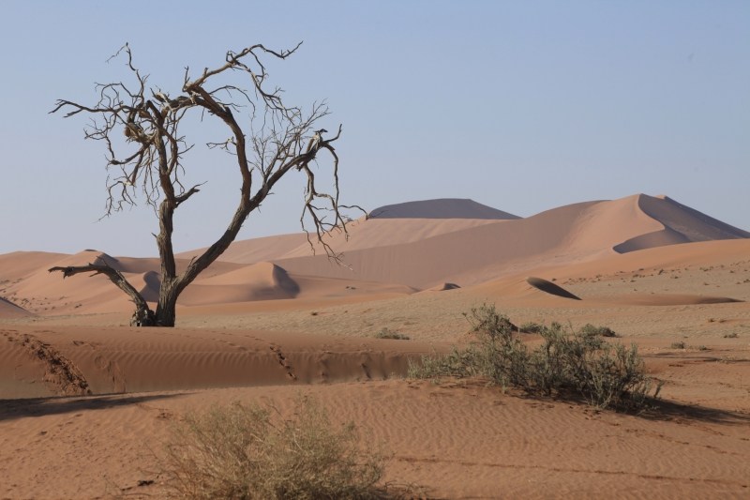
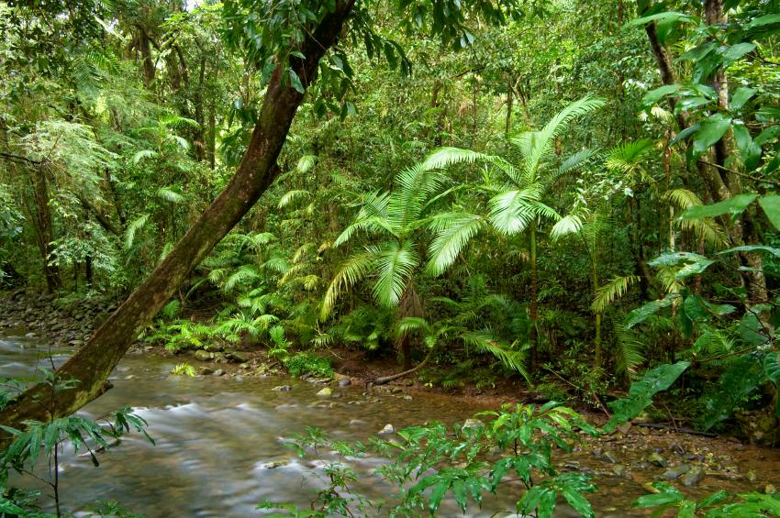
Dewpoint Temperature & Saturation
Dewpoint - temperature to which air is cooled to reach saturation
When air is saturated, humidity is 100% (rate of evaporation = rate of condensation)
At saturation, air temperature is the same as the dewpoint.
Saturation can result in fog, clouds, and possibly precipitation.
Low Humidity
High Humidity

Slide 50
Notes:
R

Slide 51
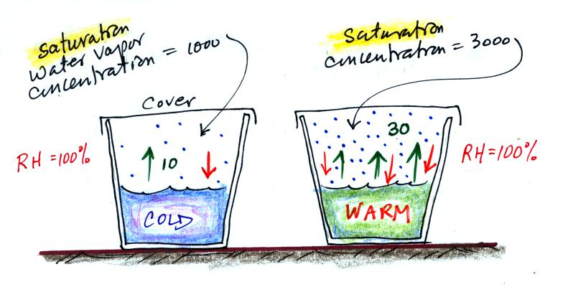
Notes:
The air is saturated in both glasses but there is more water vapor in the warm glass, because warm air can hold more moisture than cold air. So, relative humidity takes temperature into account, whereas absolute humidity is just the total amount of moisture.
Green arrows → evaporation
Red arrows → condensation

Slide 52
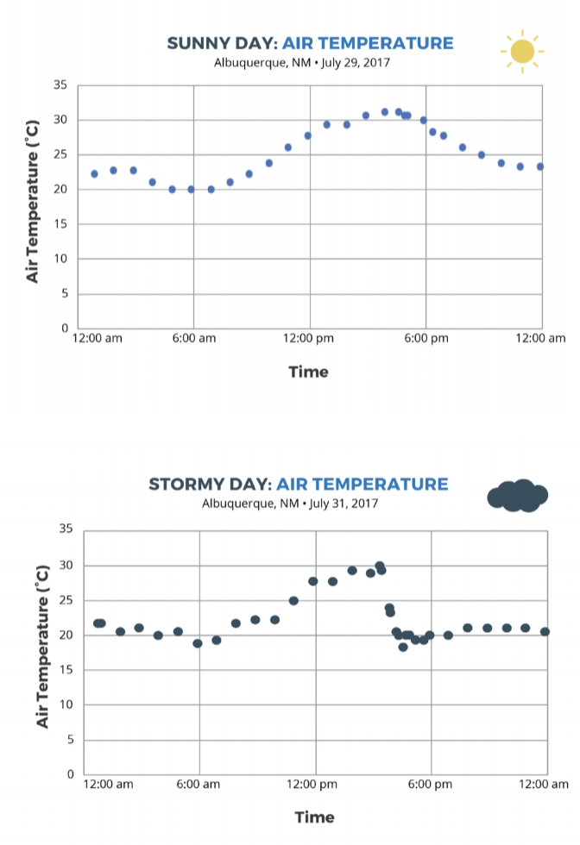
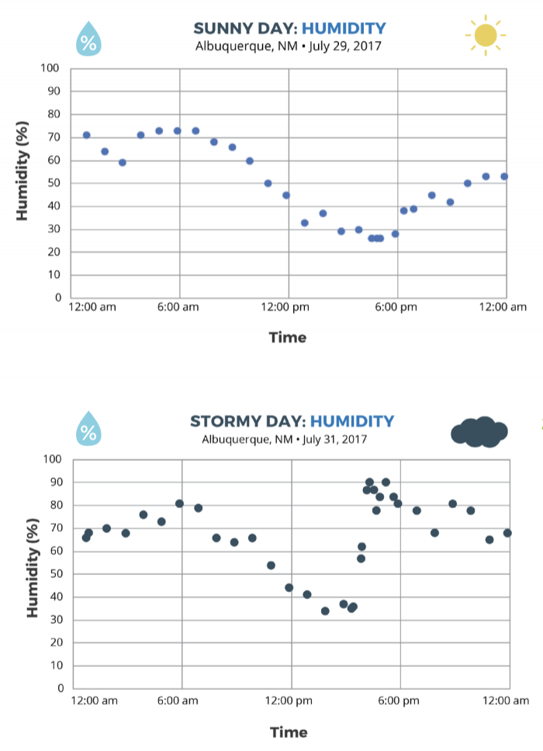
Comparing a sunny day and a stormy day
Notes:
Pass out Lesson 4 & 5 SAS packet; go through activities
What is different about a stormy day vs a sunny day?
Comparing air temperature and adding in HUMIDITY

Slide 53
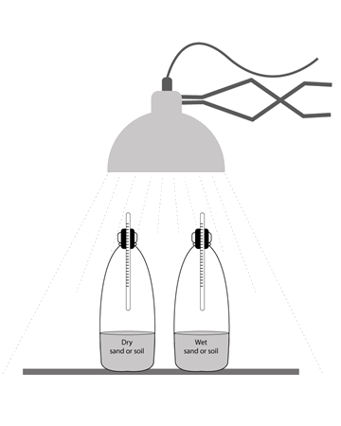
Investigation: Storm in a Bottle
Step 3: Make a storm in a bottle.
Using what you know about temperature and relative humidity, create a model of a sunny day and stormy day using clear bottles with different contents.
Notes:
What conditions are needed for a storm to form?
-We learn that a source of moisture, or humidity is needed (moist air mass, body of water, etc)

Slide 54
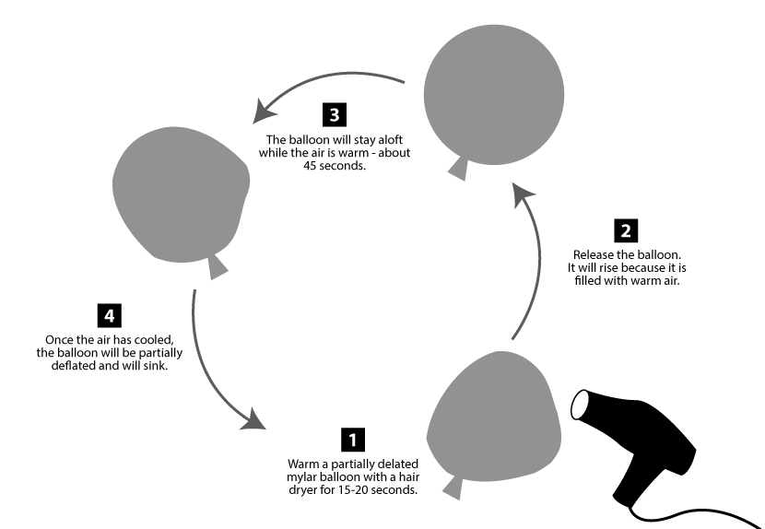
Investigation: Mylar Balloon
Step 1: Observe warmed and cooled air.
https://scied.ucar.edu/warming-mylar-balloon
Notes:
Why does warm air rise and cool air sink? Most students can recall that warm air rises, but why?

Slide 55
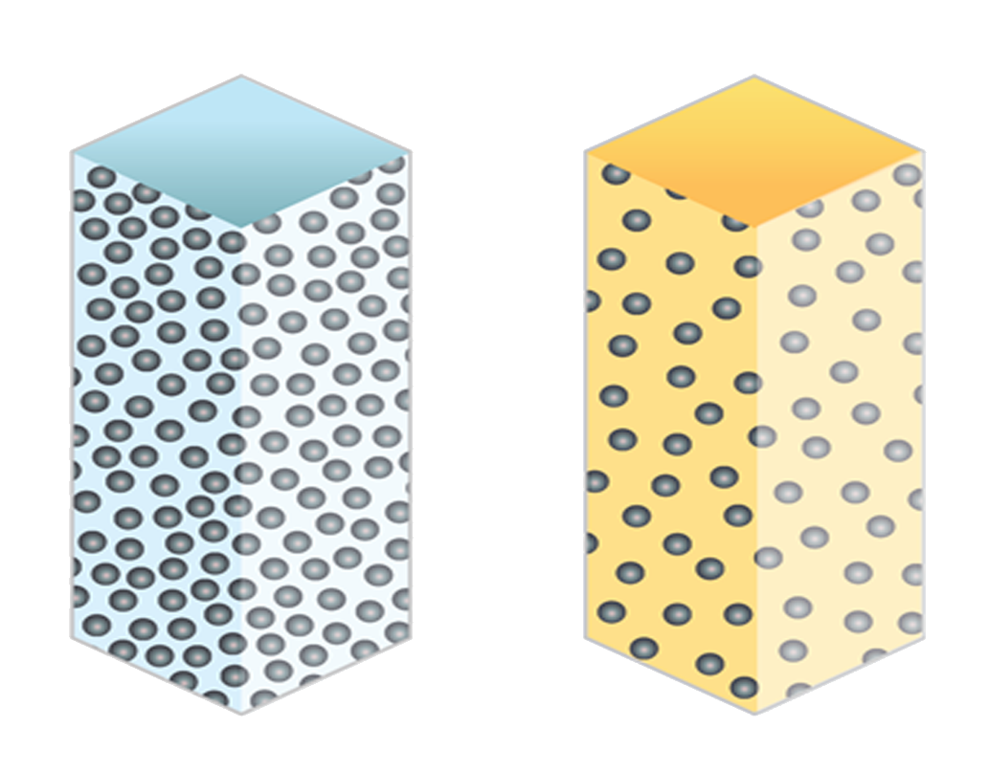
Interactive Reading
Step 2: Air on the Move
Read about the differences between cold and warm air.
Draw a diagram of 20 air molecules inside the mylar balloon when they are warmed and when they are cooler.
Cold Air
Warm Air
Notes:
To explain why warm air rises and cool air sinks:
Density differences between warm & cool air

Slide 56
Interactive Reading
Step 2: Air on the Move
Read about how gravity affects air molecules.
Draw air molecules between the planet and the top of the atmosphere.
Notes:
We read about how gravity affects air molecules, which creates pressure differences at the surface and higher up in the troposphere

Slide 57
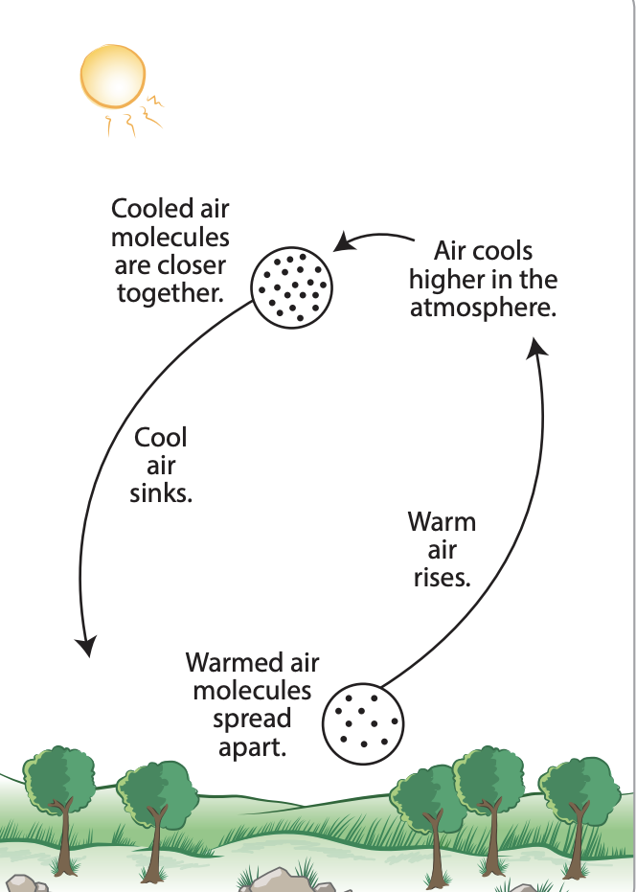
Step 2: Air on the Move (continued)
Putting it all together to explain the cycle of rising of warm air and the falling of cold air, called convection.
Notes:
Students put all that together to describe convection.
What is the story of an air molecule as moves, rising and falling, in the atmosphere?

Slide 58
Simulation: Make a Thunderstorm
https://scied.ucar.edu/make-thunderstorm
Notes:
We apply our learnings about the conditions needed for a storm to form with the Make a Thunderstorm simulation.

Slide 59
Activities Exploration: Lessons 4 & 5
Try out each of the activities wearing your “student hat” first
Refer to your Teacher Guide to begin thinking about how you would facilitate with students
Work together, discuss with each other!
Teacher coaches will practice using prompts and Talk Moves
Notes:
Explain briefly how the stations will work; assign teacher coaches and instruct them

Slide 60
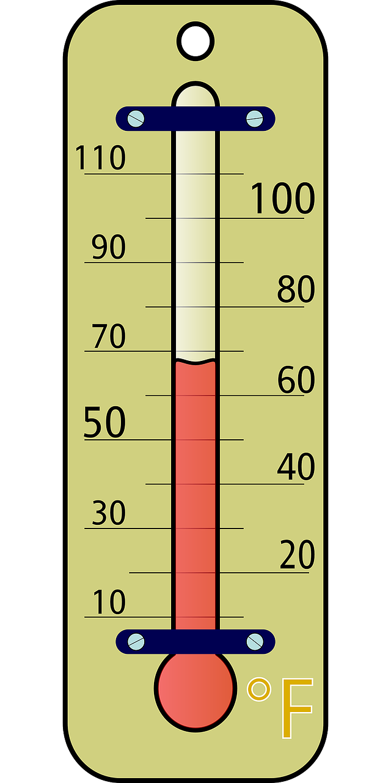
How are you feeling?
Notes:
To wrap up today… let’s take our temperature. What’s coming up for you? How are you feeling about the day? What are you wondering about?

Slide 61
end of Day 1 slides
Notes:
add word cloud from this morning to Day 3

Slide 62
Welcome to Day 2
GLOBE Weather
Notes:
Point out agendas for today

Slide 63
Looking Back:
How does energy from the Sun lead to warming of the atmosphere?
How do clouds form?
How does an isolated storm form throughout the day?
Notes:
Big ideas from yesterday...

Slide 64
Current questions:
What is different about a stormy day and a sunny day?
Why does warm air go up and cool air go down?
What are the perfect conditions to make a storm?

Slide 65
Continue Activities Exploration: Lessons 4 & 5
Try out each of the activities wearing your “student hat” first
Refer to your Teacher Guide to begin thinking about how you would facilitate with students
Work together, discuss with each other!
Teacher coaches will practice using prompts and Talk Moves
Notes:
Explain briefly how the stations will work; assign teacher coaches and instruct them

Slide 66
Step 3: Create a Model to describe how precipitation happens in an isolated storm
Draw and write in the illustration. Your model should explain:
•What happens to energy from the Sun that leads to the isolated storm?
•What happens to water at the surface and clouds that lead to the isolated storm?
•How air temperature and humidity change as air moves from the ground to the clouds?
•How air moves between the ground and where the storm forms?
Notes:
Step 3 (pg 22) of Student Activity Sheet, make a working model to track your own thinking thus far
Refer to lessons 3,4 & 5
Look at Model Idea tracker for ideas
Think of your model as telling the story of the isolated storm

Slide 67
Model Idea Tracker
What ideas do we agree should be added to the Model Idea Tracker?
Notes:
What ideas should we now add to our Model Idea tracker?
Evaporation of water at the surface is important for clouds/storms
Evaporation happens because of heating from sunlight
Clouds form when water condenses
The surface is warmer than the air above it
Air near the surface is warmer than air where clouds form
Rising temperature and rising humidity are good conditions for a storm to form
A source of humidity/moisture is needed to have a stormy day
Warm air rises and cool air sinks
Warm air can take in more water vapor than cool air

Slide 68
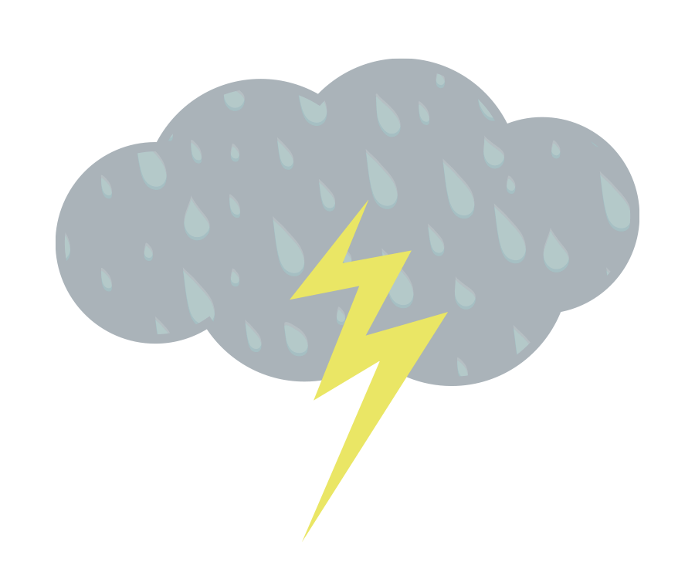
Make a Consensus Model
What has to happen for an isolated storm to form?
•Share ideas from student models from Step 3.
•Draw a Consensus Model for the class, using ideas from student models.
•Use data or other evidence from our investigations to support the ideas added
to the Consensus Model.
Notes:
Using your working models, discuss and agree upon ideas as a group to create a consensus model
Reference Model idea tracker
(if time, revise working models)
The revisions don’t have to reflect the consensus model exactly, but should be in a way that makes sense to you.

Slide 71
Notes:
do not do this as a poll everywhere….just wanted to show the graph. Insert just the graph?

Slide 72
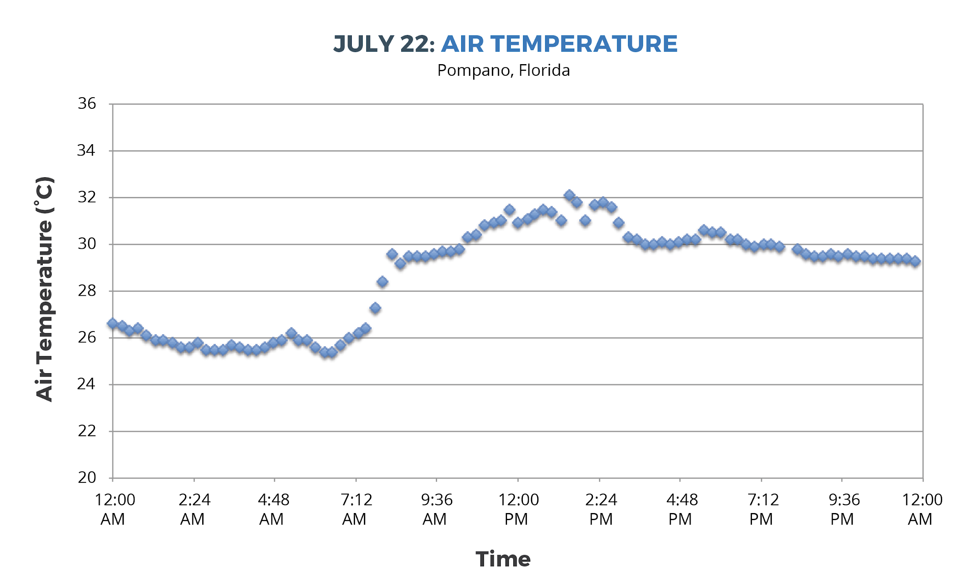
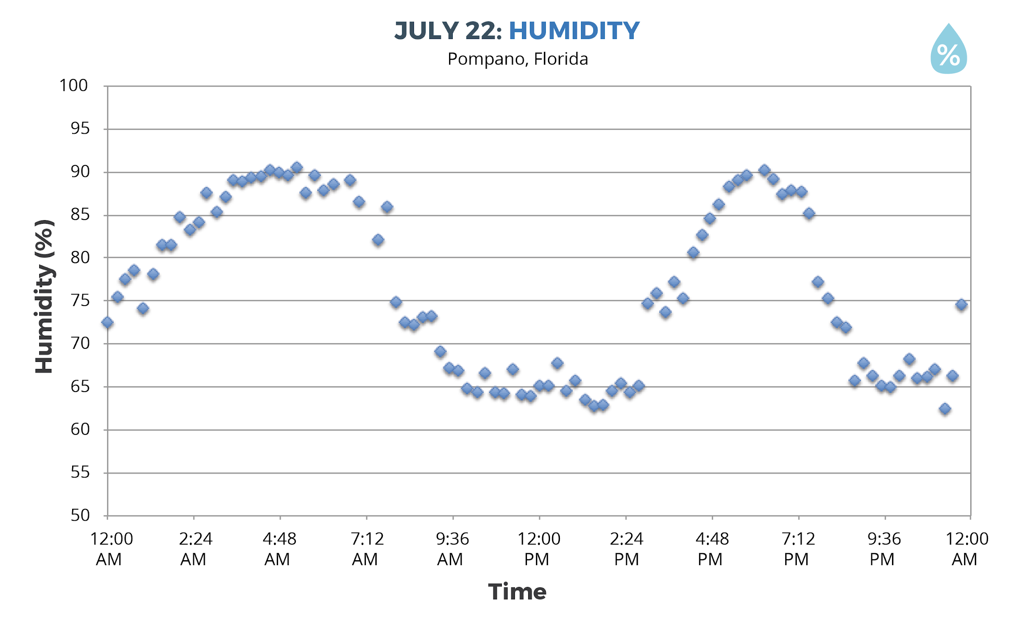
Why didn’t it rain on July 22nd?
Notes:
There wasn’t enough humidity. No drop in air temp, no spike in humidity= no storm!

Slide 73
DRIVING QUESTION BOARD
What questions can we now answer?
Do we want to add any new questions?
How can we use the DQB as an assessment?
Notes:
How can we use the DQB as an assessment?
This is a good time to assess how students are progressing. You can formalize the DQB as much as you’d like, having students write out answers to the questions or brainstorm how we could find the answer to our questions (what tests could we do?)

Slide 74
Misconceptions
How do you help students to shift their thinking when they hold these misconceptions?
Notes:
Turn to pg.34 in Teacher Guide, look over list of misconceptions common during this learning sequence. Hold a discussion around strategies to address misconceptions.

Slide 75
Sensemaking
How are you/focal student connecting
with the content?
Did any new ideas come up for you? How could these activities fit in to what you already do and extend them?
What are you wondering about now?
Where would your focal student get stuck?
What challenges come up for you?
Notes:
Group share out
explain the Thinking Routine (connect-extend-challenge)
use sentence stems

Slide 76
GLOBE Atmosphere Protocols

Slide 77
Break (10 min)

Slide 78
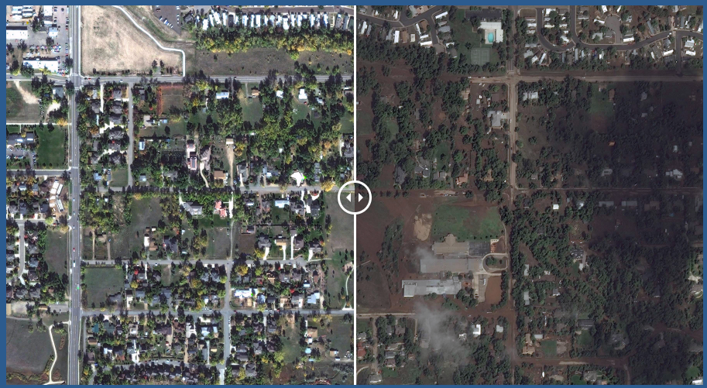
Case Study: 2013 Colorado Storm
Did the Colorado storm happen in the afternoon?
What parts of our model might explain the Colorado storm?
Photos link
Notes:
Return to the Anchoring Phenomenon again. Ask students: “Did the Colorado storm happen in the afternoon?” Students might remember that the video revealed that the storm lasted several days. Ask students what parts of their models might explain the event and what they think could be different. Since the Colorado event lasted much longer than the typical isolated storm, something else might be going on in that type of storm. Use this to initiate further investigations into different kinds of storms that students will explore in Learning Sequence 2.
“Our model helps us explain some kinds of storms, but the storm in Colorado lasted a lot longer. The Colorado storm might be a different kind of storm, so we need to do some more investigating to figure it out.”
Emphasize the power and limitation of models. Have students talk about the kinds of storms that their models explain well, but also the types of storms that do not fit their models. Explain to students that models are tools to help us explain things happening in the world but that they are not always perfect and cannot capture everything. This is especially true for models of complex systems like weather, which is why weather is predicted probabilistically.

Slide 79
What other types of storms cause precipitation?
Notes:
Have teachers turn to a shoulder partner to share their ideas about this topic
Since the isolated storm model doesn’t explain the Boulder storm, there must be other types of storms to consider. What ideas do you have about this?

Slide 80
A Front Headed Your Way
LEARNING SEQUENCE 2
What other types of storms cause precipitation?
© 2019 University Corporation for Atmospheric Research. All Rights Reserved
Notes:
Introduce Learning Sequence 2
We shift focus to look at storm fronts, which happen over a larger region and often for a longer period of time.

Slide 81
Science Talk
Notes:
Fronts

Slide 83
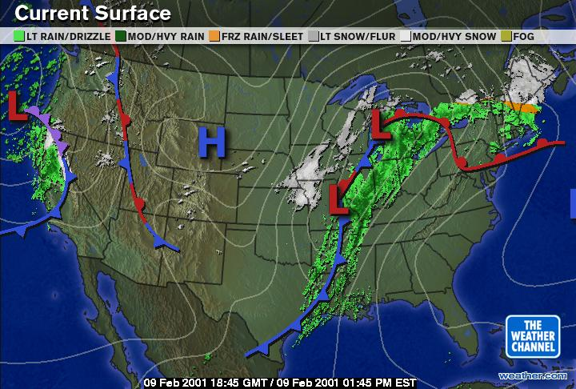
Facts about Fronts
Cold fronts move faster than warm fronts
Fronts are both horizontal and vertical
Cold air is more dense than warm air
Cold fronts → cold air pushes warm air up
Warm fronts → warm air rises over cold air
Notes:
Cold fronts have air that is more dense and high pressure, which makes them move faster.

Slide 85
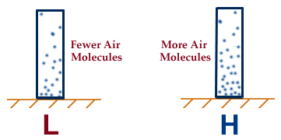
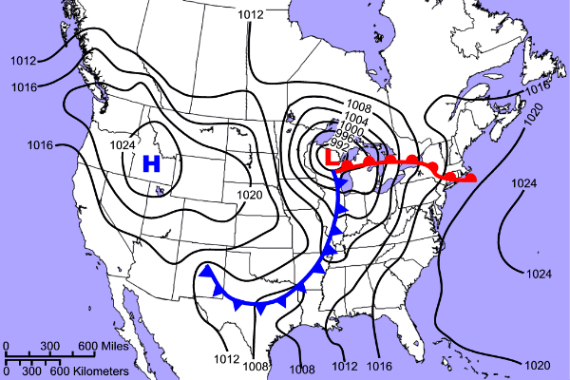
Air pressure and fronts
Air generally moves from areas of high pressure to low pressure.
Differences in air pressure can cause fronts to move.

Slide 86
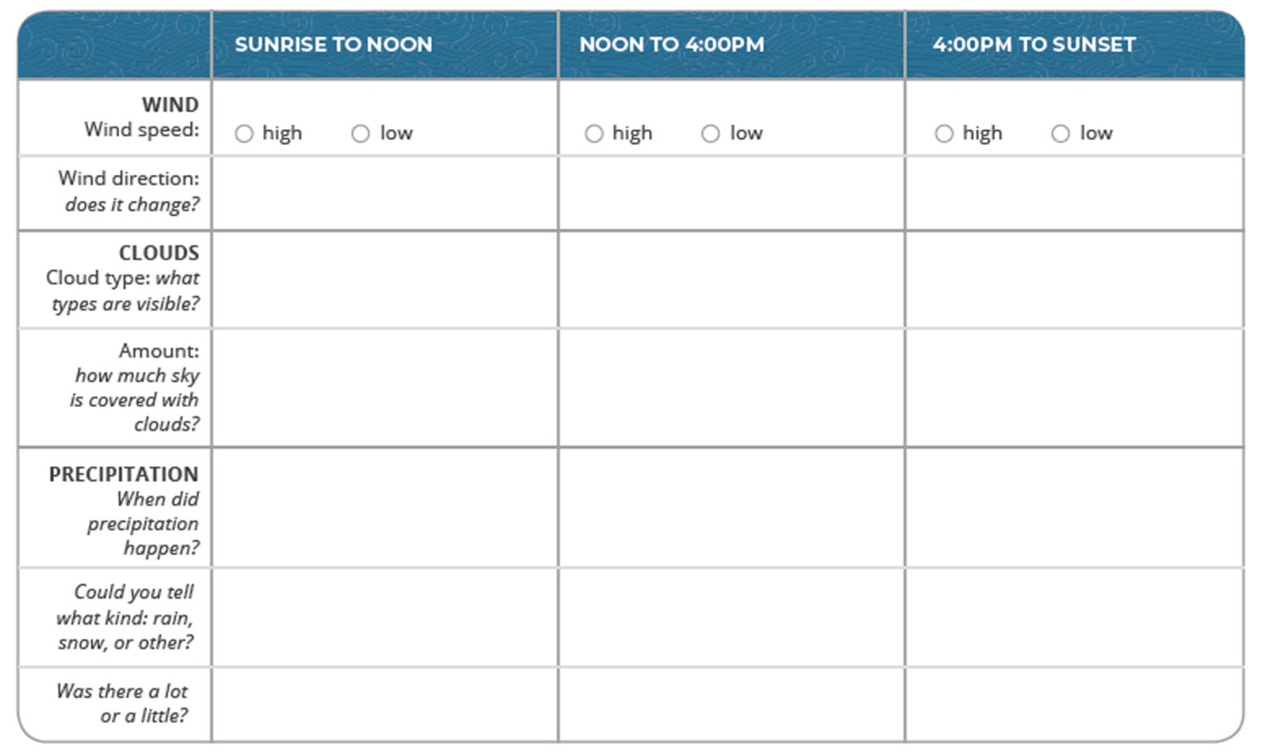
Cold front time-lapse video
Step 1: Make observations about the cold front.
Notes:
Pass out Lesson 7-9 SAS packets
Students make observations of the cold front time-lapse video and brainstorm about storms they have experienced are different than isolated storms

Slide 87
Weather Forecast for a Cold Front
Make a claim: What day did the cold front move through the area? Use evidence to support your idea.
Step 3: Interpret a weather forecast for a cold front.
Work with your group to interpret what is happening before, during, and after the front.
Notes:
Examine a weather forecast of a cold front.

Slide 88
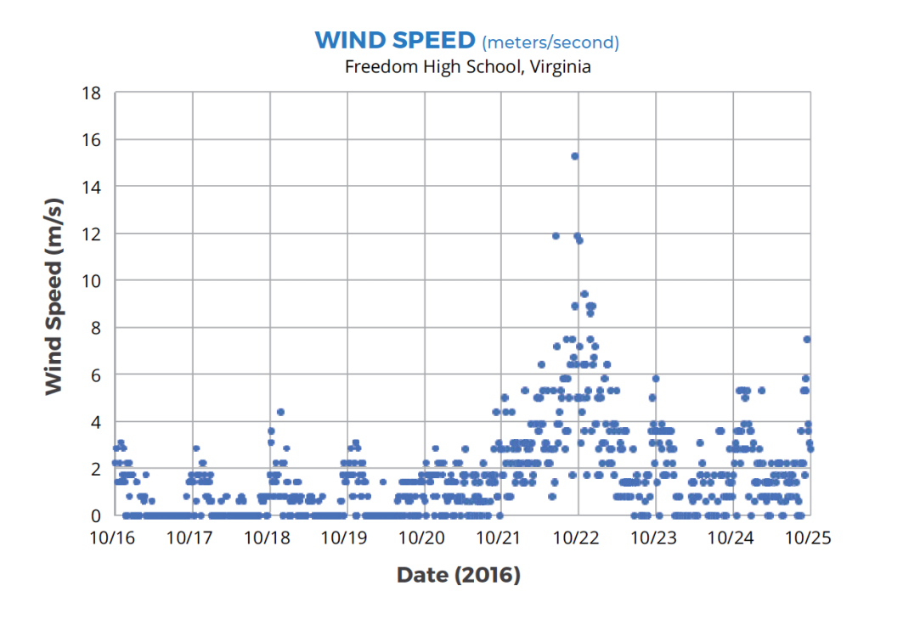
Step 3: Describe the wind speed before, during, and after a cold front.
Circle on the graph when the cold front passed through South Riding, VA.
Notes:
Students look at air temp, humidity, and this time wind speed data about a storm front, so over several days vs just one day as before, to consider how the air changes before, during and after a cold front.

Slide 89
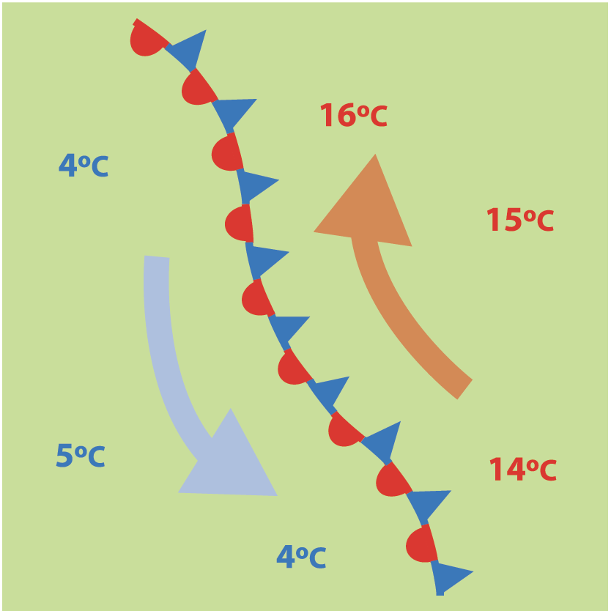
Gathering more information
Step 4: Investigate air masses and fronts.
Read the article about air masses and fronts.
Stop and think as you encounter questions in the text.
Notes:
Readings on air masses and fronts to figure out what happens when different air masses come together

Slide 90
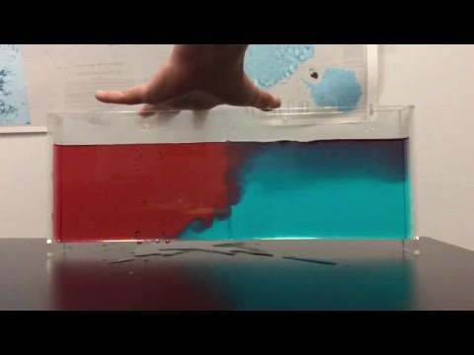
Storms and Precipitation along a Front
Notes:
Demo with whole group, then leave set up for teachers to try during activities exploration.
What did you notice?
What happened to the warm fluid?
What happened to the cold fluid?
Why did this happen?

Slide 91
Activities Exploration: Lessons 7-9
Try out each of the activities wearing your “student hat” first
Refer to your Teacher Guide to begin thinking about how you would facilitate with students
Work together, discuss with each other!
Teacher coaches will practice using prompts and Talk Moves
Notes:
Pass out Lesson 7-9 SAS packet
Explain briefly how the stations will work
Decide who will be the coaches, call them over to brief them quickly once you release the others. Give them the coaching prompts and Talk Moves checklist on a clipboard

Slide 92
Lunch Break- be back at 1:00pm

Slide 93
Make a Model
Step 3: Develop a model for explaining precipitation during the front.
Your model needs to explain:
The location of the cold air mass.
The location of the warm air mass.
The direction that each air mass is moving.
Where you’d expect clouds to form.
Write a caption for your model.
Notes:
Pass out Lesson 9: Step 3 of the Student Activity Sheet
Model. Explain to students that we need to model how precipitation is happening along the front. Direct students to the list of items to include in their model in Lesson 9: Step 3 of their student activity sheets. (Note: The model has the air before the front on the right side and the air after the front on the left side.)

Slide 94
Model Idea Tracker
What ideas do we agree should be added to the Model Idea Tracker?
Notes:
What ideas should we now add to our Model Idea tracker?
Evaporation of water at the surface is important for clouds/storms
Evaporation happens because of heating from sunlight
Clouds form when water condenses
The surface is warmer than the air above it
Air near the surface is warmer than air where clouds form
Rising temperature and rising humidity are good conditions for a storm to form
A source of humidity/moisture is needed to have a stormy day
Warm air rises and cool air sinks
Warm air can take in more water vapor than cool air
Air masses can be different temperatures (warm, cold).
Air masses can have different amounts of moisture (a lot or a little).
When a cold air mass meets a warm air mass, the cold air will push the warm air up in the atmosphere.
As the warm air mass moves up, it cools and moisture in the air condenses, forming clouds, which can lead to precipitation.

Slide 95
Develop a class Consensus Model
Create a Consensus Model for Precipitation Along a Cold Front.
Discuss ideas from your individual models
Be sure to include the ideas from the Model Idea Tracker in your model.
Notes:
Each table group creates a consensus model on big chart paper.
Do mini-gallery walk to share

Slide 96
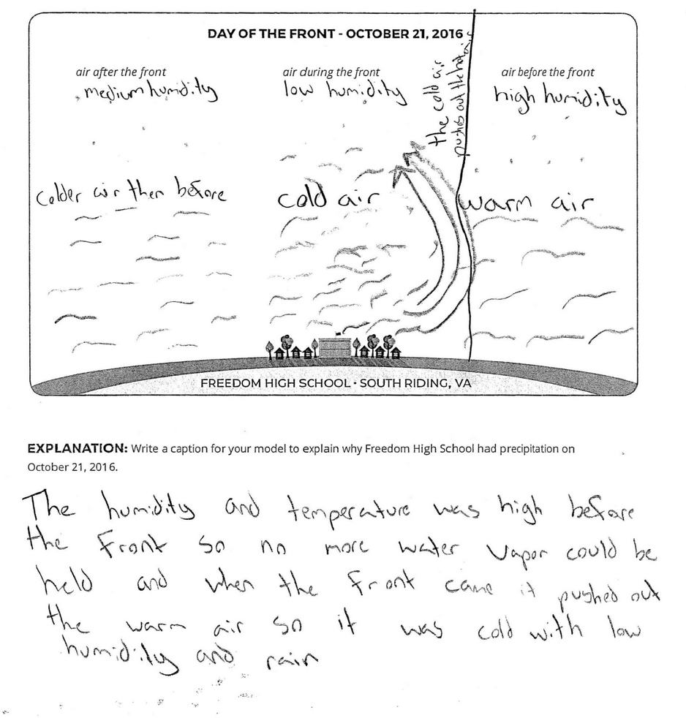
Notes:
Example of a student model

Slide 97
Lesson 9: Step 6: Focus on the big picture using our cold front model.
Choose a day: Each member of your group will choose one day of data to map.
Color and label your map:
Color locations where the temperature is greater than 30℃ RED.
Color locations where the temperature is equal to, or less than, 30℃ BLUE.
Draw slanted rain lines near the location if it had precipitation.
Add the red and blue colors to the key.
Notes:
Pass out Lesson 9: Step 6 of the Student Activity Sheet
Read through the instructions together for labeling and coloring their maps. Break students into groups of four and ensure that each student within the group is assigned a different day to map.
Tell students to use data to locate the front on a map and to identify where and why certain locations have precipitation. Point out that students will be considering how conditions changed over four days at each specific location but also how conditions changed over the four days for the entire region. Let students know that by examining a map view we are able to gain a larger perspective over a region, which is different than the localized cross-sectional views from before.

Slide 98
Step 6 continued: Focus on the big picture using our cold front model.
Compare Maps:
Line up all four maps in order, September 8-September 11.
Follow directions to add the front and air masses to your maps.
Notes:
Students map their data and combine their maps for analysis. Students color and label maps individually. In groups of four, students combine their maps into a four-day sequence. Together, students locate the front and label this on each of the four maps. They use the temperature data to locate and color the cold and warm air masses.

Slide 99
Break (10 min)

Slide 100
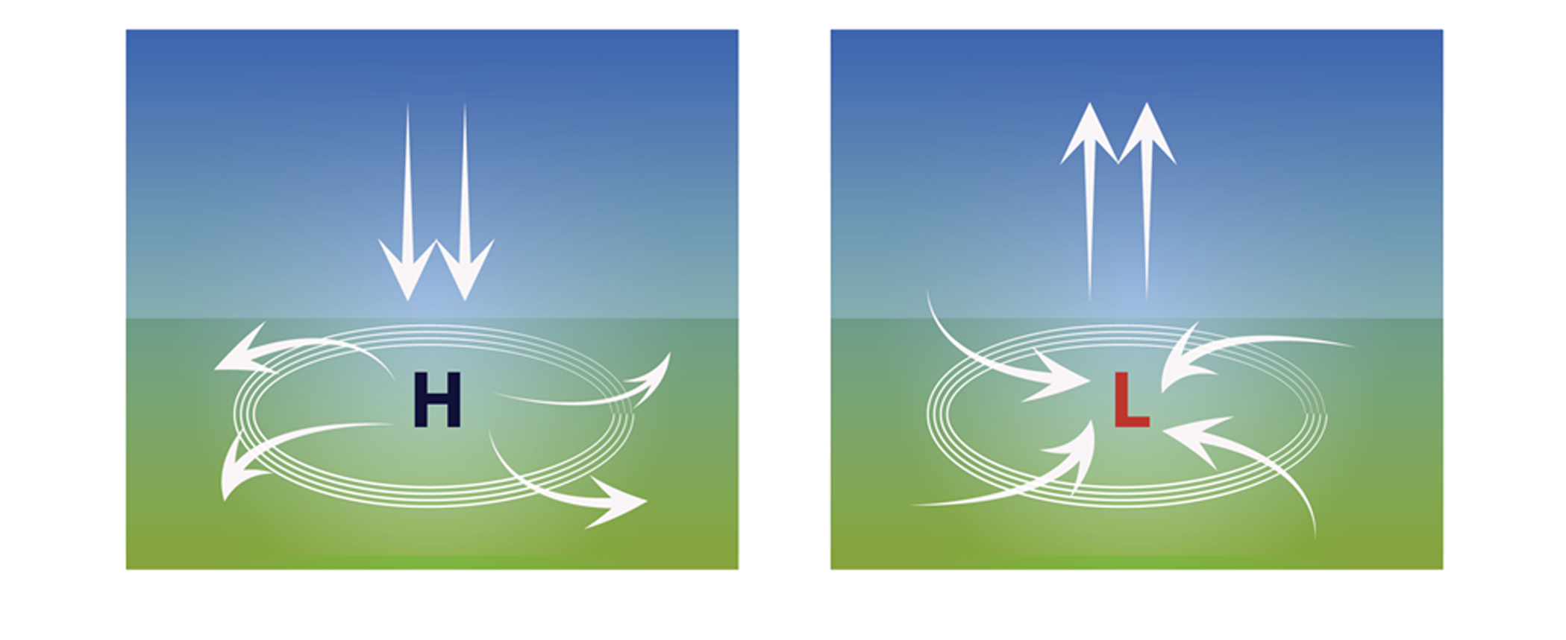
Air movement in high & low pressure
Notes:
Connect air pressure to rising and sinking air. Direct students’ attention to Lesson 10: Step 1 of their student activity sheets.
Read the page
Point out that students are first introduced to the symbols for high and low pressure used on weather maps.
Discuss the image that shows how air moves in areas of high and low pressure:
How the density of the sinking air in an area of high pressure is different than the density of the rising air in a low-pressure area?
How does the vertical up and down movement of air pressure connect with the horizontal toward and away movement? (focus on the arrows moving toward the area of low pressure and the arrows moving away from the area of high pressure)
Make a hands-on connection to air movement in high and low pressure. Each person makes a balloon filled with a golf-ball-sized amount of lentils.
Tell students that the beans inside the balloon represent molecules of air. They are to place their balloon on a piece of paper and trace a circle around the edges of their balloon. Have one student push down on the balloon, simulating high pressure. The other student should trace a new circle around the edges of the “pressurized” balloon. Next simulate low pressure by releasing the balloon. Compare the size of the two circles. Students can take turns simulating high pressure on the balloon and low pressure by releasing the balloon.
Take turns explaining to each other what happens to air under high pressure and low pressure, using the following prompts:
What happens to air when there is high pressure? Where does it go?
The circles you drew show how air moved at the ground level.
Why was the circle bigger for the air under high pressure?

Slide 101
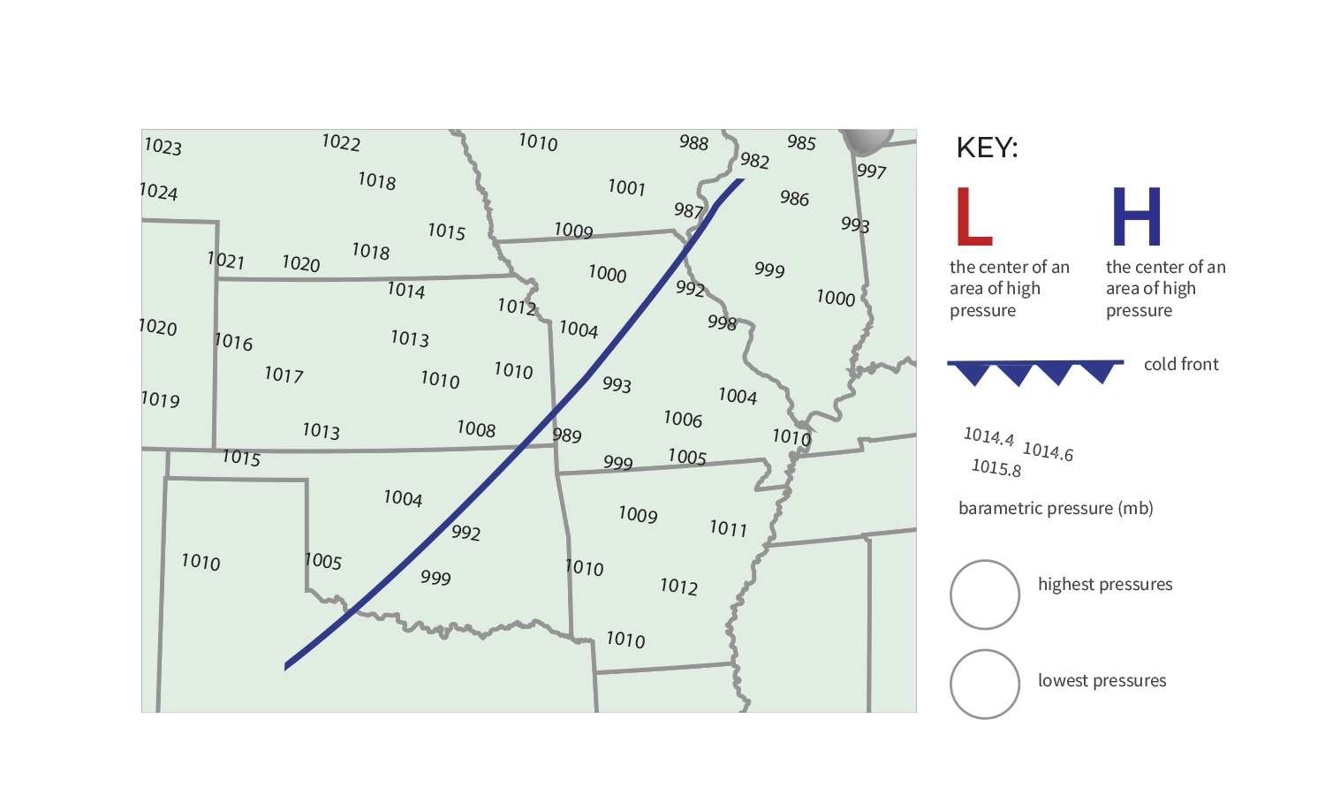
Front on the Move
barometric pressure (mb)
Notes:
Turn to Lesson 10: Step 2 student activity sheet
To help us determine which way the front is moving, we incorporate PRESSURE to our model
Discuss
Which way did the wind blow? What evidence do you have to support your claim?
This is the first time students are introduced to the symbols for a front, which they likely have seen in weather forecasts. The triangles always point in the direction the front is moving!
Have teachers draw the front, H & L symbols onto their SAS
Also, note that we switched from a cross sectional model to using maps.

Slide 102
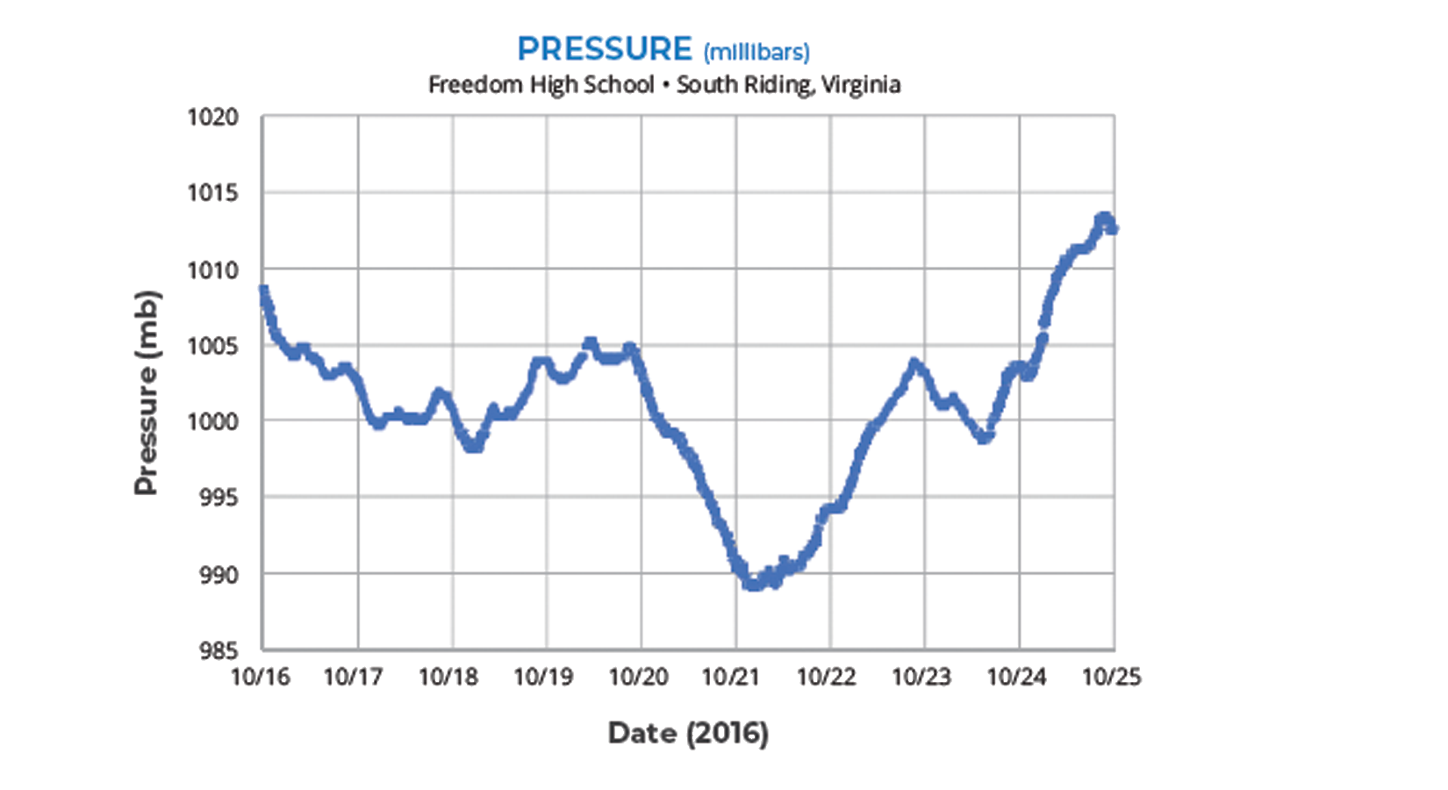
Step 3: Analyze pressure data in one location.
How did the pressure change over time (before, during, and after the cold front)?
Notes:
Lesson 10: Step 3 of the Student Activity Sheet, students analyze a pressure graph of this same storm front, as observed from Freedom High School.
What do you see? What are you noticing?
Where is the pressure the lowest in relation to a storm front? (Just before/during the storm)
What is the pressure like just after the storm? (High, cool air but less moisture)

Slide 103
Case Study: 2013 Colorado Storm
Compare the Colorado storm with what we know about isolated storms and cold fronts.
Notes:
Revisit the Anchoring Phenomenon. The stage is set for using these models to figure out what’s happening with the Colorado storm.
Now students get to examine new data from the Colorado storm and compare it with what they know about typical isolated storms and cold fronts.
Look at the Table of Rainfall (Lesson 11: Step 1) pg. 42 SAS, make a claim about the CO Storm (poll everywhere)

Slide 105
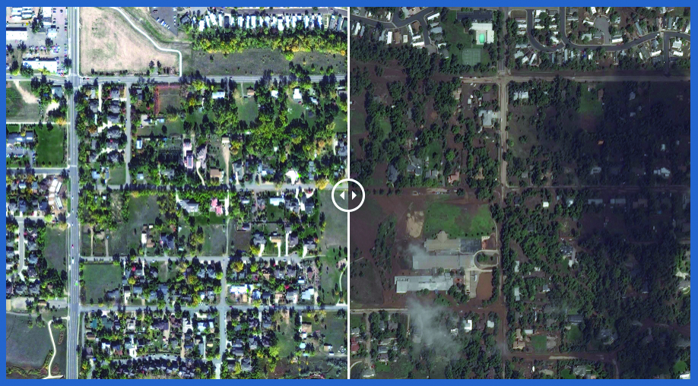
How is the Colorado Storm different from other storms we have learned about?
Notes:
Do Lesson 11: Steps 2 & 3
Do Step 2 on own, then find a partner and share models and discuss Step 3 questions, focusing on what was unique about CO Storm
Whole class debrief
What was unique about the CO Storm?
This storm is different from isolated storms and typical cold fronts because of the length of time it rained and the lack of movement (stalling).
Model ideas from the CO storm:
A warm, moist air mass got pushed up by a cooler air mass.
Low pressure pulled more air towards the storm system
High pressure was pushing air away from it.
Three areas of high pressure “trapped” the front and it stalled
Low pressure kept pulling in moisture from the Gulf of Mexico and Pacific Ocean.

Slide 106
DRIVING QUESTION BOARD
What questions can we now answer?
Do we want to add any new questions?

Slide 107
Model Idea Tracker
What ideas do we agree should be added to the Model Idea Tracker?
Notes:
What ideas should we now add to our Model Idea tracker?
Evaporation of water at the surface is important for clouds/storms
Evaporation happens because of heating from sunlight
Clouds form when water condenses
The surface is warmer than the air above it
Air near the surface is warmer than air where clouds form
Rising temperature and rising humidity are good conditions for a storm to form
A source of humidity/moisture is needed to have a stormy day
Warm air rises and cool air sinks
Warm air can take in more water vapor than cool air
Air masses can be different temperatures (warm, cold).
Air masses can have different amounts of moisture (a lot or a little).
When a cold air mass meets a warm air mass, the cold air will push the warm air up in the atmosphere.
As the warm air mass moves up, it cools and moisture in the air condenses, forming clouds, which can lead to precipitation.
Air moves from high to low pressure
Areas of high pressure are usually behind the cold front, while areas of low pressure are around the front at the northern end.

Slide 108
Misconceptions
What strategies have you had success using to address these misconceptions?
Notes:
Turn to pg.68 in Teacher Guide, look over list of misconceptions common during this learning sequence. Hold a discussion around strategies to address misconceptions.

Slide 109
Sensemaking
How are you/focal student connecting
with the content?
Did any new ideas come up for you? How could these activities fit in to what you already do and extend them?
What are you wondering about now?
Where would your focal student get stuck?
What challenges come up for you?
Notes:
Group share out
explain the Thinking Routine (connect-extend-challenge)
use sentence stems

Slide 110
Break (10 min)

Slide 111
Worldwide Weather
LEARNING SEQUENCE 3
Why do storms move in predictable patterns around the world?
© 2019 University Corporation for Atmospheric Research. All Rights Reserved
Notes:
Introduce Learning Sequence 3
LS3 considers how and why storms move around the Earth.

Slide 112
How do storms move around the world?
Notes:
Find someone who….

Slide 113
Storm movement time-lapse video
Step 1: How do storms move across North America?
Watch a video of storm movement across North America from March to April 2017.
Find one part of the video that captures your eye.
Capture what you saw in a drawing.
Explain how or why these patterns form.
Wonder: what new ideas or questions do you have?
Notes:
Lesson 12: Step 1 & 2 of the Student Activity Sheet
NORTH AMERICA STORM MOVEMENT TIME-LAPSE VIDEO
Use FIND-CAPTURE-EXPLAIN-WONDER routine to think about the patterns of storms moving across N America
Draw in Lesson 12: Step 1 SAS
Time-lapse video of storm movement across North America from March to April 2017:
https://www.youtube.com/watch?v=jC3H2k8lONU&feature=youtu.be
In this video, the white areas are places with more water vapor (moisture) in the air, which indicates where precipitation is happening. The date appears in the upper left. Students are seeing the curvature of Earth in this video because the satellite is so far away, so due east is in the upper right and due west is in the upper left. Two cold fronts pass though this video:
The best option is March 6–8
A second option is March 29–31
Patterns students might notice are as follows:
Air with water vapor in it generally travels west to east across North America.
Air with water vapor in it travels in squiggly, curling, and/or spinning lines.
Certain areas have repeated patterns in cloud cover (e.g., the West Coast gets a lot of water vapor from the Pacific Ocean, and some areas, like Mexico, have a “pulsing pattern” in water vapor).

Slide 114
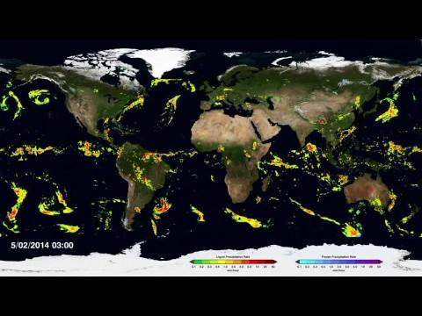
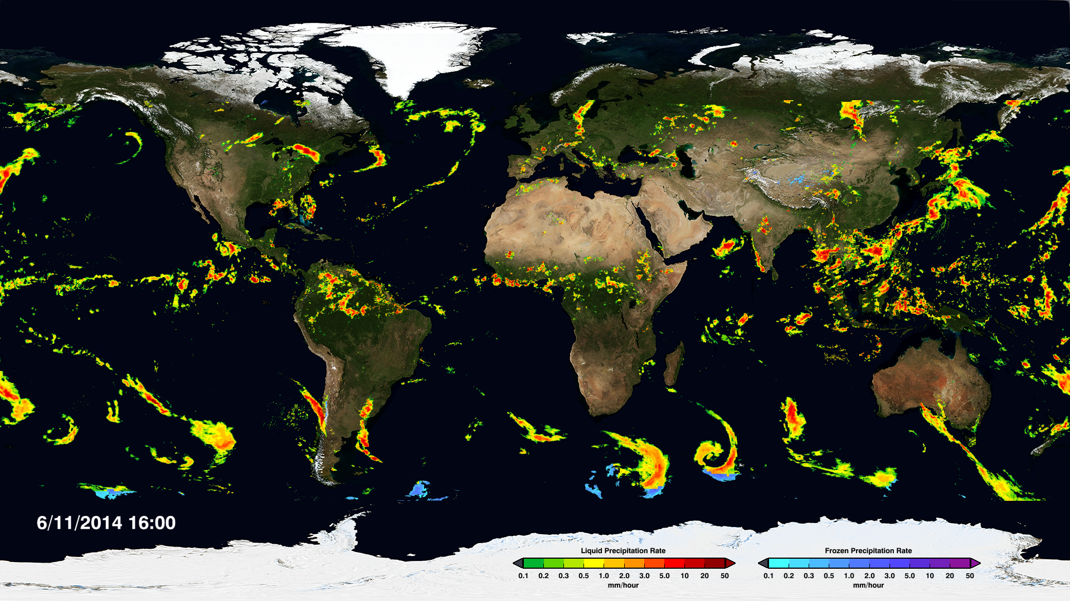
NASA Global Rainfall & Snowfall (April-Sept 2014)
Notes:
Lesson 12: Step 3 & 4 SAS
This image/video shows global precipitation which is an indicator of storms.
Use Use FIND-CAPTURE-EXPLAIN-WONDER routine again.

Slide 115
What could be causing patterns of global storm movement?
Step 5: Form an initial explanation. Answer the questions:
What do you already know about what causes rain?
What do you already know about what causes air to move?
How could the same processes affect the whole world?
Notes:
Lesson 12: Step 5 of the Student Activity Sheet
Facilitate a whole class discussion about students’ initial explanations. Have students share their observations about both N American storms and world wide storms to answer the question “what could be causing patterns of global storm movement?”

Slide 116
Science Talk
Notes:
Science talk about fronts

Slide 118
SNOWBALL FIGHT!
Write down:
a question that you still have about weather or the curriculum
what your biggest take-away is from today

Slide 119
end Day 2

Slide 120
Welcome to Day 3
GLOBE Weather
Notes:
Point out agendas for today

Slide 121
Housekeeping
Paperwork for stipend payment
Make sure we have your summer contact info
Spreadsheet of GLOBE Weather materials

Slide 122
Looking back
Specific local conditions allow for the formation of short-lived, afternoon storms (isolated storms)
The interaction of differing air masses can cause storm systems that last for several days over a large area (storm fronts)
Unique conditions, such as those in the Colorado storm, can result in unpredictable storm systems.
Storms move in patterns around the world
Notes:
What evidence are you aware of that storms move in patterns around the world?

Slide 123
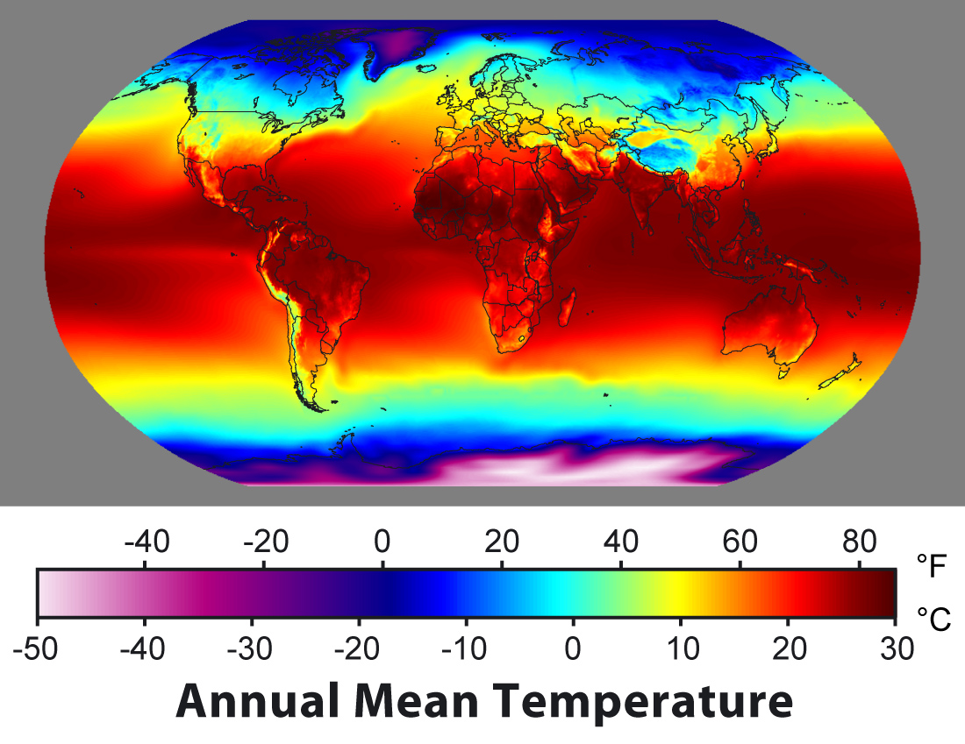
Step 1: Observe patterns in annual average temperature.
Notes:
Pass out Lesson 13-14 SAS packet
We explore “Why is it hotter at the equator than other places on Earth?”

Slide 124
Why is it hotter at the equator than other places on Earth?
STEP 2: Observe Energy Angles
Work in groups of three to investigate what happens to light when it shines on graph paper at different angles.
Notes:
To answer that we must understand what happens when sunlight strikes Earth’s surface.

Slide 125
Why is it hotter at the equator than other places on Earth?
Notes:
We extend to explain how uneven heating of the Earth relates to air movement

Slide 126
Step 4: Analyze temperature and latitude
Notes:
We zero in on latitude and why temperature is predictable at specific places as we begin to focus on weather in the tropics, where most of the storms seem to happen (and also where it is hottest!).

Slide 127
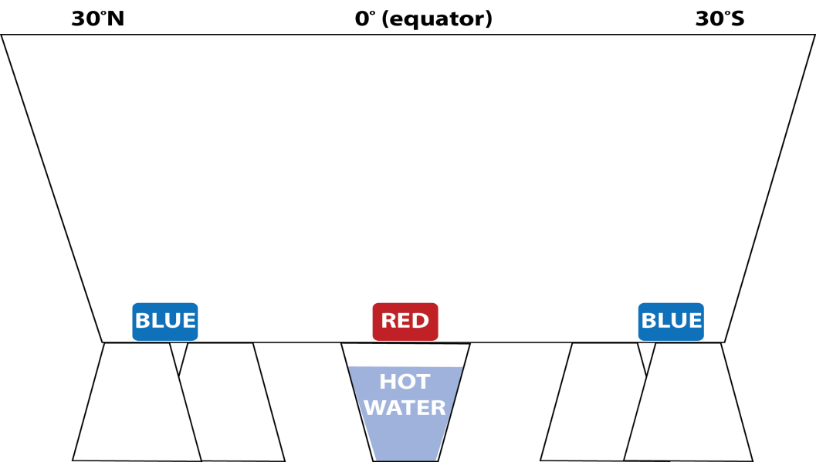
Demonstration: Global Convection Cells
Step 3: Record observations of the water movement.
Draw how the water moves through the tank.
Notes:
We return to convection to understand how air moves between the tropics and the midlatitudes.

Slide 128
Activities Exploration: Lessons 13 & 14
Try out each of the activities wearing your “student hat” first
Refer to your Teacher Guide to begin thinking about how you would facilitate with students
Work together, discuss with each other!
Teacher coaches will practice using prompts and Talk Moves

Slide 129
Break (10 min)

Slide 130
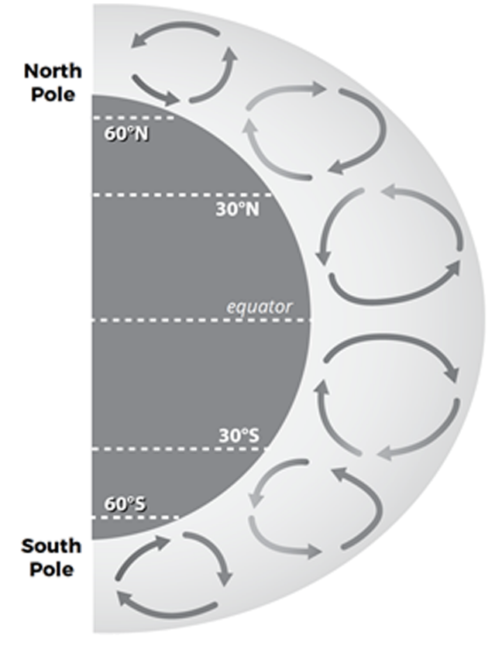
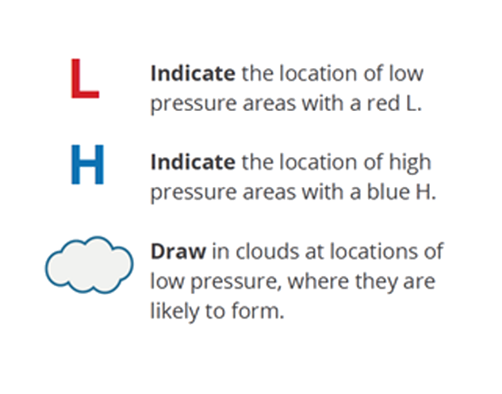
Global Air Circulation Diagram
Step 5: Create a model to describe air pressure and clouds at different latitudes.
Notes:
Lesson 14: Step 5 of the Student Activity Sheet
Introduce the Global Air Circulation Diagram in Lesson 14: Step 5. Orient students to this diagram and point out that it shows how air moves around the whole world, not just in the tropics.
Have students create a model of air pressure and humidity. Annotating the illustration in Lesson 14: Step 5, students should create a model locating the areas of low and high atmospheric pressure and the locations that are likely to be cloudy because air is rising. Use the arrows indicating air movement as clues.
Lead a class discussion about the diagram. Focus students on convection near the equator and encourage students to draw on their understanding of convection from Learning Sequence 1 and high and low pressure from Learning Sequence 2 to explain air movement in tropical convection. The one important thing for students to notice in the midlatitudes at this point is that convection moves in the opposite direction. This will be revisited in Lesson 15.
Use the prompts below to guide your discussion:
Where is air rising from Earth’s surface into the atmosphere and why?
Worldwide, where is air sinking from the atmosphere to Earth’s surface and why?
How is air moving across Earth’s surface and why?
Where do you think there are areas of high and low pressure and why?

Slide 131
Consensus Model: Air Movement in the Tropics
Create a model that will answer the question:
How and why does air move in the tropics?
Identify ideas from the Model Idea Tracker that will help us answer the question.
Consider how the model for global air circulation you created in Step 5 helps answer the question.
Notes:
Revisit the Learning Sequence 3 phenomenon and question: Why do storms move in predictable patterns around the world? Remind students that the class is investigating air movement patterns because precipitation is moisture in the air. Remind students that we’re focusing only on air movement in the tropics for now.
Review the question that the Consensus Model will help us answer:
How and why does air move in the tropics?
Take stock of ideas from the Model Idea Tracker that will help answer this question. Have students nominate ideas from the Model Idea Tracker that they think will be helpful for answering this question. All of the ideas from Learning Sequence 3 will be helpful as well as some ideas from Learning Sequences 1 and 2 about warm air rising, cool air sinking, and air moving from high to low pressure.
Develop a class Consensus Model. Have small groups consider ideas from the models they created in Lesson 14: Step 4 and Step 5 and the ideas from the Model Idea Tracker. Have each group present which ideas they propose including in the Consensus Model. As small groups present, have students discuss if they agree or disagree with the ideas in each group’s model. Come to consensus about what should be in the model and document a Consensus Model in a public space that reflects agreed upon ideas.
KEY MODEL IDEAS THAT SHOULD BE REPRESENTED IN THE CONSENSUS MODEL:
As warm air rises at the equator, it creates an area of low pressure.
Sunlight (solar radiation) is more concentrated at the equator because incoming sunlight shines directly on the equator, concentrating it in a smaller area.
Sunlight (solar radiation) is more spread out toward the poles because incoming sunlight hits the surface at an angle, spreading the light out over a larger area.
The amount of concentrated solar radiation influences air temperatures; more concentrated solar radiation causes warmer air temperatures and more spread out solar radiation causes cooler air temperatures.
There are more areas where warm air is rising near the equator and more areas where cool air is sinking at 30°N and 30°S.
Cooler air moves along the surface of the Earth toward the area of low pressure to replace the rising warm air.
Horizontal movement of air along the surface of the Earth is wind, which causes storms to move.

Slide 132
NASA Global Rainfall & Snowfall (April-Sept 2014)

Slide 133
A Curveball
When air and storms move, why do they curve?
The Coriolis effect...
Because the Earth is spinning, air does not travel in a straight line!
White arrows→ How storms move with a non-spinning Earth
Black arrows→ How storms move with a spinning Earth
Notes:
Pass out Lesson 15 student activity sheet, balloons
Due to rising and sinking of air (convection) and the uneven heating of the Earth we would expect storms to move north from the equator towards the poles and then straight south again (as shown by the white arrows). But as we saw in the video of Global Rain & Snowfall, storms actually curve and twist around the Earth, in predictable patterns (as seen by the black arrows). Why?
With a partner, make a model of the Coriolis effect activity, follow directions on Lesson 15 sheet

Slide 134
Demonstrate Understanding: Back to Back Strategy
If air at an area of high pressure is sinking, why would these other arrows move away from it?
Notes:
Demonstrate our understanding of air under high pressure and low pressure. Form two lines, standing back-to-back with a person from the other line.
Listen to the question the teacher asks related to the activity:
If air at an area of high pressure is sinking, why would these other arrows move away from it?
Reflect individually for about 30 seconds.
Then say: Turn.
Students discuss their reflections with the student with whom they were back-to-back.
Because of the Coriolis effect…
Storms move counter-clockwise in the northern hemisphere
Storms move clockwise in the southern hemisphere
Prevailing winds in three areas of convection N and S of the equator
Where would areas of High and Low pressure be?
where warm air is rising= low
where cool air is sinking= high
Prevailing winds: 3 areas of convection N of equator & 3 areas of convection S of equator
storms move towards the equator between the midlatitudes & equator; storms move towards the poles above/below that, and then back towards the equator from the poles

Slide 135
Model Idea Tracker
What ideas do we agree should be added to the Model Idea Tracker?
Notes:
What ideas should we now add to our Model Idea tracker?
Evaporation of water at the surface is important for clouds/storms
Evaporation happens because of heating from sunlight
Clouds form when water condenses
The surface is warmer than the air above it
Air near the surface is warmer than air where clouds form
Rising temperature and rising humidity are good conditions for a storm to form
A source of humidity/moisture is needed to have a stormy day
Warm air rises and cool air sinks
Warm air can take in more water vapor than cool air
Air masses can be different temperatures (warm, cold).
Air masses can have different amounts of moisture (a lot or a little).
When a cold air mass meets a warm air mass, the cold air will push the warm air up in the atmosphere.
As the warm air mass moves up, it cools and moisture in the air condenses, forming clouds, which can lead to precipitation.
Air moves from high to low pressure
Areas of high pressure are usually behind the cold front, while areas of low pressure are around the front at the northern end.
Air temperature increases in places with more concentrated solar radiation (the Equator) and decreases in places with less concentrated solar radiation
In the tropics, air moves across Earth’s surface towards the equator due to convection.
Air deflects across the Earth’s surface due to the Earth’s rotation (east to west in the tropics, west to east in the midlatitudes)

Slide 136
Storms in the Philippines and where you live
Step 3: Record an explanation.
Draw an arrow to indicate storm direction in the Philippines.
Draw a different symbol to show where you live.
Draw an arrow to indicate storm direction where you live.
Notes:
Lesson 15: Step 3 of the Student Activity Sheet
Use their model and new ideas about the Coriolis effect to record an explanation that describes where it is likely that storms will originate in the Philippines and where they live.
Share out.

Slide 137
Connections
How can we help students make connections between weather and our daily lives?
Notes:
Think Pair Share
How weather affects us.
Why being able to anticipate where storms come from is important for communities.
Using our understanding of weather to prepare for storms.

Slide 138
DRIVING QUESTION BOARD
This is where the students post their questions and where students return to answer their questions throughout the unit.
Unit Driving Question:
What causes different kinds of storms?
Notes:
As we complete Learning Sequence 3, let’s take a moment to revisit our Driving Question Board…
What questions we can answer now?
What could we do with any unanswered questions at this time?

Slide 139
Misconceptions
What strategies have you had success using to address these misconceptions?
Notes:
Turn to pg.101 in Teacher Guide, look over list of misconceptions common during this learning sequence. Hold a discussion around strategies to address misconceptions.

Slide 140
Sensemaking
How are you/focal student connecting
with the content?
Did any new ideas come up for you? How could these activities fit in to what you already do and extend them?
What are you wondering about now?
Where would your focal student get stuck?
What misconceptions do they (we) hold?
What challenges come up for you?
Notes:
Group share out
explain the Thinking Routine (connect-extend-challenge)
use sentence stems

Slide 141
Lunch Break- be back at 12:30pm

Slide 142
Snow Day
CULMINATING TASK
How can we apply what we’ve learned about weather to a winter storm?
© 2019 University Corporation for Atmospheric Research. All Rights Reserved
Notes:
Introduce Culminating Task
We apply our learnings about weather and storms to a new type of storm--- snow storm!

Slide 143
Where did the moisture come from?
Where do you think the storm will go next?
Notes:
Introduce the California storm (Winter Storm Quid)
Read the forecast aloud.
Remember, to cause precipitation storms need 2 things:
Rising cooling air
Moisture
Where did the moisture come from?
Which direction is the CA storm moving?

Slide 144
Why did the storm cause rain in some places and snow in other places in California?
Notes:
Heavenly is at higher elevation than South Lake Tahoe, and we learned in Learning Sequence 1 that air temperature decreases as altitude increases. Lower temperatures would allow for snow instead of rain.

Slide 145
What Model Ideas are applicable to Culminating Task: Challenge 1?
Notes:
Discuss at your table.
Evaporation of water at the surface is important for clouds/storms
Evaporation happens because of heating from sunlight
Clouds form when water condenses
The surface is warmer than the air above it
Air near the surface is warmer than air where clouds form
Rising temperature and rising humidity are good conditions for a storm to form
A source of humidity/moisture is needed to have a stormy day
Warm air rises and cool air sinks
Warm air can take in more water vapor than cool air
Air masses can be different temperatures (warm, cold).
Air masses can have different amounts of moisture (a lot or a little).
When a cold air mass meets a warm air mass, the cold air will push the warm air up in the atmosphere.
As the warm air mass moves up, it cools and moisture in the air condenses, forming clouds, which can lead to precipitation.
Air moves from high to low pressure
Areas of high pressure are usually behind the cold front, while areas of low pressure are around the front at the northern end.
Air temperature increases in places with more concentrated solar radiation (the Equator) and decreases in places with less concentrated solar radiation
In the tropics, air moves across Earth’s surface towards the equator due to convection.
Air deflects across the Earth’s surface due to the Earth’s rotation (east to west in the tropics, west to east in the midlatitudes)

Slide 146
As the storm moved east, why did it snow in some areas but not in others?
Complete Steps 1- 4 in small groups
Notes:
Pass out Culminating Task 2 sheets
Here we see the path of the storm front over several days. As the storm moves inland from the west to the east, it becomes cold enough to snow in Nevada. The question we investigate now is why do some areas get more snow than others? And further, why did some areas get no snow at all?
Complete Steps 1-4 in small groups.

Slide 147
Areas with humidity >70% are colored blue
How does the humidity data help you understand why it snowed in some places but not in others?
Notes:
How does the humidity data help you understand why it snowed in some places but not in others?
Places with high humidity & near the L pressure area would get snow.

Slide 148
Discussion:
Why did some communities have more snowfall than others?
Why didn’t it snow everywhere?
Did it always snow in places that had high humidity? Why/Why not?
Where might schools close due to snow?
Notes:
Find a partner to discuss the questions, focus on sharing your hypothesis for where there might be a snow day
*Use page 140 Teacher guide to answer question prompts

Slide 149
Where will students have a snow day on February 24, 2017
Complete Steps 1- 4 in small groups
Notes:
Work in small groups

Slide 150
Where will students have a snow day on February 24, 2017

Slide 151
Step 4: Warning Map
Where will it snow on February 24?
Notes:
What is the story of this storm that students would need to tell to predict where the snow day would be?

Slide 152
What Model Ideas are applicable to Culminating Task: Challenge 2 & 3?
Thoughts? What do you like about this activity? What is still challenging?
Notes:
Discuss at your table.
Evaporation of water at the surface is important for clouds/storms
Evaporation happens because of heating from sunlight
Clouds form when water condenses
The surface is warmer than the air above it
Air near the surface is warmer than air where clouds form
Rising temperature and rising humidity are good conditions for a storm to form
A source of humidity/moisture is needed to have a stormy day
Warm air rises and cool air sinks
Warm air can take in more water vapor than cool air
Air masses can be different temperatures (warm, cold).
Air masses can have different amounts of moisture (a lot or a little).
When a cold air mass meets a warm air mass, the cold air will push the warm air up in the atmosphere.
As the warm air mass moves up, it cools and moisture in the air condenses, forming clouds, which can lead to precipitation.
Air moves from high to low pressure
Areas of high pressure are usually behind the cold front, while areas of low pressure are around the front at the northern end.
Air temperature increases in places with more concentrated solar radiation (the Equator) and decreases in places with less concentrated solar radiation
In the tropics, air moves across Earth’s surface towards the equator due to convection.
Air deflects across the Earth’s surface due to the Earth’s rotation (east to west in the tropics, west to east in the midlatitudes)

Slide 153
Wrap up GLOBE Weather
How do you plan to use GLOBE Weather?
What adaptations or extensions might you use?
How can you make this relevant for your students?
Notes:
What ideas for adaptations do you have to make the curriculum meaningful/relevant to your students? What local weather phenomena can you include?

Slide 154
Break (10 min)

Slide 155
GLOBE Connections
From Observations to Investigations (LS1)
take the next step and use student data to develop research questions that form the basis of an investigation
Finding Freedom: A Mini Data Exploration (LS2)
access the GLOBE database using the GLOBE Online Visualization Tool to explore data from Freedom High School
Connecting with GLOBE Schools Around the World (LS3)
go deeper in understanding patterns of storms by connecting with GLOBE teachers and students from around the world
Notes:
Have teachers navigate to globeweathercurriculum.org
Give a brief overview of the 3 different types of GLOBE Connections and where they can find them. Do example 2 together.

Slide 156
Make a Plan!
GLOBE Connections
How can you incorporate one of these
three GLOBE Connections into a lesson?
Consider:
What steps do you need to take to implement this GLOBE Connection?
Do you need any additional information?
Are there any hurdles or obstacles you might need to anticipate?
Notes:
Provide time for them to either work alone or in small groups to come up with a plan on how they could incorporate one of the 3 options into their lessons.
What steps do you need to take or additional information do you need to implement this GLOBE Connection?
Any hurdles or obstacles you might need to anticipate or plan for?

Slide 157
Assessments
Pre-assessment built in to Lesson 1 (Anchor activity)
Summative assessment for each Learning Sequence (3)
Overall assessment for the entire unit
Formative assessments built in throughout the curriculum
exit tickets, student models, discussions, driving question board
Notes:
Assessment section at the end of the binder

Slide 158
How do I find more
GLOBE Weather resources?
Notes:
We have been mentioning a globe weather website, powerpoints, and additional resources over the past couple of days. We are now going to take a few moments to explore what the website has to offer.

Slide 159
© 2019 University Corporation for Atmospheric Research. All Rights Reserved
Notes:
globeweathercurriculum.org
We have a wealth of resources on this site that go well beyond just a pdf copy of the curriculum.

Slide 160
globeweathercurriculum.org
GLOBE Weather Home page
Overview of curriculum
Testimonials
Download the entire curriculum as one PDF
Table of Contents
Notes:
When you arrive at the home page, you have a variety of options to navigate to different parts of the curriculum.
CLICK There is a complete overview of the curriculum, including a list of materials. This is a great place to start learning about the curriculum. (CLICK to show and to make disappear)
Also perhaps mention the teacher guide/front matter for a complete overview of the materials in order for teachers/coordinators to learn more about the unit.
Testimonials from our field test teachers
If you would like to download the entire curriculum in a single PDF (CLICK)
However, we also wanted to make this site flexible to a variety of needs. By clicking on the Table of Contents, the different elements section, OR the Curriculum tab at the top of the webpage, you can access the different sections of the curriculum.CLICK to show TOC.

Slide 161
Each section of the curriculum has its own webpage with:
Resources
Teacher Guide
All Activity Sheets for Lessons
Powerpoints
Assessments
GLOBE Connections
Background Content
Lesson Resources
Notes:
When you arrive at a particular section of the curriculum, you will see specific resources for that particular section or learning sequence.
Using Learning Sequence 1 as an example, you can see a list of resources that include (CLICK after each one):
Teacher Guide for Learning Sequence 1, which includes an overview of the materials and step by step instructions for activities.
The activity sheets for all of Learning Sequence 1 are in a single pdf
We also have powerpoint slides to help organize and guide your students through lessons and activities.
If there are any pre- or summative assessments these will also be listed here as well as on the separate assessments webpage.
We have also provided information on ways to connect to the GLOBE community through our GLOBE Connections webpage.
Links to the additional background information referenced in the teacher guides
And just when you thought you had it all..CLICK...when you scroll down the page we also have the specific resources for each of the lessons.
Specific links used in each lesson
Any supporting videos (example of activities)
As well as opportunities to extend the lesson with GLOBE Protocols.

Slide 163
We want your feedback!
https://forms.gle/emxRmut6rz3RcCPN8
Notes:
FYI, I created a feedback google form for SUNY, put it in the folder, and then updated the link to it on this slide. --Emily

Slide 164
Thank You!
Photo by Eliot Foust

