Slide 1
Snow Day?
How can we apply what we’ve learned about weather to a winter storm?

Slide 2

California Storm
Why did the storm cause rain in some places and snow in other places in California?

Slide 3
Introduction to the Winter Storm
Watch the video:
  Winter Storm Quid Weather Forecast from the Weather Channel
What did you notice in the video?
Notes:
Introduce students to this winter storm.
Tell students about this winter storm called Quid and that students can draw on ideas from Learning Sequences 1, 2, and 3 to be able to warn people in the storm’s path. Once we know the storm’s path, we can warn people who will be affected. Show students a video, which forecasts how this winter storm could affect the Midwest.
WINTER STORM QUID WEATHER FORECAST
https://scied.ucar.edu/winter-storm-quid
(Credit: the Weather Channel)
This short video from the Weather Channel gives a sense of what the storm was shaping up to be as it crossed the United States in February 2017. (Note: The Weather Channel names winter storms. This one was named Quid.)
Introduce the three challenges that are part of the Culminating Task. Explain to students that they will work in groups of two or three to understand this winter storm as it moved from California to the Rockies to then predict how it will affect the Midwest.
Their tasks are:
Understand factors that increase the chances of precipitation.
Predict which communities in the storm’s path in the Midwest should prepare for heavy snow and take safety precautions.

Slide 4
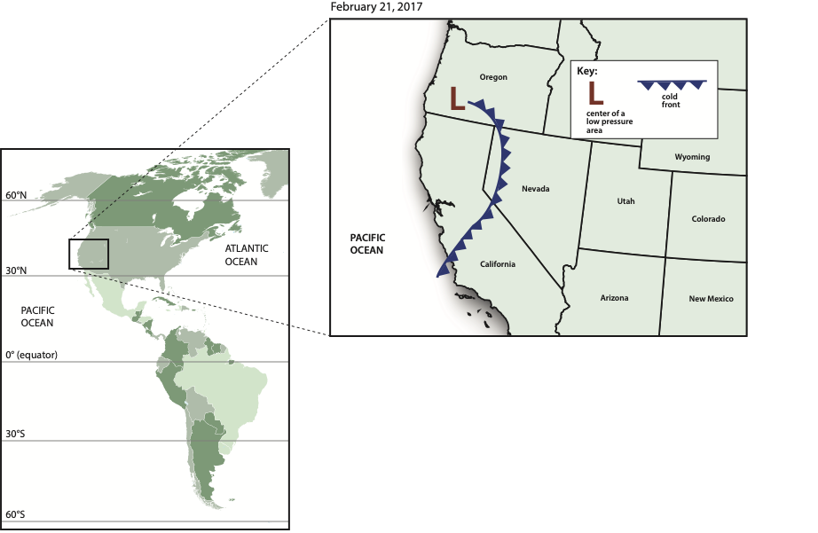
California Storm
Why did the storm cause rain in some places and snow in other places in California?
Notes:
Motivate a purpose for Challenge 1. Tell students that when the storm was in California, heavy rain fell in some areas and heavy snow fell in other areas. Explain that students will need to figure out why that happened and also where the storm came from and where it is going.
Introduce Challenge 1. Pass out the Challenge 1: Student Activity Sheet and orient students to the map, which shows a zoomed-out box of the area where the storm hit (the symbols on the map should be familiar to students at this point, review as needed). Together, read the introduction addressing where it rained along the West Coast on February 20, 2017.
Prepare students to work on Challenge 1. Arrange students in partners or groups of three (students will work in the same groups throughout all three challenges of the Culminating Task). Display the class Consensus Models developed during Learning Sequences 1, 2, and 3 as well as the Model Idea Tracker. Tell students they can use these ideas and models to help them with the challenge.

Slide 5
Step 1: Analyzing the California Storm
Work in small groups to use the maps and what you have learned about storms to answer the questions in Step 1.
Notes:
Challenge 1: Step 1
Work on Challenge 1 in small groups. Give students time to answer the questions in Challenge 1: Step 1 about the California storm. As students work, circulate the groups and prompt students to draw on previous models and Model Ideas.
What is the direction of prevailing winds across North America?
How can you use the symbol for a cold front to figure out the front’s direction?

Slide 6
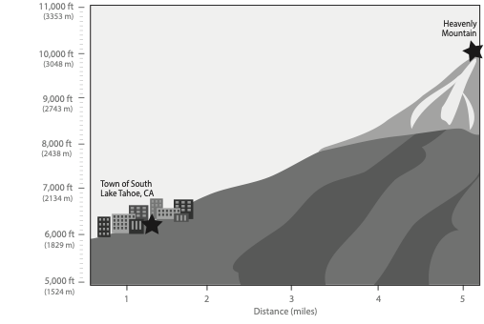
Step 2: More details about the California storm
Answer the questions in Step 2 with your group.
Draw on the cross section:
  Where the atmosphere is colder and where the atmosphere is warmer.
  The location of rain, snow, and mixed rain/snow.
  Where you would like more information to decide.
Notes:
Challenge 1: Step 2
Draw student attention to Challenge 1: Step 2, which provides more detail about the California storm. The new information details South Lake Tahoe experiencing rain while Heavenly Mountain experiences snow. Give students time to answer the Step 2 questions with their group. Encourage students to sketch on the cross section what is happening in the air at South Lake Tahoe compared with Heavenly Mountain. Introduce the idea that as the weather transitions from rain to snow there will likely be an area that experiences a rain-snow mixture. Student answers about where the rain-snow mixture might have happened will vary. There is not enough data for them to pinpoint exactly where that happens, but they should understand that it will happen somewhere between the town and the mountaintop.
What do we know about temperatures at lower and higher altitude?
How might air temperature at the Heavenly summit be different from air temperature at South Lake Tahoe?
Share initial ideas with another group. Have students share their ideas about Steps 1 and 2 in Challenge 1 with another small group. Give students time to edit and add to their explanations as they share and discuss similarities and differences between their initial responses to the questions.

Slide 7
Making sense
Where do you think the cold front was located before it passed over California?
Where do you think the moisture that’s in this storm came from before it was in the atmosphere?
Where do you think the storm will go next?
Why did it snow at Heavenly Mountain and rain in South Lake Tahoe?
If you were to decide whether rain or snow will fall during a storm, what information would you look at and why?
Notes:
Discuss Challenge 1 questions as a whole class. Focus on coming to consensus about each question and recording the consensus explanation for the class. Students can continue to edit their ideas if they hear something new or different they’d like to add. Have students share their images of what is happening on a document camera to support their explanations.
Where do you think the cold front was located before it passed over California?
• It’s moving from west to east, according to global circulation, which means it was over the Pacific Ocean.
Where do you think the moisture that’s in this storm came from before it was in the atmosphere?
• It evaporated from the Pacific Ocean. (Some water evaporated from Lake Tahoe, but it was a small amount compared with the amount that evaporated from the ocean.)
Where do you think the storm will go next?
• Surface winds blow west to east at the midlatitudes, so this storm should move east due to these winds.
• The cold front symbol has the triangles pointing toward the east, so that is the direction the storm is moving.
Why did it snow at Heavenly Mountain and rain in South Lake Tahoe?
• The air temperature is cooler higher in the troposphere. We know that from the Virtual Ballooning investigation. So, it should be colder at Heavenly, which is a higher altitude than South Lake Tahoe. This means it would snow at Heavenly if the temperature is freezing.
• Both locations are at high altitude, but Heavenly is much higher, and it must be below freezing.
If you were to decide whether rain or snow will fall during a storm, what information would you look at and why?
• You would look at air temperature because if it is a certain temperature, the water will freeze to snow.

Slide 8
California Storm
Why did the winter storm cause rain in some places and snow in other places in California?
Notes:
Return to the Challenge 1 question. Revisit the question: “Why did the storm cause rain in some places and snow in other places in California?” Have students discuss an explanation to this question in groups and/or write a response on an Exit Ticket before the end of the lesson.

Slide 9

Where’s the Snow?
As the storm moved east, why did it snow in some areas but not others?

Slide 10

Looking back
What information would you need to decide whether rain or snow will fall during a storm?
Where is the storm heading next and how do you know?
Notes:
Navigate from the previous lesson. Review what students learned about winter storm Quid in Challenge 1 and revisit the two questions that ended the previous challenge:
What information would you need to decide whether rain or snow will fall during a storm?
Where is the storm heading next and how do you know?
Listen for the following responses:
You need to look at temperature. If it’s colder in the atmosphere, it will snow.
This winter storm will move east because of prevailing surface winds in the midlatitudes.

Slide 11
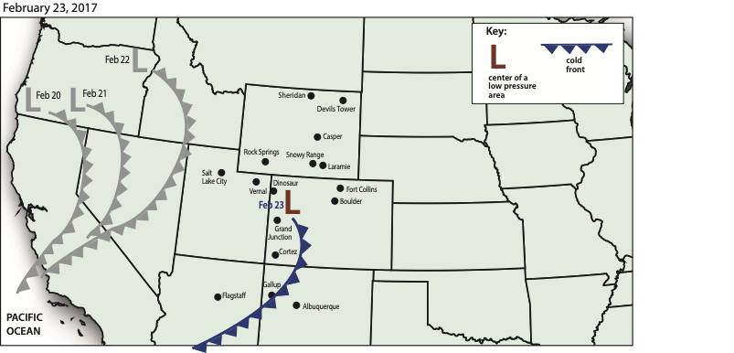
Steps 1-4: Snowfall, School Closure, Air Movement along a Front and Humidity
Notes:
Challenge 2: Steps 1-4
Discuss where the winter storm is heading. Project the class map for Challenge 2 and explain that in Challenge 2 students will analyze precipitation data for the winter storm three days after it was in California. The storm is now located in the Rocky Mountains. Their goal is to identify places with heavy precipitation and decide what is causing precipitation in this area.
Prepare to complete Challenge 2. Pass out the Challenge 2: Student Activity Sheet. Read the instructions together for Challenge 2 and outline the four steps students will complete. Orient students to what is shown on the map over the four days of the storm. Have students return to their groups/partners from the previous day. Remind students to use their class Consensus Models and Model Idea Tracker to help them decide what is happening to cause heavy precipitation.
Work on Challenge 2 in small groups. Give students 20 minutes to work on Challenge 2: Steps 1-4. In Step 1, students will write the snowfall totals from the data table on their map and identify the communities that had significant snow. In Step 2, students use the snowfall map to predict where schools might close. For Step 3, students consider patterns in snowfall and why some areas had more snow than others. Step 4 reminds students of the two things needed for precipitation (rising, cooling air and humidity). Students draw air movement and cloud formation in the cross sections showing low pressure and the front and relate distance from the storm to the amount of snowfall received. Step 4 continues with students completing the humidity map and determining which locations didn’t have enough moisture to result in a storm.
As students work, circulate the groups and prompt students to draw on previous models and Model Ideas.
Think about how precipitation forms around a front. What’s happening to the air along the front?
What happens to air in a low-pressure area?
Even though a cold front is passing through all these towns, why might some not get any precipitation? What’s an important ingredient that could be missing?

Slide 12
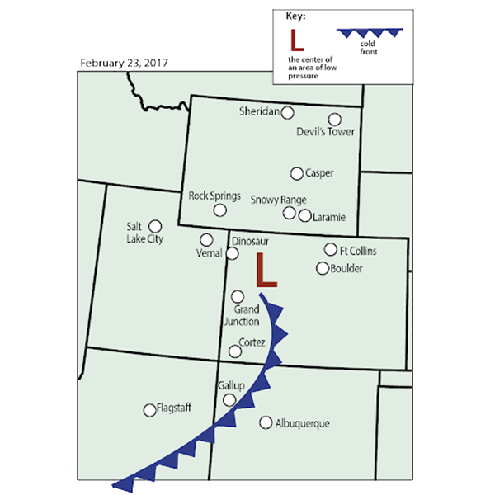
What did you notice about the pattern of snowfall?
Location | Snow (cm)
Rock Springs, WY | 45.7
Laramie, WY | 7.6
Snowy Range, WY | 61.0
Sheridan, WY | 1.3
Devils Tower, WY | 0
Casper, WY | 13.7
Dinosaur, CO | 19.1
Grand Junction, CO | 0
Fort Collins, CO | 3.8
Boulder, CO | 1.3
Cortez, CO | 0
Flagstaff, AZ | 0
Salt Lake City, UT | 8.6
Vernal, UT | 17.8
Gallup, NM | 0
Albuquerque, NM | 0
Notes:
Discuss Challenge 2 questions as a whole class. Project the map for Challenge 2 and discuss the following question prompts. Focus on coming to consensus about each question and recording the consensus explanation for the class. Students can continue to edit their answers from Steps 1-4 if they hear something new or different they’d like to add. Have students share their images of what is happening on a document camera to support their explanations.
Where were the communities with heavy snowfall located in relation to the storm?
• These locations are near or just behind the area of low pressure at the northern end of the cold front.
Explain why places like Cortez, Gallup, and Albuquerque didn’t get any snowfall at all.
• They are not close enough to the low pressure area, which is necessary for warmer, moist air to rise up into the atmosphere.
Did it always snow in areas that had high humidity? Explain why or why not. Give examples.
• Devils Tower is the only location that had high humidity but absolutely no snow. Since it is the farthest from the low-pressure system, there was no mechanism for the moisture to rise up into the atmosphere. In general, areas with high snowfall did indeed also have high humidity.
Compare the two areas with the highest snowfall to the two areas with the highest humidity.
• The areas with the highest snowfall did indeed have high humidity, but the areas with the highest humidity didn’t happen to have all that much snow due to the large distance between them and the storm.
Why do some communities have more snowfall than others? What is happening to air in these areas?
• Areas of low pressure have warm, rising air with moisture. This means there is more moisture rising in this area, so there is a higher potential for more precipitation. (Students’ Step 4 drawings may vary but should indicate that an area of low pressure is where warm air, or relatively warm air, with moisture is rising and then cooling to create storms and precipitation.)
Why didn’t it snow everywhere?
• Some of the places where it didn’t snow were too far from the storm.
Where might schools close?
• Students’ answers may vary but should include all locations with significant snow (Rock Springs, WY; Dinosaur, CO; Vernal, UT). Students may include locations with less snow depending on their experience with snowstorms and school cancelations. (Students will learn more about safety and cancelations in Challenge 3.)

Slide 13
Challenge 2: Where’s the Snow?
As the storm moved east, why did it snow in some areas but not others?
Notes:
Return to the Challenge 2 question. Revisit the question: “As the storm moved east, why did it snow in some areas but not others?” Have students discuss an explanation to this question in groups and/or write a response on an Exit Ticket before the end of the lesson.

Slide 14

We’re Warning You
Where will schools have a snow day on February 24?

Slide 15
Looking back
How do we know where it will snow? What’s happening to the air in this area?
Where is the storm heading next and how do you know?
Notes:
Navigate from the previous lesson. Review what students learned about this winter storm in Challenge 2. Focus the review discussion on the questions that ended the previous challenge:
How do we know where it will snow?
What’s happening to the air in this area?
Where is the storm heading next, and how do you know?
Listen for the following responses:
It will snow in places near the front that have sufficient moisture. Most of these places are near the area of low pressure because there is more rising moisture here.
This winter storm will move east because of prevailing surface winds in the midlatitudes.

Slide 16
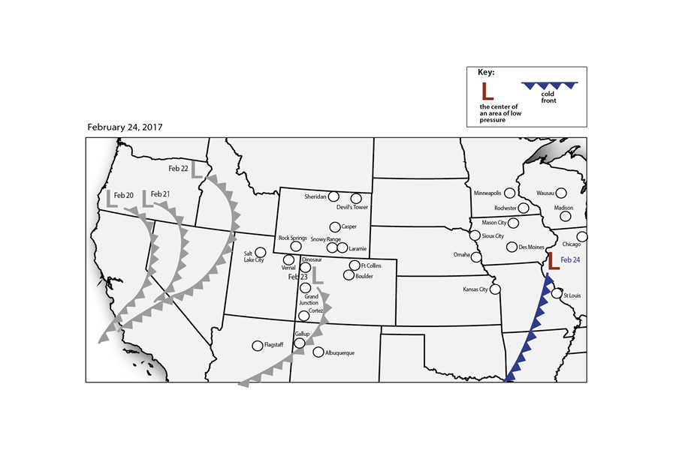
Where will schools have a snow day on February 24?
Complete Steps 1-3 with your group
Notes:
Challenge 3: Steps 1-3
Introduce Challenge 3. Project the class map for Challenge 3 and explain that students will take what they know about this winter storm on February 23, 2017 and make a prediction about which locations will be in the path of the storm on February 24, 2017. Explain that weather predictions are often made to help keep people safe. Introduce how winter storms can prove hazardous (e.g., blowing snow can reduce visibility on the roads, ice can cause people to slip while walking and have auto accidents). Challenge students to identify which communities need to consider closing schools and businesses to stay safe. (Note: As you introduce the class map, students may notice that the front and low-pressure areas are moving at different rates than they were a few days before. It’s not uncommon for a storm system’s rate of movement to change.)
Prepare to complete Challenge 3. Pass out the Challenge 3: Student Activity Sheet. Have students return to their groups/partners from the previous day. Have students take out the class Consensus Models and their Model Idea Tracker. Tell students they can draw on these ideas and models to help them with the challenge.
Work on Challenge 3 in small groups. Give students 20 minutes to work on Steps 1-3 in Challenge 3. Have students make predictions about where it will snow on February 24, 2017 based on characteristics of the storm on February 23, 2017. As students work, circulate the groups and prompt students to draw on previous models and Model Ideas.
In Challenge 2, what was the air pressure like in places where heavy amounts of snow fell? [low]
What was happening to the air in this area? [it was rising]
What side(s) of the low-pressure area did the snow fall in Challenge 2? [on the north and west sides]

Slide 17
Discussion
When did it snow on February 23, 2017? Compare the locations with snow to the location of the front and low-pressure system.
PREDICTION: Where do you think it will snow on February 24, 2017?
Notes:
Discuss Challenge 3 questions as a whole class. Project the map for Challenge 3 and discuss question prompts from Steps 1, 2, and 3. Students do not need to come to consensus on their predictions yet.

Slide 18
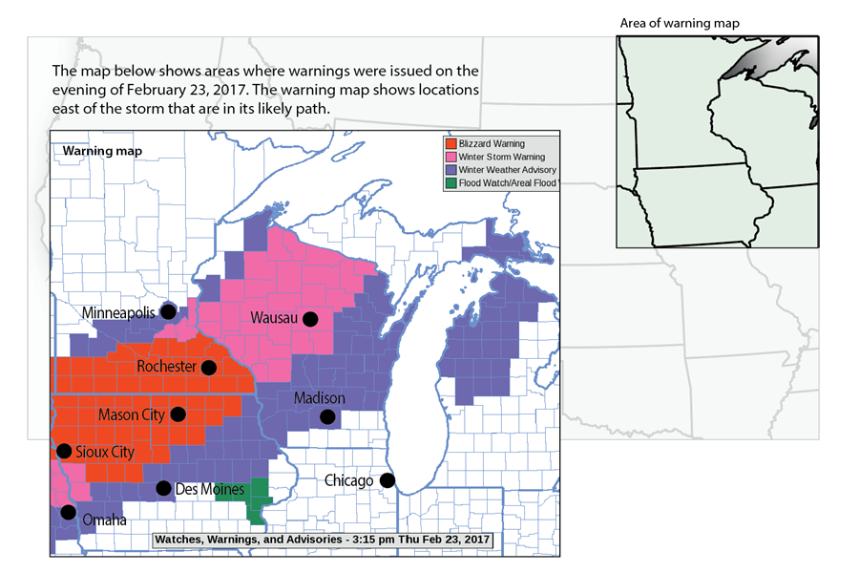
Step 4: Warning Map
Notes:
Challenge 3: Step 4
Read the warning map and snow day text in Step 4. Explain that these are the areas where warnings were issued as places that may be vulnerable to severe weather on February 24, 2017. Have students read the warning map and text: Is it a snow day? Students answer the question at the end of the text on their own.
What locations should cancel school based on the reading above and your predictions of snowfall from Step 3?
NOTE: Students need to view the warning map in color. Consider making a class set of color print outs for repeated use or plan to have students use a computer or tablet to view the map in color. The warning map is also included in the slide set.

Slide 19
Step 5: Discuss with the class
Where will it snow on February 24?
Revise your predictions.
Notes:
Challenge 3: Step 5
Discuss and revise predictions with the class in Step 5. Tell students that scientists, including meteorologists, revise their predictions once they have more information. Have students revise their predictions for February 24, 2017 to take into account the warning information and text. Discuss and revise predictions about where it will snow on February 24, 2017.

Slide 20
Conclusion
Discuss our community:
What types of weather hazards do we face that can close schools, businesses, or roads in our area?
How could what we learned in this unit help us prepare for severe weather in our area?
Notes:
Conclude the discussion and focus on preparing for severe weather in your area.
What types of weather hazards do we face that can close schools, businesses, or roads in our area?
How could what we learned in this unit help us prepare for severe weather in our area?

Slide 21
What do we know about storms?
Think of a precipitation event in our community.
  Construct an explanation for why that storm happened.
Notes:
Return to the unit driving question: “What do we know about storms?” Ask students to think of one type of precipitation event in their local area. It can be an isolated storm, a front, or a different precipitation pattern. Ask students to explain as much as they can about why they think this storm happened. This activity can occur as a class discussion and/or an individual writing task, followed by small group sharing of ideas.

Slide 22

Driving Question Board
What can we answer now?
What should we do with our unanswered questions?
Notes:
Return to the Driving Question Board to answer any lingering questions. Ask students to revisit the Driving Question Board to answer any questions. There may be several questions remaining on the board that were not answered in the course of the unit. Consider having students take responsibility for researching one question from the board and reporting what they learned back to the class.

Slide 23


Wrap up: Applying our knowledge
How can we use what we have learned about weather?
Notes:
Wrap up the GLOBE Weather unit. Have students brainstorm answers to the question: “How can we use what we’ve learned about weather?” There are many correct answers to this question, so encourage students to be creative. Student answers may be individual (e.g., “Now we know what the meteorologist on TV is talking about.”) or larger and more involved (e.g., “Now we can collect our own weather data or research what types of storms happen where we live.”).

