Slide 1
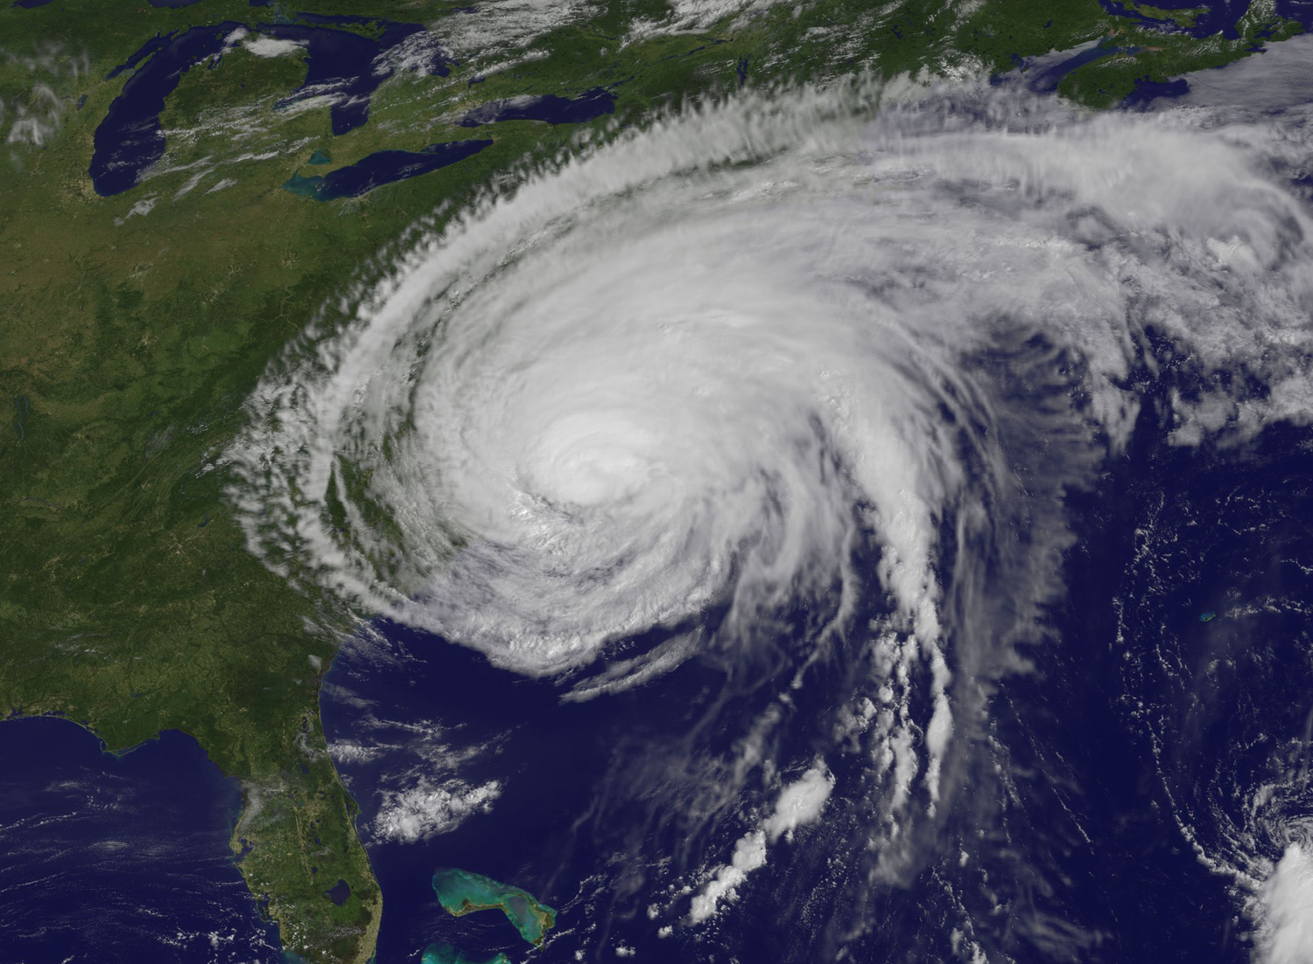
Weather Headlines
Tracking
Hurricane
News

Slide 2
What’s a Hurricane?
Hurricanes form from disturbances in the atmosphere over warm, tropical ocean water.
They die down when they move over land or out of the tropics and into cooler latitudes.
These storms are called typhoons or tropical cyclones in other areas of the world.
http://spark.ucar.edu/shortcontent/hurricanes

Slide 3
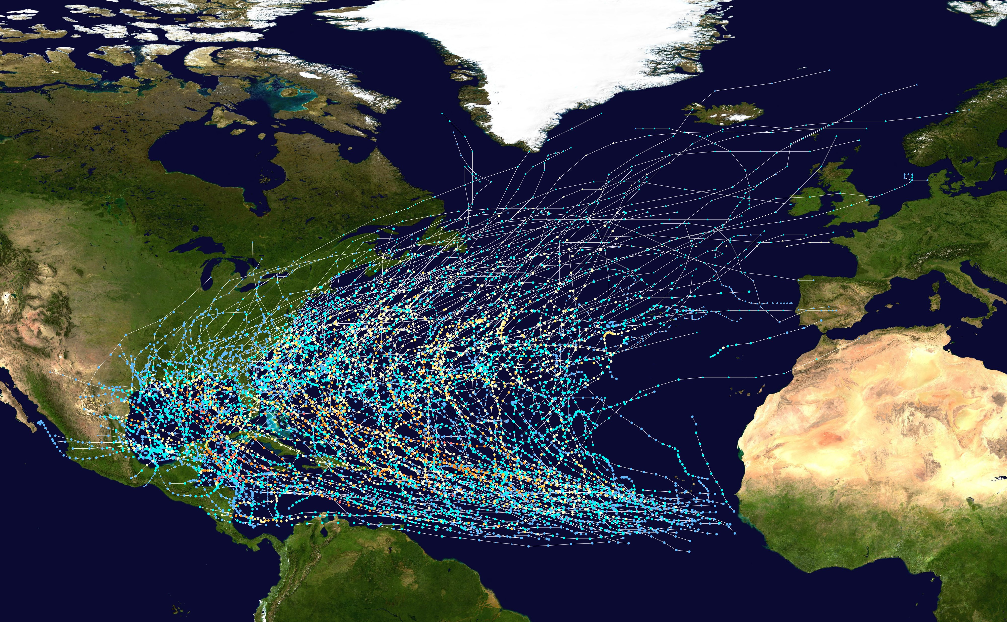
Where do hurricanes go in the Atlantic?
http://upload.wikimedia.org/wikipedia/commons/c/c5/Atlantic_hurricane_tracks_1980-2005.jpg
Notes:
Hurricane tracks 1980-2005
Colors indicate Saffir Simpson scale (blue = tropical storm, yellow = cat 1-2, orange = cat 3-4, red = cat 5)

Slide 4
Hurricane strength
The Saffir-Simpson Hurricane Wind Scale estimates potential property damage.
Category 1 | Winds 74-95 mph | Some damage
Category 2 | Winds 96-110 mph | Extensive damage
Category 3 | Winds 111-129 mph | Devastating damage
Category 4 | Winds 130-156 mph | Catastrophic damage
Category 5 | Winds 157 mph or higher | Catastrophic damage
Note: The scale indicates strength by the winds, not the storm size.
http://www.nhc.noaa.gov/aboutsshws.php

Slide 5
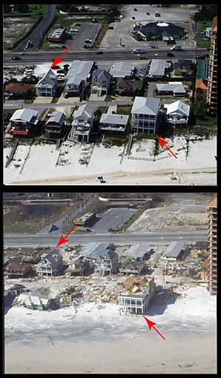
Hurricane damage
Winds: depending on the category of storm.
Storm surge: sea level may temporarily rise up to 30 feet as wind pushes water towards the land and low pressure allows water to creep higher.
Rain: hurricanes carry so much water and rain from the storm can cause massive flooding.
http://spark.ucar.edu/shortcontent/hurricane-damage
Notes:
Image: Houses in Orange Beach, Alabama, a barrier island community before (top) and after (bottom) Hurricane Ivan, which hit the coast in September 2004. Credit: USGS

Slide 6
Hurricane Irene
On Aug 20, 2011 Irene became a tropical storm
Strengthened to a Category 3 storm
Made landfall many times along its path (Puerto Rico, Bahamas, North Carolina, New York and New Jersey)

Slide 7
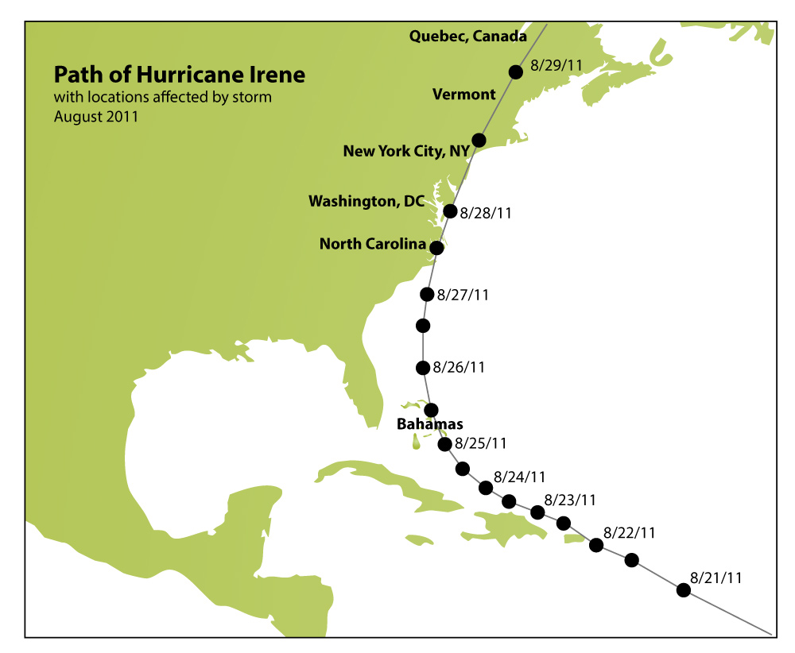
Notes:
For more info: http://www.co-ops.nos.noaa.gov/publications/Hurricane_Irene_Water_Level_and_Meteorological_Data_Report.pdf

Slide 8
Tracking Hurricane News
Objective: Create a timeline of Hurricane Irene through stories about how the storm affected people and places.
Step 1: read an article and take notes
Step 2: present your article to the class, take notes about other articles for your timeline
Step 3: Make a timeline using your notes about the hurricane stories.
Notes:
Encourage students to be creative with their timelines, using a format of their choice, while also including their research.

