Slide 1
Welcome to GLOBE Weather
A New NGSS-Based Middle School Unit UCAR- Boulder, Colorado
Train the Trainer
September 25-26, 2019
Notes:
We are excited to share with you this new curriculum, culminating product of a 2 year project, 5 week unit of instruction for use with middle school students.
Over the next three days we will dig in to the curriculum, hone in our understanding of weather concepts and hopefully make space to discover what questions we have about the content (maybe answer some of those questions), and introduce you to using the GLOBE program in your classroom.
Introduce ourselves
Schedule for the day: Reference agenda & resources handout, scheduled breaks, but take care of yourselves!
In your binder is the full curriculum!!! Also downloadable from the GLOBE Weather Curriculum website.
I thought we could point out the agenda and resource sheets which will be tucked inside their binders, and show folks where to find the slides right away in case they want to follow along, which may be an easy way for them to get to different links embedded in the slides (the curriculum website, globe connections, the eval at the end...)

Slide 2
Goal setting
What do I hope to walk away with from this workshop?
Notes:
Write down somewhere (don’t share)
Who is your focal audience?
Think of your focal audience, what groups of teachers might need extra resources and support
Our goals for you: Familiarity with GLOBE weather curriculum as a tool

Slide 3
Timeline of GLOBE Weather
Design & Development Process
Winter-Spring 2017
Year 1
Field Test Teacher PD Aug 2017
Year 1 Student Field Test
Fall 2017
Analysis of Year 1 Field Test
Fall 2017 - Winter 2018
Year 2 Student Field Test
Fall 2018
Year 2
Field Test Teacher PD Aug 2018
Revision & Development
Winter-Spring 2018
Analysis of Year 2 Field Test
Fall 2018 - Winter 2019
Final Revisions
Feb-April 2019
Dissemination:
GLOBE Weather workshops + GLOBE Weather website
Notes:
background of the project

Slide 4
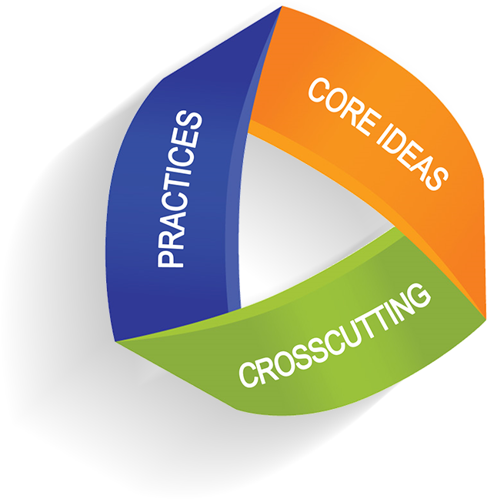
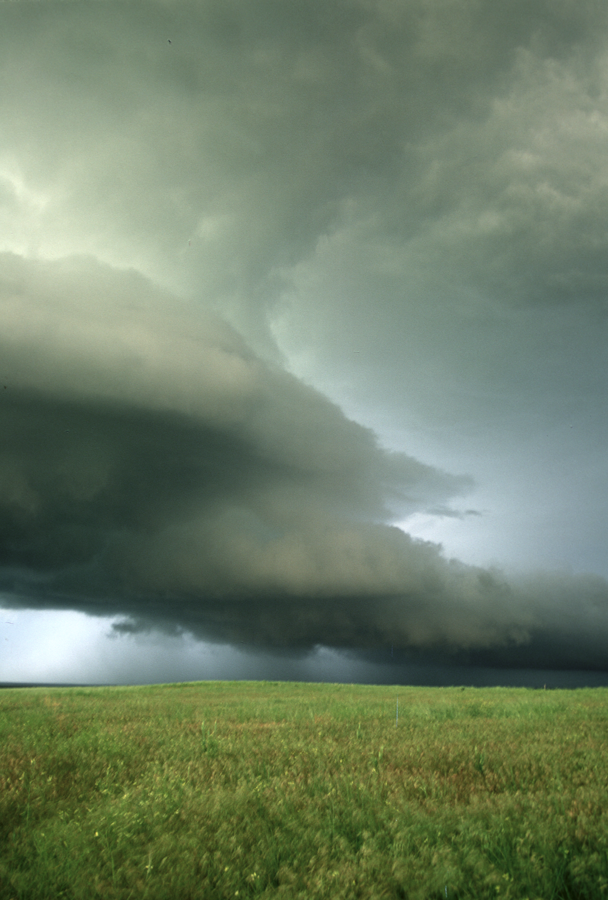
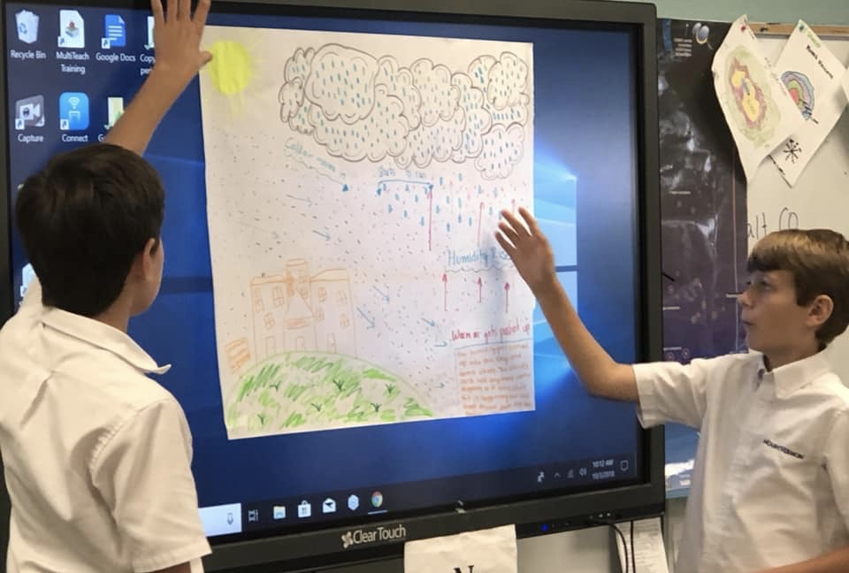
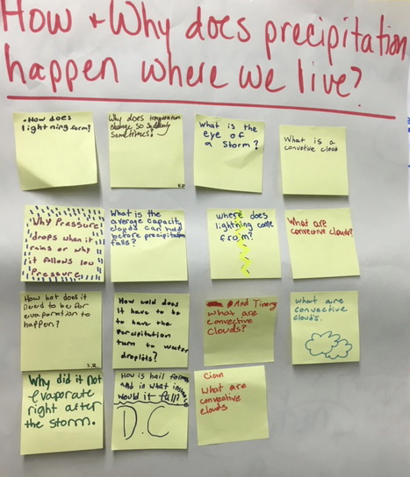
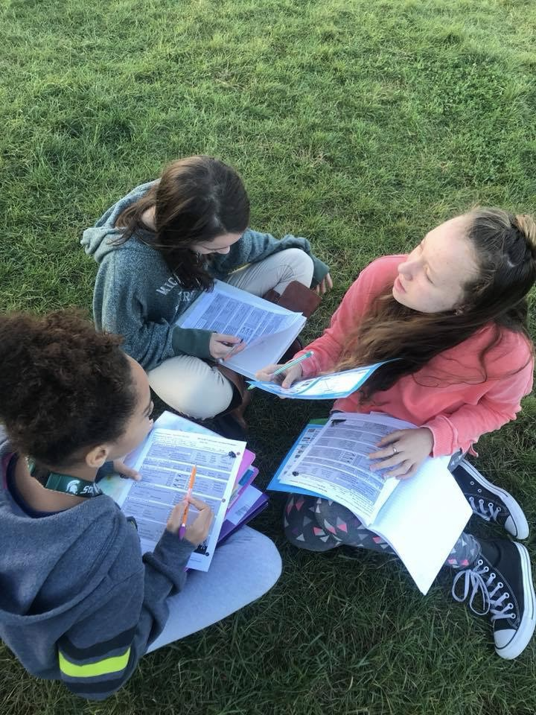
Overview of GLOBE Weather
NGSS
Storyline approach
A focus on weather phenomena
Student experiences with data analysis & modeling
Connection to the GLOBE Program
Notes:
Storyline as a way to sequence learning in a logical flow from beginning to end, connecting what we’ve just done to what we did before and to what is coming next.
Phenomena: Surprising or interesting things students have experienced but cannot easily explain.
Data analysis: Using strategies to interpret what i see/ what it means, drawing and writing on graphs and maps.
Modeling: different types of models: working models, consensus models, tracking model ideas
Questioning: Driving questions board to track and revisit student generated questions
Connection to GLOBE: GLOBE is a NASA program, GLOBE Weather introduces teachers to using GLOBE resources to: collect weather data using GLOBE protocols, Analyze GLOBE weather data
As many states and districts are moving towards adopting NGSS, there is a growing need for curriculum that is aligned. This unit was created to meet that need.

Slide 5
Features of GLOBE Weather
Scavenger Hunt!
Can you find examples of these curriculum features throughout the curriculum?
Notes:
Explain how the curriculum is organized
Start w overview section, go through up to pg 18 (icons page) then introduce Scavenger Hunt:
Pull out Note Capture Tool
As we go through the curriculum, be on the look out for these icons, make note of how you might use them with your PD audiences on your note capture tool
Some are teacher icons, some are student icons
Cues for NGSS, 3-Dimensional teaching aspects, data analysis, student grouping, the 5E stages of Inquiry
I encourage you to keep returning to the note capture tool as we encounter more of the features.

Slide 6
GLOBE Weather Curriculum
Anchor phenomenon
Three guided-inquiry learning sequences
Culminating task
Assessments
Snow Day?
Applying our learning to other types of storms
An Unexpected Storm
Extreme rainfall events impact a community
From Cloud to Storm
A Front Headed Your Way
Worldwide Weather
Short-lived, isolated storms
How and why storms move around the Earth
Stormy weather over a large region for many days
Notes:
Here is how the story unfolds: Change of scale, different ways that we experience weather: local, regional, global
Reference curriculum binder: organization/tabs
Mention frontmatter, background info at the beginning of each learning sequence, and assessments

Slide 7
Use text messaging or web responses like a clicker to gather real-time student responses: www.polleverywhere.com
From your laptop:
Navigate to: PollEv.com/melissarumme026
Enter your screen name
From your mobile device:
Compose a new text message to the number 22333
To join the session send the message melissarumme026
Notes:
9:45-9:55 Melissa
Let’s take a moment to discuss our level of familiarity with NGSS
explain Poll Everywhere
PRESENTER NOTE: be sure to log in to Poll Everywhere in advance! Must have chrome extension installed to use w/in Google slides. If using Powerpoint, might have to re-imbed poll everywhere slides for them to be active

Slide 8
Notes:
9:45-9:55 Melissa
Do the Poll question, reveal the results
Quick Discussion: Reference the “homework question” about how they are currently engaging with teachers in PD/the GLOBE community? What do you see is the value of basing these activities around NGSS??
GLOBE Wx was designed to meet the need for robust NGSS based curriculum. If you are working with audiences new to NGSS, this curriculum is a great place to start examining what is different about an NGSS based unit (oriented around a phenomenon, students engaging with science practices, investigations driven by student questions, etc)

Slide 9
NGSS https://www.nextgenscience.org/
Science and Engineering Practices:
Developing and using models
Analyzing and interpreting data
Disciplinary Core Ideas:
ESS2-C:The Roles of Water in Earth’s Surface Processes
ESS2-D: Weather and Climate
Crosscutting Concepts:
Cause and effect
Systems and systems modeling
Patterns
Performance Expectations:
MS-ESS2-5:Collect data to provide evidence for how the motions and complex interactions of air masses result in changes in weather conditions.
MS-ESS2-4: Develop a model to describe the cycling of water through Earth's systems driven by energy from the sun and the force of gravity.
MS-ESS2-6:Develop and use a model to describe how unequal heating and rotation of the Earth cause patterns of atmospheric and oceanic circulation that determine regional climates.
Notes:
9:55-10:00 John
Look at example of an NGSS page in the curriculum pg 36
Explain 3-Dimensional Teaching if needed
Reference SCIENCE PRACTICES HANDOUT: Other SEPs included in GLOBE Weather, but not listed here: asking questions, explaining, communicating

Slide 10
NGSS 3-Dimensional Assessments Must:
Be focused on a phenomenon
Require students to engage in sensemaking
Require students to use both science ideas and practices
Make sense to students
Support intended purpose and use
Notes:
10:00-10:10 John
The Task Annotation Project in Science surfaced some features that routinely distinguish NGSS tasks from science tasks not designed for the NGSS—the ”must haves” of any NGSS assessment.
Review one assessment item from binder and determine the extent to which it addresses these features.
reference Science Practices Handout to pick out SEPs students use w the assessment
Be focused on a phenomenon
Isolated thunderstorm
Require students to engage in sensemaking
Describing a concept and why it's important and how we might use this in the future to understand the Boulder storm
Require students to use both science ideas and practices
Ideas:
Think about the time-lapse video of a stormy day. Draw what the weather is like at different times throughout the day, using each of the boxes below. Include what you know about how clouds, water, air, and sunshine move and change throughout the day.
Practices:
Beginning to make a time-series model
Make sense to students
Describing a storm over time should make sense to students from their expereinces and the time-lapse video
Support intended purpose and use
Used for formative assessment (exit ticket/homework)

Slide 11
Assessments
Pre-assessment built is into Lesson 1 (Anchor activity)
Summative assessments for each Learning Sequence (3)
Overall assessment for the entire unit
Formative assessments are built in throughout the curriculum
exit tickets, student models, discussions, driving question board
Notes:
10:08-10:10 John
Assessment section at the end of the binder

Slide 12
What is inquiry?
ENGAGE: Learners are engaged collaboratively by questions
EXPLORE: Learners give priority to evidence
EXPLAIN: Learners formulate explanations from evidence
ELABORATE: Learners revise their explanations in light of alternative explanations
EVALUATE: Learners communicate and justify their proposed explanations
Notes:
We engage with weather phenomenon using the inquiry cycle, or 5E’s. The 5E’s are referenced at the beginning of each lesson. These align to the NGSS science practices as well, we are learning by doing what scientists do. Look at LS1 as an example (table of contents, at beginning of each lesson). By the time we get to explain, we are really looking for understanding in the way students are explaining what they are seeing.
Elements of inquiry approach to learning:
Open ended questioning vs questions with yes/no answers
Engaging students with phenomenon that don’t have one obvious answer
Asking students to design their own explanations by constructing models
Providing time to share our ideas with each other, and then to go back and update/revise our ideas
LOTS of discussion

Slide 13
An alarming statistic!
A review of research on student discussion revealed that its use in middle and high school classrooms varied from only 14 to 68 seconds per class period.
(Wilkinson & Nelson 2013)
Notes:
In order for inquiry to work, we must have a culture of talk in our classroom (asking questions, explaining, revising our thinking, sharing our thinking with others…).
Make time for students to share their ideas! Activating the speaking part of our brains helps with memory & retention. Students should be talking way more than the teacher!
But how do we get students to use their talk time to deepen thinking? We all know kids will talk with their friends forever, but we want them to be talking about their learning, which means we have to structure the way we engage students in talking so we can cultivate a culture in our classroom that supports productive talk, or talk that extends our thinking.

Slide 14
Inquiry and Productive Talk
For inquiry to work, students must engage in productive talk, or talk that extends our thinking.
How can we support teachers in creating a culture of talk in their classrooms?
Notes:
GLOBE Weather prioritizes student discussion throughout. We are attending to this piece now because rich conversations that push students to think deeper don’t just magically happen. We have to teach students how to talk to each other in an academic way, to disagree, to challenge each other.
I’d like us to spend a few moments now thinking about this question:
How can we support teachers in creating a culture of talk in their classrooms?
Thankfully we have tools: Reference Primer, checklist, talk moves
During activities time I encourage you to practice engaging in productive talk. You can use the checklist, sentence stems and the coaching prompts to get a sense for what this type of discussion should look like, which will help us support teachers to do this as well.

Slide 15
How can we support teachers in creating a culture of talk in their classrooms?
1- On your own, read through the Elements of Academically Productive Talk. What questions come up for you?
2- Stand up and find a partner. Discuss something that you found compelling/intriguing from the reading.
4- Join to make a group of four. Discuss ideas for attending to this in your own workshops. What have your experiences been?
All- Whole group share out
Notes:
Open up the PRIMER, go through the list of 7 things to support productive talk. Point out Checklist of Talk Moves, Sentence stems as tools for productive talk.
1-2-4-All discussion, use sentence stems in your discussion
GLOBE Weather is structured around having lots of student discussion. We are attending to this piece now because rich conversations that push students to think deeper don’t just magically happen. We have to teach students how to talk to each other in an academic way, to disagree, to challenge each other.

Slide 16
Break (15 min)

Slide 17
How do I find GLOBE
Weather resources?
Notes:
Emily
We are now going to take a few moments to explore what the website has to offer.

Slide 18
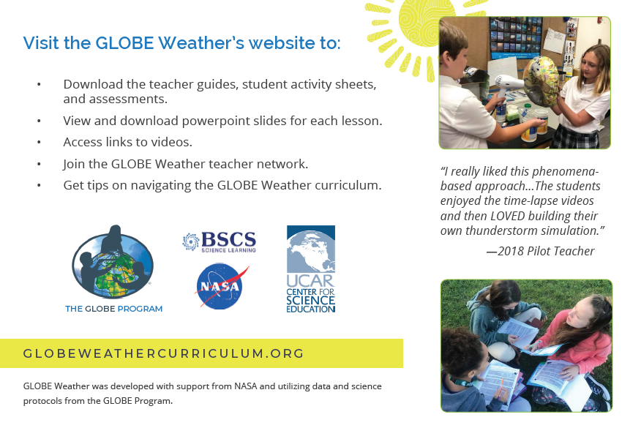
© 2019 University Corporation for Atmospheric Research. All Rights Reserved
Notes:
Emily
globeweathercurriculum.org
We have a wealth of resources on this site that go well beyond just a pdf copy of the curriculum.

Slide 19
globeweathercurriculum.org
GLOBE Weather Home page
Overview of curriculum
Testimonials
Download the entire curriculum as one PDF
Table of Contents
Notes:
Emily
When you arrive at the home page, you have a variety of options to navigate to different parts of the curriculum.
CLICK There is a complete overview of the curriculum, including a list of materials. This is a great place to start learning about the curriculum. (CLICK to show and to make disappear)
Also perhaps mention the teacher guide/front matter for a complete overview of the materials in order for teachers/coordinators to learn more about the unit.
Testimonials from our field test teachers
If you would like to download the entire curriculum in a single PDF (CLICK)
However, we also wanted to make this site flexible to a variety of needs. By clicking on the Table of Contents, the different elements section, OR the Curriculum tab at the top of the webpage, you can access the different sections of the curriculum.CLICK to show TOC.

Slide 20
Each section of the curriculum has its own webpage with:
Resources
Teacher Guide
All Activity Sheets for Lessons
Powerpoints
Assessments
GLOBE Connections
Background Content
Lesson Resources
Notes:
Emily
When you arrive at a particular section of the curriculum, you will see specific resources for that particular section or learning sequence.
Using Learning Sequence 1 as an example, you can see a list of resources that include (CLICK after each one):
Teacher Guide for Learning Sequence 1, which includes an overview of the materials and step by step instructions for activities.
The activity sheets for all of Learning Sequence 1 are in a single pdf
We also have powerpoint slides to help organize and guide your students through lessons and activities.
If there are any pre- or summative assessments these will also be listed here as well as on the separate assessments webpage.
We have also provided information on ways to connect to the GLOBE community through our GLOBE Connections webpage.
Links to the additional background information referenced in the teacher guides
And just when you thought you had it all..CLICK...when you scroll down the page we also have the specific resources for each of the lessons.
Specific links used in each lesson
Any supporting videos (example of activities)
As well as opportunities to extend the lesson with GLOBE Protocols.

Slide 21
Training resources:
Science Talk videos on the curriculum website (www.globeweathercurriculum.org)
GLOBE Weather Workshop website on our SciEd site (https://scied.ucar.edu/events/globe-weather-workshops)
workshop slides
handouts, agendas
workshop outline
supplies list
misconceptions activity
GLOBE Weather Educators facebook group
Notes:
Emily

Slide 22
An Unexpected Storm
What do we know about storms?
© 2019 University Corporation for Atmospheric Research. All Rights Reserved
Notes:
Julie -
Introduce Anchor
“Severe weather can put people’s lives and property at risk. If we can predict when severe weather is likely to happen, we can help people be better prepared when it happens. In this unit, we are going to explore where, when, and why storms form and how we can predict the ways in which they might impact communities, especially by bringing heavy rain or snow.”
Introduce the CO storm:
2013 there was an unusual storm that lasted for 7 days, dropping over 15 inches of rain, causing about $2 billion worth of damages.

Slide 23
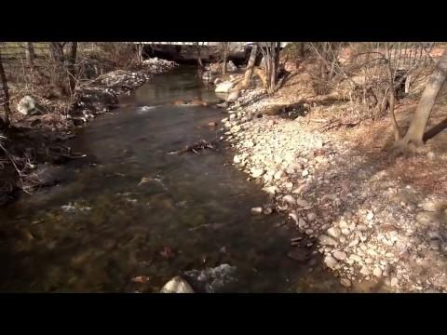
An Unexpected Storm
STEP 1:
What happens in the atmosphere to cause a storm?
https://scied.ucar.edu/boulder-floods
Notes:
Julie -
Watch video (say that we recommend watching the video more than once, but we’ll watch it only once here - give prompts)
Discussion: us using Talk Moves checklist questioning when applicable. Record ideas on chart paper
Have teachers take out sentence stems half sheet
With our first group share-out, I’d like us to try using the Sentence stems as a way to support discussion with our students, which they will be doing a lot of in GLOBE Weather. (Questioning/Discussing/Argumentation are science practices!)
Prompts:
What did you hear in the video about the causes of the precipitation?
Where did all the moisture over CO come from?
What had to happen to make that moisture turn into rain?
Make sure to focus on what caused the rainstorm (not the flood). “Is that a cause of the storm or an effect from the storm?”

Slide 24
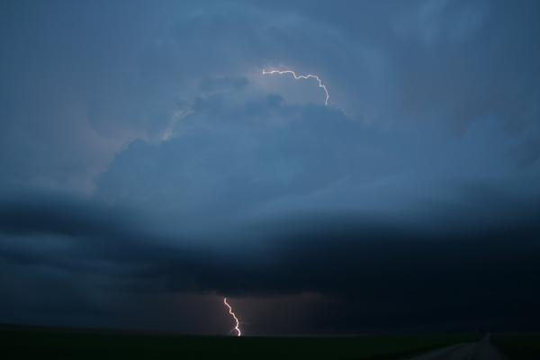
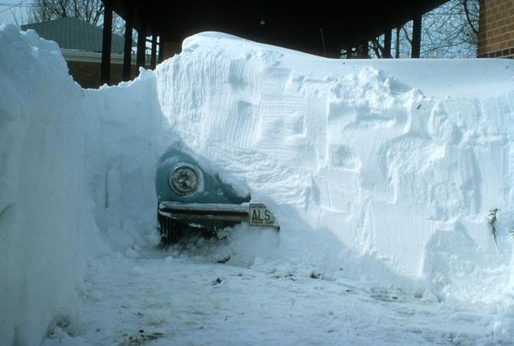
An Unexpected Storm
STEP 2: What are my experiences with storms?
Notes:
Becca
Think about a storm you have experienced and would like to share about.
2 minutes to share storm experiences with a partner
Whole class discussion:
Ask for teachers to share what they heard from their partners.
Have teachers take out sentence stems half sheet
Prompts:
How do storms begin in the first place?
What needs to happen so that rain or snow starts to fall?
Why do some places get heavier precipitation but other places do not?
Where does all the water come from before it falls as rain or snow?
Focus on water cycle, record ideas on chart paper from before

Slide 25
An Unexpected Storm
STEP 3: Represent what you know about storms
What caused the rain in the Colorado storm?
Notes:
Julie
Pass out Lesson 1: Step 3 SAS
Draw & label a picture in the box on your SAS. Your picture is a model of how this storm happened.
Your picture should show all of the factors that led to rain.
Include labels in your drawing that explain how each factor led to rain.
Share models with others at your table, comparing/contrasting with each other. One person from each group report the the whole group about trends from their models.
***This type of model development is a consistent feature of GLOBE Weather***
If time, draw a consensus model.

Slide 26
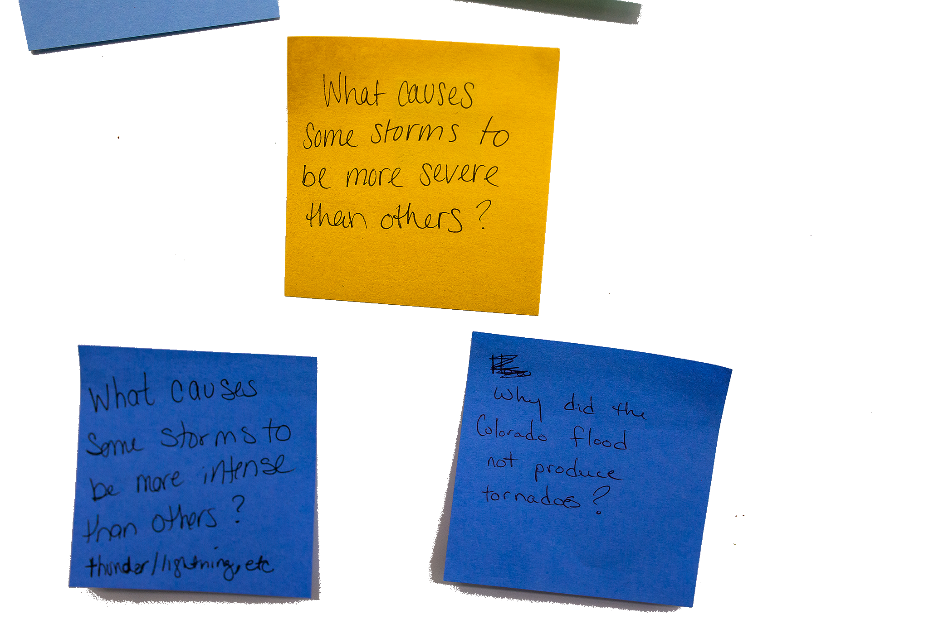
DRIVING QUESTION BOARD
This is where the students post their questions and where students return to answer their questions throughout the unit.
Unit Driving Question:
What causes different kinds of storms?
Notes:
Becca (Julie put up post-it notes)
By the end of the unit, students should be able to answer the driving question, but they also likely have their own questions. And perhaps you have some questions that have started to come up as well. We don’t want to lose track of these questions, so we will track them on our DQB
Write unit driving question across top of the driving question board: What causes different kinds of storms?
Write questions on your own related to “What causes different kinds of storm?” and the Anchoring Phenomenon (Colorado Storm) on the post-it notes provided at your table. Write one question per post it!
Form “Scientist Semi-circle” and take turns reading/posting questions to the DQB. After a question is added, ask if anyone else has the same question or a related question. Group like questions together.
Chart papers hanging on wall, divided into 4 sections: LS1, LS2, LS3, Other. As question is read out, we decide which section the question should be posted in

Slide 27
Lunch Break (1 hour)

Slide 28
From Cloud to Storm
LEARNING SEQUENCE 1
What causes an isolated storm?
© 2019 University Corporation for Atmospheric Research. All Rights Reserved
Notes:
Emily
Introduce Learning Sequence 1
We begin to investigate what causes a storm to form and first consider isolated storms, which are localized, short lived storms.

Slide 29
What scientific concepts do we draw upon to explain how a storm forms?
Notes:
Emily
Have them discuss with a partner, maybe write out as a list:
What are the steps for storm formation, and what science concepts are a work during each of those steps (first.. the sun warms the ground-- we must understand radiation and heat transfer, etc)

Slide 30
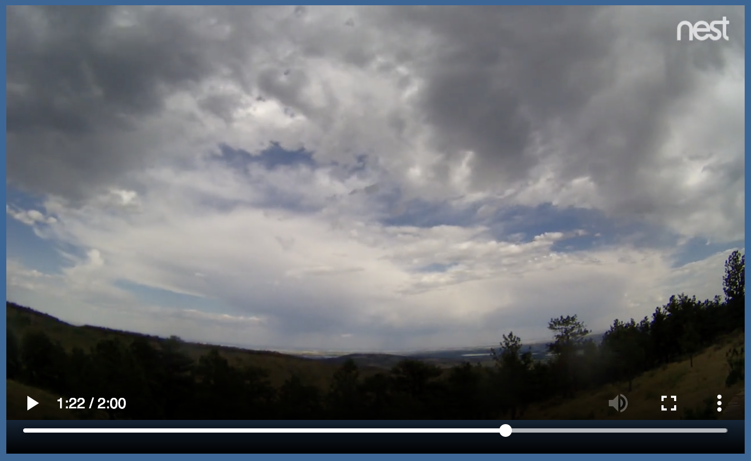
Watching the Sky
What we can learn about storms by watching clouds in the sky?
Students watch time lapse videos of a sunny day & a stormy day
Notes:
Emily
Let’s see how students will explore these topics (and how you will explore them in just a few minutes!)
We first understand the weather by what we observe in the sky
Watch time lapse video to see that storms form throughout the day, and typically happen in the afternoon

Slide 31
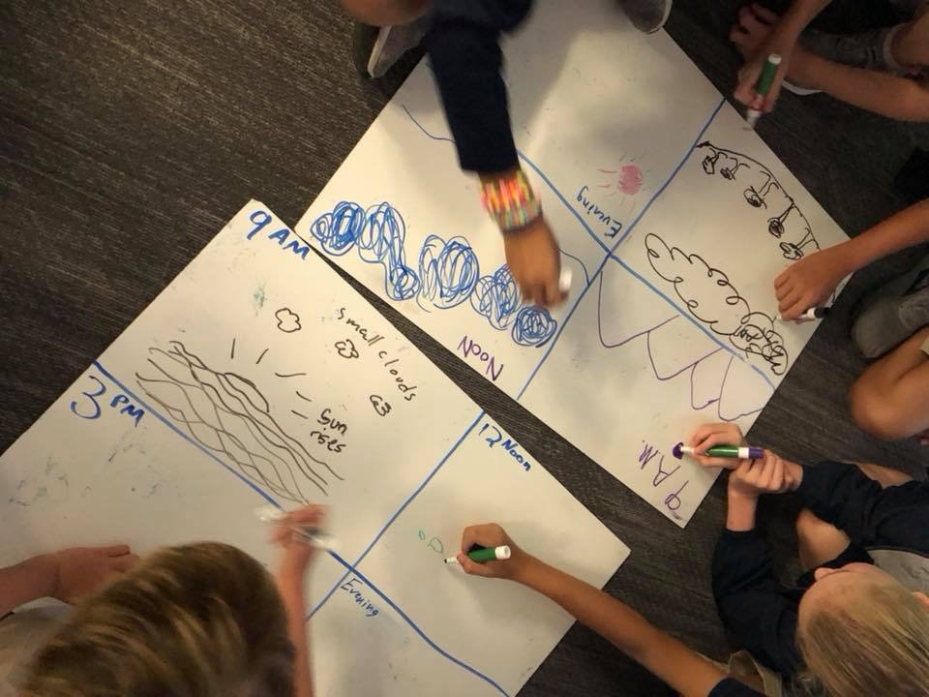
Watching the Sky
Students construct a time series diagram showing how an isolated storm forms throughout the day.
Notes:
Emily
We organize our thinking around what happened throughout the day when a storm formed by making a time series diagram.

Slide 32
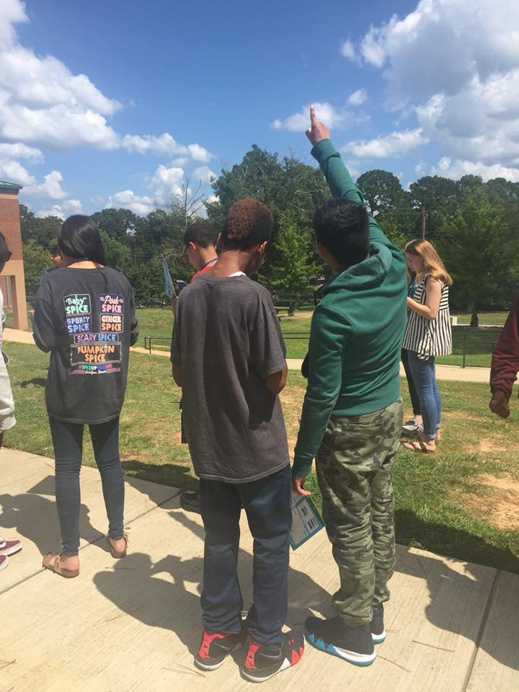
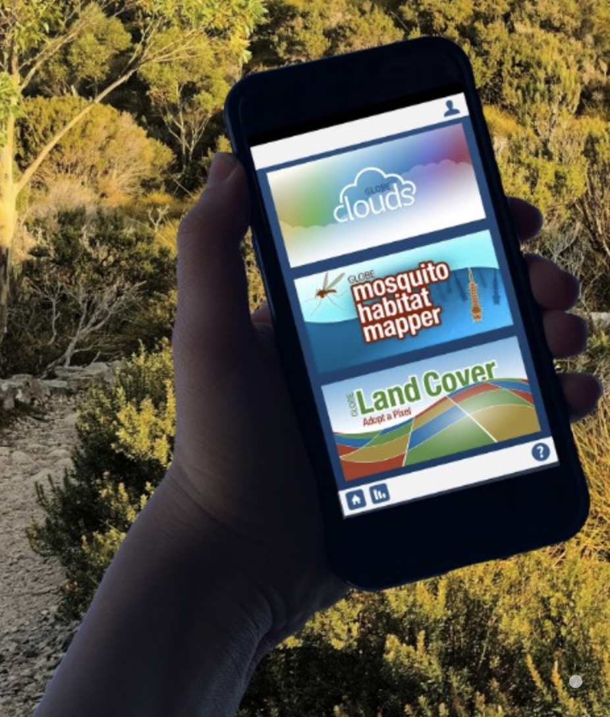
Watching the Sky
Students observe clouds outside
An opportunity to use GLOBE protocols to
collect data as a citizen scientist
Notes:
Emily
We go outside to make cloud observations
First opportunity to use the GLOBE protocols
Storyline link: using what we observe to motivate students to investigate further

Slide 33
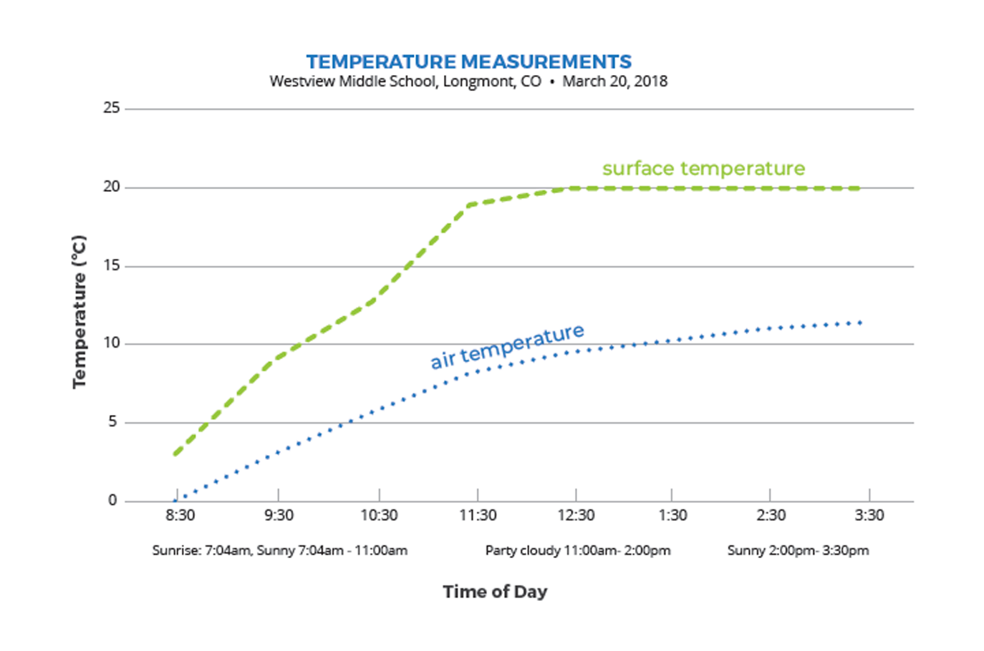
Investigation: Surface Temperature
Notes:
PASS OUT LESSON 3 PACKET
Now that have made the connection between clouds and storms, we naturally consider what processes are responsible for clouds to form, and to do so we must start by investigating temperature. Lesson 3 helps students puzzle through how water from the ground ends up as clouds in the atmosphere.
Students use data to compare surface temperature and air temperature, If doing the GLOBE Surface Temperature and Air Temperature protocols your students, would collect their own data and make a graph of that.
Westview Middle School DATA SET (if questions about where the data come from)
Middle school students in Longmont, Colorado wanted to know how the ground temperature (surface temperature) compared to air temperature. They measured both temperatures over a school day. Their surface temperature data were measured on their school track and their air temperature thermometer was located on the school roof. The students agreed these two surfaces were the most similar, which is why they selected the school track for their surface temperature location. They measured both temperatures every hour during the school day. They also made observations of cloud cover.

Slide 34
WHAT I SEE & WHAT IT MEANS
The green line is always above the blue line
The surface is
warmer than the air
Notes:
They use the Identify and Interpret (I²) Sensemaking Strategy to analyze and interpret the graphed data
What I See: Look at different parts of the graph. Do you notice patterns? Differences? Parts of the Graph?
What it Means: Write a What It Means statement to explain what you think is happening in each part of the graph.

Slide 35
How does temperature relate to cloud formation?
How does surface temperature compare to air temperature?
How does the Sun warm the atmosphere?
How might temperature change as you increase in altitude?
SHARE
-
TRADE
Notes:
Share-Trade:
Find a partner. Use your WIS/WIM statements to discuss your ideas about the question on the slide.
Trade WIS/WIM papers, find a new partner and discuss the 2nd question.
Trade WIS/WIM papers again, find a new partner and discuss the 3rd question, which isn’t explicitly addressed with the surface temperature graph, but could be implied...
This is where some of the common misconceptions about weather start to come up.
Understanding of the water cycle is important
Understanding why water evaporates, where the source of heat comes from
Understanding how the air is warmed
Understanding trends in air temp
Understanding how temperature related to clouds forming

Slide 36
Why are there storms on some days but not others?
Notes:
Stand up, put your hand up, and 5 five your partner when you find them
What is different about a sunny day and a stormy day?
Use evidence to support your answers

Slide 37
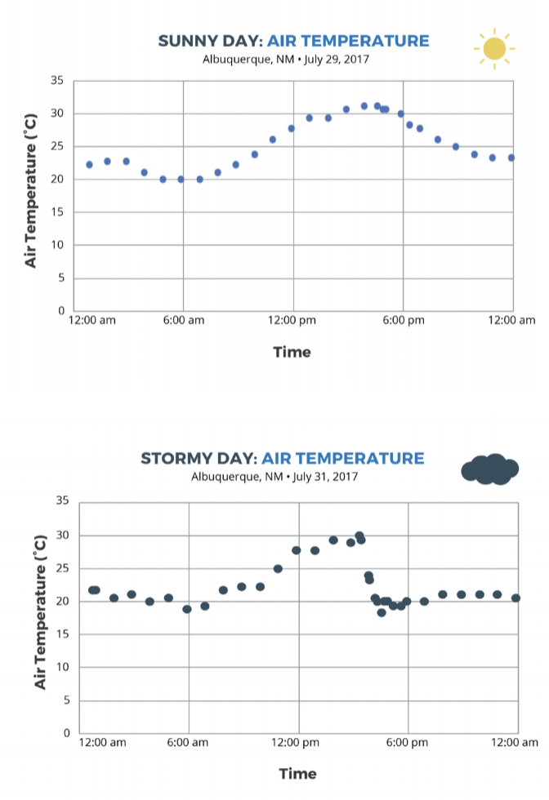
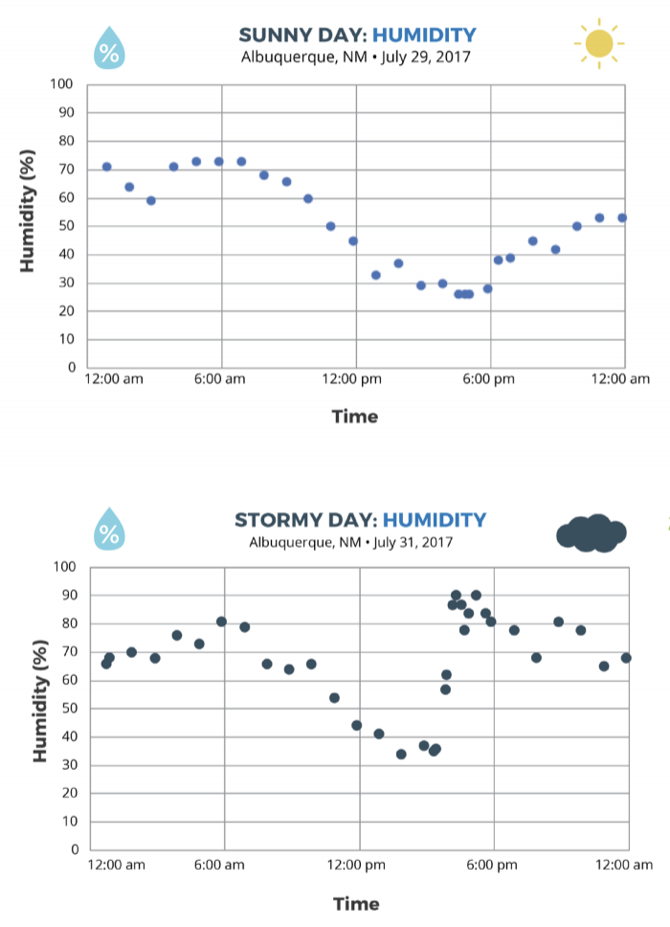
Comparing a sunny day and a stormy day
Notes:
What is different about a stormy day vs a sunny day?
Comparing air temperature and adding in HUMIDITY/a source of moisture

Slide 38
Break (15 min)

Slide 39
Activities Exploration
LEARNING SEQUENCE 1
Try out the activities wearing your “student hat” first
Refer to your Teacher Guide to begin thinking about how you would facilitate the activity
Coaching prompts and Talk Moves are facilitation supports as well
Work together, discuss with each other!
Notes:
Explain stations quickly
refer to teacher guide in binders
coaching prompts, KEY Patterns
talk moves/checklist

Slide 40
Current questions:
What is different about a stormy day and a sunny day?
Why does warm air go up and cool air go down?
What are the perfect conditions to make a storm?
Notes:
Storyline link: these questions are driving our explorations, and hopefully new questions are emerging as well. Students may be trying to apply the LS1 learnings to the CO Storm at this point, and they should realize that we don’t have the whole story yet.

Slide 41
Step 3: Create a Model to describe how precipitation happens in an isolated storm
Draw and write in the illustration. Your model should explain:
What happens to energy from the Sun that leads to the isolated storm?
What happens to water at the surface and clouds that lead to the isolated storm?
How air temperature and humidity change as air moves from the ground to the clouds?
How air moves between the ground and where the storm forms?
Notes:
Turn to Lesson 5: Step 3 (pg 22) of Student Activity Sheet, make a working model to track your thinking thus far. *ENCOURAGE THEM TO USE THE COLORED PENCILS, MARKERS, ETC
Refer to lessons 3, 4 & 5
Think of your model as telling the story of the isolated storm

Slide 42
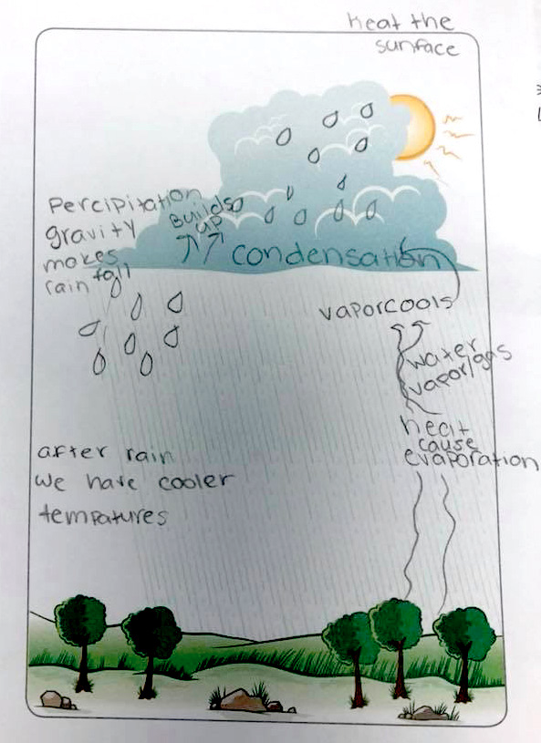
Example of a student model
Notes:
example of a student model, just for kicks

Slide 43
Model Idea Tracker
What ideas do we agree should be added to the Model Idea Tracker?
The Model Idea Tracker is used to record consensus ideas that help explain a phenomenon. These ideas are generated by students and agreed upon as a class.
Notes:
The Idea Tracker will be built upon throughout the entire unit. These ideas are important understandings that we uncover as the story unfolds!

Slide 44
Notes:
You can add a new model idea, or you can “vote” to agree with an idea that someone else has put up already

Slide 45
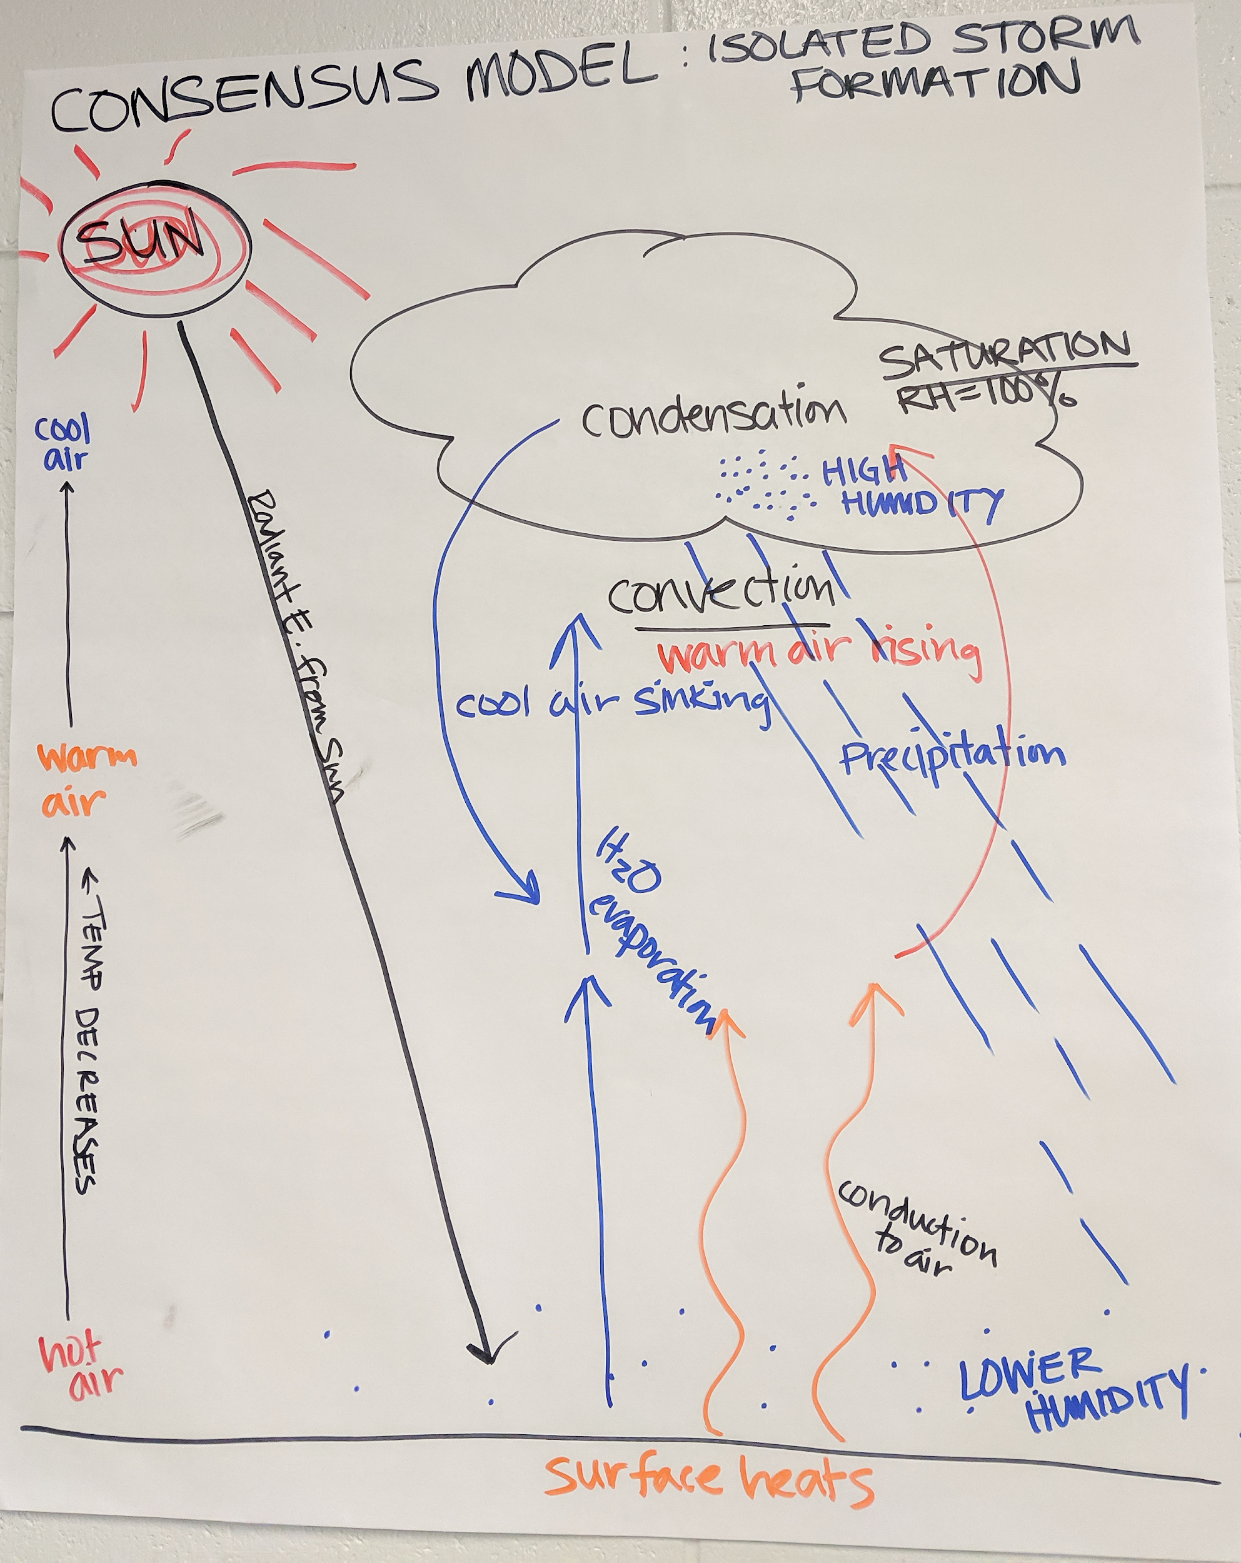
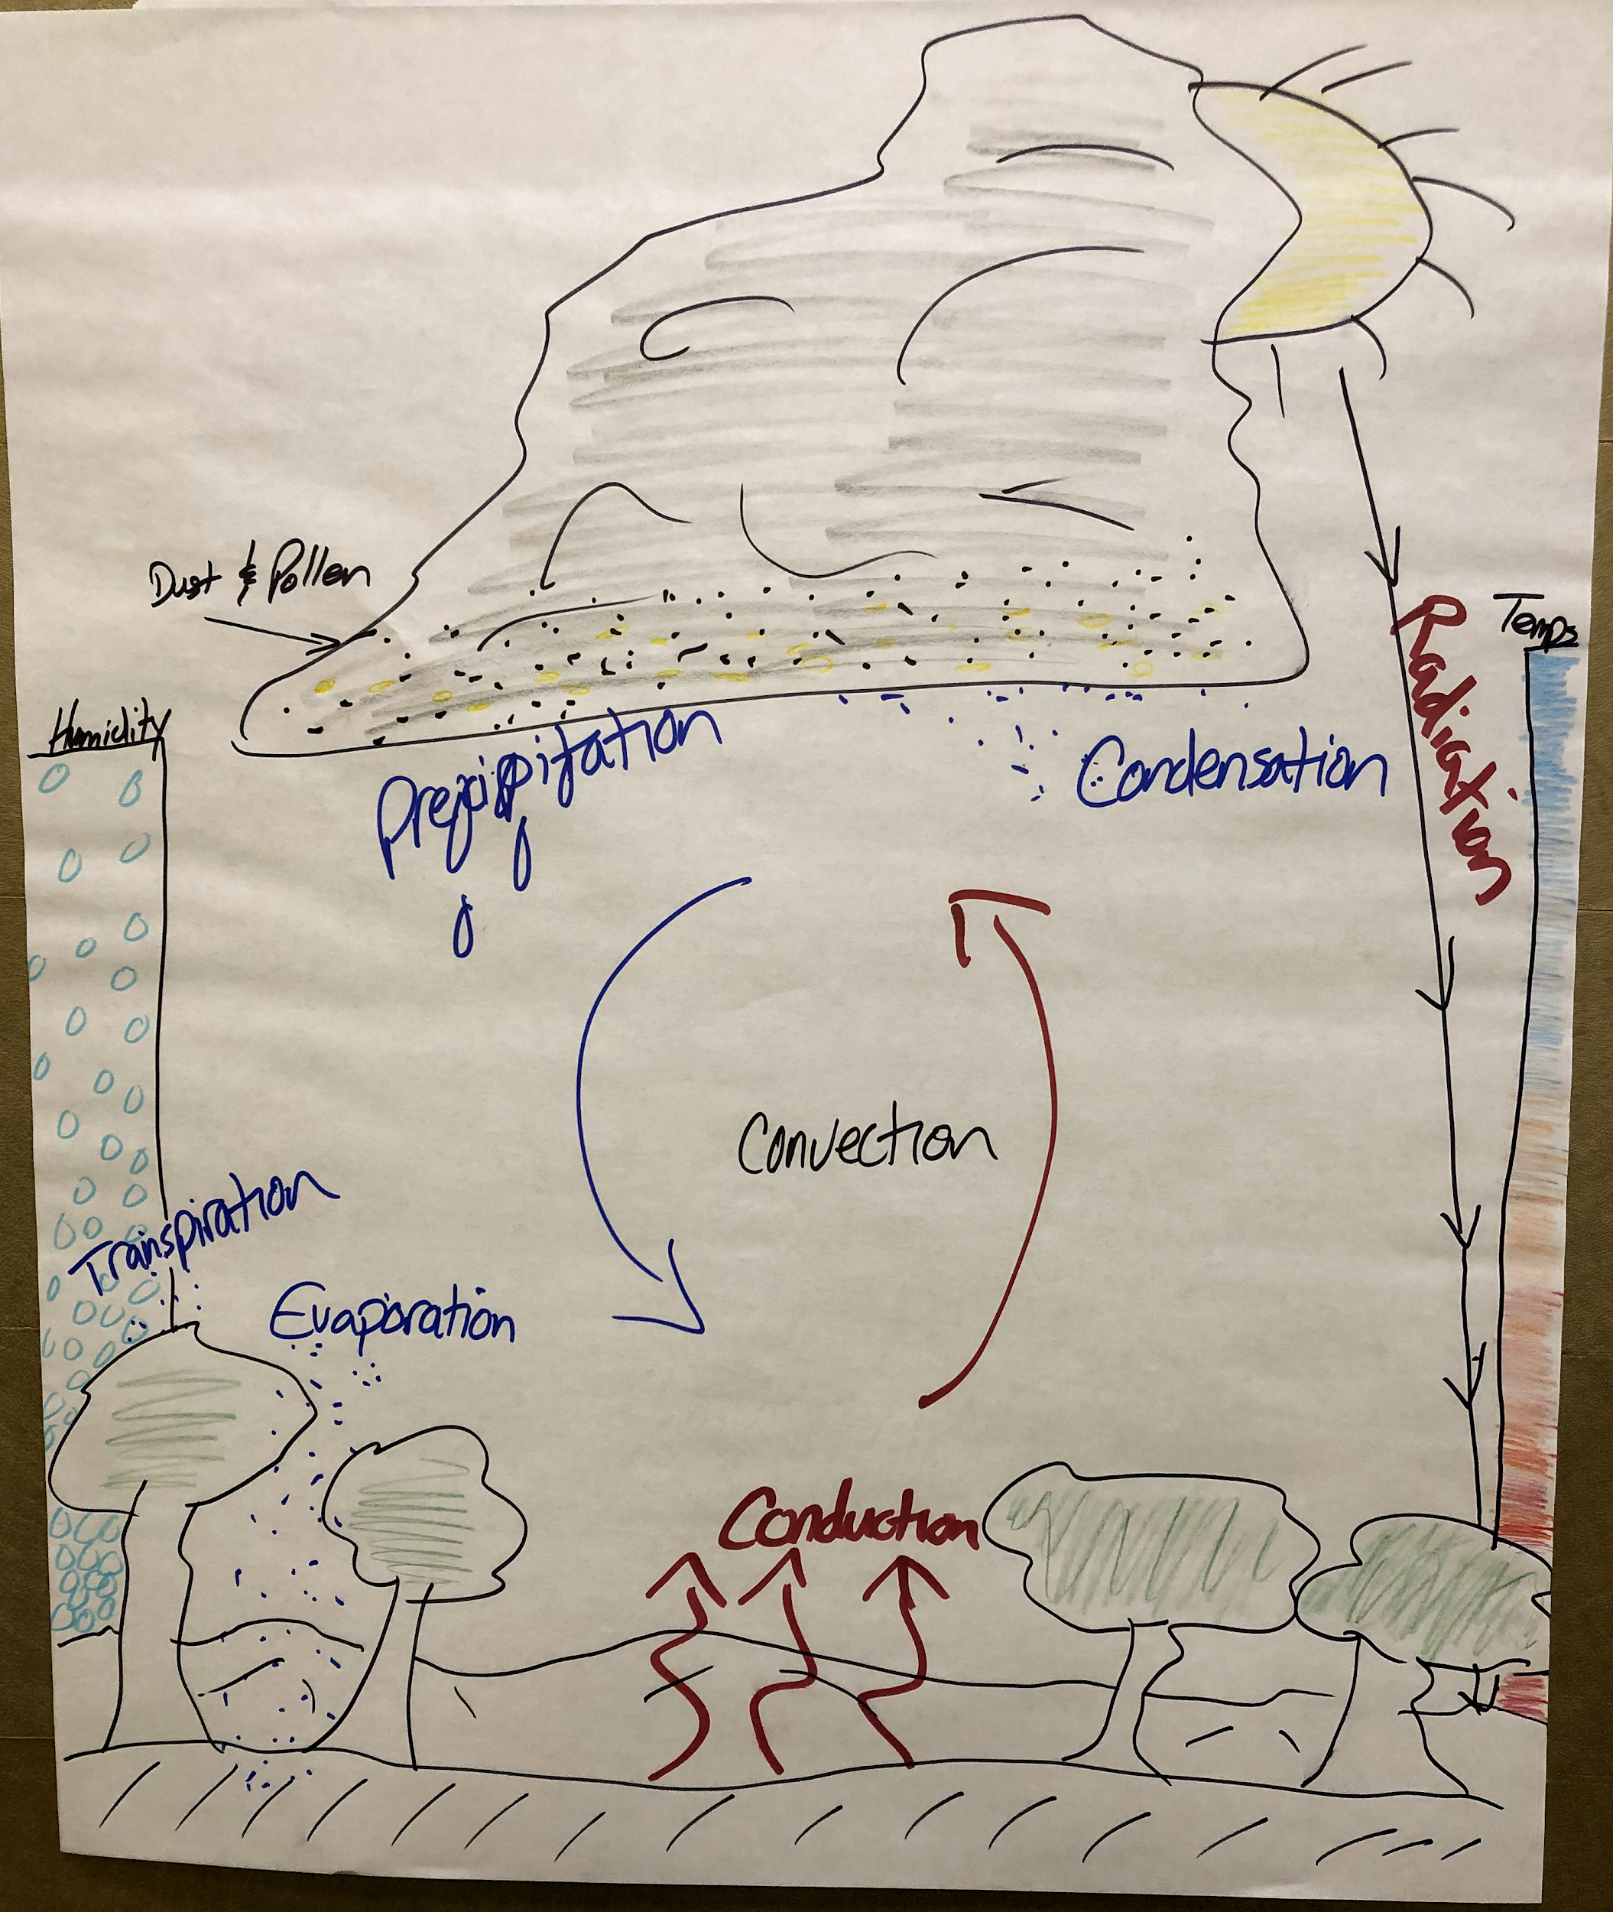
Consensus Model
Notes:
Make Consensus model together,
THEN show pictures of isolated storm consensus models from past teacher workshops

Slide 46
Misconceptions
How do you help students shift their thinking when they hold misconceptions?
Notes:
Turn to pg.34 in Teacher Guide
Look over list of misconceptions common during this learning sequence. Hold a discussion around strategies to address misconceptions.

Slide 47
DRIVING QUESTION BOARD
What questions can we now answer?
Do we want to add any new questions?
How can we use the DQB as an assessment?
Notes:
How can we use the DQB as an assessment?
This is a good time to assess how students are progressing. You can formalize the DQB as much as you’d like, having students write out answers to the questions or brainstorm how we could find the answer to our questions (what tests could we do?)

Slide 48
Sensemaking
Wearing your “trainer hat”
How is your focal audience
connecting with the content?
Did any new ideas come up for you? How could these activities fit into what you already do and extend them?
What are you wondering about now?
Where would your focal audience need support?
What challenges come up for you?
Notes:
Pass out Workshop Implementation Guide, capture notes you want to remember for planning your own PD in the LS1 section here.
Structured discussion about how to teach this to their audiences
explain the Thinking Routine (connect-extend-challenge)
discuss at tables then share out
use sentence stems?

Slide 49
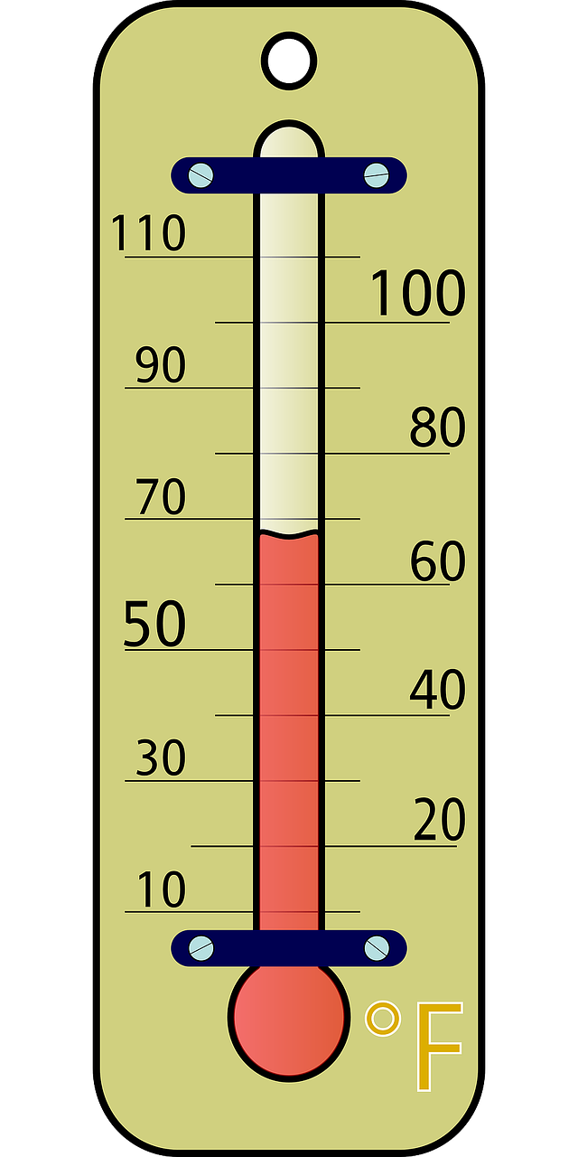
How are you feeling?
Notes:
To wrap up today… let’s take our temperature. What’s coming up for you? How are you feeling about the day? What are you wondering about?

Slide 50
end of Day 1 slides

Slide 51
Welcome to Day 2
GLOBE Weather
Notes:
Point out agendas for today

Slide 52
Looking Back:
How does energy from the Sun lead to warming of the atmosphere?
How does an isolated storm form throughout the day?
What role does humidity play in storm formation?
Notes:
Big ideas from yesterday...

Slide 53
Does our model for an isolated storm explain the Colorado storm?
Notes:
Image of the isolated storm model: does the model fit for all storms?
Reference the consensus model we made yesterday as well

Slide 54
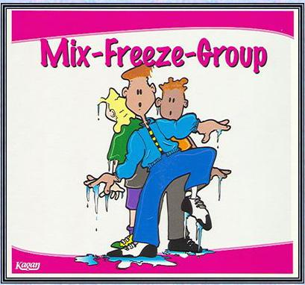
What other types of storms cause precipitation?
Notes:
Mix around, call our “freeze”, form a group of 3 with people you are near.
Since the isolated storm model doesn’t explain the Boulder storm, there must be other types of storms to consider. What ideas do you have about this?
Use evidence to support your answers

Slide 55
A Front Headed Your Way
LEARNING SEQUENCE 2
What other types of storms cause precipitation?
© 2019 University Corporation for Atmospheric Research. All Rights Reserved
Notes:
Introduce Learning Sequence 2
We shift focus to look at storm fronts, which happen over a larger region and often for a longer period of time.

Slide 56
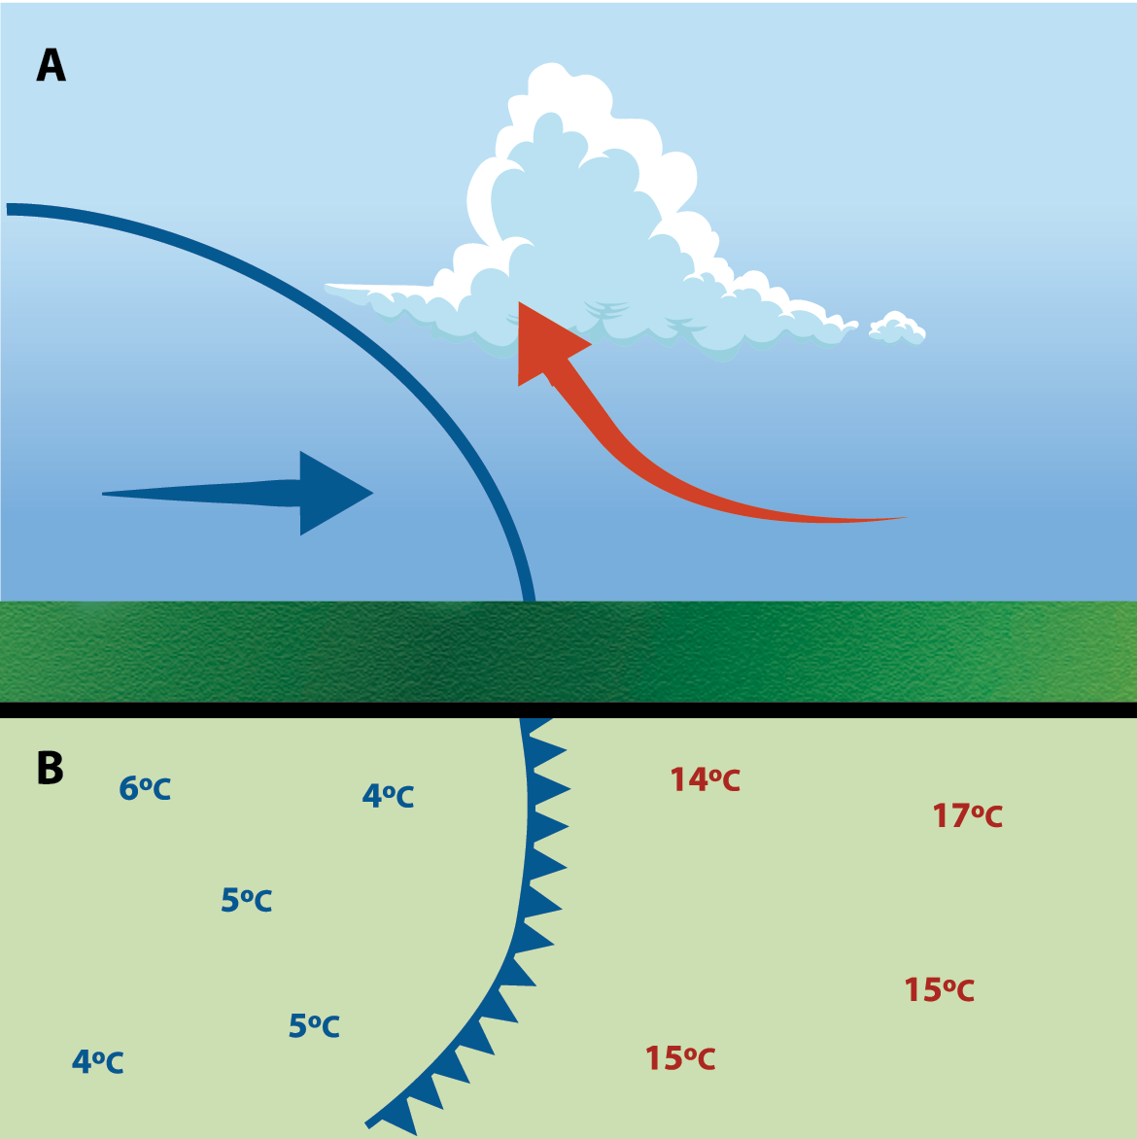
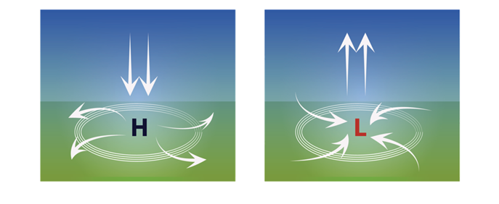
What is the weather like before, during and after a storm front?
Notes:
big ideas in LS2:
looking at weather over several days
focusing on before, during & after a storm
looking at temp & humidity data, and adding in wind speed data
air masses and fronts (cold fronts)
air moves from high to low pressure
high and low pressure associated with fronts, why storm fronts move

Slide 57
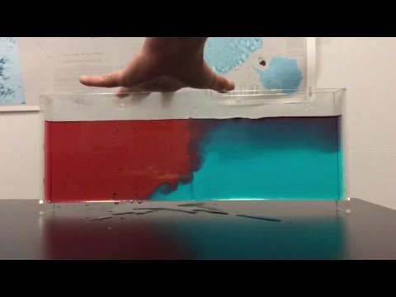
Storms and Precipitation along a Front
Notes:
Pass out Lesson 9 SAS, Demo with whole group
What did you notice?
What happened to the warm fluid?
What happened to the cold fluid?
Why did this happen?

Slide 58
Activities Exploration
LEARNING SEQUENCE 2
Try out the activities wearing your “student hat” first
Refer to your Teacher Guide to begin thinking about how you would facilitate the activity
Coaching prompts and Talk Moves are facilitation supports as well
Work together, discuss with each other!
Notes:
Emily
Explain stations quickly

Slide 59
Make a Model
Step 3: Develop a model for explaining precipitation during the front.
Your model needs to explain:
The location of the cold air mass.
The location of the warm air mass.
The direction that each air mass is moving.
Where you’d expect clouds to form.
Write a caption for your model.
Notes:
We need to model how precipitation is happening along the front. Direct students to the list of items to include in their model in Lesson 9: Step 3 of their student activity sheets. (Note: The model has the air before the front on the right side and the air after the front on the left side.)

Slide 60
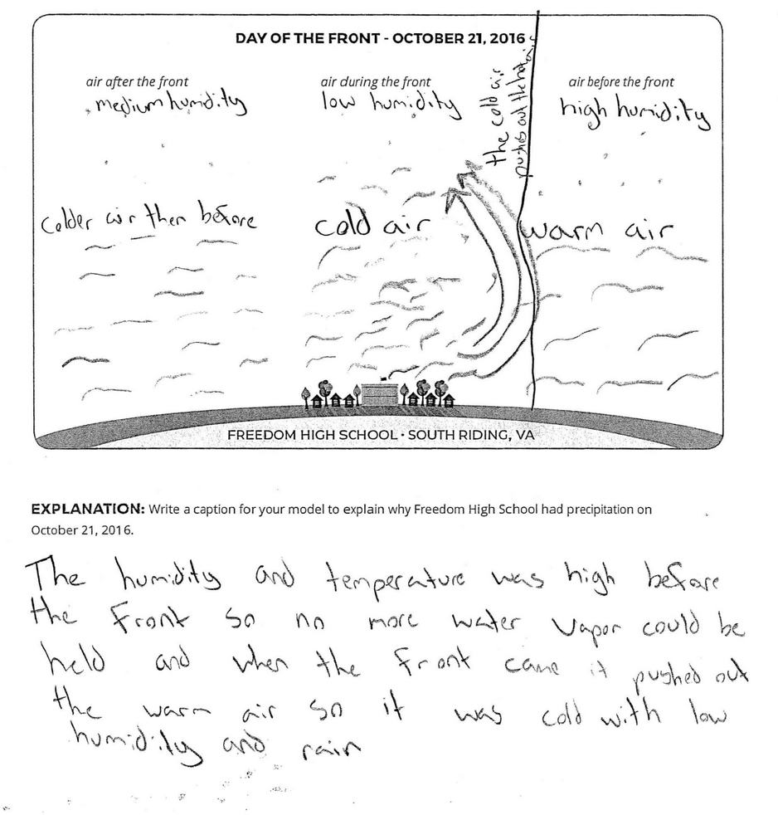
student model
Notes:
Example of a student model

Slide 61
Model Idea Tracker
What ideas do we agree should be added to the Model Idea Tracker?

Slide 62
Notes:
You can add a new model idea, or you can “vote” to agree with an idea that someone else has put up already

Slide 63
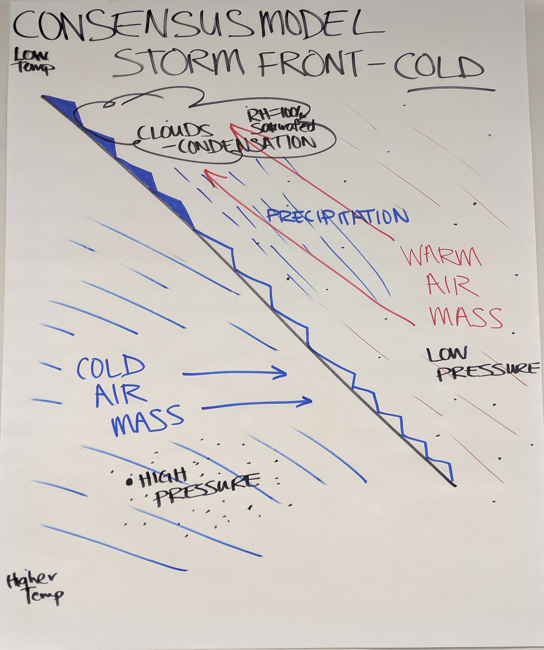
Develop a class Consensus Model
Notes:
For the sake of time, we will just look at this example together rather than go through the process of making one.
(this is the consensus model Melissa made with teachers at Jackson State)

Slide 64
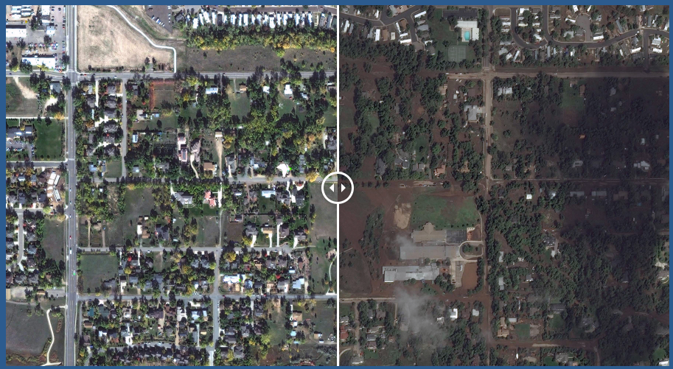
Case Study: 2013 Colorado Storm
Compare the Colorado storm with what we know about isolated storms and cold fronts.
Notes:
Revisit the Anchoring Phenomenon. The stage is set for using these models to figure out what’s happening with the Colorado storm.
Now students get to examine new data from the Colorado storm and compare it with what they know about typical isolated storms and cold fronts.
Look at the Table of Rainfall (Lesson 11: Step 1) pg. 42 SAS, make a claim about the CO Storm (poll everywhere)

Slide 65
Notes:
Look at the Table of Rainfall (Lesson 11: Step 1) pg. 42 SAS, make a claim about the CO Storm (poll everywhere)

Slide 66
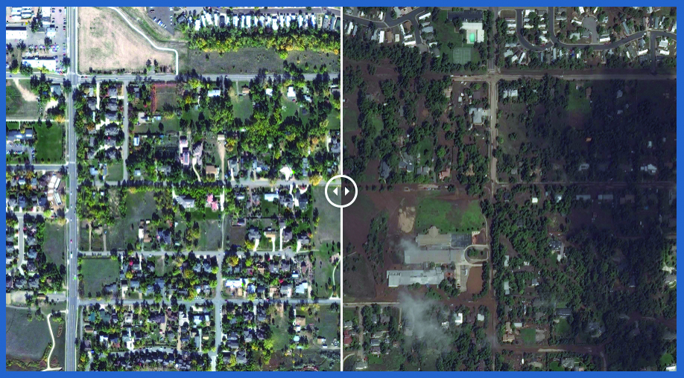
How is the Colorado Storm different from other storms we have learned about?
Notes:
What was unique about the CO Storm?
This storm is different from isolated storms and typical cold fronts because of the length of time it rained and the lack of movement (stalling).
Model ideas from the CO storm:
A warm, moist air mass got pushed up by a cooler air mass.
Low pressure pulled more air towards the storm system
High pressure was pushing air away from it.
Three areas of high pressure “trapped” the front and it stalled
Low pressure kept pulling in moisture from the Gulf of Mexico and Pacific Ocean.

Slide 67
Sensemaking
Wearing your “trainer hat”
How is your focal audience connecting
with the content?
Did any new ideas come up for you? How could these activities fit into what you already do and extend them?
What are you wondering about now?
Where would your focal audience need support?
What challenges come up for you?
Notes:
Use Workshop Implementation Guide, capture notes you want to remember for planning your own PD in the LS2 section here.
Structured discussion about how to teach this to their audiences
explain the Thinking Routine (connect-extend-challenge)
discuss at tables then share out
use sentence stems?

Slide 68
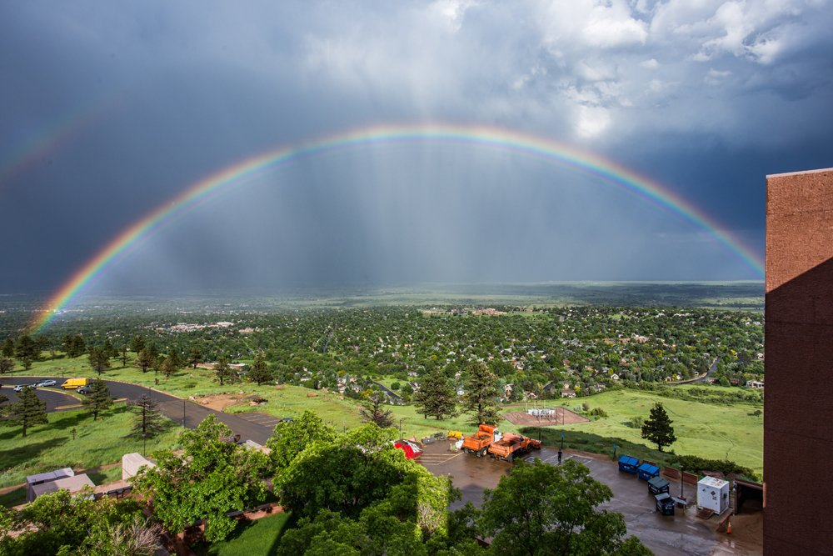
Group photo!
Notes:
time for a group photo!

Slide 69
Break (15 min)

Slide 70
Looking back
Specific local conditions allow for the formation of short-lived, afternoon storms (isolated storms)
The interaction of differing air masses can cause storm systems that last for several days over a large area (storm fronts)
Unique conditions, such as those in the Colorado storm, can result in unpredictable storm systems
New idea: Some places have more storms than others
Notes:
How do we know that storms move in patterns? What evidence can you think of that would support this idea?

Slide 71
Worldwide Weather
LEARNING SEQUENCE 3
Why do storms move in predictable patterns around the world?
© 2019 University Corporation for Atmospheric Research. All Rights Reserved
Notes:
Introduce Learning Sequence 3
LS3 considers how and why storms move around the Earth.

Slide 72
How do storms move around the world?
Notes:
Find someone who….has similar shoes
Use evidence to support your answers

Slide 73
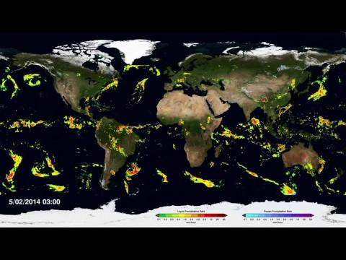
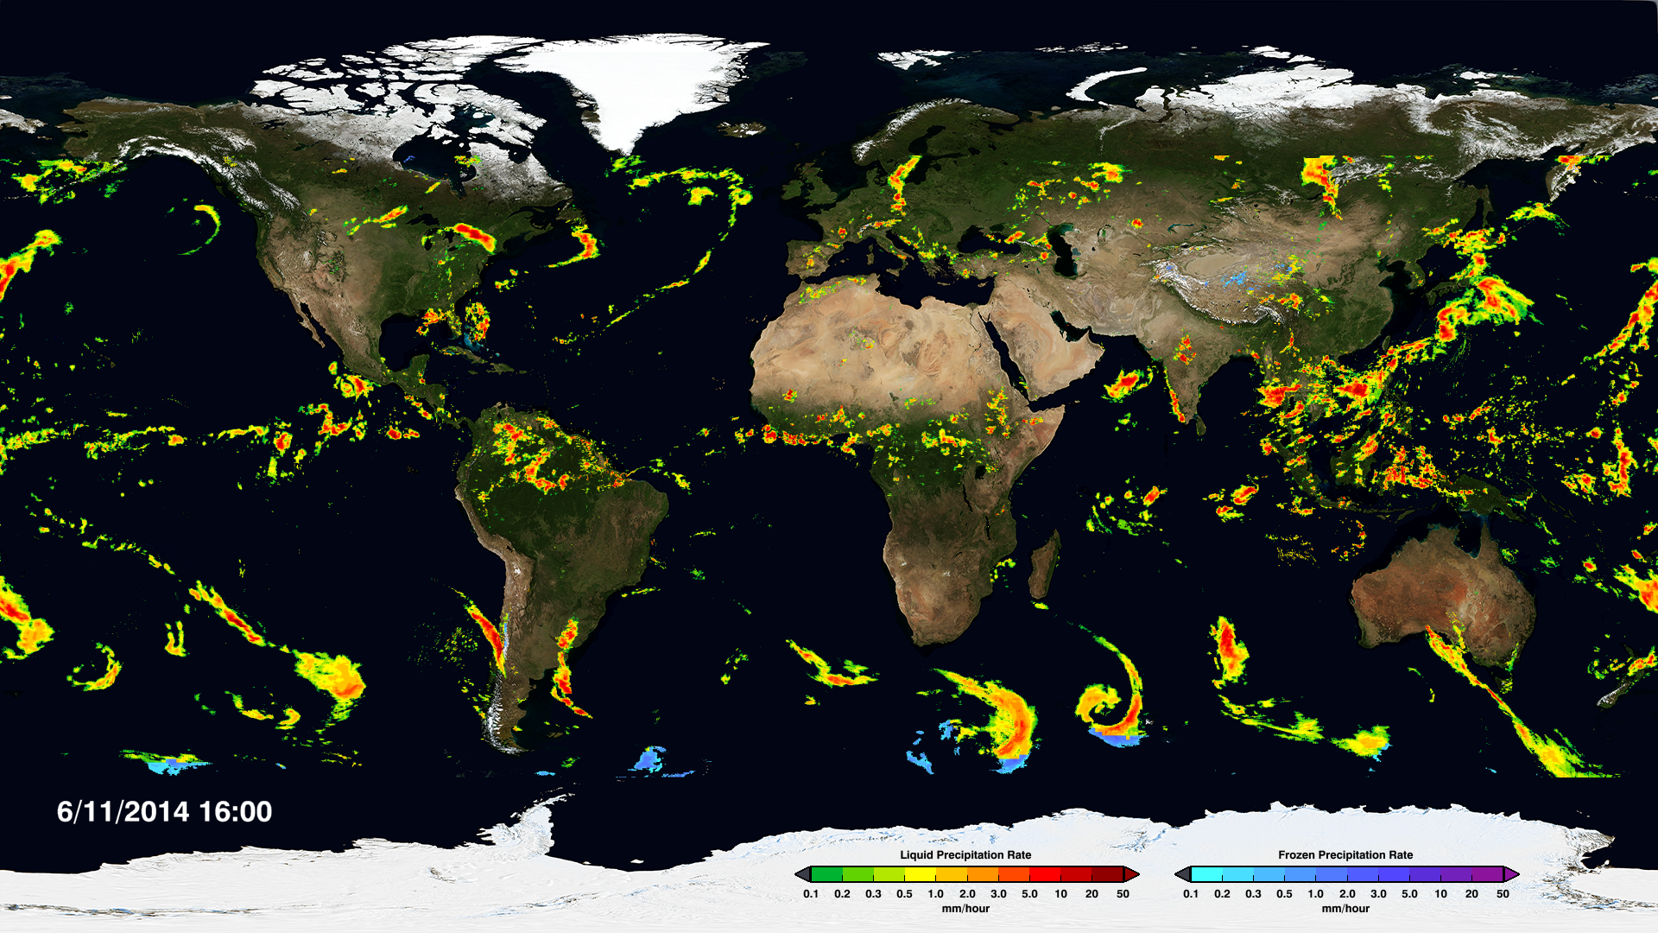
NASA Global Rainfall & Snowfall (April-Sept 2014)
Notes:
Lesson 12: Step 3 & 4 SAS
This image/video shows global precipitation which is an indicator of storms.
Use Use FIND-CAPTURE-EXPLAIN-WONDER routine again.

Slide 74
What could be causing patterns of global storm movement?
Step 5: Form an initial explanation. Answer the questions:
What do you already know about what causes rain?
What do you already know about what causes air to move?
How could the same processes affect the whole world?
Notes:
We ask students to form an initial explanation for what they saw in the video, drawing upon their experiences in LS1 & LS2
(Lesson 12: Step 5 of the Student Activity Sheet)

Slide 75
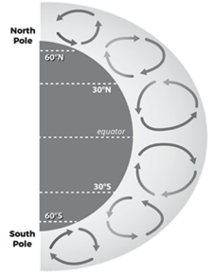
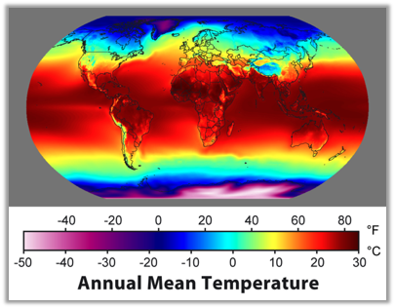
Focus on air movement in the Tropics
How do areas of High and Low pressure cause air to move along the surface and into the Troposphere?
It’s hotter at the Equator, but why?
How does this affect air movement?
Notes:
Big ideas in LS3
Global scale convection: L and H pressure due to different latitudes receiving more/less direct solar radiation, Hadley cells

Slide 76
NASA Global Rainfall & Snowfall (April-Sept 2014)
Notes:
But wait...do the Hadley cells fully explain the patterns we see here?
(What explains the curving??)

Slide 77
When air and storms move, why do they curve?

Slide 78
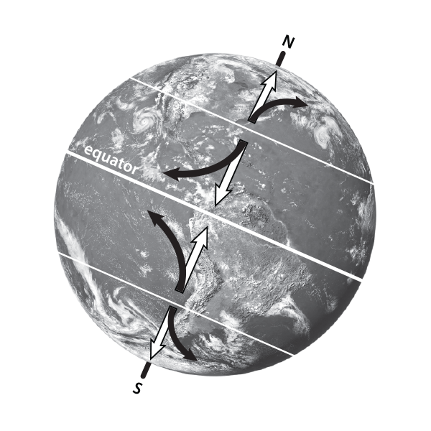
A Curveball
The Coriolis effect...
Because the Earth is spinning, air does not travel in a straight line!
White arrows→ How storms move with a non-spinning Earth
Black arrows→ How storms move with a spinning Earth
Notes:
Pass out Lesson 15 student activity sheet, balloons
Due to rising and sinking of air (convection) and the uneven heating of the Earth we would expect storms to move north from the equator towards the poles and then straight south again (as shown by the white arrows). But as we saw in the video of Global Rain & Snowfall, storms actually curve and twist around the Earth, in predictable patterns (as seen by the black arrows).
With a partner, make a model of the Coriolis effect activity, follow directions on Lesson 15

Slide 79
Activities Exploration
LEARNING SEQUENCE 3
Try out the activities wearing your “student hat” first
Refer to your Teacher Guide to begin thinking about how you would facilitate the activity
Coaching prompts and Talk Moves are facilitation supports as well
Work together, discuss with each other!
Notes:
Explain stations quickly

Slide 80
Model Idea Tracker
What ideas do we agree should be added to the Model Idea Tracker?

Slide 81
Notes:
You can add a new model idea, or you can “vote” to agree with an idea that someone else has put up already

Slide 82
Consensus Model: Air Movement in the Tropics
Create a model that will answer the question:
How and why does air move in the tropics?
Identify ideas from the Model Idea Tracker that will help us answer the question.
Consider how the model for global air circulation you created in Step 5 helps answer the question.
Notes:
Make consensus model in table groups; do gallery walk afterwards.
KEY MODEL IDEAS THAT SHOULD BE REPRESENTED IN THE CONSENSUS MODEL:
As warm air rises at the equator, it creates an area of low pressure.
Sunlight (solar radiation) is more concentrated at the equator because incoming sunlight shines directly on the equator, concentrating it in a smaller area.
Sunlight (solar radiation) is more spread out toward the poles because incoming sunlight hits the surface at an angle, spreading the light out over a larger area.
The amount of concentrated solar radiation influences air temperatures; more concentrated solar radiation causes warmer air temperatures and more spread out solar radiation causes cooler air temperatures.
There are more areas where warm air is rising near the equator and more areas where cool air is sinking at 30°N and 30°S.
Cooler air moves along the surface of the Earth toward the area of low pressure to replace the rising warm air.
Horizontal movement of air along the surface of the Earth is wind, which causes storms to move.

Slide 83
Sensemaking
Wearing your “trainer hat”
How is your focal audience connecting
with the content?
Did any new ideas come up for you? How could these activities fit into what you already do and extend them?
What are you wondering about now?
Where would your focal audience need support?
What challenges come up for you?
Notes:
Use the Workshop Implementation Guide, capture notes you want to remember for planning your own PD in the LS3 section here.
Structured discussion about how to teach this to their audiences
explain the Thinking Routine (connect-extend-challenge)
discuss at tables then share out
use sentence stems?

Slide 84
Lunch Break- be back at 1:00pm

Slide 85
Snow Day
CULMINATING TASK
How can we apply what we’ve learned about weather to a winter storm?
© 2019 University Corporation for Atmospheric Research. All Rights Reserved
Notes:
Introduce Culminating Task
We apply our learnings about weather and storms to a new type of storm--- snow storm!

Slide 86
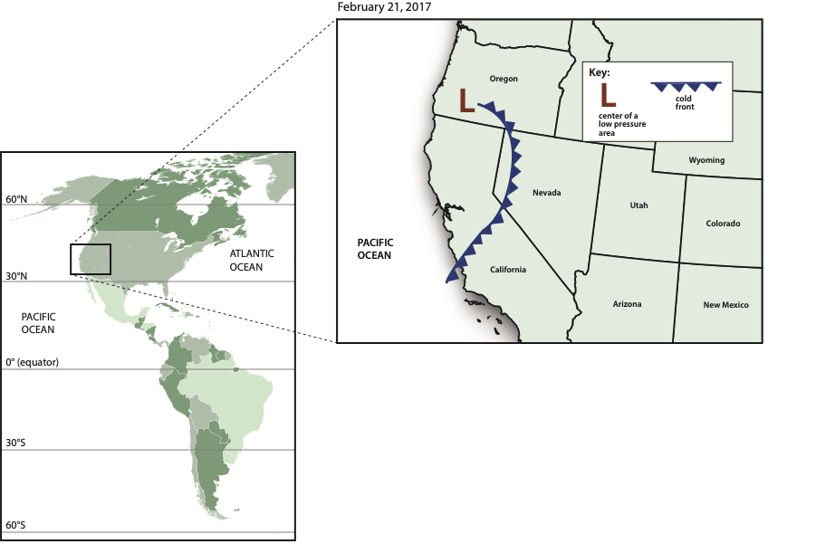
Where did the moisture come from?
Where do you think the storm will go next?
Notes:
Introduce the California storm (Winter Storm Quid)
Read the forecast aloud.
Remember, to cause precipitation storms need 2 things:
Rising cooling air
Moisture
Where did the moisture come from?
Which direction is the CA storm moving?

Slide 87
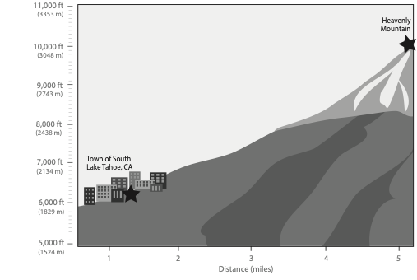
Why did the storm cause rain in some places and snow in other places in California?
Notes:
Heavenly is at higher elevation than South Lake Tahoe, and we learned in Learning Sequence 1 that air temperature decreases as altitude increases. Lower temperatures would allow for snow instead of rain.
*Point out that exact location of rain/snow mix is unknown unless we have the air temps at specific locations on the map.

Slide 88
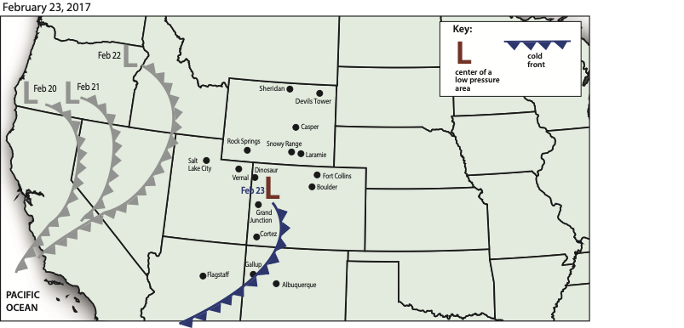
As the storm moved east, why did it snow in some places but not others?
Notes:
Here we see the path of the storm front over several days. As the storm moves inland from the west to the east, it becomes cold enough to snow in Nevada. The question we investigate now is why do some areas get more snow than others? And further, why did some areas get no snow at all?

Slide 89
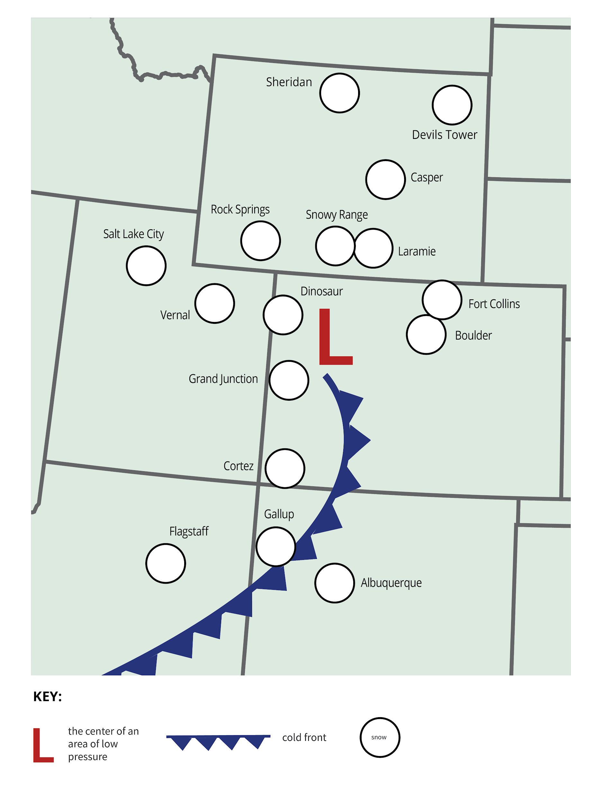
Areas that received heavy snowfall are colored blue
Areas with no snowfall have a “x” on the map
What was the trend in snowfall?
Heavy Snow
No Snow

Slide 90
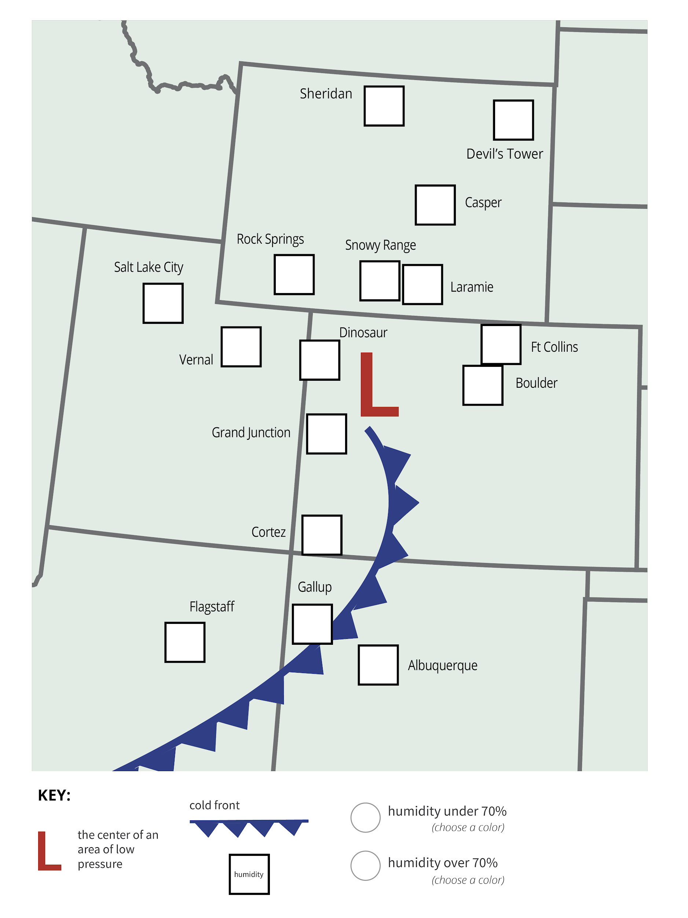
Areas with humidity >70% are colored blue
How does the humidity data help you understand why it snowed in some places but not in others?
Notes:
How does the humidity data help you understand why it snowed in some places but not in others?
Places with high humidity & near the L pressure area would get snow.

Slide 91
Discussion:
Why did some communities have more snowfall than others?
Why didn’t it snow everywhere?
Did it always snow in places that had high humidity? Why/Why not?
Where might schools close due to snow?
Notes:
Find a partner to discuss the questions, focus on sharing your hypothesis for where there might be a snow day
*Use page 140 Teacher guide to answer question prompts

Slide 92
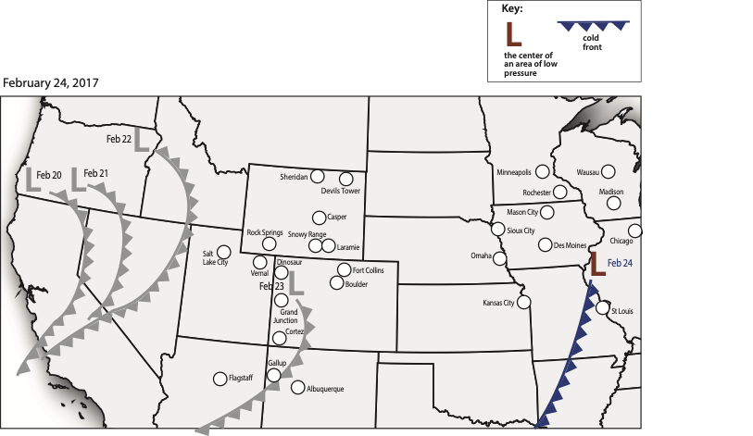
Complete Steps 1- 4 in table groups
Notes:
Work in small groups

Slide 93
Use the locations of snowfall on February 23 to predict were students will have a snow day on February 24.
Notes:
Locations with a blue circle had 5cm or more of snow on Feb 23

Slide 94
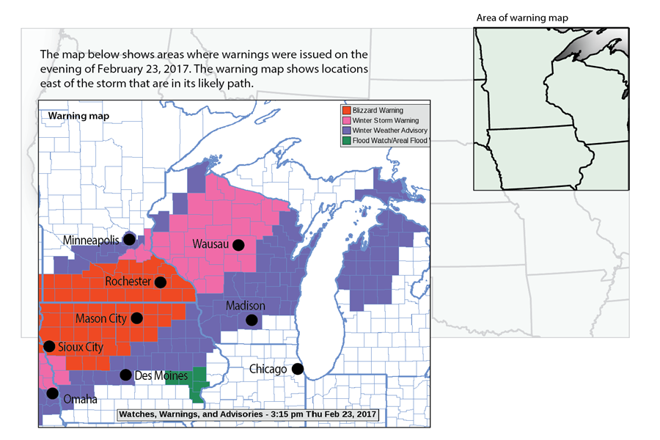
Step 4: Warning Map
Where will it snow on February 24?
Notes:
What is the story of this storm that students would need to tell to predict where the snow day would be?

Slide 95
Training Tips
What Model Ideas are applicable to Culminating Task: Challenges 1-3?
Thoughts?
What do you like about this activity?
What might still be challenging?
Notes:
Discuss at your table, refer to the Model Idea tracker on chart paper.
What are possible ideas for re-teaching or extending if students are still confused?

Slide 96
The GLOBE Program: Global Learning and Observations to Benefit the Environment
How to participate:
Protocol eTrainings
GLOBE Observer
International Virtual Science Symposium (IVSS)
Annual Meetings and Learning Expeditions
Examples of GLOBE Protocols:
Atmosphere - air temperature, precipitation, clouds
Hydrosphere - temperature, pH, mosquito habitats
Soils/Pedosphere - soil moisture, temperature, characterization
Biosphere - green up/down, land cover, fire fuel, carbon cycle
Notes:
Vision: A worldwide community of students, teachers, scientists, and citizens working together to better understand, sustain, and improve Earth’s environment at local, regional, and global scales.
Mission: To promote the teaching and learning of science, enhance environmental literacy and stewardship, and promote scientific discovery.

Slide 97
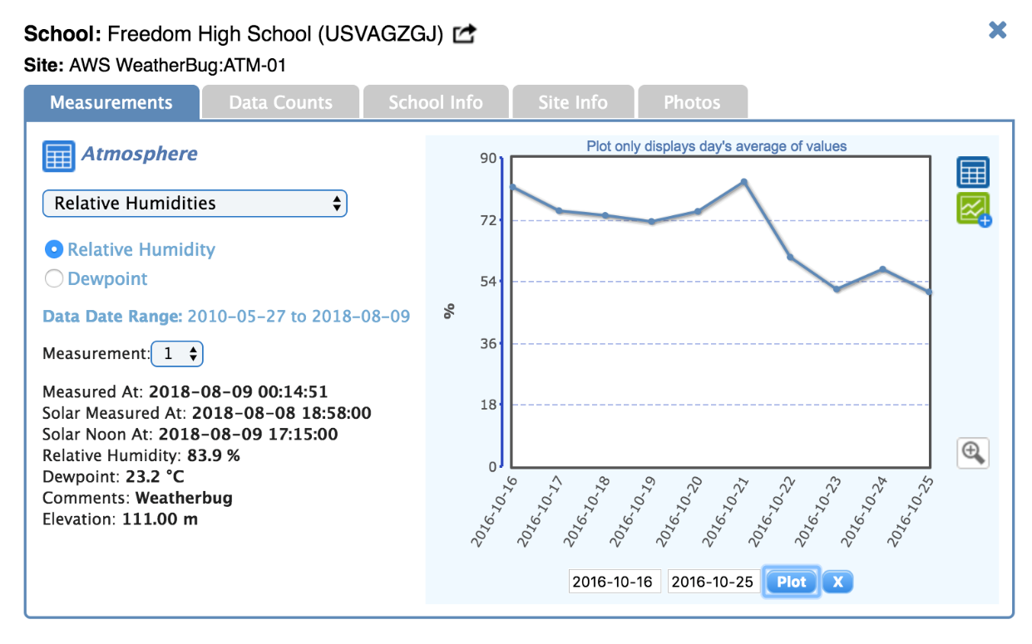
GLOBE Connections
From Observations to Investigations (LS1)
take the next step and use student data to develop research questions that form the basis of an investigation
Finding Freedom: A Mini Data Exploration (LS2)
access the GLOBE database using the GLOBE Online Visualization Tool to explore data from Freedom High School
Connecting with GLOBE Schools Around the World (LS3)
go deeper in understanding patterns of storms by connecting with GLOBE teachers and students from different countries
Notes:
Have partners navigate to globeweathercurriculum.org
Give a brief overview of the 3 different types of GLOBE Connections and where they can find them. Talk in detail about LS1 connection (next slide)

Slide 98
Research Projects with GLOBE
https://www.globe.gov/science-symposium
Notes:
Highlight event -
Focus on - Resources available; badges - addressing scientist skills

Slide 99
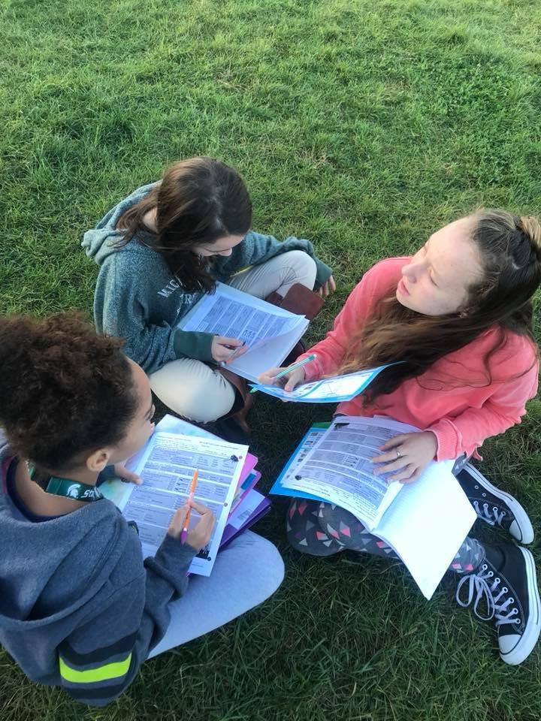
Using GLOBE in a Sequence
Notes:
This is the first time that GLOBE has offered structured curriculum that builds upon each lesson/protocol.
Brainstorm other extensions/resources for incorporating this into the classroom.
(Protocol bundles: https://www.globe.gov/web/earth-systems/community)

Slide 100
Break (15 min)

Slide 101
How do you plan to use GLOBE Weather?
What adaptations or extensions might you use?
How can you make this relevant for your audiences?
Notes:
What local weather phenomena can you include?
How could you weave this in to trainings you already do?
What completely new ideas do you have?

Slide 102
What teachers have said about
GLOBE Weather Workshops:
Love the hands on; love going outside!
Will use DQB, Model Ideas, Discussion Strategies in other areas, not just with GLOBE Weather
More workshop time! (We offered 2.5-3 days...)
Would like to run full lessons in the workshop
Need support getting/funding the supplies
More support for productive talk/ student discussions
Would love a key to the student activity sheets (in progress...)
What about ideas for differentiation?
More background/content training
Would like a follow up day and/or ongoing instructional support

Slide 103
Make a Plan!
Begin thinking about your next steps as a GLOBE Weather trainer...
Use the GLOBE Weather Workshop Implementation Planning Guide
Brainstorm ideas and discuss with each other

Slide 104
Wrap up GLOBE Weather
Revisit your goal from yesterday

Slide 105
SNOWBALL FIGHT!
Write down:
A question that you still have about GLOBE Weather
OR
What your biggest take-away is from the training
Notes:
Everyone writes on a piece of paper, crumples up into a “snowball”
At the same time, everyone underhand tosses their snowball towards someone else
Everyone picks up one snowball, and at the same time tosses it again.
Everyone picks up one snowball, this time you open it up and read it to yourself.
Share aloud/discuss

Slide 106
We want your feedback!
https://forms.gle/ow99FpnZybZjaBS78
Notes:
New survey created and link updated!

Slide 107
Thank You!
Photo by Eliot Foust

